Slide 1

MANIPAL INSTITUTE OF TECHNOLOGY
(A constituent unit of MAHE, Manipal) · School of Computer Engineering
B.Tech. Practice School — Final Project Presentation
Enterprise-Scale Intelligent PDF Parsing and Structured Data Extraction System for Pharmaceutical Research Documents using AWS
Vansh Amit Jogani
220953126 · Computer and Communication Engineering
Under the guidance of
Internal Guide
Ms. Chithra K
Asst. Professor, SCE, MIT Manipal
External Guide
Neha Agrawal
Manager – Data Delivery, Eli Lilly
July 2026

Slide 2
Presentation Outline
Introduction
Methodology & Architecture
1
6
Literature Survey & Background
Result Analysis
2
7
Tools & Technologies
Additional Contributions
3
8
Problem Definition
Timeline & Skills
4
9
Objectives
Conclusion & Future Scope
5
10
School of Computer Engineering
2 / 30

Slide 3
Introduction — The Problem Space
Pharmaceutical labs generate massive volumes of research PDFs — stability studies, certificates of analysis, batch records.
Documents vary widely in format, layout and structure across laboratories and vendors.
Scanned documents introduce OCR challenges; character-level errors matter in identifiers and results.
Tables frequently span multiple pages — the “table bleed” problem.
Manual extraction is slow, error-prone and does not scale to hundreds of documents.
Domain areas
Cloud Computing · Data Engineering · Document AI · OCR
Days
Hours
manual extraction time per batch
target with automation
School of Computer Engineering
3 / 30

Slide 4
Introduction — The Solution
A scalable, cloud-native, template-free system that automatically parses diverse research PDFs and converts them into standardised JSON for downstream analytics, reporting and regulatory archival.
Why it matters
Organisation
Shifts reviewers from reading every line to checking only flagged values
Reusable across vendors and document types — no per-template engineering
Built entirely on managed, serverless AWS services
Eli Lilly and Company, Hyderabad
Enterprise Data — Data Delivery team
Six-month internship: 16 Jan – 15 Jul 2026, Agile delivery
School of Computer Engineering
4 / 30

Slide 5
Literature Survey & Background Theory
Traditional OCR (Tesseract)
Amazon Textract
Basic text extraction; struggles with the complex, multi-column, table-heavy layouts common in scientific documents.
Deep-learning form and table extraction, enterprise-grade — but outputs unstructured text. Used here as the OCR ground-truth baseline.
Visual Language Models
Knowledge Distillation
Combine visual + language understanding for layout-aware extraction; outperform text-only pipelines. Adopted as the core engine.
Train a smaller domain-specific model from a larger one for efficient inference at scale — retained as future scope.
Event-driven AWS architectures (S3 → Lambda → Glue) form the established pattern for automated, serverless document processing.
School of Computer Engineering
5 / 30

Slide 6
Tools & Technologies Evaluated
Docling (open source)
Internal GenAI gateway
AWS services stack
NOT ADOPTED
ADOPTED
CORE STACK
Evaluated as a Textract replacement. Textract alone outperformed both Docling and Docling + Textract, and Docling added overhead with no quality gain — dropped.
Migrated from AWS Bedrock to an internal GenAI gateway for access to stronger models — significantly improved extraction quality across all document types.
S3 (storage + triggers), Lambda (orchestration), Glue (ETL), Textract (OCR), Secrets Manager, CloudWatch — an event-driven pipeline.
Also evaluated: parallel processing, prompt engineering, suggested-schema generation, and a self-healing rerun mechanism.
School of Computer Engineering
6 / 30

Slide 7
Problem Definition
Without automation, data ingestion is delayed, manual errors affect reliability, scaling across document types is hard, and regulatory documentation lacks structured archival.
Heterogeneous formats
Table bleed
Digital vs scanned PDFs; layouts vary across labs and vendors.
Tables span multiple pages and must be reconstructed as one.
OCR inaccuracies
Schema variability
Character-level errors in identifiers and numeric values.
No standard structure across document types.
There is a strong need for a robust, scalable, secure system that transforms heterogeneous research PDFs into standardised structured data.
School of Computer Engineering
7 / 30

Slide 8
Objectives
Event-driven AWS ingestion pipeline triggered by S3 uploads
Intelligent PDF parsing for heterogeneous document formats
1
2
OCR integration for scanned research documents
Multi-page table detection and reconstruction (table bleed)
3
4
Standardised JSON output with consistent schemas
Enterprise CI/CD and monitoring integration
5
6
Secondary, forward-looking objective: explore knowledge distillation for efficient domain-specific inference.
School of Computer Engineering
8 / 30

Slide 9
Methodology — Five Phases
Phase 1
›
Phase 2
›
Phase 3
›
Phase 4
›
Phase 5
Infrastructure
Event Pipeline
Intelligent Parsing
Validation
Enhancement
AWS onboarding, IAM, CI/CD, Agile setup
S3 → Lambda → Glue ETL orchestration
Textract + VLM, table detect, JSON
Precision, Recall, Jaccard, self-healing
Knowledge distillation (explore)
The core innovation is a template-free extraction engine: rather than a parser per document type, a Visual Language Model infers each page's structure, anchored and validated by a reliable OCR baseline.
School of Computer Engineering
9 / 30

Slide 10
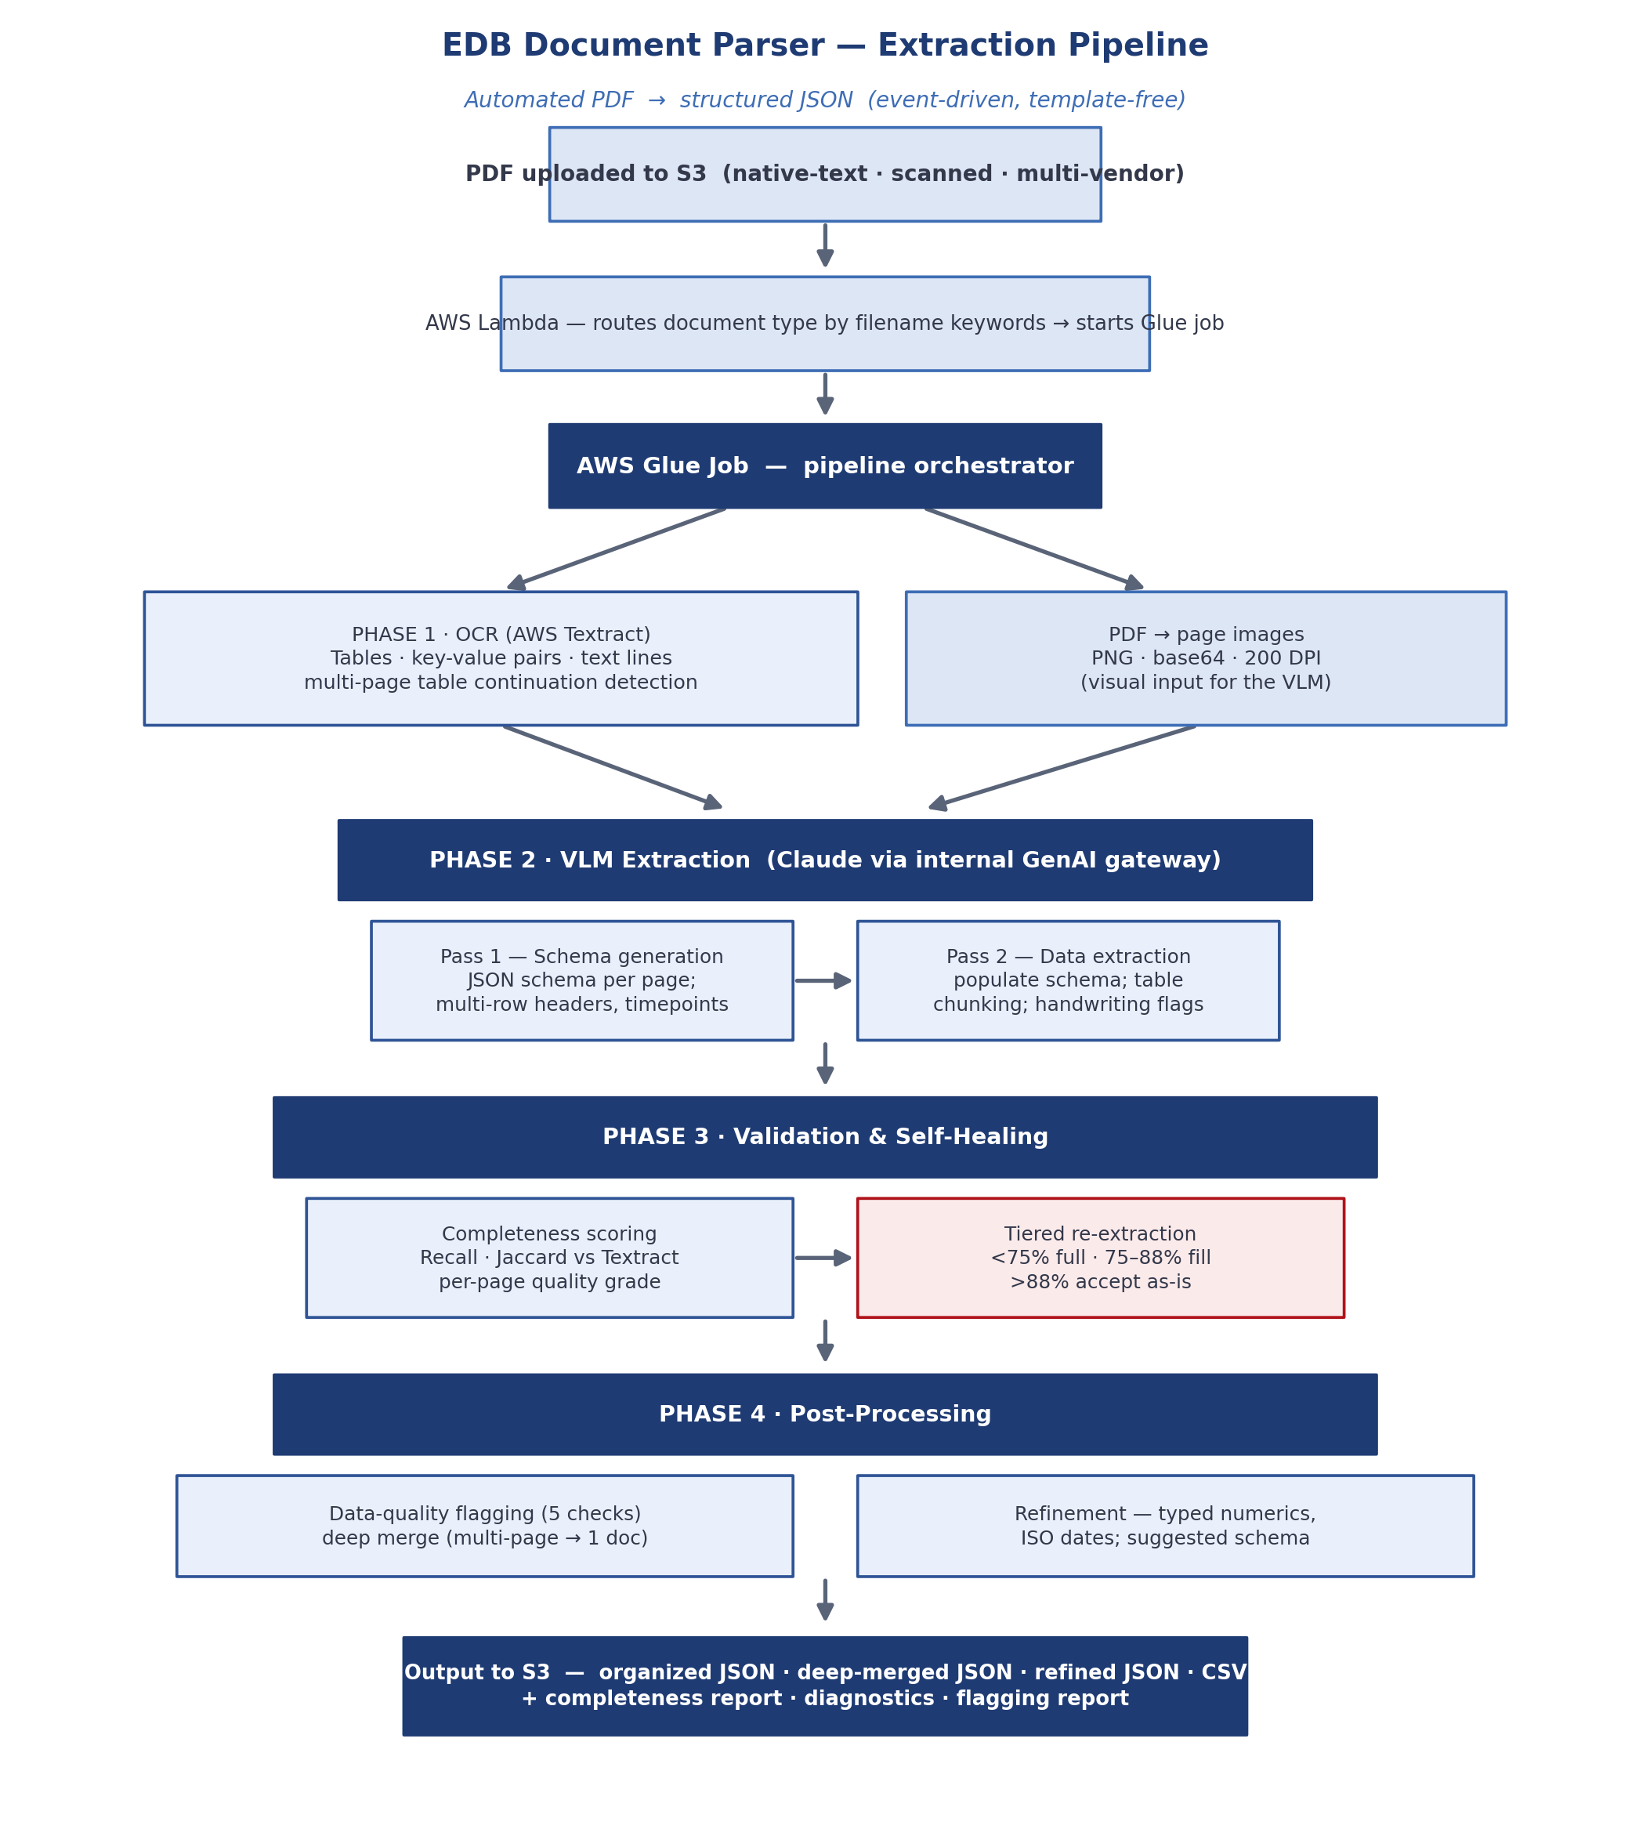
System Architecture
Event-driven and template-free
OCR + page images feed the VLM
Two VLM passes: schema, then data
Every page scored and self-healed
Merge, flag, refine → clean JSON
Output to S3
Organized JSON
Deep-merged JSON
Refined JSON + CSV
Completeness & flagging reports
School of Computer Engineering
10 / 30

Slide 11
Phase 1 & 2 — OCR and VLM Extraction
Phase 1 · OCR + rendering
Phase 2 · VLM (two passes)
AWS Textract: tables, key-value pairs, text lines
Multi-page table continuation detection
Each page also rendered to a 200-DPI image
Textract output = interpretation-free ground truth
Pass 1 — generate a JSON schema per page
Handles multi-row headers, timepoints, continuations
Pass 2 — populate the schema with values
Table chunking; handwriting flagged
Key insight: the model must receive the page image, not text alone. Adding image inputs let the VLM exploit visual layout and materially improved extraction quality.
School of Computer Engineering
11 / 30

Slide 12
Phase 3 — Validation & Self-Healing
Validation metrics
Precision
Recall
Jaccard
TP / (TP+FP)
TP / (TP+FN)
|A∩B| / |A∪B|
Tiered self-healing re-extraction
Recall < 75%
Full re-extraction of the missing rows / key-value pairs
75% – 88%
Lightweight fill directly from the Textract output
Recall > 88%
Accept the page as-is
Only the affected pages are reprocessed — never the whole document.
School of Computer Engineering
12 / 30

Slide 13
Phase 4 — Data Quality & Post-Processing
Five data-quality checks
EU comma normalisation (1,5 → 1.5)
Plausibility vs spec upper bound (>2×)
Timepoint consistency (≥10× jumps)
1
2
3
Handwriting & signature detection
Out-of-specification values
4
5
Then: merge · refine · suggest
Deep merge
Refinement
Suggested schema
Continuation tables joined in order; per-page results merged into one unified document.
Typed numerics, ISO dates, and results parsed into value + unit + qualifier.
Auto-generated schema so the LRL team can run in manual mode and pick fields.
School of Computer Engineering
13 / 30

Slide 14
Result Analysis — Validation Framework
~85%
19
Textract
average recall across the test set
representative documents evaluated
OCR output used as the ground-truth reference
Key findings
High recall — most relevant information is captured consistently across all documents.
Precision looks numerically lower, but this is an artefact: the pipeline adds structure (headers, labels, field names) absent from the unstructured Textract reference, so those are counted as false positives.
Structured outputs were shared with the LRL team for domain-expert review — confirming real-world usability.
School of Computer Engineering
14 / 30

Slide 15
Result Analysis — Domain-Expert Evaluation
~95%
Strengths confirmed
Improvement areas
High value-capture rate across the corpus
Per-page quality scoring — a key strength
Native PDFs scored consistently well
Test conditions correctly separated
GMP metadata extracted faithfully
Format drives quality, not content
OCR accuracy on scanned documents
Schema consistency across pages/files
Multi-page table merge completeness
Character-level accuracy in identifiers
Structured numeric-result parsing
Scanned landscape tables hardest
accuracy reported in LRL written feedback
School of Computer Engineering
15 / 30

Slide 16
Result Analysis — Throughput & Deployment
~500
~25
S3-triggered
PDFs in 30–45 min (stress test)
concurrent workers at peak load
runs automatically on upload
Deployment journey
›
›
›
Development
Quality Assurance
QA-functional + KT
Production
S3-triggered automation
stack issue resolved
handed to a teammate
pending a consuming team
School of Computer Engineering
16 / 30

Slide 17
Additional Contributions
Three further pieces of work delivered during the internship — all automating manual data-engineering effort and making the platform more observable.
1
2
3
GA4 Enhancement Pipeline
Agentic DLT Config Generator
EDB Components Dashboard
Characterised and set out a plan to cut web-analytics latency from ~72 hours toward under 4 hours.
An autonomous agent that builds a data-load pipeline config from any REST API — hours of work in minutes.
A lineage-and-usage dashboard making the platform's reusable components observable.
School of Computer Engineering
17 / 30

Slide 18
GA4 Pipeline — Problem & Root Causes
72 hrs
Context
Clickstream from ~240 websites flows GA4 → BigQuery → Export Manager → Glue → S3 → Enterprise Data Backbone. Three-day-old data was driving business decisions.
clickstream data was ~3 days stale
Root causes of the delay
Design waits for BigQuery tables to fully stabilise before exporting (+24–48h).
Batch state management only exports settled tables (+24h).
Sequential daily runs operate in a narrow processing window (+24h).
No incremental or streaming approach — everything is batch.
School of Computer Engineering
18 / 30

Slide 19
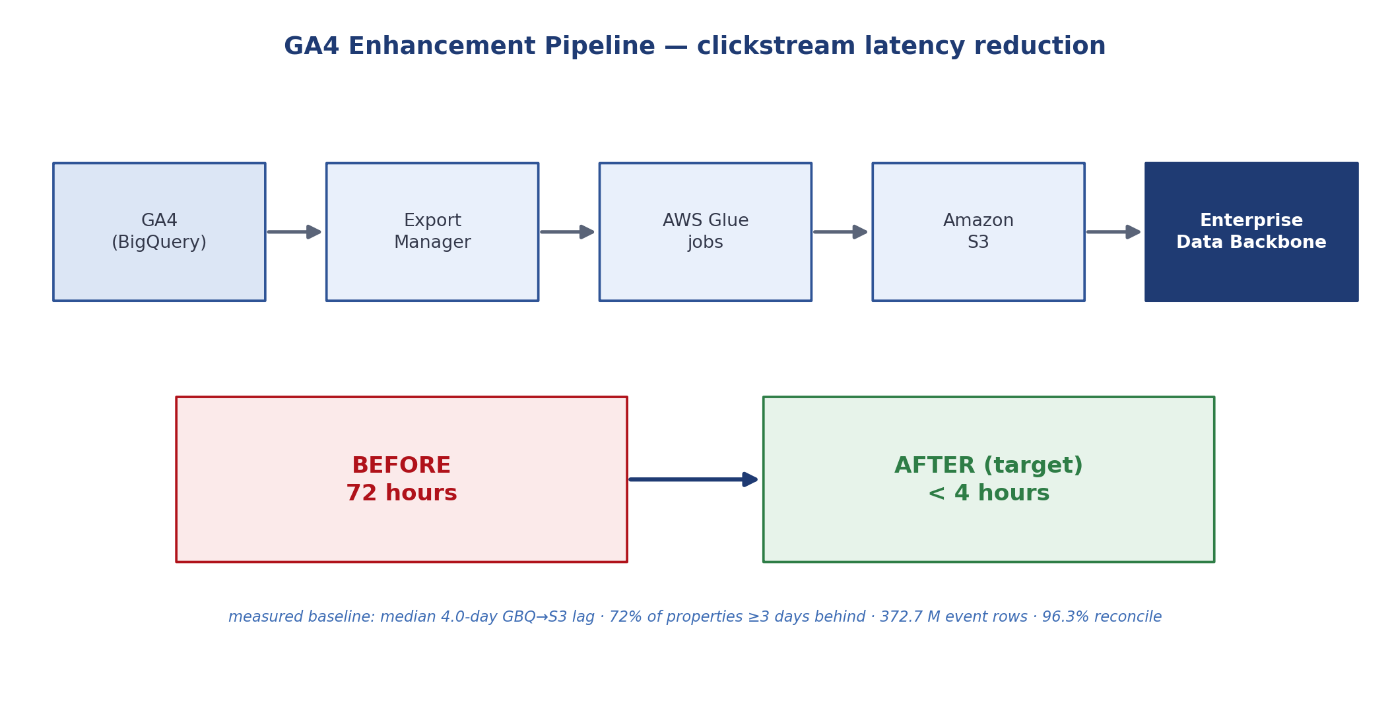
GA4 Pipeline — Measured Baseline
4.0 d
median lag
72%
≥ 3 days behind
372.7 M
event rows
96.3%
reconciled
A reconciliation pipeline measured the BigQuery → S3 gap day-by-day and property-by-property over a 161-day window — turning an anecdotal “3 days” into a precise, defensible baseline.
School of Computer Engineering
19 / 30

Slide 20
GA4 Pipeline — Solution & Status
Proposed enhancement
Status at end of internship
Export available data incrementally from intraday tables
Raise DAG frequency to every few hours
Reconcile late-arriving data afterwards
Target: under 4 hours — an 18× improvement
Baseline metrics + discrepancy report — complete, running daily
Enhancement — designed and ready
Blocked on repository security-scanning & PR-automation compliance
Production rollout planned for a later quarter
72 hrs → < 4 hrs
the latency reduction the enhancement is designed to deliver
School of Computer Engineering
20 / 30

Slide 21
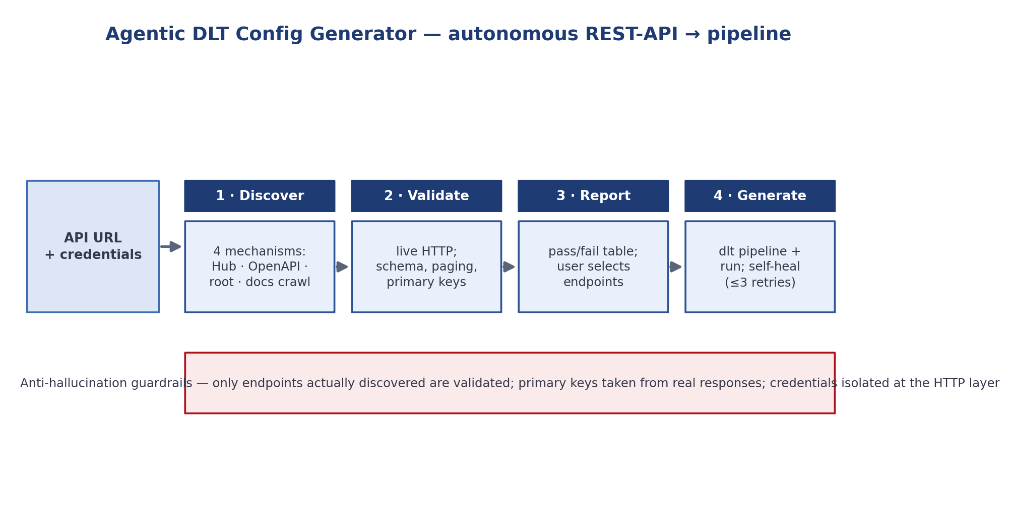
Agentic DLT Config Generator
Writing a data-load (dlt) configuration by hand is laborious — researching endpoints, pagination, primary keys and auth, then debugging. This agent does it autonomously from just a URL and credentials.
School of Computer Engineering
21 / 30

Slide 22
Agentic DLT — Guardrails & Impact
Anti-hallucination guardrails
hours → minutes
Only endpoints actually discovered are validated
Discovery and validation are exhaustive, not sampled
Primary keys are taken only from real response data
Credentials are isolated at the HTTP layer — never in prompts
to onboard a new REST API
Destination-agnostic
The generated pipelines run against any dlt destination — Postgres, BigQuery, Snowflake, DuckDB or S3. Built end-to-end during the internship: local execution, pagination + authentication, and internal-gateway integration.
School of Computer Engineering
22 / 30

Slide 23
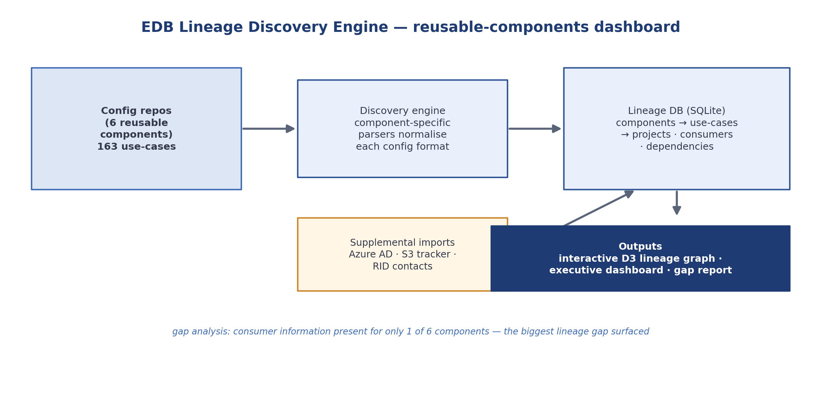
EDB Reusable-Components Dashboard
The platform is built from reusable components, but there was little visibility into how each is used and who consumes its output. A discovery engine makes that usage and lineage visible.
School of Computer Engineering
23 / 30

Slide 24
EDB Dashboard — Coverage & Findings
Discovery coverage — 163 use-cases across 6 components
Veeva Raw → Refine
56
1 of 6
File Consumption (DAG)
35
components have consumer info — the biggest lineage gap
Veeva Source → Raw
34
API Ingestion
22
Also delivered
Web Direct Download
10
Change-request attribution across all components
Lineage tracker & development-timeline view
Interactive D3 graph + gap report; demoed to leads
FastAPI Consumption
6
School of Computer Engineering
24 / 30

Slide 25
Timeline — Six Months
Jan
Onboarding, CI/CD, first S3→Lambda→Glue pipeline
Feb
Project familiarisation; validation metrics; multimodal VLM inputs
Mar
Parsing core, prompt engineering, gateway, 19-doc run shared with LRL
Apr
Data-quality flagging; dev deploy; ~95% LRL feedback; midterm eval
May
QA deploy; ~500-PDF stress test; DLT generator; GA4 baseline metrics
Jun
Parser QA + KT; GA4 discrepancy report; EDB components dashboard
School of Computer Engineering
25 / 30

Slide 26
Skills & Professional Development
Technical
AWS (S3 · Lambda · Glue · Textract)
LLM & VLM workflows
Prompt engineering
CI/CD — GitHub Actions
Infrastructure as code (SAM)
dlt & API ingestion
Apache Spark
Google BigQuery
Data-quality engineering
SQLite & D3 dashboards
Professional
Agile / Scrum delivery — sprints, story points, definitions of ready/done; ~35 compliance courses completed.
Cross-team collaboration, knowledge-transfer sessions, code reviews, and demos to leadership.
School of Computer Engineering
26 / 30

Slide 27
Conclusion
A template-free OCR + VLM pipeline with self-healing validation reliably converts diverse pharmaceutical PDFs into structured JSON.
Evaluation showed ~85% average recall on 19 documents, and ~95% accuracy in domain-expert review, with per-page quality scoring recognised as a key strength.
The apparent precision gap is an artefact of comparing structured output against an unstructured OCR reference — recall is the meaningful measure of completeness.
The system reached QA with knowledge transfer complete, and three further contributions made the enterprise data platform faster, more automated and more observable.
School of Computer Engineering
27 / 30

Slide 28
Future Scope
Format-aware routing
Fixed standardised schema
Send scanned and landscape documents down specialised paths, since format drives quality.
Adopt consistent field names across all document types to eliminate schema drift.
Hardened accuracy
Path to production
Identifier-format validation and locale-aware numeric normalisation for scanned docs.
Full CI/CD on the repository and a consuming team to move from QA to production.
Knowledge distillation
GA4 rollout
Use the structured data to train a smaller domain-specific model for cheaper inference.
Deploy the intraday enhancement to bring latency toward the sub-4-hour target.
School of Computer Engineering
28 / 30

Slide 29
References
[1] Amazon Web Services — Amazon Textract Developer Guide
[2] Amazon Web Services — AWS Lambda Developer Guide
[3] Amazon Web Services — AWS Glue Developer Guide
[4] Amazon Web Services — AWS Serverless Application Model (SAM)
[5] Anthropic — Claude Models Documentation
[6] dltHub — dlt (Data Load Tool) Documentation
[7] DS4SD — Docling: Document Processing Library
[8] GitHub — GitHub Actions Documentation
[9] Apache Software Foundation — Apache Spark Documentation
[10] SQLite Consortium — SQLite Documentation
[11] D3 — Data-Driven Documents
Documentation sources; peer-reviewed literature for the OCR / VLM discussion to be finalised by the author.
School of Computer Engineering
29 / 30

Slide 30
Thank You
Questions & Discussion
Vansh Amit Jogani
220953126 · vanshjogani04@gmail.com
School of Computer Engineering · Manipal Institute of Technology

