Slide 1
Multimodal AAC Chatbot
Bonus-Driven Final System (Project 4)
Syed Omer Shah | Vansh Thakkar
CSE 635 | NLP and Text Mining | May 2026

Slide 2
Problem & Goals
Real-time, grounded, multimodal AAC under a 5-second SLA
• AAC users with motor / speech impairments need fast, identity-faithful replies
• LLMs raise two new risks: hallucinated personal facts + unbounded latency
• Goal: 3 grounded, polarity-correct options per turn, in under 5 seconds
• Goal: keep all face frames and biosignals client-side (privacy first)
• Goal: implement all 5 P4 required nodes + all 5 P4 bonuses

Slide 3
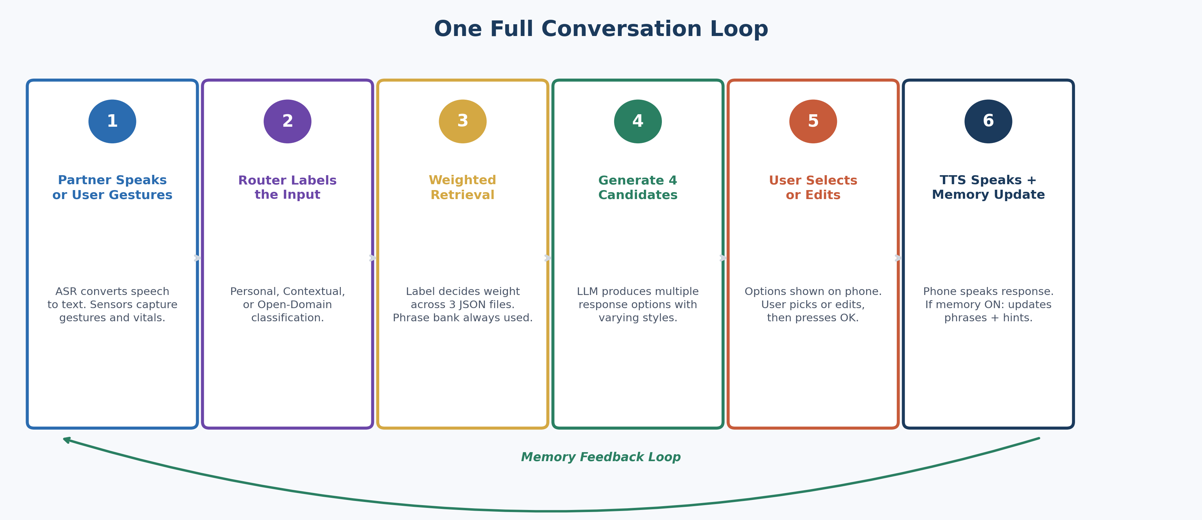
System Architecture
7-node LangGraph-style pipeline with deadline-raced LLM rewriter
• FaceCue + Multimodal Mapping
• Parallel Prep (Router + Memory)
• Source Priority Planner
• Bucket Selector (12 buckets)
• Retrieve & Rerank (LTM/STM/PB)
• Evidence Refiner + Groundedness Guard
• Candidate Generator (rules + LLM)

Slide 4
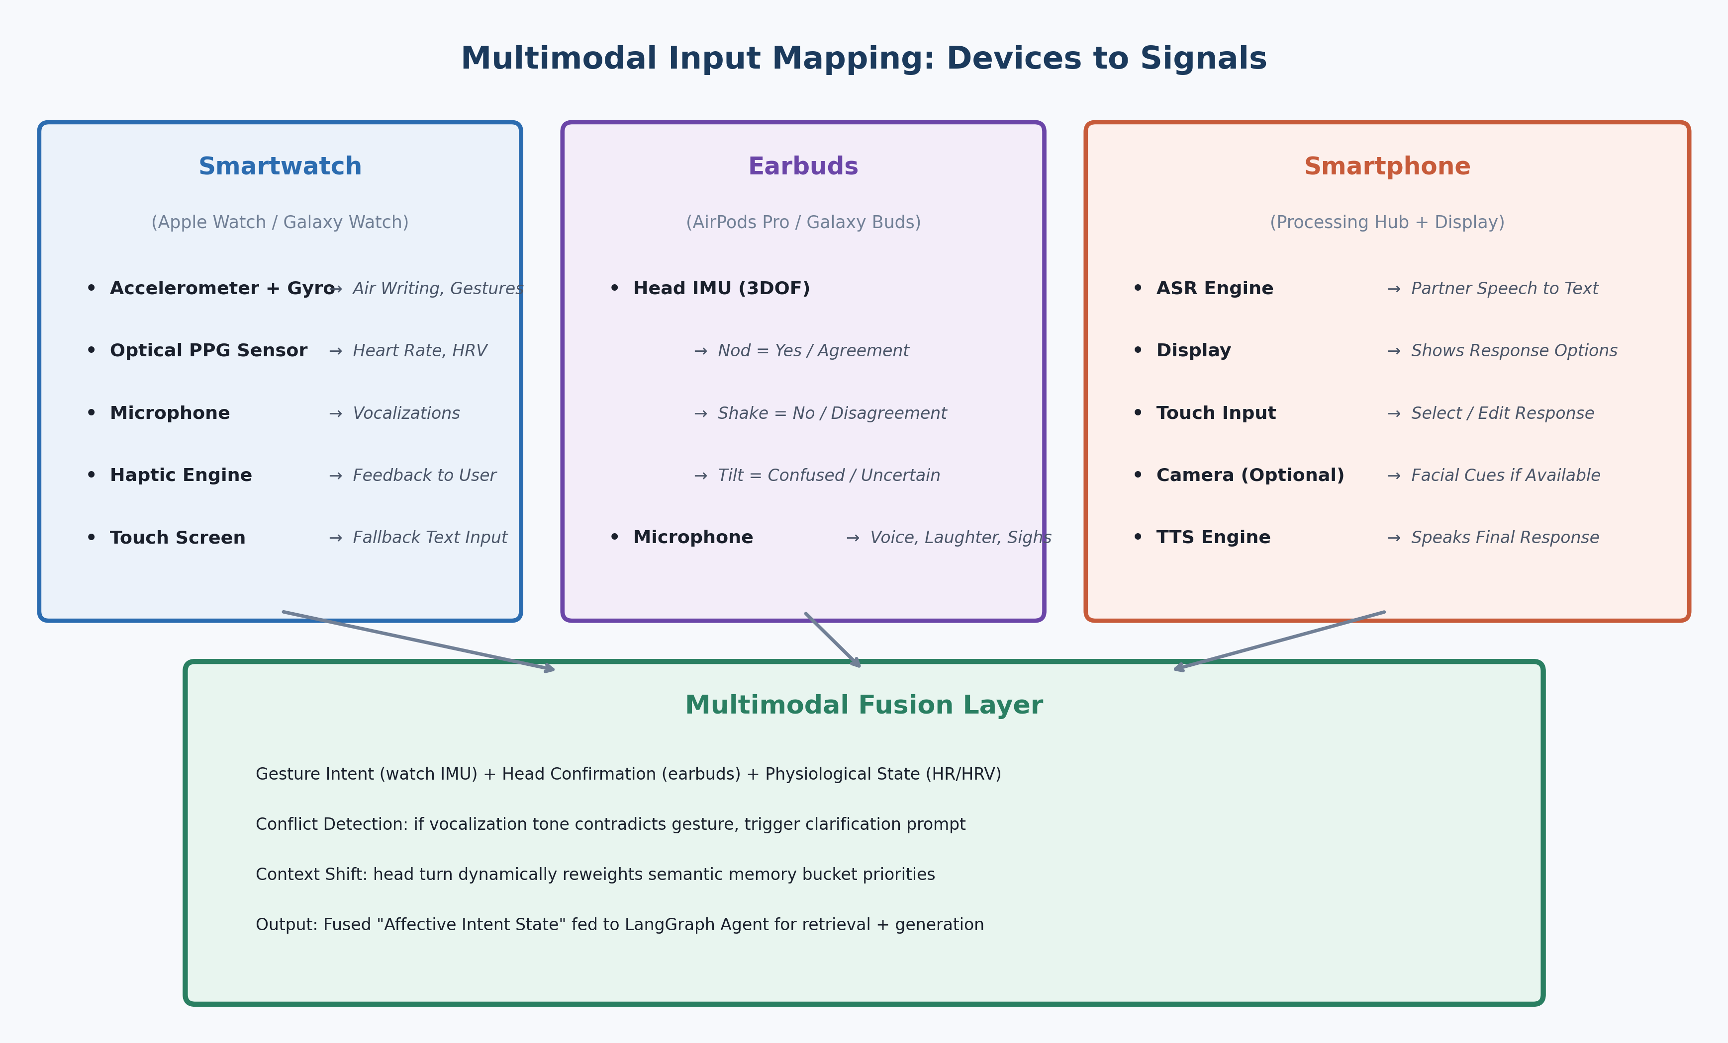
Multimodal Input Mapping
Channels -> polarity / tone / verbosity / bucket boosts
• Face: FER+ 7-class emotion locks tone
• Gesture: thumbs / palm sets polarity
• Heart rate: >+25 bpm -> short verbosity
• Gaze: +0.30 boost on gazed bucket (Bonus 1)
• Vocal vs Air-sign conflict -> trust spatial (Bonus 2)
• Camera off -> 3 different tone variants

Slide 5
Bonuses 1-3
Gaze activation, conflict resolution, bucket priors
• 1. Gaze-Based Retrieval Activation - GAZE_TO_BUCKET adds +0.30; redirects retrieval reliably on every probed case
• 2. Vocal-vs-Air-Sign Conflict Resolution - deliberate spatial channel wins; logged in conflict_resolved
• 3. Acceptance-Weighted Bucket Priors - bucket_acceptance counter incremented on selection; prior added to retrieval score
• All three implemented in home/aac/multimodal.py + home/aac/pipelines/nodes.py

Slide 6
Bonuses 4-5
Latency race + online phrase-bank update
• 4. Latency-Optimised Fallback - llm._generate_text iterates flash-lite -> flash; rule-based floor ready immediately; 5s SLA enforced
• Eval: max latency 4.33s, p95 = 2.43s, fallback engaged on 11/20 turns
• 5. Online Index Update on Selection - confirm_response calls record_selection: PB phrases boosted +0.15 or added; bucket_acceptance updated
• Eval: 5-turn rollout added 2 new phrases, boosted 3 existing

Slide 7
Final Evaluation (n=20)
All targets met
Metric | Value
BLEU-2 (peak) | 0.219
ROUGE-L (peak) | 0.366
Groundedness (peak) | 0.545
NLI faithfulness | 0.800
Intent accuracy | 0.65
Bucket routing acc. | 0.70
Polarity adherence | 0.95
Memory write acc. | 0.90
Multimodal alignment | 0.875
Latency avg (ms) | 1825
Latency p95 (ms) | 2428
SLA <5s hit | Yes
LLM fallback rate | 0.45

Slide 8
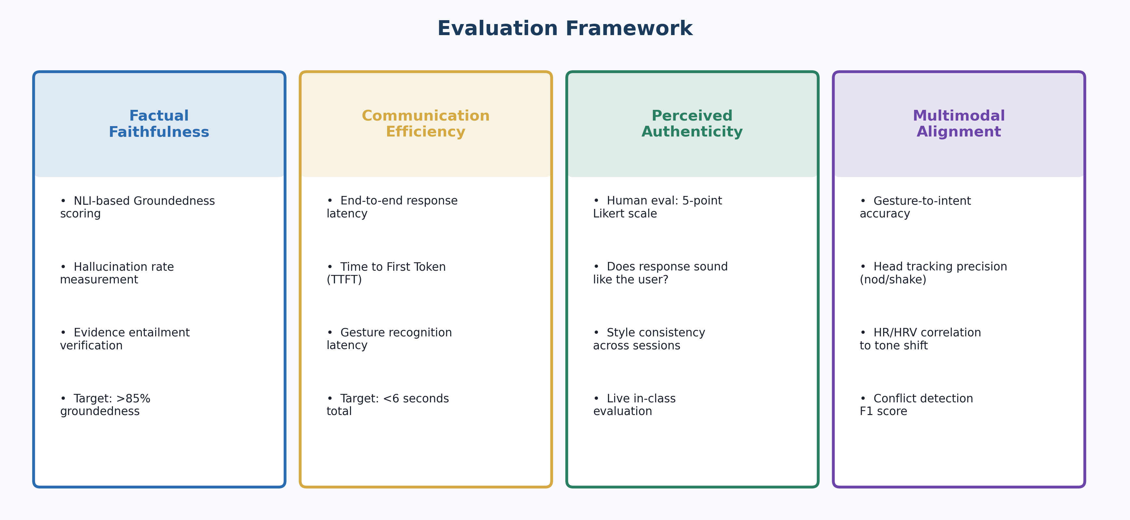
Per-Metric Distribution
Across 20 held-out cases

Slide 9
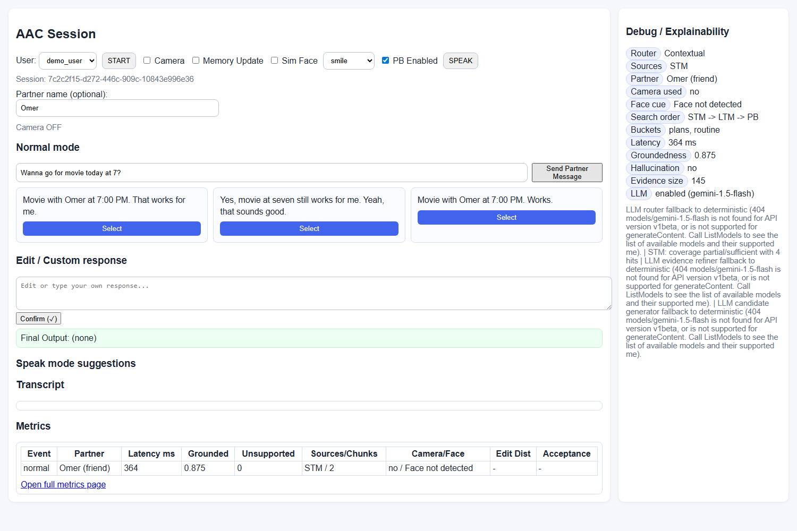
Live Demo
Browser UI: face-api.js, hand gesture, sensors panel
• Three options every turn
• Polarity-correct lead
• Tone matches detected emotion
• Sensors panel: HR / gaze / air-sign
• Memory pools live-update
• Demo video included in zip

Slide 10
Limitations & Wrap-Up
Synthetic data, IRB next, ethical guard-rails on
• Evaluated on synthetic personas - real AAC user study needs IRB review
• Phrase bank stays per-user, client-side; only 7-class emotion label leaves browser
• LLM acts as rewriter; rule-based floor authoritative on polarity + do-not-say
• GroundednessGuard blocks hallucinated medication / clinical claims
• Deliverables: Final_Report.pdf, Final_Slides.pptx, source tree, demo video
• Repo: github.com/VanshPT/Multimodal_AAC (refined fork)

