Slide 1
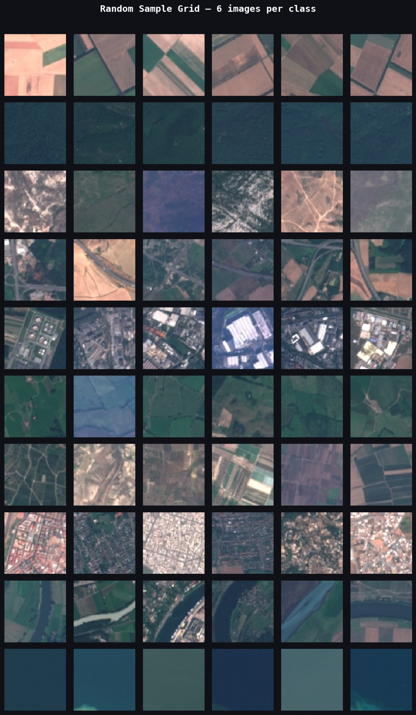
MACHINE LEARNING · REMOTE SENSING
EuroSAT
Land-Use Classification
Environmental Impact Prediction using
Sentinel-2 Satellite Data & Deep Learning
10
24K+
64×64
95.4%
Classes
Images
Resolution
Accuracy

Slide 2
Presentation Flow
A structured walkthrough — from the real-world problem to model results and impact
01
02
03
The Problem
The Data
Data Exploration
Why land-use mapping matters & the scale challenge
EuroSAT dataset — classes, distribution & visual quality
Spectral analysis, pixel stats & inter-class similarity
04
05
06
The Model
Results & Analysis
Real-World Impact
ResNet50 + transfer learning pipeline
Accuracy, confidence calibration & failure modes
Applications, deployability & next steps

Slide 3
01
SECTION 01
The Problem
Why does automated land-use classification matter? What is at stake for the environment, and why can't humans do this alone?

Slide 4
The Scale of the Problem
Monitoring Earth's surface manually is no longer feasible — the data outpaces human capacity
🌍 Scale
🌿 Environmental Urgency
Earth's land surface spans 150 million km². Manual surveys take decades. Satellite sensors produce terabytes of new imagery every single day.
Deforestation, desertification, urban sprawl and crop failure are happening faster than we can detect. Delay = irreversible damage.
📡 Data Abundance
🧑‍🔬 Human Limitation
ESA's free Sentinel-2 satellite covers the globe every 5 days at 10m resolution. The raw data exists — the bottleneck is analysis.
Even with thousands of analysts, consistent, real-time global classification is impossible by hand. We need automation.

Slide 5
Our Solution
Apply deep learning to automatically classify satellite imagery — fast, consistent, scalable
Train a deep learning model to look at a 64×64 satellite image patch
and instantly classify what type of land it shows — at planetary scale.
🛰️
🧠
🗺️
Sentinel-2 Input
ResNet50 Model
Land-Use Output
Free, open-access satellite imagery from ESA. Global coverage, every 5 days.
State-of-the-art deep CNN. Transfer learning from ImageNet. Fine-tuned on EuroSAT.
10 classes identified instantly: crops, forest, roads, water, buildings and more.

Slide 6
02
SECTION 02
The Data
Meet the EuroSAT dataset — 27,000 labeled satellite images across 10 land-use classes, derived from the ESA Sentinel-2 mission.

Slide 7
What Is EuroSAT?
A benchmark dataset for land-use classification built from Sentinel-2 multispectral satellite imagery
🛰️ Source
ESA Sentinel-2 satellite — 13 spectral bands, 10m ground resolution
🖼️ Image Size
Each image is 64×64 pixels, covering ~640m × 640m of real terrain
🏷️ 10 Classes
AnnualCrop · Forest · HerbaceousVegetation · Highway · Industrial · Pasture · PermanentCrop · Residential · River · SeaLake
📦 Dataset Split
18,957 training · 5,455 validation · balanced test set
⚖️ Class Balance
Slight imbalance (1.44× ratio) — manageable, representative of real distributions
6 samples per class

Slide 8
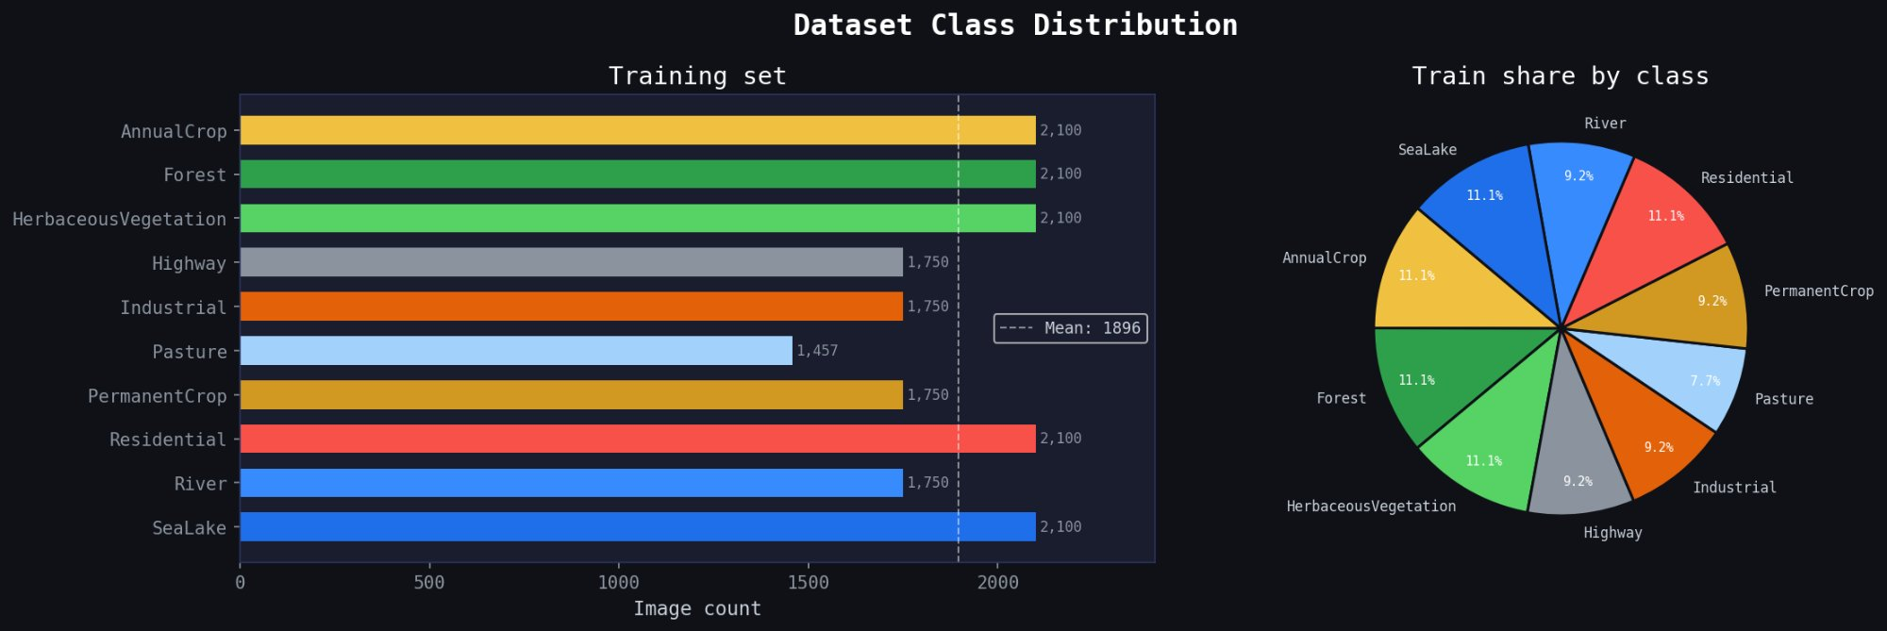
Dataset Class Distribution
How many images are there per class? Is the data balanced enough for fair training?
✅ Majority class
AnnualCrop, Forest, HerbaceousVeg, Residential, SeaLake: 2,100 images each
⚠️ Minority class
Pasture: 1,457 images — 1.44× below max class count
📊 Overall
24,412 total images. Imbalance ratio of 1.44× is mild and manageable.
💡 A balanced dataset is critical — if one class has far more samples, the model will be biased toward predicting it. This dataset is well-designed.

Slide 9
03
SECTION 03
Data Exploration
Before training any model, we deeply analyze the data — visually, statistically, and spectrally. What patterns exist? What makes each class unique?

Slide 10
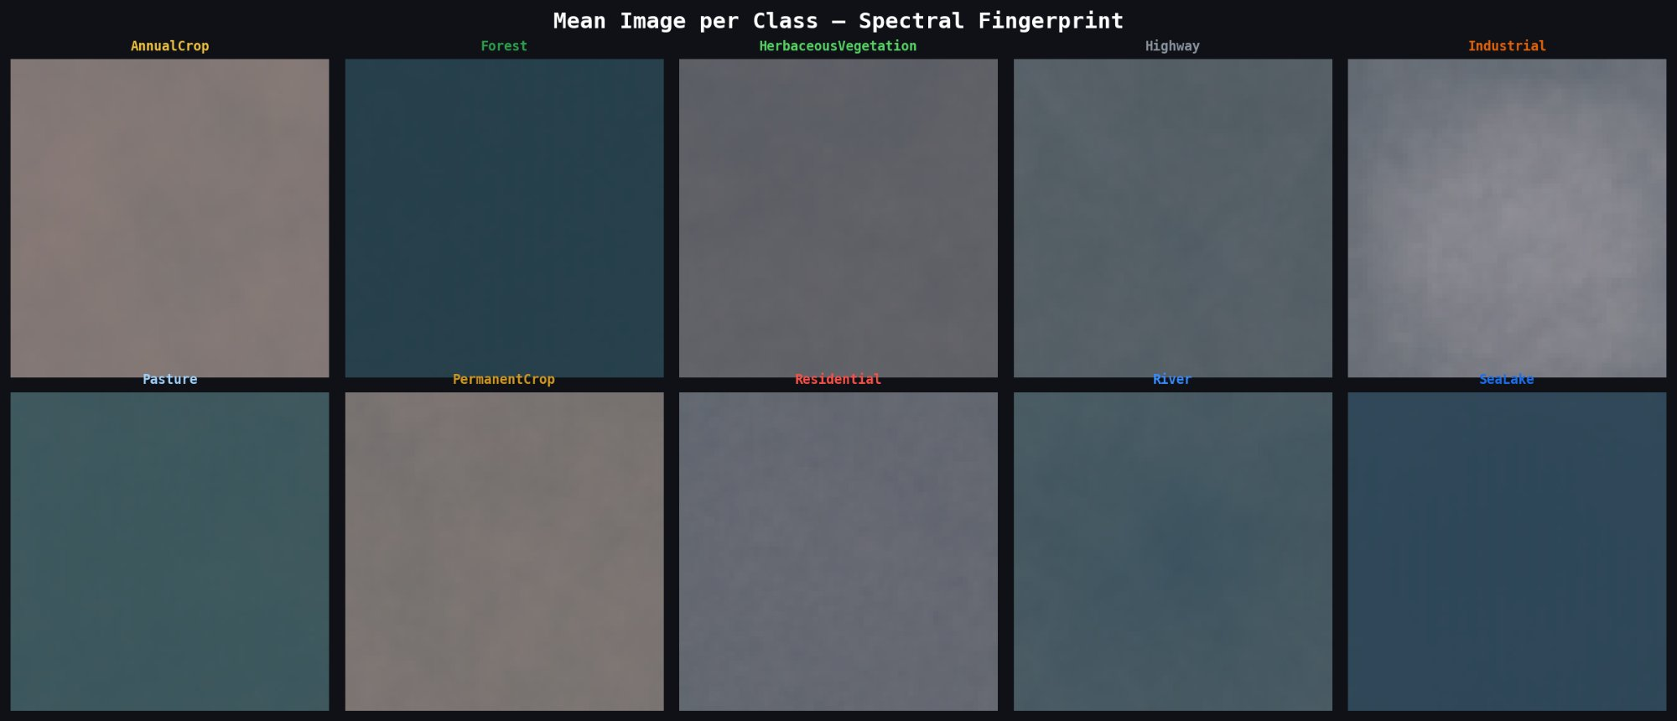
What Does Satellite Data Look Like?
Each class has a distinct visual appearance — but some look dangerously similar at first glance
Mean 'spectral fingerprint' per class — averaged over all training samples
🔵 Forest & SeaLake — dark, near-uniform textures. Very low brightness variance.
🟤 AnnualCrop & PermanentCrop — warm brownish tones with grid-like field patterns.
⬜ Industrial & Highway — higher brightness, man-made geometric structures.
🟢 Vegetation classes share similar green hues — making them the hardest to separate.

Slide 11
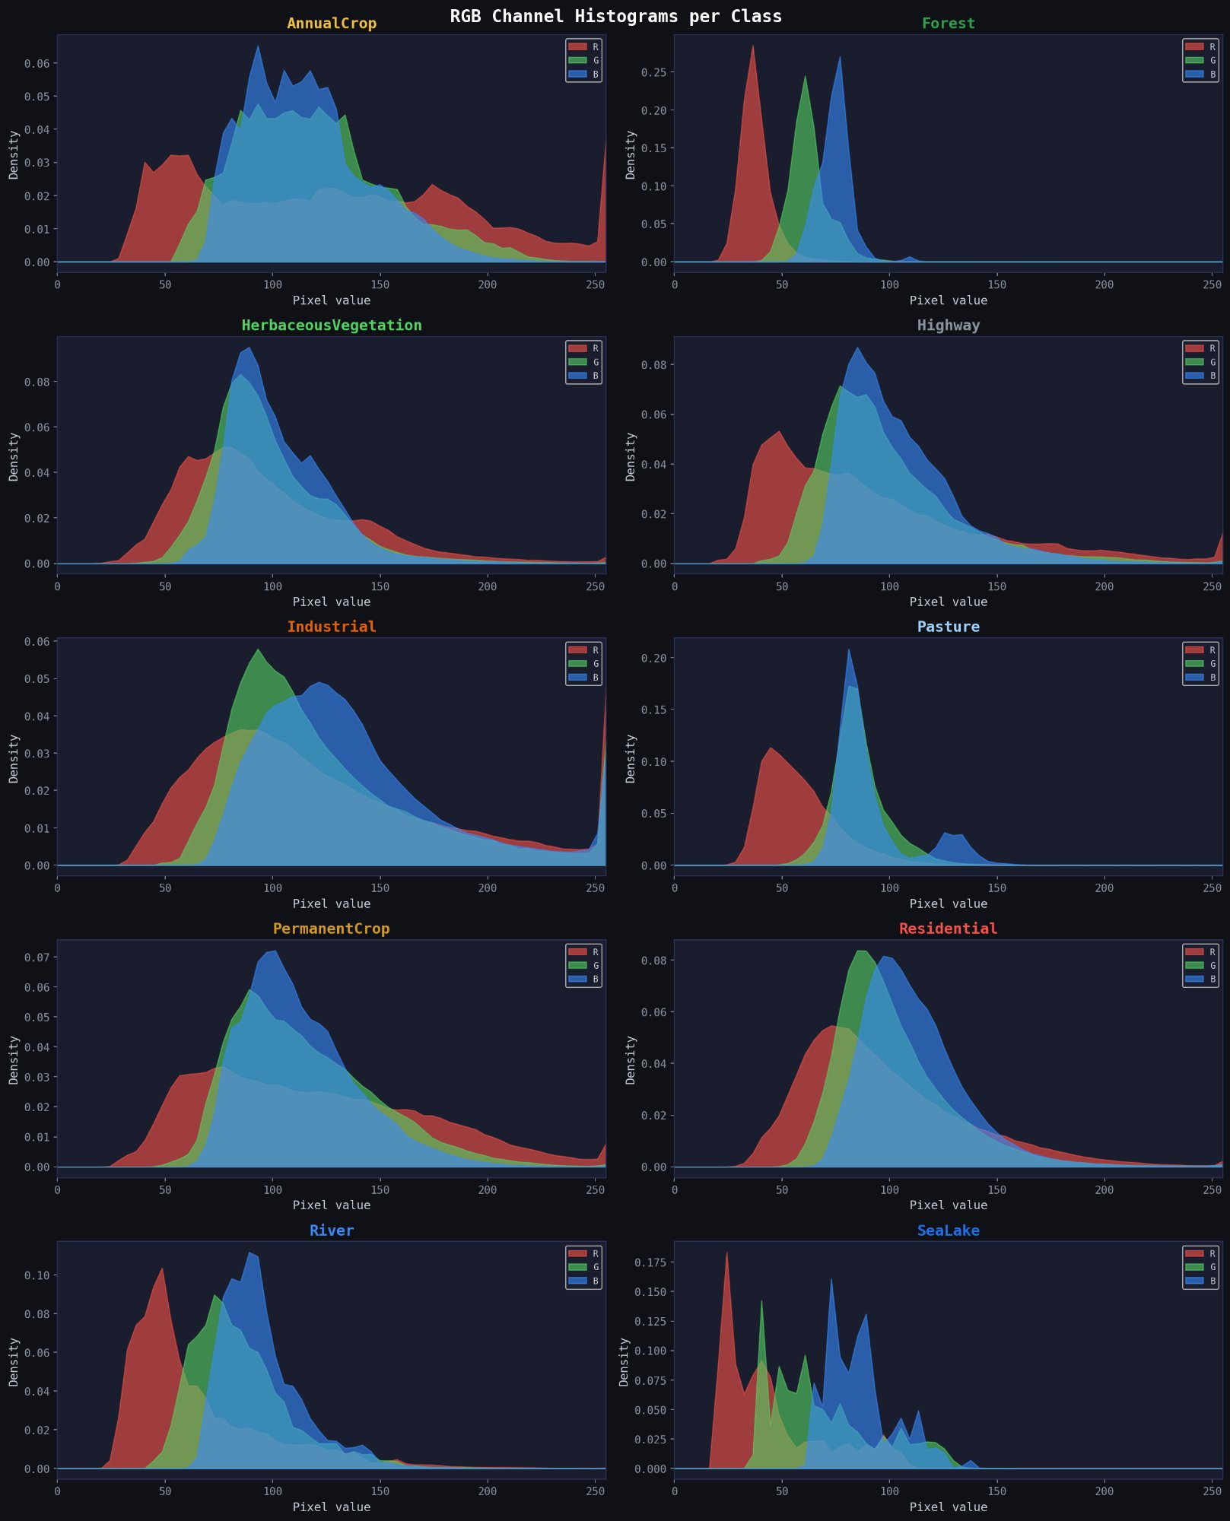
Spectral Channel Analysis
RGB histograms reveal each class's unique color signature — the raw material the model must learn from
Key Observations
Forest
Very narrow, dark peak in all channels — extremely homogeneous canopy texture.
SeaLake
Multi-modal distribution — calm shallow and deep water have different spectral responses.
Industrial
Wide spread across all channels — diverse rooftop materials and structures.
AnnualCrop
Broad distribution — seasonal crop cycles produce varied field colors year-round.
💡 Even with distinct spectral signatures, raw pixel values alone cannot separate all classes — this is exactly why deep learning is needed.

Slide 12
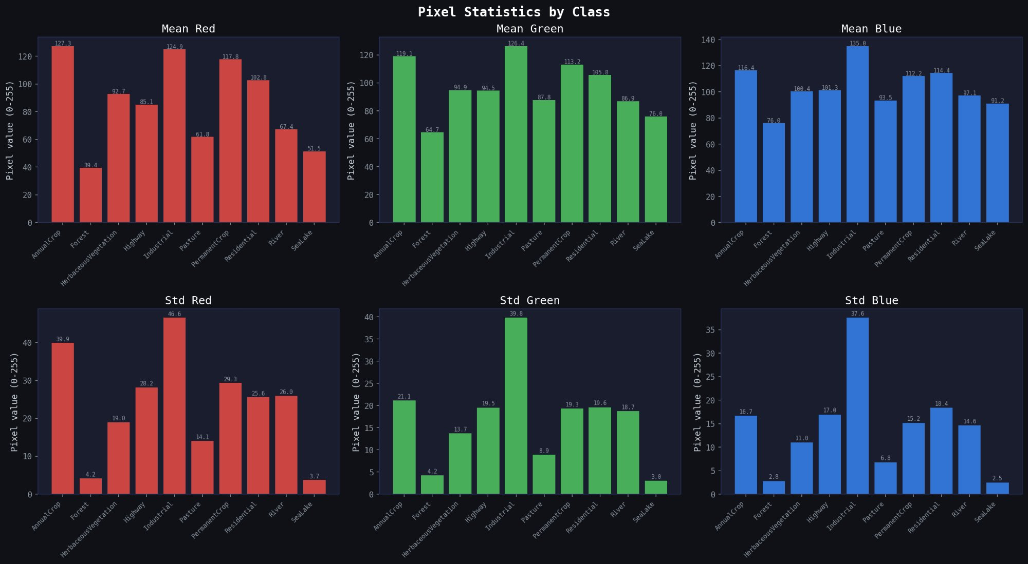
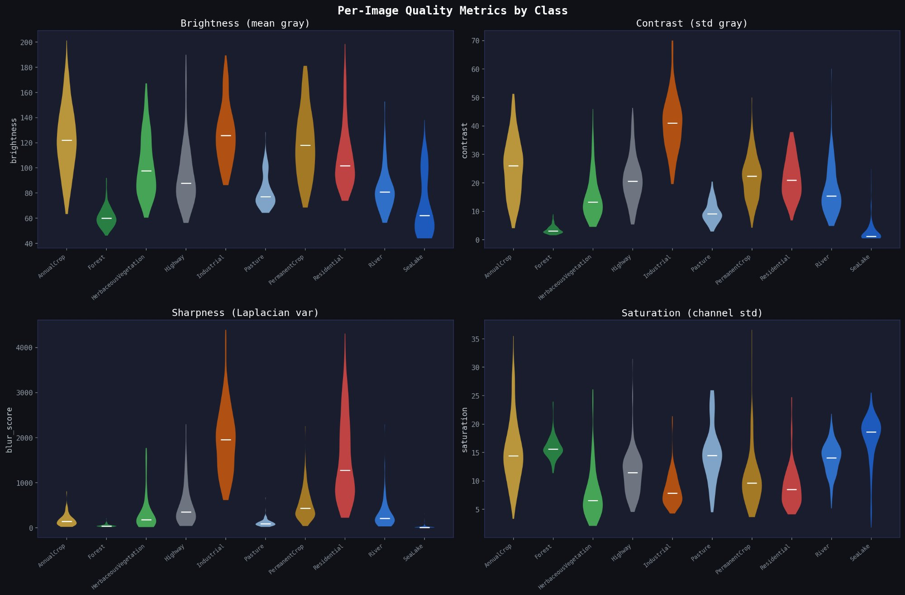
Image Quality & Pixel Statistics
Brightness, contrast, sharpness and saturation vary significantly across classes — understanding this prevents training surprises
Forest & SeaLake: near-zero std → uniform, predictable textures — easy targets for the model
Industrial: highest contrast std (46.6) → heterogeneous man-made structures, harder to generalize
AnnualCrop: wide brightness range → seasonal variation means the model must generalize across lighting
Pasture: narrowest saturation → washed-out colors, can visually blend with other vegetation classes

Slide 13
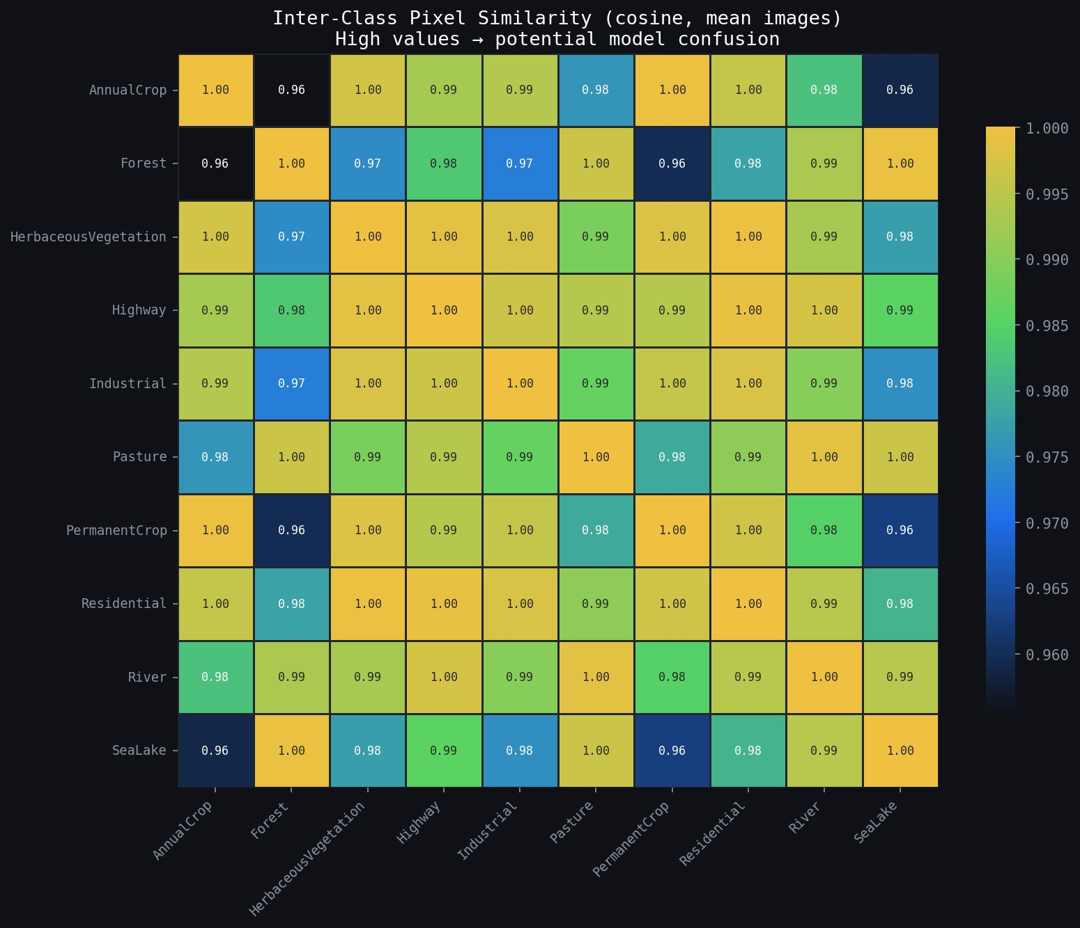
How Similar Are the Classes?
Cosine similarity of mean class images — high similarity = potential for model confusion
Why This Matters
⚠️ Most class pairs score 0.96–1.00 in raw pixel cosine similarity — nearly identical in color space
🔍 Forest ↔ AnnualCrop at 0.96: the most 'different' pair — yet still visually very close
❌ This tells us: a simple color/pixel matcher would fail. The model MUST learn textures and shapes
✅ Deep convolutional features (ResNet50) solve this by capturing spatial structure beyond color

Slide 14
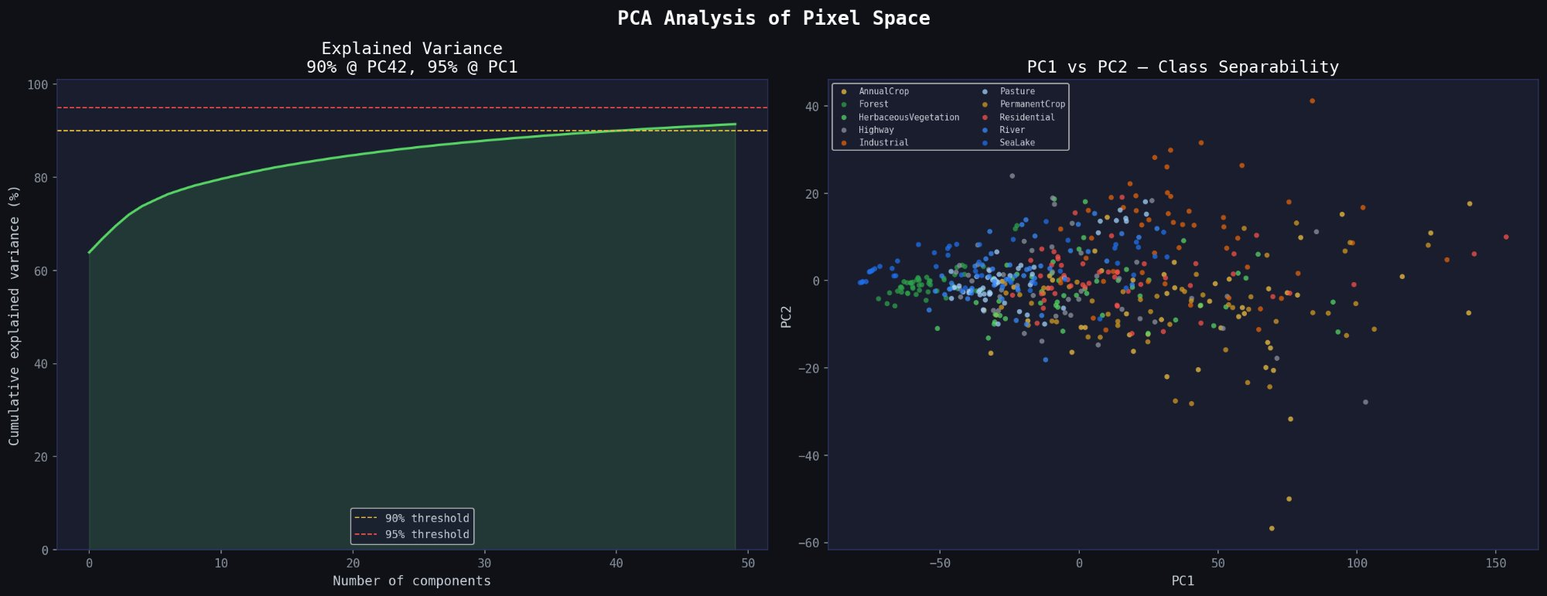
Can Raw Pixels Separate the Classes?
PCA reduces 12,288 pixel dimensions to 2D — can we see class clusters forming?
❌ Raw pixel PCA shows heavy overlap between all classes — no clean separation is visible. The model cannot simply memorize RGB values. This confirms we need a deep feature extractor that learns spatial patterns and textures, not just colors.

Slide 15
04
SECTION 04
The Model
How do we go from raw 64×64 satellite patches to accurate land-use predictions? Meet the ResNet50 transfer learning pipeline.

Slide 16
Why Transfer Learning?
Training from scratch requires millions of images. Transfer learning lets us start from a model that already understands the visual world.
❌ Training From Scratch
✅ Transfer Learning (ResNet50)
• Needs millions of labeled images to converge
• Pretrained on 1.2M ImageNet images — edges, shapes, textures already learned
• Takes days/weeks of GPU compute
• Fine-tune on just ~18K EuroSAT images
• Risk of overfitting on small datasets
• Converges in hours, not days
• Must learn everything from scratch — even basic edges and shapes
• Proven architecture with strong regularization via residual connections
💡 ResNet50 already knows what an 'edge', 'texture', 'blob' or 'pattern' looks like — we just teach it which patterns correspond to Forest vs Industrial vs SeaLake.

Slide 17
The Full Model Pipeline
From raw satellite patch to predicted land-use class — step by step
01
02
03
04
05
Input Image
Augmentation
ResNet50 Body
Custom Head
Prediction
64×64 px Sentinel-2 RGB patch. Resized to 224×224 for ResNet50 input.
Random flips, rotation, color jitter. Normalize with ImageNet mean/std.
49 conv layers extract hierarchical features. Residual connections prevent vanishing gradients.
Global avg pool → 512-dim FC layer → Dropout (0.5) → 10-class output.
Softmax probabilities over 10 classes. Argmax = predicted land-use category.
→
→
→
→
⚙ Loss: Cross-Entropy
⚙ Optimizer: Adam
⚙ LR Scheduler: CosineAnnealing
⚙ Early Stopping: patience=5
⚙ Hardware: CUDA GPU

Slide 18
05
SECTION 05
Results & Analysis
How well did the model perform? We evaluate accuracy, confidence calibration, t-SNE feature visualization, and analyze where and why errors occur.

Slide 19
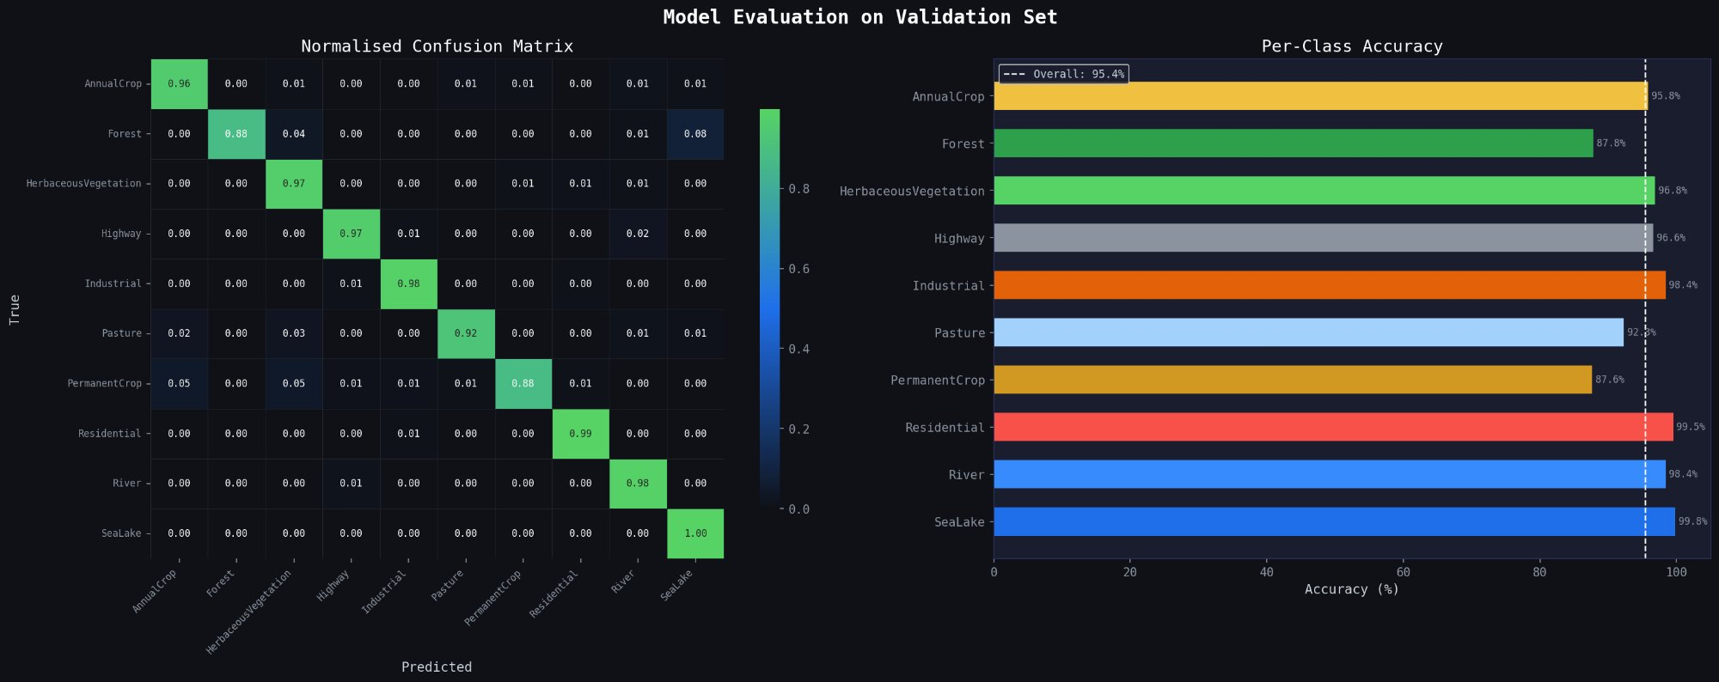
Model Performance on Validation Set
Normalised confusion matrix and per-class accuracy breakdown
95.4%
Overall Accuracy
99.5%
Best: SeaLake
87.6%
Weakest: PermanentCrop
💡 The diagonal of the confusion matrix is nearly all 1s — meaning the model correctly identifies almost every class. The only notable off-diagonal errors are Forest being confused with SeaLake and PermanentCrop with AnnualCrop.

Slide 20
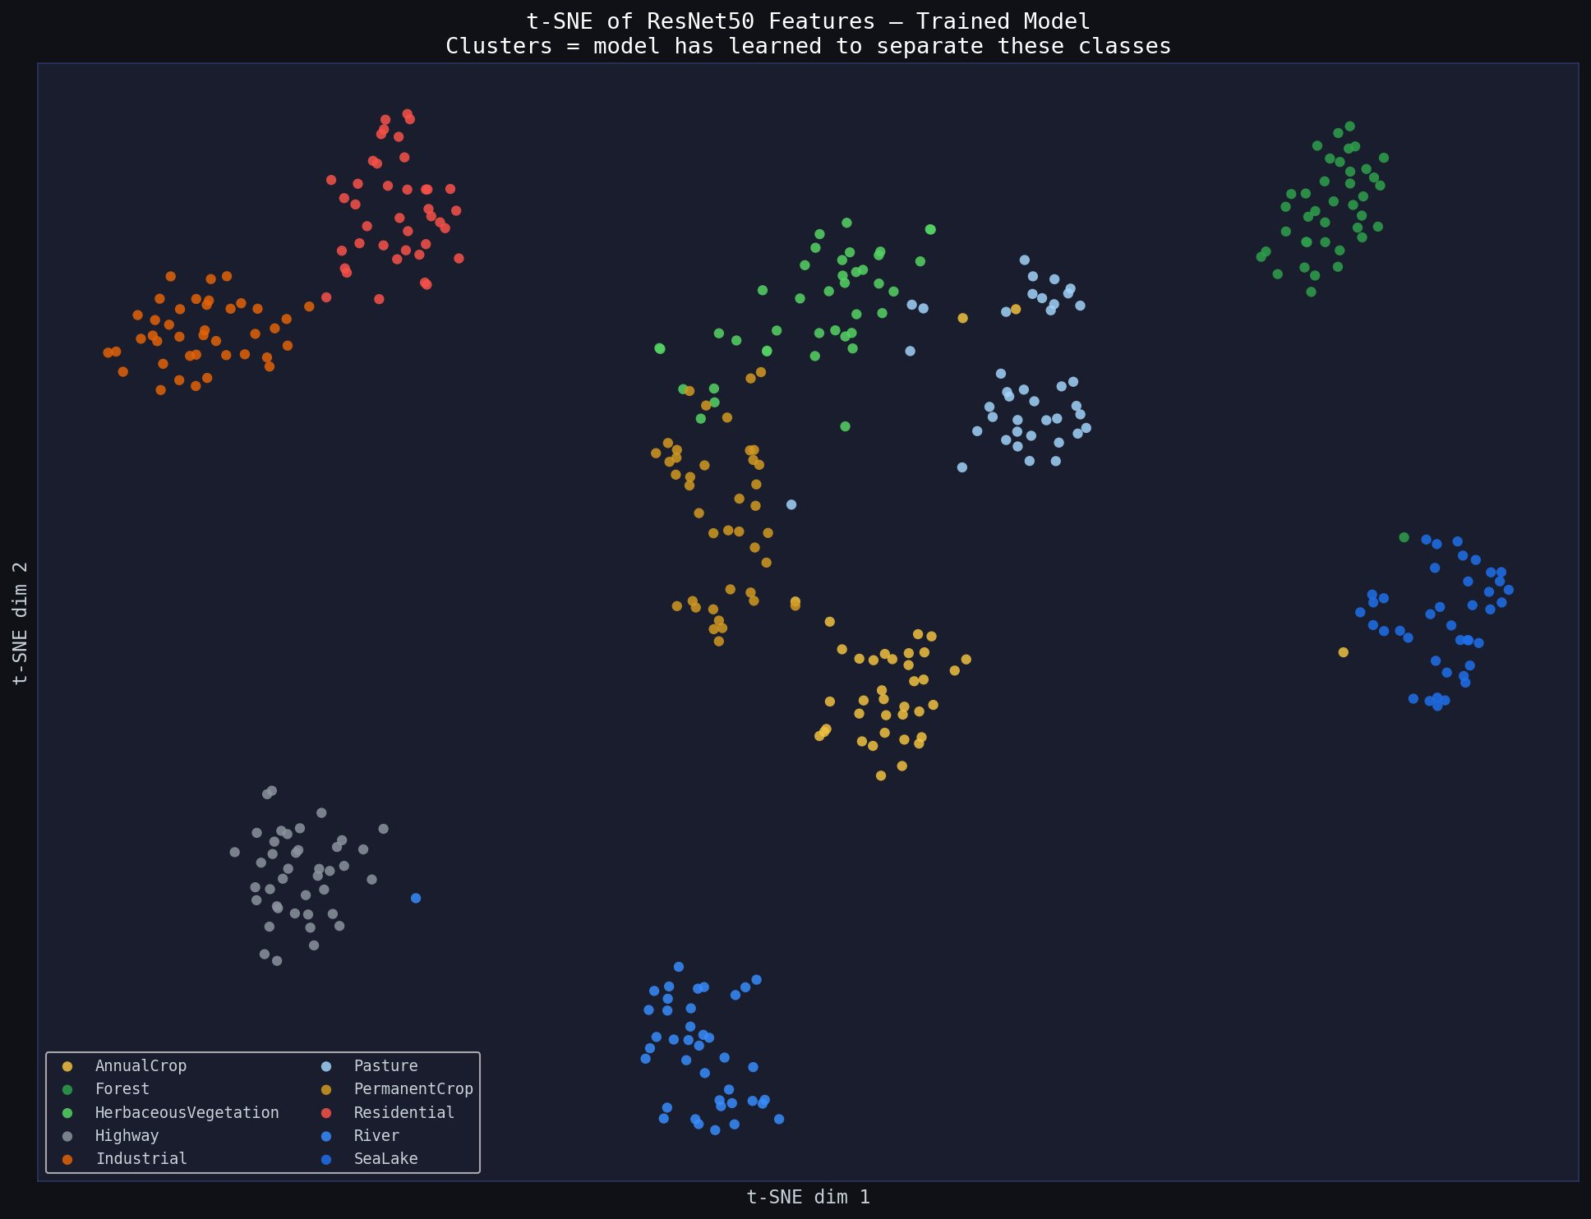
t-SNE: What Has the Model Learned?
Visualising ResNet50 deep features after training — did it form meaningful class clusters?
Reading This Plot
✅ Each color = one class. Tight clusters = model has learned to separate them well.
🎯 SeaLake, Highway, Industrial form the tightest clusters — consistent visual patterns.
⚠️ AnnualCrop and PermanentCrop show slight overlap — both are row-crop field types.
🧠 Compare this to the raw pixel PCA — the transformation is remarkable. Deep learning works.

Slide 21
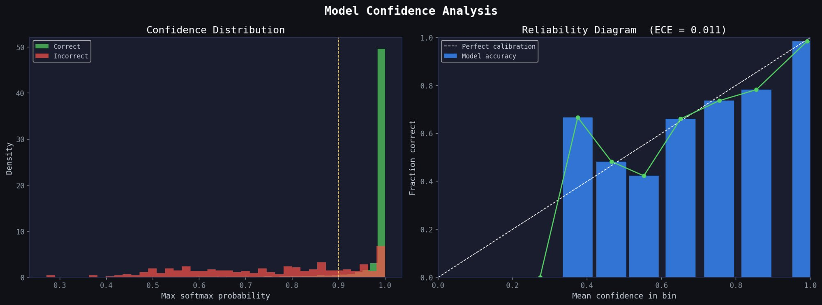
Model Confidence & Calibration
Accuracy alone isn't enough — a trustworthy model must also know when it is uncertain
What is Calibration?
ECE = 0.011
Confidence Distribution
A calibrated model that says '90% confident' should be correct ~90% of the time. Uncalibrated models are over- or under-confident — dangerous in production.
Expected Calibration Error of 0.011 (near-perfect, 0 = ideal). This model's confidence scores are accurate and trustworthy for real-world deployment.
Correct predictions (green) cluster near 1.0 confidence. Incorrect predictions (red) are spread lower — the model knows when it's unsure.

Slide 22
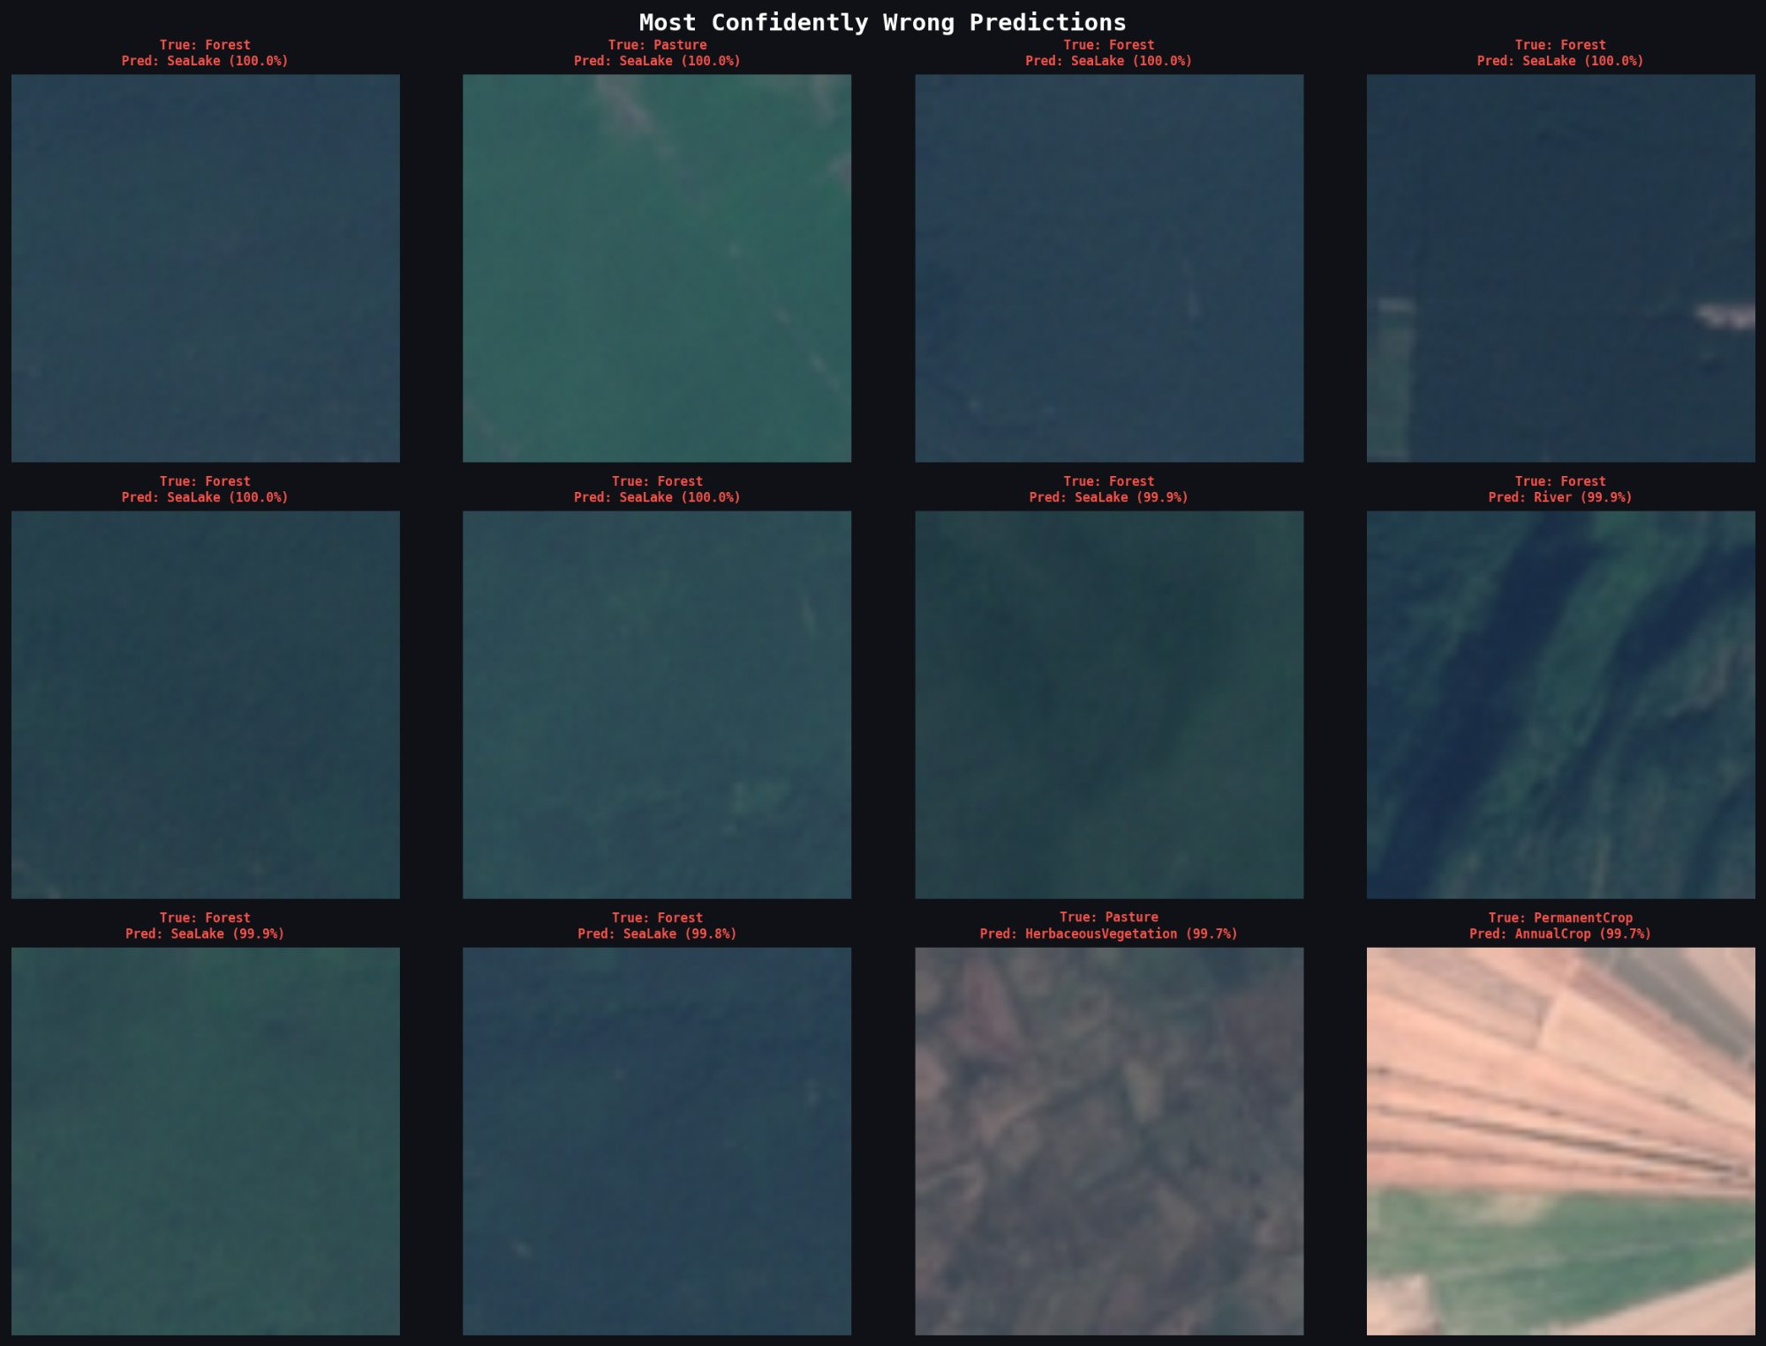
Where Does the Model Fail?
Examining the most confidently wrong predictions — understanding failures drives improvement
Failure Patterns
True: Forest → Predicted: SeaLake
Dark, uniform forest canopies and calm deep water have near-identical spectral signatures. Without NIR bands, they look the same.
True: Pasture → Predicted: SeaLake
Flooded or irrigated pasture fields can appear water-like in RGB bands.
True: Pasture → Predicted: HerbaceousVeg.
Natural grass and managed pasture share virtually identical spectral profiles.
True: PermanentCrop → Predicted: AnnualCrop
Orchards and annual crop fields both show row patterns at this resolution.
🔧 Fix: Adding Sentinel-2's NIR and SWIR spectral bands would immediately resolve Forest/SeaLake confusion — vegetation reflects strongly in NIR, water does not.

Slide 23
06
SECTION 06
Real-World Impact
A 95.4% accurate satellite classifier is not just a research result — it is a deployable tool that can transform environmental monitoring.

Slide 24
Real-World Applications
From conservation monitoring to urban planning — automated land-use classification at planetary scale
🌳 Deforestation Alerts
🌾 Agricultural Intelligence
🏙️ Urban Expansion Monitoring
Automatically detect Forest → AnnualCrop/Industrial transitions. Trigger conservation alerts within days of change.
Track crop types, predict harvest yields, detect illegal cultivation. Enables national-scale food security monitoring.
Classify residential growth patterns. Flag encroachment on greenbelts. Support city planning with real data.
💧 Water Resource Mapping
📋 Policy & Compliance
🌡️ Climate Modelling
Monitor SeaLake and River extents for drought early-warning, flood zone mapping, reservoir levels.
Automate EU land-use directive compliance checks. Reduce manual inspection costs by 90%+.
Feed land-cover maps into carbon sequestration and climate models. Track ecosystem changes over decades.

Slide 25
What's Next?
The current model is a strong foundation — these improvements would push it toward production deployment
1. Add Spectral Bands
2. Multi-Temporal Analysis
3. Ensemble Models
Include Sentinel-2 NIR & SWIR bands. This would directly resolve the Forest/SeaLake confusion and boost accuracy beyond 97%.
Train on image sequences over time, not single snapshots. Seasonal changes provide rich temporal context that removes ambiguity.
Combine ResNet50 with Vision Transformers (ViT) and EfficientNet. Ensemble typically gains 1–2% accuracy with strong calibration.
4. Real-Time Pipeline
5. Explainability (GradCAM)
6. Global Deployment
Connect directly to Sentinel-2 data API. Run inference every 5 days on new imagery. Generate automated change-detection alerts.
Visual explanations of which image regions drive predictions. Essential for regulatory approval and scientific trust.
Scale beyond Europe. Validate on Africa, Asia, South America. Build a global land-use change monitoring system.

Slide 26
Key Takeaways
01 The Problem Is Real & Urgent
02 Data Quality Shapes Model Success
Manual land-use mapping cannot scale. Satellites produce more data than humans can analyze. AI automation is not optional — it is necessary.
EDA revealed spectral fingerprints, class imbalances, and inter-class confusion zones before a single model was trained. Know your data.
03 Deep Features Beat Raw Pixels
04 Calibration Enables Trust
t-SNE proves ResNet50 learns spatial textures far beyond color. The 95.4% accuracy is earned, not luck.
An ECE of 0.011 means this model is deployable. Confidence scores are meaningful — critical for real-world use cases.
🚀 Next: Add NIR/SWIR bands · Multi-temporal sequences · Global deployment pipeline · Automated change-detection alerts

