Slide 1
Credit Card Fraud Detection
Machine Learning with Business Data · Mini Project
[Team names] · [Course / section] · [Repository link]
Complete the bracketed fields and use the team’s final project wording.

Slide 2
Problem and challenges
Person 1 · fraud detection, severe imbalance, precision and recall
Team: write the problem explanation and why fraud screening matters in your own words.
Use the class-balance evidence on the next slides; emphasize how few rows are fraud.
02 / 16

Slide 3
Dataset
Person 1 · verified transaction counts and feature groups
284,807 raw rows · 492 frauds · 1,081 duplicates removed · 283,726 retained
Train 170,235 / 284 fraud · validation 56,745 / 94 · test 56,746 / 95
03 / 16

Slide 4
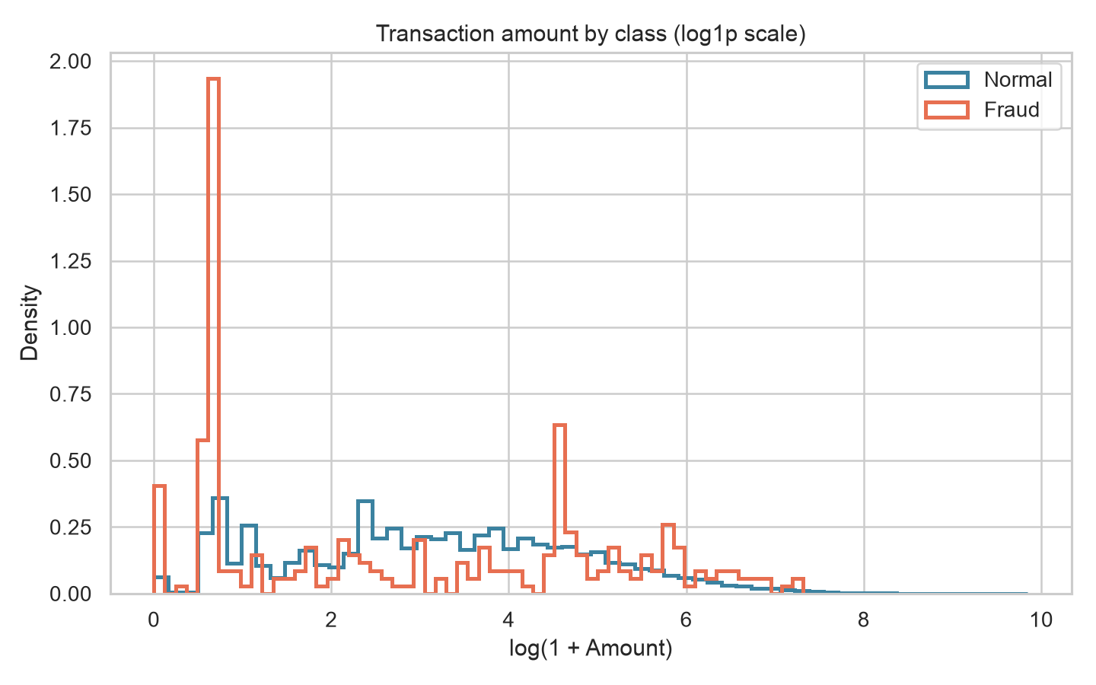
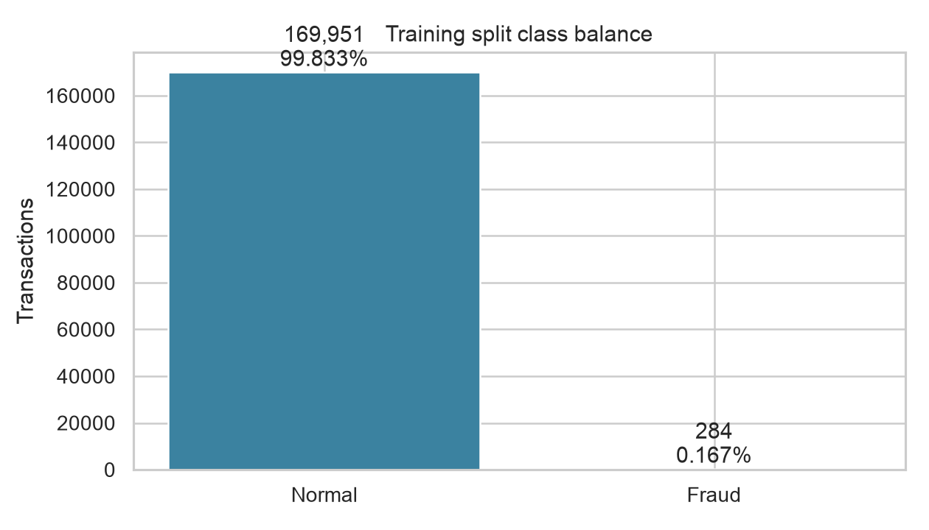
EDA highlights
Person 1 · class balance and key distribution charts
V1–V28 plus log1p(Amount) and relative Hour · train-only standardization
Thresholds use validation rows; the final metrics below use the held-out test split.
04 / 16

Slide 5
Data and evaluation pipeline
Person 2 · raw data to validation threshold to final test
Raw CSV → deduplicate → derive features → stratified split → train-only scale
Train models → choose thresholds/members on validation → evaluate once on test
05 / 16

Slide 6
Five frameworks and shared setup
Person 2 · model families, common network and training controls
XGBoost · Keras · PyTorch Lightning · fastai · TabNet
All five trained on the same splits; local run used Apple Silicon CPU.
06 / 16

Slide 7
Fair comparison rules
Person 2 · validation/test boundary and selected metrics
Choose the F1 threshold on validation; freeze it before test evaluation.
Report precision, recall, F1, PR-AUC, ROC-AUC and confusion counts; accuracy is weak here.
07 / 16

Slide 8
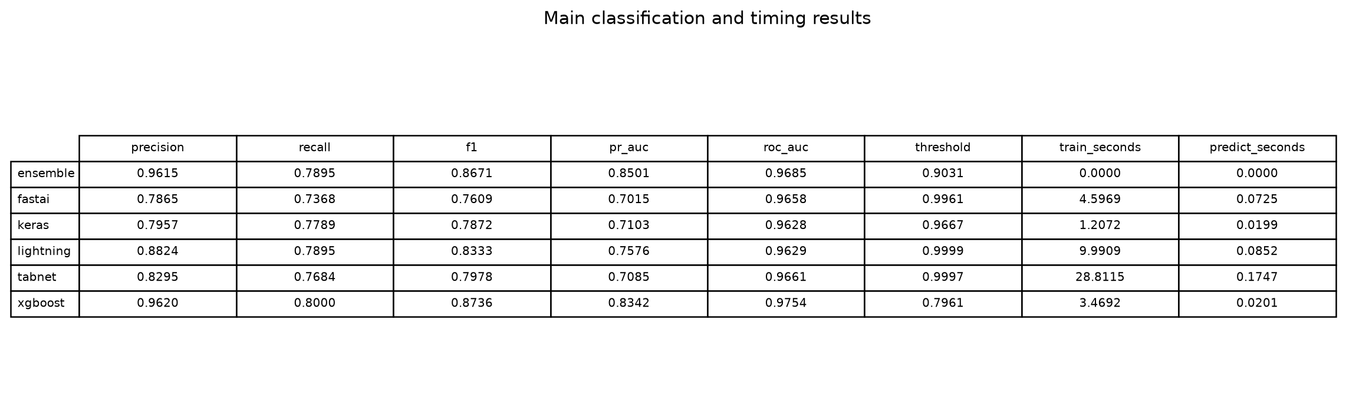
Main results
Person 3 · final comparison table from committed results
XGBoost led single models: test PR-AUC 0.8342 · precision 0.9620 · recall 0.8000 · F1 0.8736
Team: explain the metric trade-off and include the model comparison table.
08 / 16

Slide 9
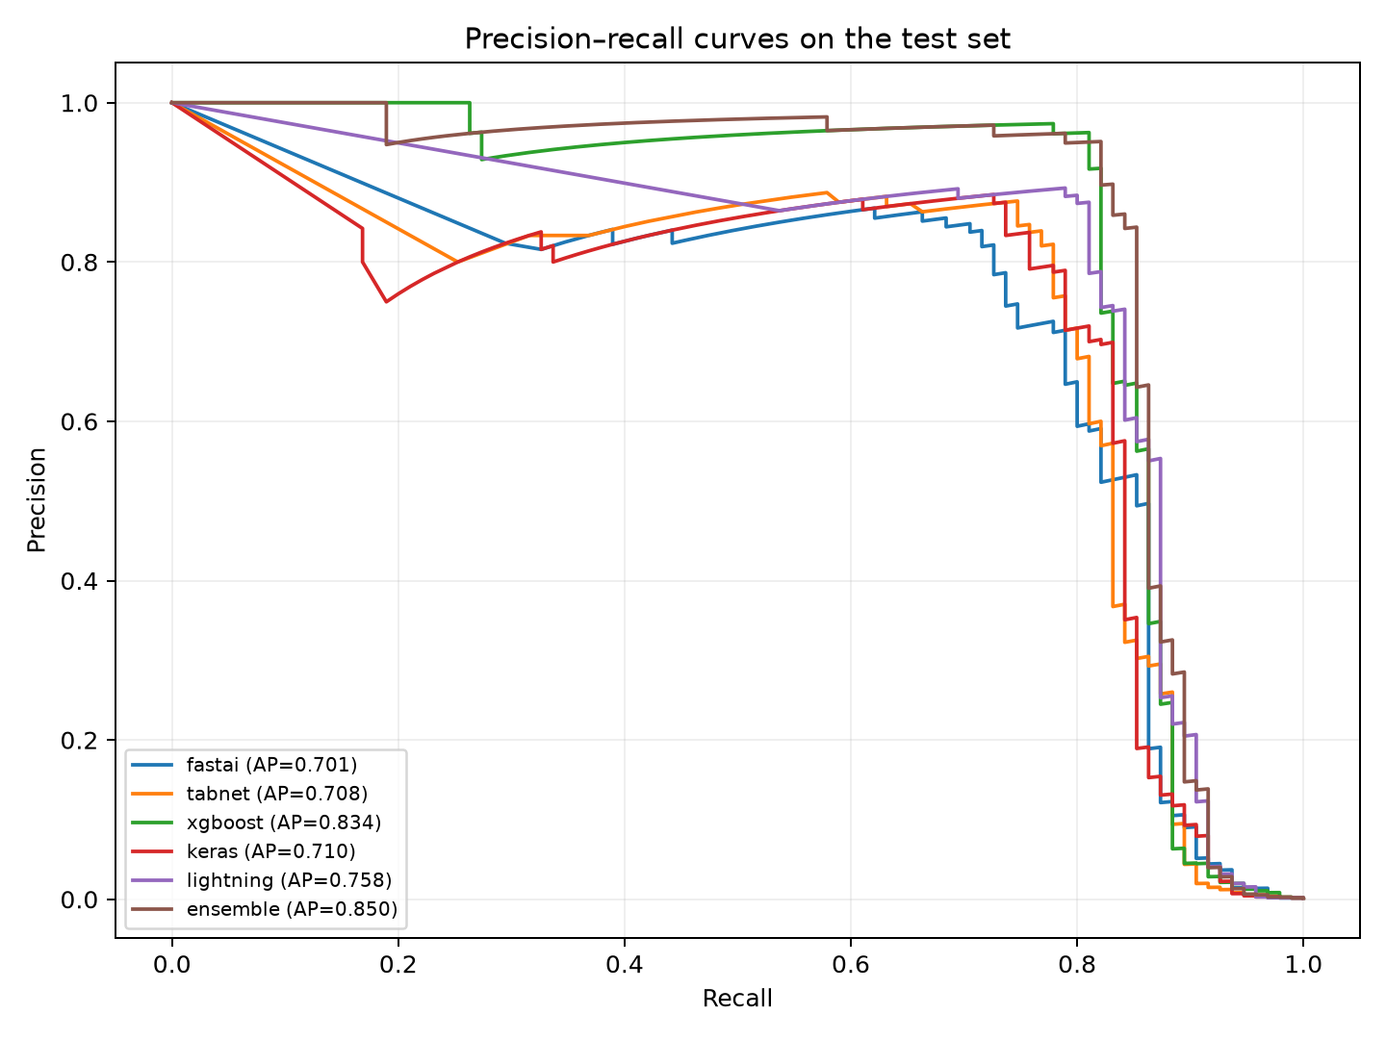
PR curves and confusion matrices
Person 3 · final curves and test-set error counts
Read precision against recall on the held-out test set; the no-skill baseline is the fraud rate.
These curves compare saved test predictions; thresholds were set on validation.
09 / 16

Slide 10
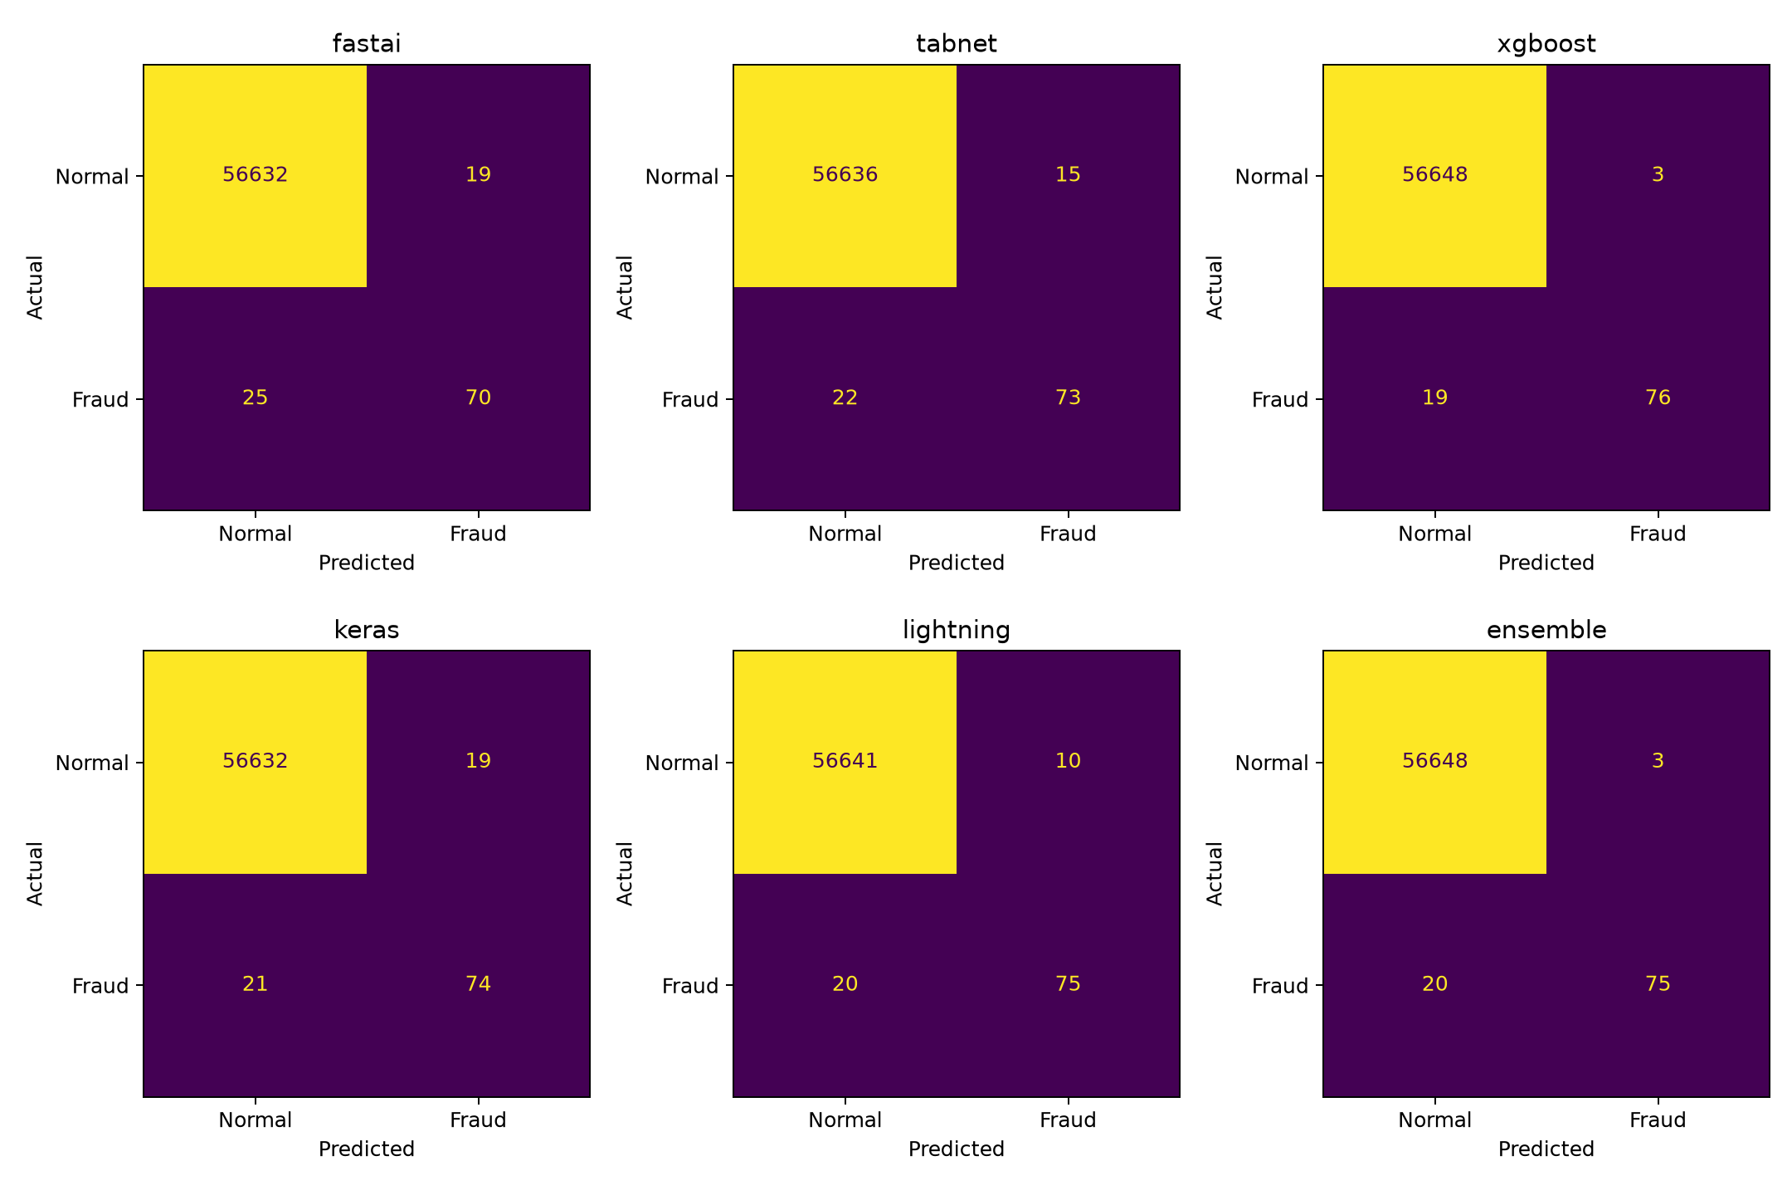
Simplicity, transparency and efficacy
Person 3 · rubric scores with evidence
At validation-selected thresholds, XGBoost found 76/95 test frauds with 3 false alarms.
Counts are from the held-out test split; review the missed-fraud and false-alarm trade-off.
10 / 16

Slide 11
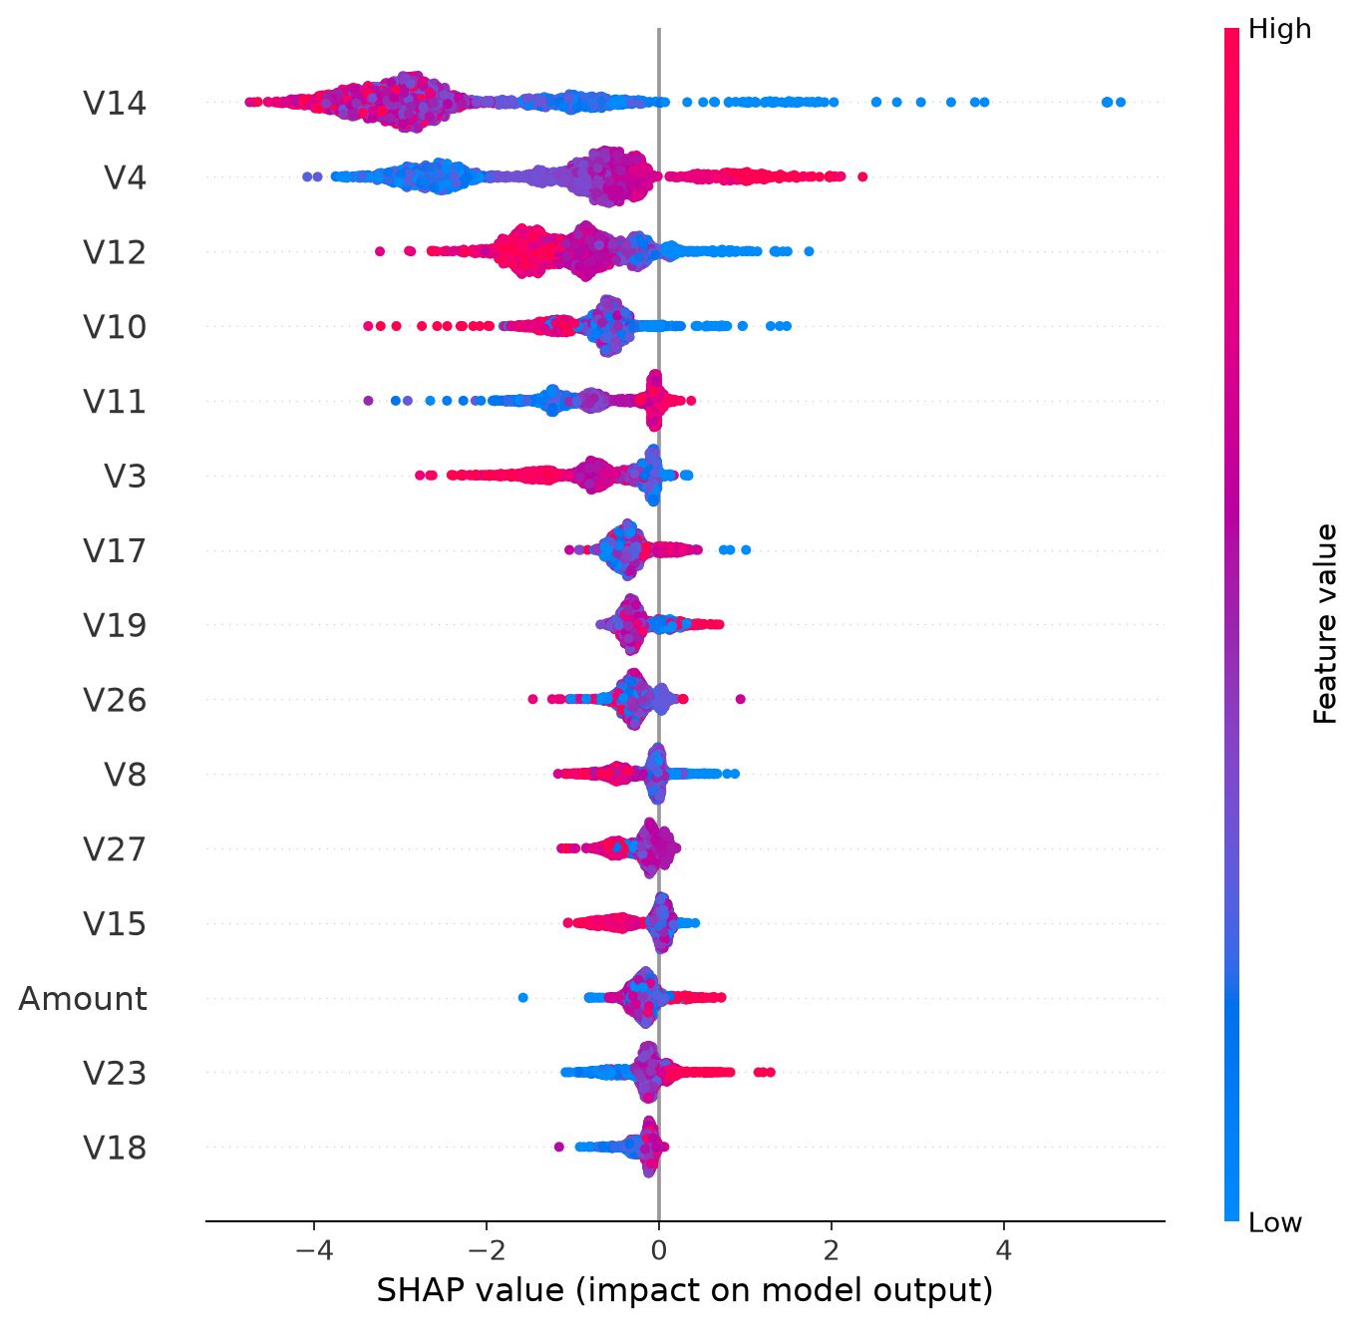
Model transparency examples
Person 1 and Person 3 · SHAP and TabNet masks
Importance and local explanations show model behavior, not causal effects.
V1–V28 are anonymized PCA components; their real-world meaning is not available.
11 / 16

Slide 12
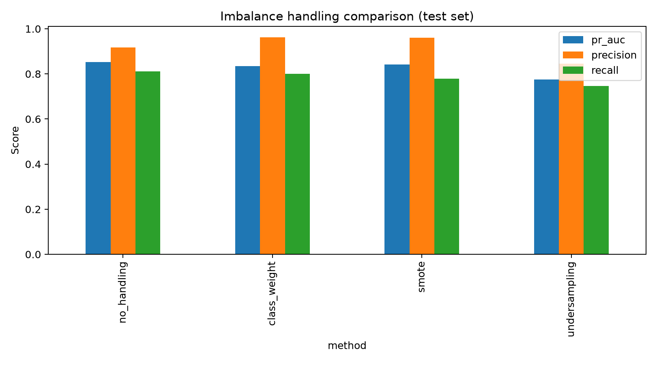
Imbalance experiment
Person 1 · class weighting, SMOTE and undersampling
Test PR-AUC: no resampling 0.8522 · class weights 0.8342 · SMOTE 0.8425 · undersampling 0.7755
SMOTE and undersampling were applied to training data only.
12 / 16

Slide 13
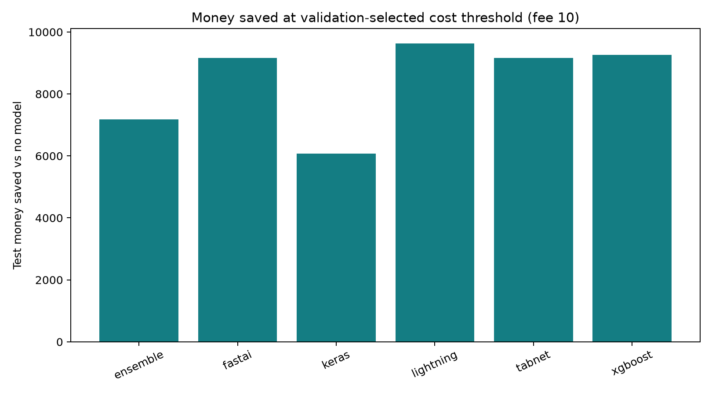
Money-based threshold
Person 3 · cost curve, fee assumptions and savings
At $10 review fee, ensemble test cost $5,788.89 vs $12,973.06 with no model.
Modeled savings $7,184.17; assumed fee and missed-fraud costs are scenarios, not bank data.
13 / 16

Slide 14
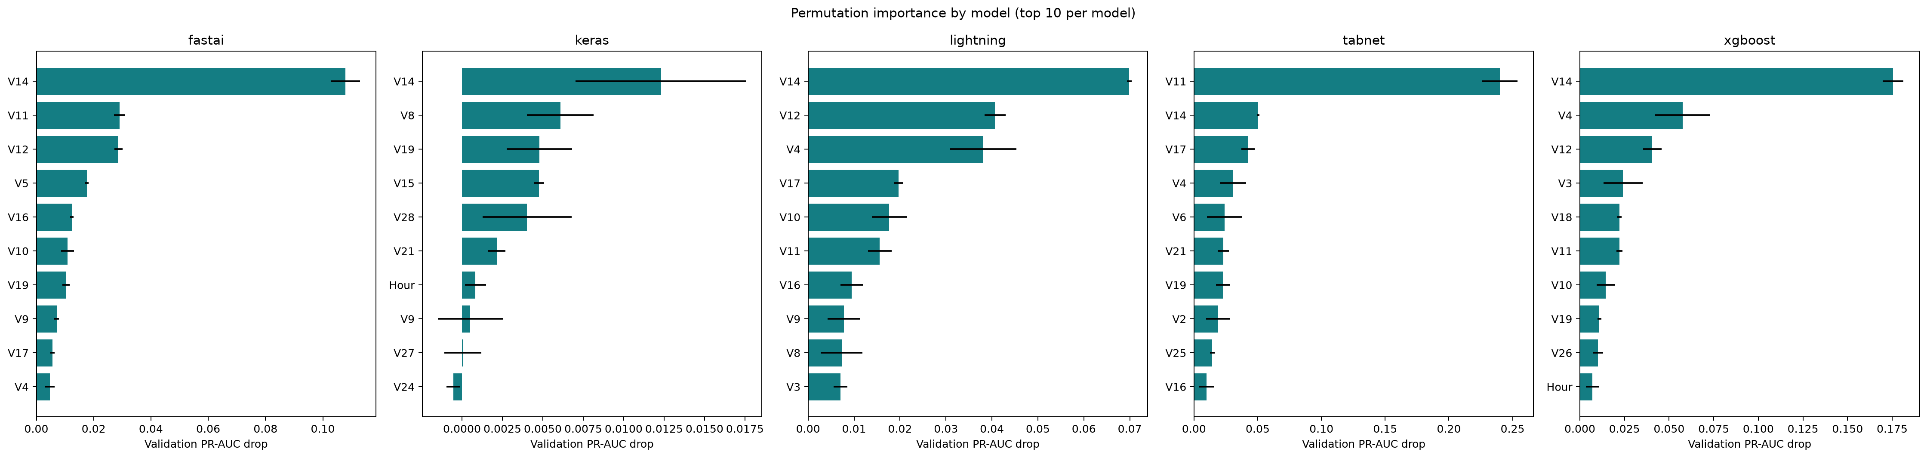
Combined model
Person 2 · validation-selected members and ensemble result
Validation PR-AUC selected XGBoost + Lightning + Keras; row-ID aligned probabilities were averaged.
Ensemble test PR-AUC 0.8501; XGBoost had higher F1 (0.8736 vs 0.8671) and recall.
14 / 16

Slide 15
Conclusion and limitations
Person 3 · evidence-based conclusion and limitations
Limitations: CPU-only run · one fixed split · hidden PCA feature meanings · assumed review fees
Flash/Colab was not verified; write the final conclusion in the team’s own words.
15 / 16

Slide 16
Demo
Person 2 and team · timed demonstration sequence
Demo flow: run `python src/run_all.py`, then open saved comparison, explanation and cost outputs.
Rehearse the duration with your group; keep a saved-chart fallback ready.
16 / 16

