Slide 1

DESIGN AND ANALYSIS OF ALGORITHM
FIRST SEMESTER PPT
NAME: VANSH KUMAR THAKUR
COURSE: M.SC DATA SCIENCE
SEMESTER: FIRST (IST)
SUBMITTED TO:
MS. MANPREET KAUR
(ASSISTANT PROFESSOR)

Slide 2
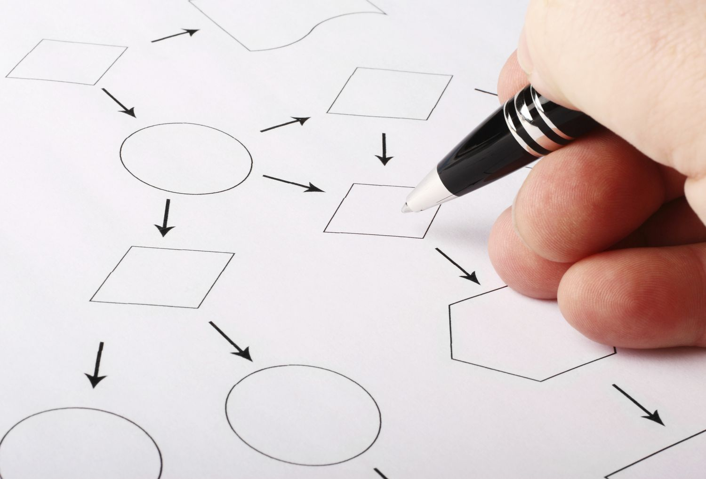
ALGORITHM
An algorithm is a step-by-step procedure for solving a problem or accomplishing a goal. It can also be defined as a sequence of instructions that a computer must perform to solve a problem. Algorithms can instruct a computer how to perform a calculation, process data, or make a decision.
Algorithms are widely used throughout all areas of IT. In mathematics, computer programming and computer science, an algorithm usually refers to a small procedure that solves a recurrent problem. Algorithms are also used as specifications for performing data processing and play a major role in automated systems.

Slide 3
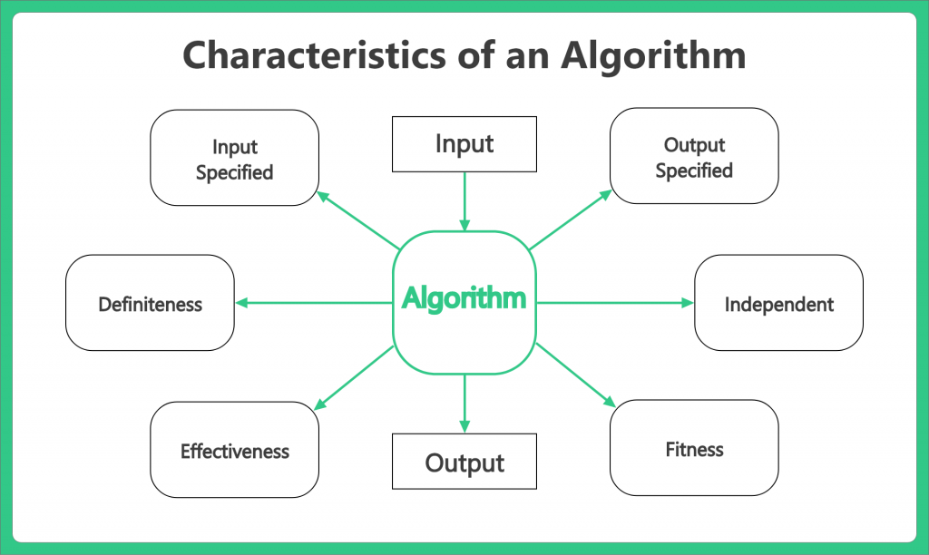

Slide 4
CHARACTERISTICS OF AN ALGORITHM
Input specified: The input is the data to be transformed during the computation to produce the output. An algorithm should have 0 or more well-defined inputs.
Output specified: The output is the data resulting from the computation (your intended result). An algorithm should have 1 or more well-defined outputs, and should match the desired output.
Definiteness: Algorithms must specify every step and the order the steps must be taken in the process. Definiteness means specifying the sequence of operations for turning input into output. Algorithm should be clear and unambiguous.
Effectiveness: For an algorithm to be effective, it means that all those steps that are required to get to output must be feasible with the available resources. It should not contain any unnecessary and redundant steps which could make an algorithm ineffective.
Finiteness: The algorithm must stop, eventually. Stopping may mean that you get the expected output OR you get a response that no solution is possible. Algorithms must terminate after a finite number of steps. An algorithm should not be infinite and always terminate after definite number of steps.
Independent: An algorithm should have step-by-step directions, which should be independent of any programming code. It should be such that it could be run on any of the programming languages.

Slide 5
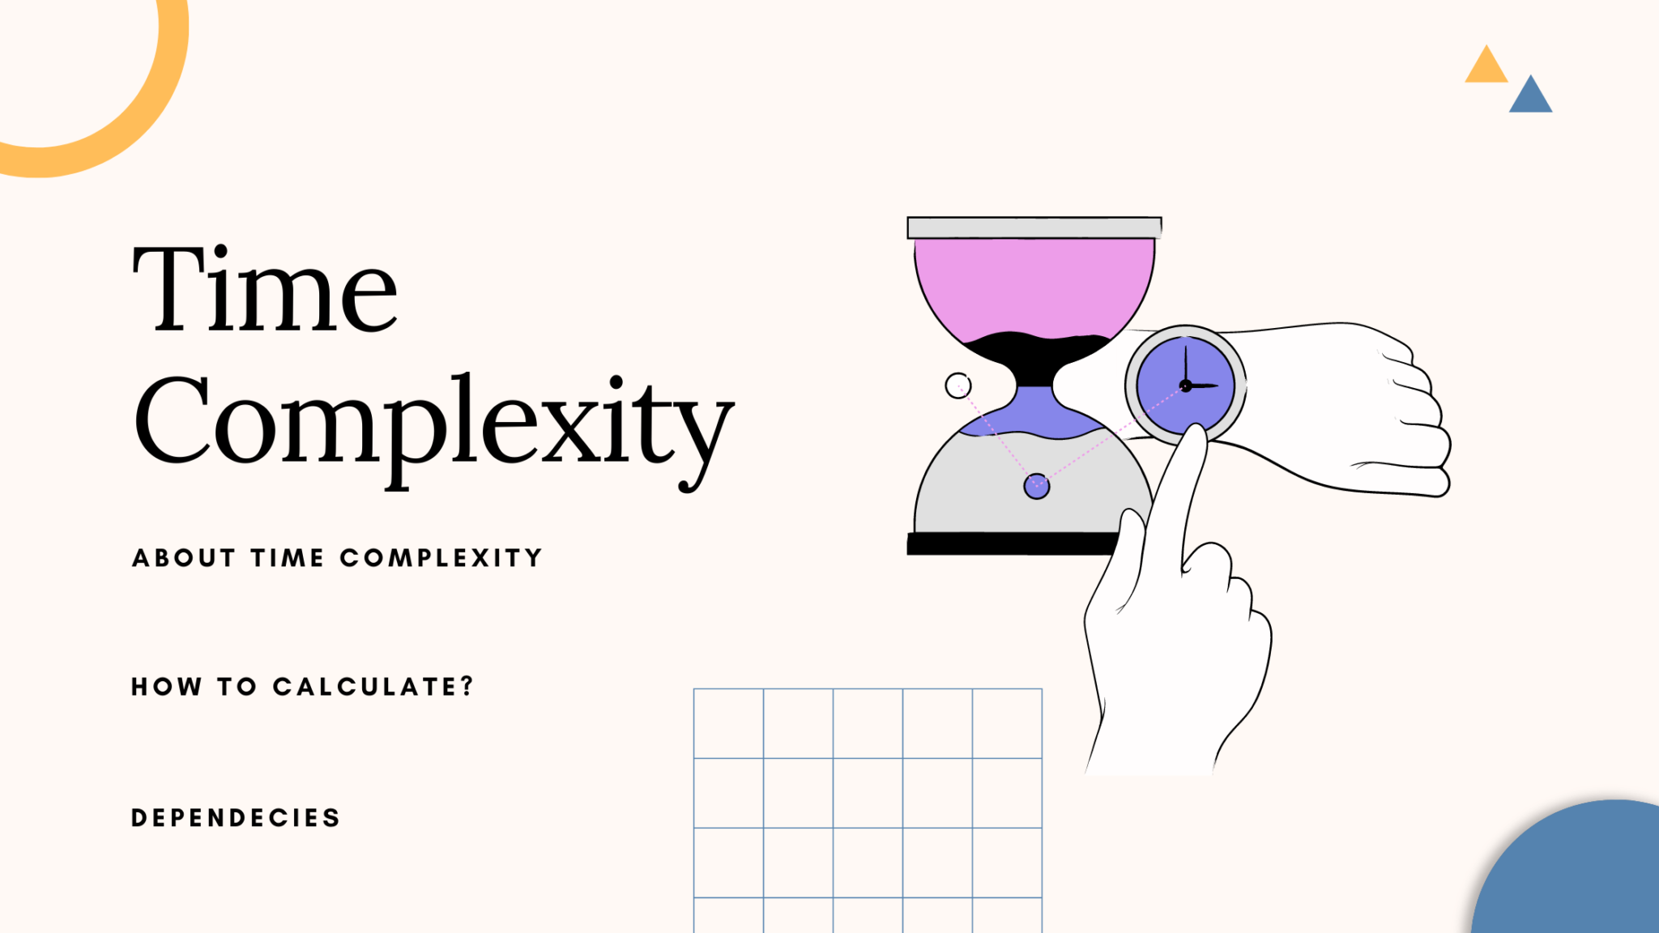
TIME COMPLEXITY
DEFINATION:
In theoretical computer science, the time complexity is the computational complexity that describes the amount of computer time it takes to run an algorithm.
The time complexity of an algorithm is the amount of time it takes for each statement to complete. As a result, it is highly dependent on the size of the processed data. It also aids in defining an algorithm's effectiveness and evaluating its performance.

Slide 6
Recursion ALGO | Iteration ALGO
Recursion uses the selection structure. | Iteration uses the repetition structure.
Infinite recursion occurs if the step in recursion doesn't reduce the problem to a smaller problem. It also becomes infinite recursion if it doesn't convert on a specific condition. This specific condition is known as the base case. | An infinite loop occurs when the condition in the loop doesn't become False ever.
The system crashes when infinite recursion is encountered. | Iteration uses the CPU cycles again and again when an infinite loop occurs.
Recursion terminates when the base case is met. | Iteration terminates when the condition in the loop fails.
Recursion is slower than iteration since it has the overhead of maintaining and updating the stack. | Iteration is quick in comparison to recursion. It doesn't utilize the stack.
Recursion uses more memory in comparison to iteration. | Iteration uses less memory in comparison to recursion.
Recursion reduces the size of the code. | Iteration increases the size of the code.

Slide 7
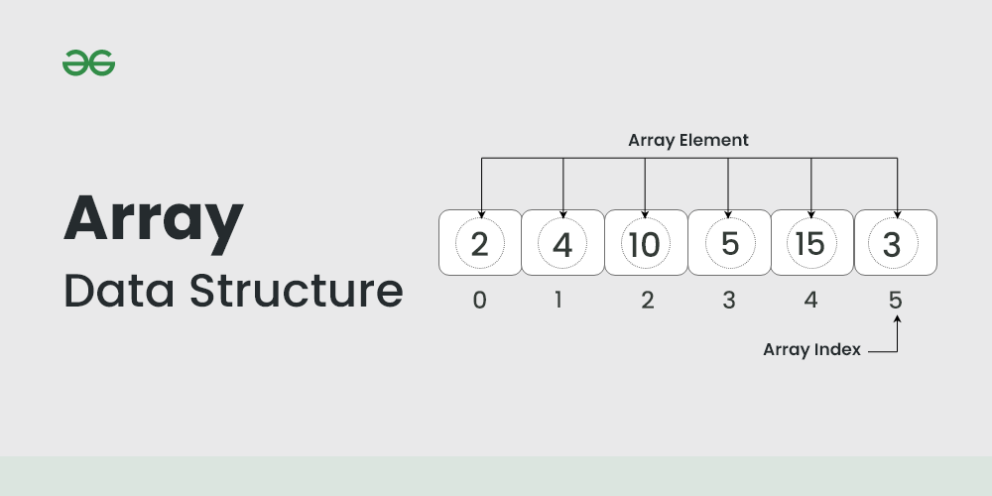
ARRAYS
An array is a linear data structure that collects elements of the same data type and stores them in contiguous and adjacent memory locations.
SYNTAX FOR CREATING AN ARRAY:
NUMPY: arr= np.array([“List”])
ARRAY: arr= array(data_type,value_list)

Slide 8
ARRAY OPERATIONS
append() | Adds an element at the end of the list
clear() | Removes all the elements from the list
copy() | Returns a copy of the list
count() | Returns the number of elements with the specified value
extend() | Add the elements of a list (or any iterable), to the end of the current list
index() | Returns the index of the first element with the specified value
insert() | Adds an element at the specified position
pop() | Removes the element at the specified position
remove() | Removes the first item with the specified value
reverse() | Reverses the order of the list
sort() | Sorts the list

Slide 9
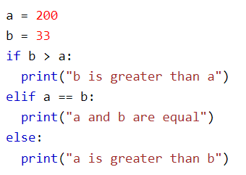
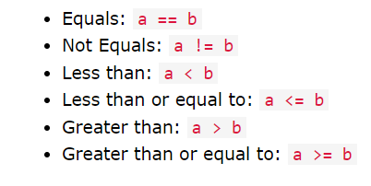
IF ELSE STATEMENT
The if-else statement in Python is used to execute a block of code only if a certain condition is true.
An "if statement" is written by using the if keyword.
The elif keyword is Python's way of saying "if the previous conditions were not true, then try this condition".
The else keyword catches anything which isn't caught by the preceding conditions.

Slide 10
FOR LOOP | WHILE LOOP
For loop is used to iterate over a sequence of items. | While loop is used to repeatedly execute a block of statements while a condition is true.
For loops are designed for iterating over a sequence of items. Eg. list, tuple, etc. | While loop is used when the number of iterations is not known in advance or when we want to repeat a block of code until a certain condition is met.
For loop require a sequence to iterate over. | While the loop requires an initial condition that is tested at the beginning of the loop.
For loop is typically used for iterating over a fixed sequence of items | While loop is used for more complex control flow situations.
For loop is more efficient than a while loop when iterating over sequences, since the number of iterations is predetermined and the loop can be optimized accordingly. | While a loop may be more efficient in certain situations where the condition being tested can be evaluated quickly.

Slide 11
FOR AND WHILE LOOP EXAMPLES
for i in range(10): print(i) # while loop i = 0 while i < 10: print(i) i += 1
list = [1, 2, 3, 4, 5] for i in list: print(i)
i = 0 while i < 10: print(i) i += 1

Slide 12
FUNCTIONS
A function is a block of code which only runs when it is called.
You can pass data, known as parameters, into a function.
A function can return data as a result.
CREATING A FUNCTION:
CALLING A FUNCTION:
def my_function(): print("Hello from a function") my_function()
def my_function(): print("Hello from a function")

