Slide 1


Slide 2
ROADMAP
What this presentation covers
01
02
03
The Problem
The Google Idea
The Matrices
Keyword-density search engines & spam (pre-1998)
A hyperlink is a vote of confidence
Adjacency A → Stochastic S → Google G
04
05
06
The Eigenvector
Live Demo
Real World & Viva
Solving G·v = λ·v with λ = 1
Python terminal + interactive website
Applications, syllabus map, Q&A
Google PageRank | A Linear Algebra Application | Unit 2
02

Slide 3
1 · PROJECT BACKGROUND & HISTORY
Search before Google was broken
!
Keyword Density (before 1998)
HOW SPAMMERS GAMED IT
spam-page.html
Search engines like Yahoo! and AltaVista ranked websites by counting keywords.
Search "Cars" → the page with the word "Cars" written the most times wins.
This was fundamentally flawed.
<div style="color:white; font-size:1px">
Cars Cars Cars Cars Cars Cars Cars
Cars Cars Cars Cars Cars Cars Cars
... repeated 10,000 times ...
</div>
The word is hidden invisibly on the page.
Result: the spam page instantly ranks #1.
Content quality didn't matter at all.
Google PageRank | A Linear Algebra Application | Unit 2
03

Slide 4
1 · THE GOOGLE SOLUTION
A hyperlink is a vote of confidence
Larry Page and Sergey Brin (founders of Google, 1998) solved this using Linear Algebra.
✓
★
↻
Links are votes
Votes are weighted
It's recursive
If Apple.com links to CNN.com, Apple is saying "I trust CNN".
A link from a highly trusted site (like Apple) counts for more than a link from a random blog.
Importance depends on the importance of whoever links to you, which depends on their linkers…
λ
This isn't a simple counting problem. It is a recursive problem, and it is perfectly solved using Matrices and Eigenvectors.
Google PageRank | A Linear Algebra Application | Unit 2
04

Slide 5
2 · THE MATHEMATICS
Our tiny internet: 4 websites
Same graph used in the Python script and the website
A
Apple links to →
2 outgoing links
Apple
Bing
Bing & CNN
B
Bing links to →
1 outgoing link
CNN
C
CNN links to →
2 outgoing links
Apple & Disney
D
Disney links to →
1 outgoing link
Disney
CNN
CNN
Question: which page is the most important? We answer it with 4 matrix steps.
Google PageRank | A Linear Algebra Application | Unit 2
05

Slide 6
STEP 1
The Adjacency Matrix A
The raw structure of the web
A square 4×4 matrix of the web.
Columns = where the link comes From
Rows = where the link goes To
To \ From | Apple | Bing | CNN | Disney
Apple | 0 | 0 | 1 | 0
Bing | 1 | 0 | 0 | 0
CNN | 1 | 1 | 0 | 1
Disney | 0 | 0 | 1 | 0
Rule: A[to, from] = 1 if a link exists, else 0
Apple (column 1) → Bing (row 2) ⇒ A[2,1] = 1
Read the CNN row: 1 · 1 · 0 · 1
→ CNN receives links from Apple, Bing & Disney, a first hint that CNN matters most.
Column sums (outgoing links): 2 1 2 1
Google PageRank | A Linear Algebra Application | Unit 2
06

Slide 7
STEP 2
The Stochastic Matrix S
Turning links into probabilities
A user on Apple.com has 2 links → 50% chance to click Bing, 50% to click CNN.
To \ From | Apple | Bing | CNN | Disney
Apple | 0.00 | 0.00 | 0.50 | 0.00
Bing | 0.50 | 0.00 | 0.00 | 0.00
CNN | 0.50 | 1.00 | 0.00 | 1.00
Disney | 0.00 | 0.00 | 0.50 | 0.00
CALCULATION: divide each column by its sum
Apple : [0,1,1,0] ÷ 2 = [0, .5, .5, 0]
Bing : [0,0,1,0] ÷ 1 = [0, 0, 1, 0]
CNN : [1,0,0,1] ÷ 2 = [.5, 0, 0,.5]
Disney: [0,0,1,0] ÷ 1 = [0, 0, 1, 0]
This is a Markov Chain transition matrix (column-stochastic).
Every column sums to exactly 1.0 (100%)
Google PageRank | A Linear Algebra Application | Unit 2
07

Slide 8
STEP 3
The Google Matrix G & the Random Surfer
G = 0.85 · S + 0.15 · (1/N) · E
N = number of pages (4) | E = 4×4 matrix of all 1s | d = damping factor = 0.85
↗
85% · Clicks a link
✦
15% · Teleports randomly
Most of the time the user follows a hyperlink on the current page.
This behaviour is described by matrix S.
The user gets bored, opens a new tab and types a random URL: the Random Surfer Model.
Every page gets 0.15 / 4 = 0.0375 for free.
Google PageRank | A Linear Algebra Application | Unit 2
08

Slide 9
STEP 3 · CALCULATION
Building G, entry by entry
ONLY 3 POSSIBLE VALUES
To \ From | Apple | Bing | CNN | Disney
Apple | 0.0375 | 0.0375 | 0.4625 | 0.0375
Bing | 0.4625 | 0.0375 | 0.0375 | 0.0375
CNN | 0.4625 | 0.8875 | 0.0375 | 0.8875
Disney | 0.0375 | 0.0375 | 0.4625 | 0.0375
S = 0
0.85 × 0 + 0.0375
0.0375
S = 0.5
0.85 × 0.5 + 0.0375
0.4625
S = 1
0.85 × 1 + 0.0375
0.8875
G is still column-stochastic: each column sums to 1.
e.g. Apple column: 0.0375 + 0.4625 + 0.4625 + 0.0375 = 1.0
No zeros left → every page reachable → unique answer
Google PageRank | A Linear Algebra Application | Unit 2
09

Slide 10
STEP 4 · EIGEN CONCEPTS
The Eigenvector is the PageRank
G · v = λ · v with λ = 1
We want the steady-state vector: the long-term probability of a user landing on each page
λ
Eigenvalue
v
Eigenvector
1
Why exactly 1?
A scalar: how much G stretches the vector. For PageRank, λ = 1: G leaves v unchanged.
The direction G doesn't rotate. Its entries are the PageRank scores.
G is stochastic (columns sum to 1), so its largest eigenvalue is exactly 1.
Google PageRank | A Linear Algebra Application | Unit 2
10

Slide 11
STEP 4 · CALCULATION
Solving with np.linalg.eig(G)
pagerank_demo.py
NORMALISED EIGENVECTOR v
import numpy as np
eigenvalues, eigenvectors = np.linalg.eig(G)
i = np.argmin(abs(eigenvalues - 1)) # λ = 1
v = np.real(eigenvectors[:, i])
PR = v / v.sum() # normalise to 100%
Apple
Bing
CNN
Disney
0.2199
0.1310
0.4292
0.2199
VERIFY BY HAND: (G·v) for the CNN row
= 0.4625×0.2199 + 0.8875×0.1310
+ 0.0375×0.4292 + 0.8875×0.2199
= 0.4292 = v(CNN) ✓ so G·v = 1·v
ALL 4 EIGENVALUES OF G
+1.000
0.000
-0.425
-0.425
λ₁ = 1 is the largest; |λ₂| = 0.425 < 1 → power iteration converges
Google PageRank | A Linear Algebra Application | Unit 2
11

Slide 12
STEP 4 · ALTERNATIVE METHOD
Power Iteration: how the website computes it
Start equal, multiply by G again and again
index.html (JavaScript)
k
Apple
Bing
CNN
Disney
v₀ = [¼, ¼, ¼, ¼]
repeat:
vₖ₊₁ = G · vₖ
until vₖ stops changing
0
0.2500
0.2500
0.2500
0.2500
1
0.1437
0.1437
0.5687
0.1437
2
0.2792
0.0986
0.3430
0.2792
3
0.1833
0.1562
0.4773
0.1833
Each step is a matrix × vector product (row · vector dot products).
Converges because all other |λ| < 1, so their parts shrink to 0.
Same answer as np.linalg.eig.
4
0.2404
0.1154
0.4039
0.2404
5
0.2092
0.1397
0.4420
0.2092
10
0.2202
0.1307
0.4289
0.2202
∞
0.2199
0.1310
0.4292
0.2199
Google PageRank | A Linear Algebra Application | Unit 2
12

Slide 13
RESULT
Final PageRank scores
Eigenvector normalised so it adds up to 100%
★
Why CNN wins
#1
CNN
42.92%
CNN receives links from Apple, Bing and Disney, the most central node in this tiny internet.
#2
Apple
21.99%
#2
Disney
21.99%
=
Apple = Disney
Both receive half of CNN's vote only. A link from a powerful page is worth a lot; Bing gets half of Apple's.
#4
Bing
13.10%
Google PageRank | A Linear Algebra Application | Unit 2
13

Slide 14
SUMMARY
The full pipeline in one picture
A
S
G
v
%
Adjacency
Stochastic
Google
Eigenvector
PageRank
0 / 1 links
÷ column sum
0.85·S + 0.15/N
G·v = 1·v
v / sum(v)
Graph → Matrix → Probabilities → Eigenvector → Ranking. The same pipeline runs in pagerank_demo.py (numpy) and live in index.html (JavaScript).
Google PageRank | A Linear Algebra Application | Unit 2
14

Slide 15
SYLLABUS CONNECTION
Where our Unit 1 & Unit 2 topics appear
Eigenvalues & Eigenvectors
U2
Dot Product
U2
PageRank = eigenvector of G for λ = 1
Each entry of G·v is a row · vector dot product
Vector Norms
U2
Diagonalization
U2
L1 normalisation: v / Σvᵢ so scores sum to 1
Gᵏ = P·Dᵏ·P⁻¹ explains why power iteration converges
Linear Systems / Gauss
U1
Matrix Rank & Null Space
U1
(I − 0.85·S)·v = 0.0375·1 can be solved by elimination
rank(G − I) = 3 → 1-D null space → unique ranking
Google PageRank | A Linear Algebra Application | Unit 2
15

Slide 16
3 · TECHNOLOGY USED
Three parts of this project
Py
UI
P
Python Backend
Web Simulator
Presentation
pagerank_demo.py
index.html
create_comprehensive_ppt.py
Uses numpy to construct A, S and G
np.linalg.eig computes eigenvalues & eigenvectors, as taught in Unit 2
Option 2: enter your own custom matrix
Vanilla HTML5 Canvas, CSS (AMOLED dark), JavaScript
Same math in real time via Power Iteration
Add / delete nodes, drag, draw links: math updates live
Uses python-pptx to generate this deck
Numbers computed live with numpy, so slides = terminal = website
Google-themed dark mode design
Google PageRank | A Linear Algebra Application | Unit 2
16

Slide 17
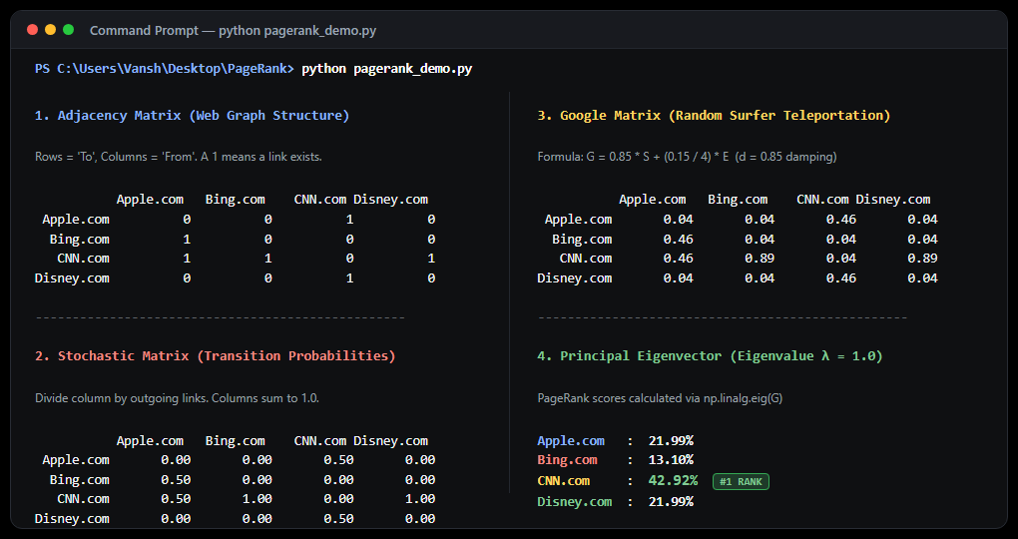
LIVE DEMO · TERMINAL
python pagerank_demo.py
Actual program output (option 1)
TERMINAL RUN
1
Exact Match
100% matches website & slides
2
NumPy eig()
Uses np.linalg.eig to get λ=1
3
Custom Input
Option 2 supports custom matrix
4
Step-by-Step
Clean output of steps 1 to 4
Google PageRank | A Linear Algebra Application | Unit 2
17

Slide 18
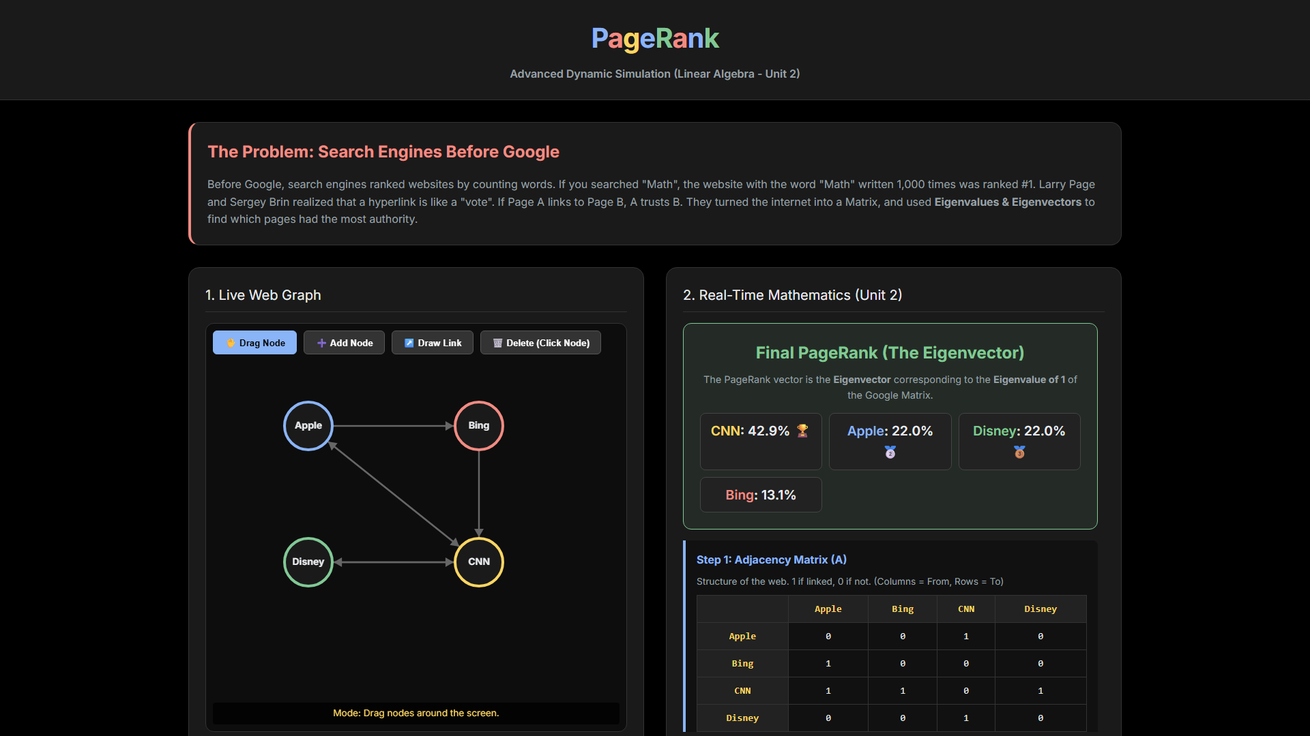
LIVE DEMO · WEBSITE
Interactive PageRank simulator
http://localhost:8080
HOW TO SHOW IT
1
Start server
python -m http.server 8080
2
Drag nodes
Rearrange the web graph
3
Draw a link
Watch A, S, G & ranks update
4
Add / delete
Grow or shrink the matrix
Google PageRank | A Linear Algebra Application | Unit 2
18

Slide 19
REAL LIFE
Where this exact math is used today
G
@
✎
Google Search
Social Networks
Research Papers
Original 1998 ranking of billions of web pages
Twitter/X "Who to follow": influence scores
Ranking papers & journals by citations
⚕
$
⚑
Biology
Fraud Detection
Sports & Roads
Finding key proteins & genes in networks
Spotting suspicious accounts in transaction graphs
Ranking teams; finding busy intersections
Google PageRank | A Linear Algebra Application | Unit 2
19

Slide 20
Thank You
One eigenvector organised the entire internet.
Questions?
pagerank_demo.py
index.html
Explanation_and_Notes.md

