Slide 1
Effect Of Golden Ratio on aesthetic choice
Kyrylo Shyvam Kumar 2021101080
Vanshika Dhingra 2021101092

Slide 2
Brief Introduction
We consider the problem of aesthetics of simple shapes, where we evaluate the effect of golden ratio on human preferences.
Early 20th research suggested that golden ratio has higher preferences in general population.
However later works question the practices:
The averaging of rankings is a procedure may bias in favor of the middle of the stimulus range
Previously studies did not have random selection.
Significant problems of 'demand characteristics'
Our study follows the experiments of Davis, (1991) whose experiments give definite refutations for the superiority of golden ration in aesthetics. The methods used are:
Selection from groups,
Production method
Pair comparison.

Slide 3
Previous works:
Green, (1995) conducted the extensive review of previous works. Some interesting ideas reviewed were if preference for ratio was influenced by culture. One comparative study, found difference in responses in Canadian and Japanese population. Japanese participants found shapes with unity ratio (square as compared to rectangle) more aesthetic.
More recent study try to approach the question from more practical perspective. Russell, (2000) experiments with different aspect ratios with a dataset of paintings and founds no correlation in golden aspect ratio and preference.
Raghubir, (2006) does similar with the shape of packages/cards. For different purposes, there were different peaks (at 1:1 or around 1.3:1) but there was nothing particular near golden ratio.

Slide 4
Introduction – Motivation and Impact
Motivation:
Validating Aesthetic Significance: Understand and validate aesthetic beliefs related to golden ratio.
Diversifying Demographics: Expanding research to diverse populations.
Transition to Digital Methodologies: Embracing digital means for the study.
Impact:
Consumer Preferences: Boosts business success by aligning products with diverse demographic aesthetics.
Enhanced Design and Art: Validates enduring aesthetics for better compositions by designers, architects, and artists.
Historical Significance: Examines if historical beliefs about beauty align with evidence.

Slide 5
Research Design and Methods
Sample Size: 30 to 40 people. We will perform 3 experiments using counterbalance technique so 6 orders in total 6-7 people for each order.
Psytoolkit/Google forms will be used.
Study Design
Target Group : Educated Indian Population
Sample Group : University Students and Professors
Research Method: Survey research and experimental research
Research Strategy: Correlational Research
Research Design: Within Group
Consent form : It would be the part of the google form we share.

Slide 6
Variables
Gender(independent)
Ratio of division of a figure (independent)
Personal aesthetic preferences(dependent)
Measures
Age, profession and gender are collected from responses of participants.
Ratio of division is provided either by participant (as a response) or experimenter depending on experiment performed.

Slide 7
Progress So Far
Preparation Of Dataset
Making google form for experiment
Conducting Pilot Study
Analysis of Data generated from Pilot Study

Slide 8
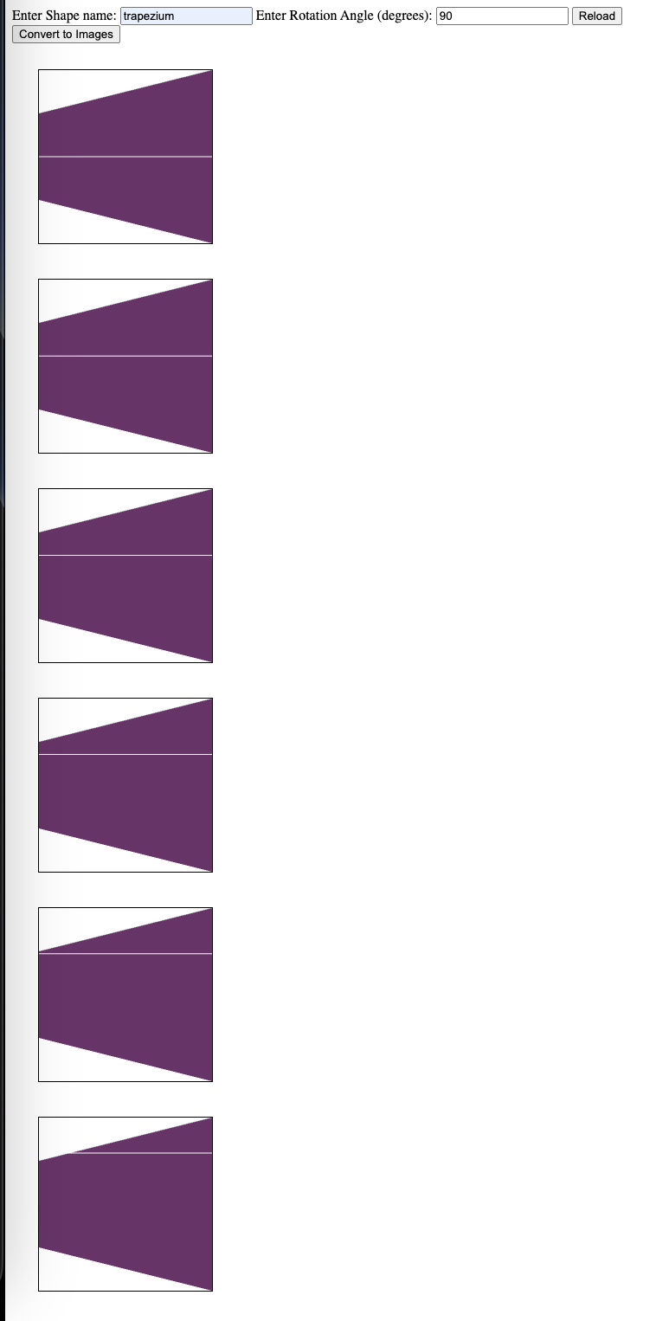
Preparation Of Dataset
We made a javascript application to generate the data that we needed for our experiment where we can specify the shape name and the angle of rotation of the figure and we can download the images.

Slide 9



Dataset Samples
This is 0 degree rotated parallelogram horizontally divided
This is 90 degree rotated rectangle vertically divided
This is 0 degree rotated trapezium horizontally divided
1:1 1.268:1 1.618:1 2.098:1 2.791:1. 3.885:1

Slide 10
Procedure for making dataset
Shapes selected were: square, rectangle, circle, ellipse, trapezium and parallelogram.
To nullify effect of orientation we present each shape, in 4 different orientations, rotated by 0,90,180,270 degrees. We also flip shapes, to make division into parts symmetric. For unsymmetric shapes like trapezium, we split both horizontally and vertically. Colour is assigned randomly across sets.
Each set consists of 6 ratios in ascending order. The motivation to keep set ordered is to allow participants to use some sort of "staircase method" to judge the aesthetics.

Slide 11
Google Forms
Consent has been taken in google form
We have added 32 questions randomly sampled ensuring that each class has same representation from a set of 56 questions.
For all the participants the questions are randomly arranged in order to remove order effects.

Slide 12
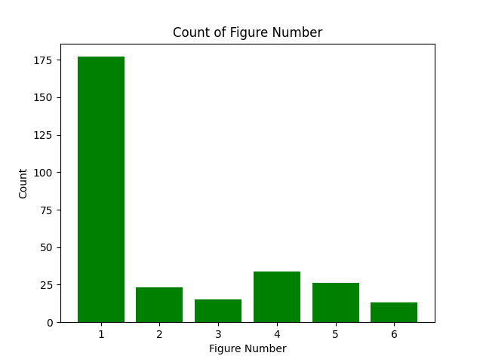
Results – Preliminary Data
What we can see from the graph is that most of the people chose the 1:1 ratio that matches with that of our hypotheses.
There is also another peak at the ratio 2.098:1.

Slide 13
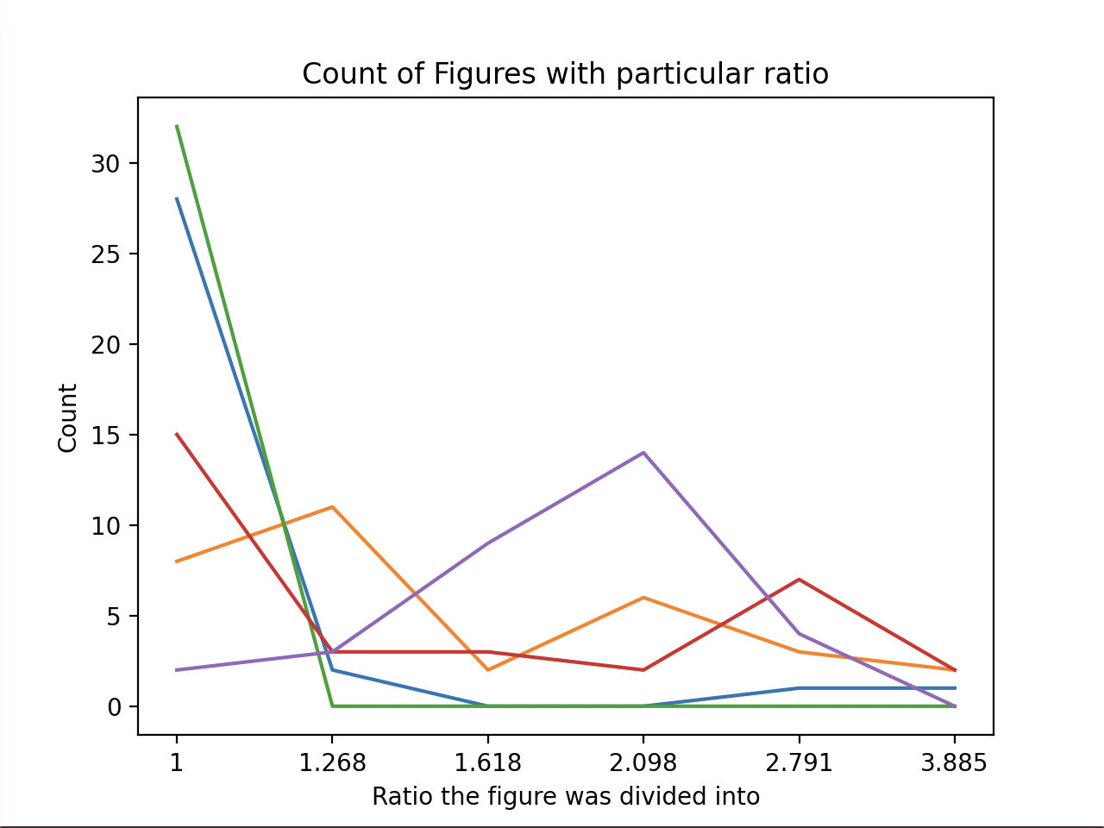
Results – Preliminary Data
Different lines represent different participants.
We see that for each participant there is one major peak. This is consistent with explanation that preference varies among people but is almost constant for a single person.
Also we can see that for most of the people the peak comes at 1:1 ratio.
Almost no one selected golden ratio

Slide 14
Problems Experienced during project completion
No publicly available dataset
Incorporating experimental design using google forms

Slide 15
Time plan and Activities
SEPTEMBER 30
Progress Report I
OCTOBER 18
Progress Report II
NOVEMBER 16-20
Final Presentation
Read more background papers
Formalize the experiment design
Prepare Dataset
Start with data collection
Validate if Pilot Study matches with hypothesis
Data Collection
Data Analysis

Slide 16
References
McManus, IC (1980). The aesthetics of simple figures. British Journal of Psychology, 71, 505-524.
Davis S T, Jahnke J C, 1991 "Unity and the golden section: Rules for aesthetic choice?" American Journal of Psychology 104 257-277.
Green, C. D. (1995). All That Glitters: A Review of Psychological Research on the Aesthetics of the Golden Section. Perception, 24(8), 937-968.
Raghubir, P., & Greenleaf, E. A. (2006). Ratios in Proportion: What Should the Shape of the Package Be? Journal of Marketing, 70(2), 95-107.
Russell, P. A. (2000). Testing the Aesthetic Significance of the Golden-Section Rectangle. Perception, 29(12), 1413-1422.

