Slide 1
Effect Of Golden Ratio on aesthetic choice
Kyrylo Shyvam Kymar 2021101080
Vanshika Dhingra 2021101092

Slide 2
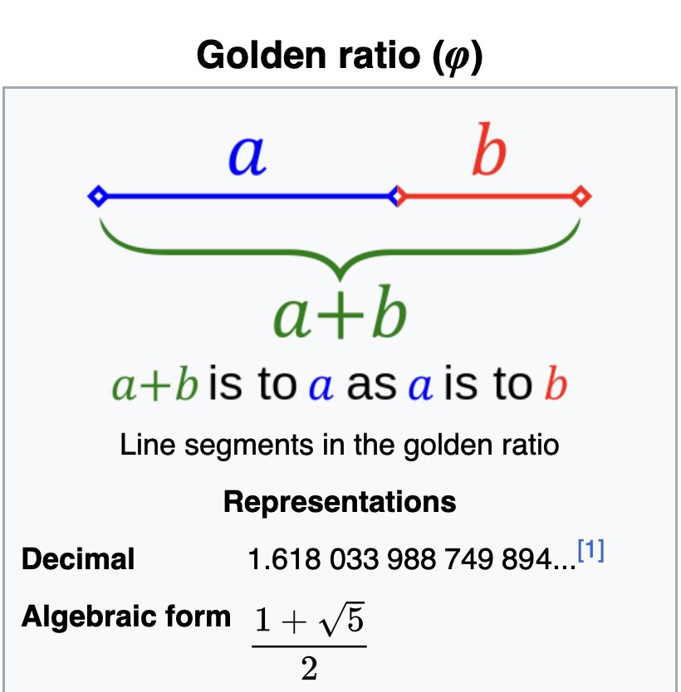
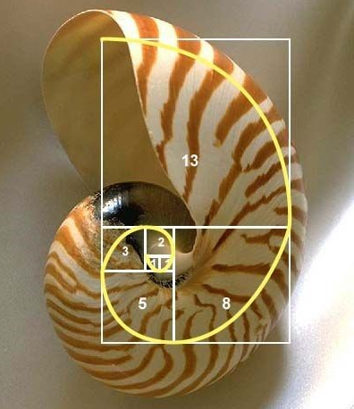
What is Golden Ratio

Slide 3
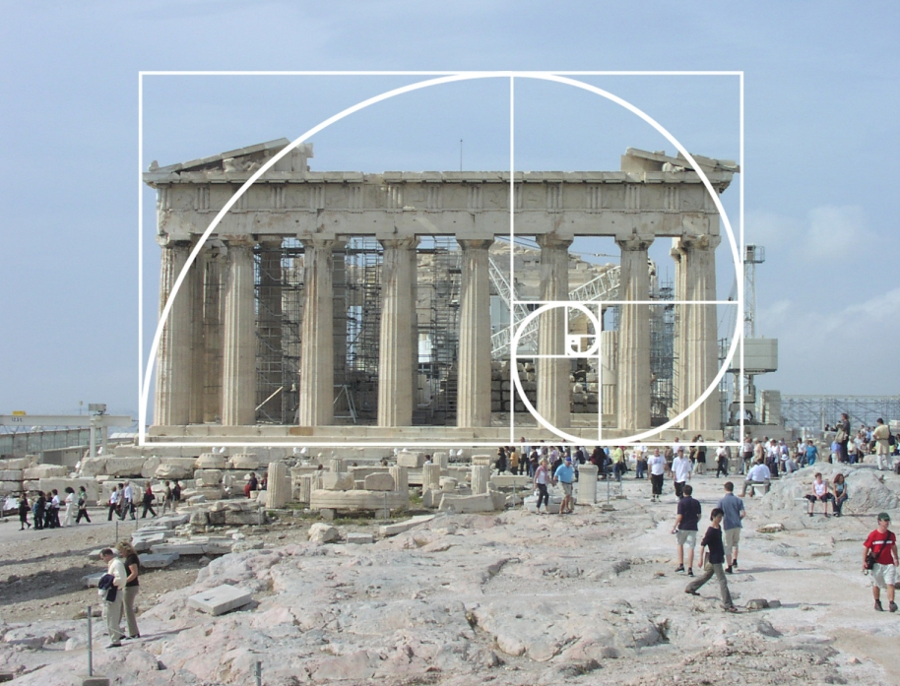
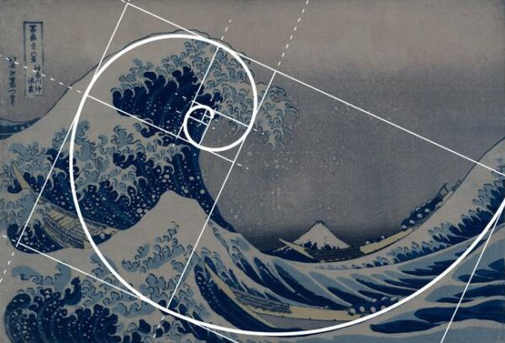
Golden ratio in Art and Architecture

Slide 4
Introduction – Brief Introduction
The problem discussed here is the problem of proportion in aesthetics, which has been a topic of concern for over two and a half millennia. This problem essentially boils down to the question of how to arrange a small number of lines in the most harmonious manner.
The golden section, often defined by the ratio of 1.618:1 has been regarded as an aesthetic ideal in architecture and art. This ratio continues to influence design principles today, even though there is limited empirical evidence supporting its preference.
Hypothesis - this study hypothesizes that aesthetic preferences in visual design will primarily align with principles of symmetry, regularity, and simplicity, rather than conforming to specific numerical ratios, such as the golden section (1.618:1)

Slide 5
Introduction – Motivation and Impact
Motivation:
Validating Aesthetic Significance: Understand and validate aesthetic beliefs related to golden ratio.
Diversifying Demographics: Expanding research to diverse populations.
Transition to Digital Methodologies: Embracing digital means for the study.
Impact:
Consumer Preferences: Boosts business success by aligning products with diverse demographic aesthetics.
Enhanced Design and Art: Validates enduring aesthetics for better compositions by designers, architects, and artists.
Historical Significance: Examines if historical beliefs about beauty align with evidence.

Slide 6
Research Design and Methods
Sample Size: 30 to 40 people. We will perform 3 experiments using counterbalance technique so 6 orders in total 6-7 people for each order.
Psytoolkit/Google forms will be used.
Study Design
Target Group : Educated Indian Population
Sample Group : University Students and Professors
Research Method: Survey research and experimental research
Research Strategy: Correlational Research
Research Design: Within Group
Consent form : It would be the part of the google form we share.

Slide 7
Variables
Gender(independent)
Ratio of division of a figure (independent)
Personal aesthetic preferences(dependent)
Measures
Age, profession and gender are collected from responses of participants.
Ratio of division is provided either by participant (as a response) or experimenter depending on experiment performed.

Slide 8
Experiment 1
Dataset:
Geometric stimuli: squares, rectangles, circles, ellipses, trapezoids, and parallelograms.
Each shape had a fixed area.
Stimuli sets consisted of six identical shapes.
Shapes were divided into two parts by a straight line to create specific area-to-area ratios.
Ratios to be tested: 1:1 (unity ratio), 1.268:1, 1.618:1 (golden section), 2.098:1, 2.791:1, and 3.885:1 as in previous research works
Design:
Within-subjects design with 42 sets of stimuli.
Shapes, orientations (horizontal and vertical), division directions (horizontal and vertical), and line positions (relative to the center for horizontal divisions) were varied systematically.
Each set of stimuli contained six comparison figures with different dividing ratios.
Procedure:
Participants received one of three random orders of presentation of stimulus sets.
In each trial, participants were presented with a set of six shapes and instructed to identify the shape that had been divided in the most pleasing way.
They were told to evaluate each set of stimuli independently.

Slide 9
Experiment 2
Materials:
Stimuli included six outline figures used in Experiment 1.
Additionally, two circles marked with a single dot on the circle's circumference were added to allow for unrestricted preferences.
Figures were presented on 21.59 x 27.94-cm white pages with varying orientations.
Two test booklets were created, one with the same figure size as Experiment 1 (26 cm²) and another with 300% enlarged figures (78 cm²).
Design:
Within-subjects design with each participant receiving one of the two test booklets.
Figures were presented in both vertical and horizontal orientations.
. Subjects were instructed to draw a dividing line through each figure to create two aesthetically pleasing areas
Subjects had the freedom to choose the direction of division.
Procedure:
Participants were given a test booklet containing figures of their assigned size.
They were instructed to use an unmarked, opaque straightedge to draw a dividing line through each figure.
For the dotted circles, subjects were instructed to draw a line starting at the dot and proceeding in any direction.
Participants were encouraged to consider all possible area-to-area comparisons before making each division.
Subjects could return to previous stimuli, erase lines, and redivide figures as desired.
After the task, participants completed a questionnaire about their undergraduate majors, artistic training, and the reasoning behind their divisions.

Slide 10
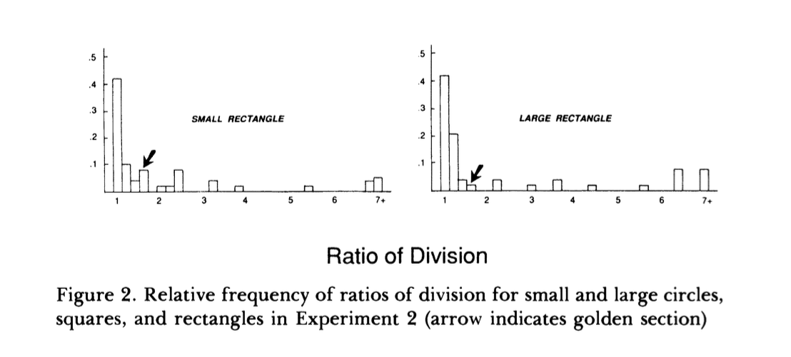
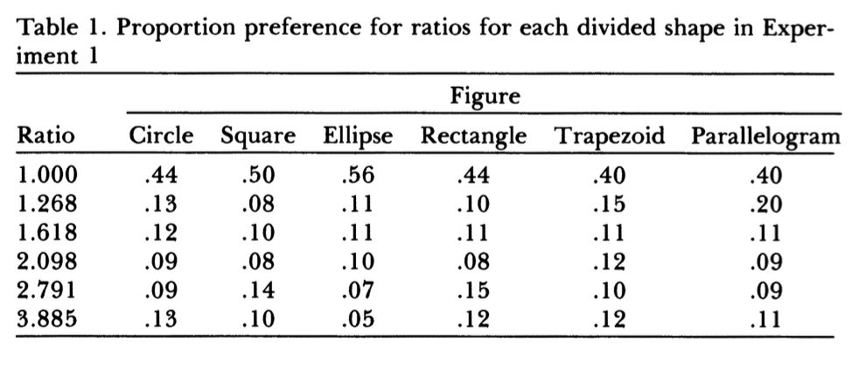
Expected Results
Statistics used in the analysis

Slide 11
Time plan and Activities
SEPTEMBER 30
Progress Report I
OCTOBER 18
Progress Report II
NOVEMBER 16-20
Final Presentation
Start with data collection
Validate if Pilot Study matches with hypothesis
Data Analysis
Read more background papers
Prepare dataset
Formalize the experiment design

Slide 12
Reference
McManus, IC (1980). The aesthetics of simple figures. British Journal of Psychology, 71, 505-524.
Davis S T, Jahnke J C, 1991 "Unity and the golden section: Rules for aesthetic choice?" American Journal of Psychology 104 257-277.

