Slide 1

Scratch Teaching Plan For Samatha extensions – pen, video sensing, text to speech, translate and more…
Vanshika Mittal
Shivali Mittal
spellotype@gmail.com

Slide 2

01.
Lesson extensions - pen blocks
https://youtu.be/QD05shAp740

Slide 3
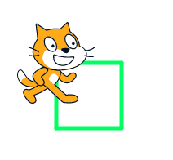
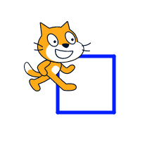
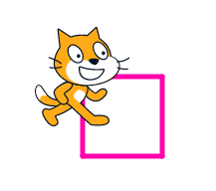
Activity 1.1 – Draw a square!!
Use the Pen blocks to make a square on the screen.
Experiment with pen colors and sizes.

Slide 4
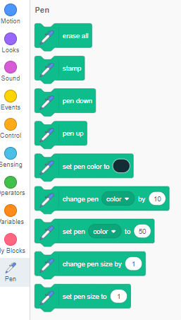

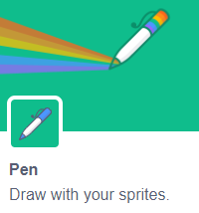
Activity 1.1 contd.
01.
Get ready
Click the Extensions button(at the bottom left of the screen)
Choose Pen to add the pen blocks to blocks palette.

Slide 5
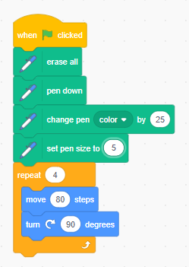
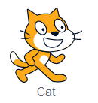
Activity 1.1 contd.
02.
03.
Choose sprite
Add code
https://scratch.mit.edu/projects/700750345/

Slide 6
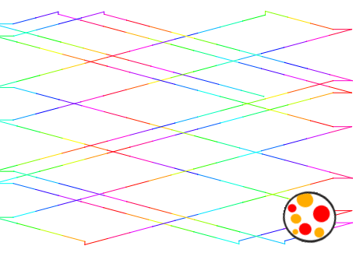
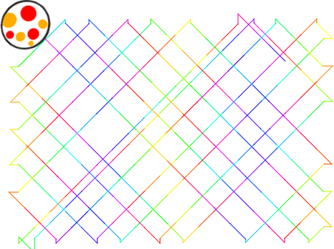
Activity 1.2 – Fun pen art!!
Use the Pen blocks to make fun pen art.. Choose a sprite such as a ball which seems to be drawing the pattern.
Experiment with pen colors, sizes and different rotation angles..

Slide 7
Activity 1.2 contd.
01.
Get ready
Click the Extensions button(at the bottom left of the screen)
Choose Pen to add the pen blocks to blocks palette.

Slide 8
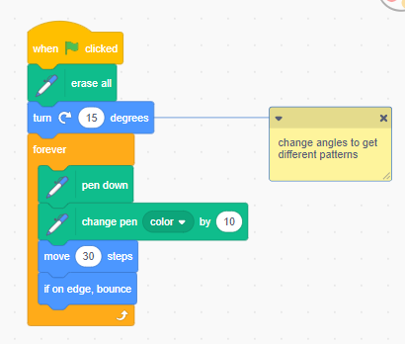
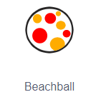
Activity 1.2 contd.
02.
03.
Choose sprite
Add code
https://scratch.mit.edu/projects/701031931/

Slide 9




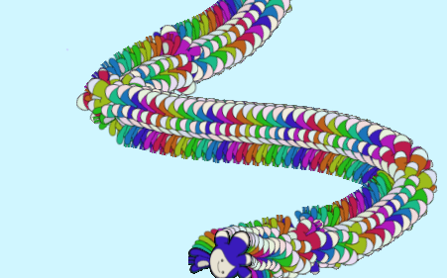
Activity 1.3 – Paint with tera!!
Make Tera change colors using the block.
Make Tera repeatedly with a loop
Make the stage clear when the green flag is clicked.

Slide 10
Activity 1.3 contd.
01.
Get ready
Click the Extensions button(at the bottom left of the screen)
Choose Pen to add the pen blocks to blocks palette.

Slide 11
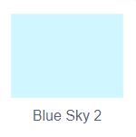

Activity 1.3 contd.
Choose backdrop
03.
Choose sprite
02.

Slide 12
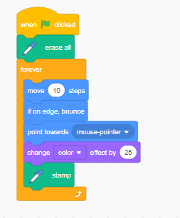
Activity 1.3 contd.
03.
Add code
https://scratch.mit.edu/projects/701455622/

Slide 13

02.
Lesson extensions - video sensing blocks
https://youtu.be/iS6jEu-dWOk

Slide 14
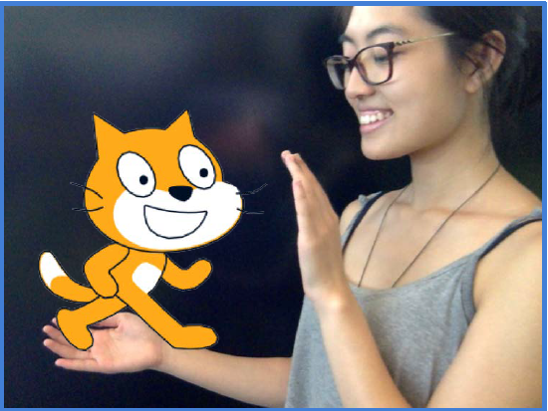
Activity 2.1 – pet the cat!!
Make the cat meow when you touch it.

Slide 15
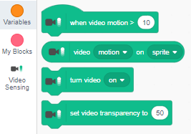
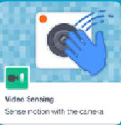
Activity 2.1 contd.
01.
Get ready
Click the Extensions button(at the bottom left of the screen)
Choose Video Sensing to add video blocks to blocks palette.

Slide 16
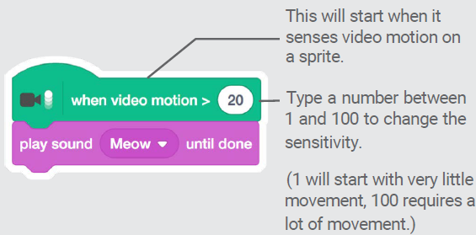
Activity 2.1 contd.
02.
03.
Choose sprite
Add code
https://scratch.mit.edu/projects/699452363/

Slide 17
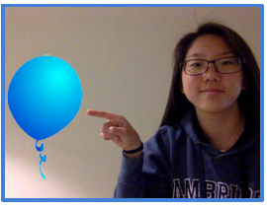
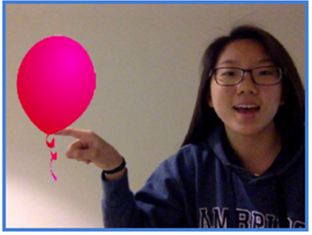
Activity 2.2 – pop the balloon!!
Use your finger to pop a balloon.

Slide 18
Activity 2.2 contd.
01.
Get ready
Click the Extensions button(at the bottom left of the screen)
Choose Video Sensing to add video blocks to blocks palette.

Slide 19
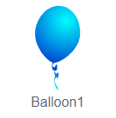
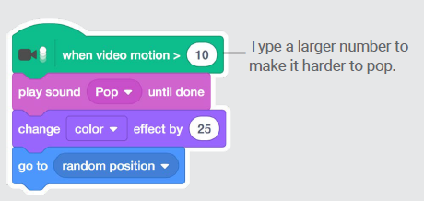
Activity 2.2 contd.
02.
03.
Choose sprite
Add code
https://scratch.mit.edu/projects/700240875/

Slide 20
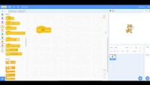
03.
Lesson extensions – text to speech blocks
https://youtu.be/vtOuK7PcQLo

Slide 21
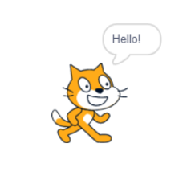
Activity 3.1 – Say hello!!
Use the Text to Speech blocks to make your sprite speak out “Hello” when it is clicked.
Experiment with different voices.

Slide 22
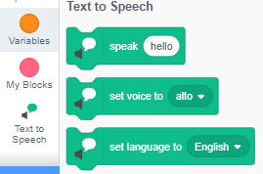

Activity 3.1 contd.
01.
Get ready
Click the Extensions button(at the bottom left of the screen)
Choose Text to Speech to add the text to speech blocks to blocks palette.

Slide 23
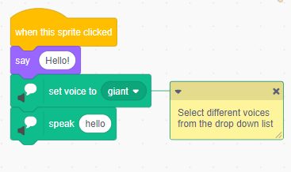
Activity 3.1 contd.
02.
03.
Choose sprite
Add code
https://scratch.mit.edu/projects/701955928/

Slide 24
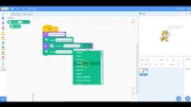
04.
Lesson extensions – translate blocks
https://youtu.be/3wUhdTllgKk

Slide 25
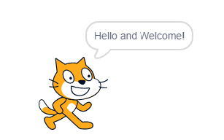
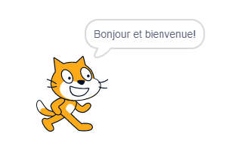
Activity 4.1 – Speak in french!!
Use the Text to Speech and Translate blocks to make your sprite speak out a phrase of your choice in English and French when it is clicked.
Experiment with different voices.

Slide 26
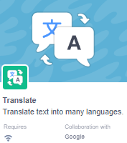
Activity 4.1 contd.
01.
Get ready
Click the Extensions button(at the bottom left of the screen)
Choose Text to Speech to add the text to speech blocks to blocks palette.
Choose Translate to add the translate blocks to blocks palette.

Slide 27
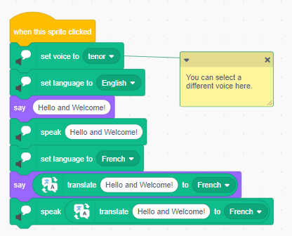
Activity 4.1 contd.
02.
03.
Choose sprite
Add code
https://scratch.mit.edu/projects/703010805/

Slide 28
Interact with projects using video sensing
Project 1
Make interactive projects like playing drums, keep away game and play ball game.
For step by step instructions, use document “Scratch-Extensions-videoCards.pdf” provided with this kit for reference.

Slide 29
Code a translator
Project 2
Make your own “translator” where a sprite will translate anything you type into a language of your choice, and read it back to you.
For step by step instructions, use document “Scratch-Extensions-translator.pdf” provided with this kit for reference.
https://scratch.mit.edu/projects/702491389/

Slide 30
Phrase Book
Project 3
Translate useful phrases into different languages with an interactive phrasebook.
For step by step instructions, use document “Scratch-Extensions-phrasebook.pdf” provided with this kit for reference.
Use files spain.png, coins.png, toilet.png provided with this kit if required to follow along as is.
https://scratch.mit.edu/projects/704026436/

Slide 31
Resources
Tutorials from the official YouTube Channel of Scratch (scratch.mit.edu) - https://youtube.com/playlist?list=PLpfxVARjkP-_f-E9IU6IHmy5ECj0HqiLB
Scratch Create-Along : Create a Scratch project in a one-hour livestream with the Scratch Team - https://youtube.com/playlist?list=PLpfxVARjkP-953-E52NskKvbCBXEgHkwr
Scratch Basics Playlist - https://youtube.com/playlist?list=PLSgUBfi51uldLxNsADEYyXoXMuBTuR7om

