Slide 1
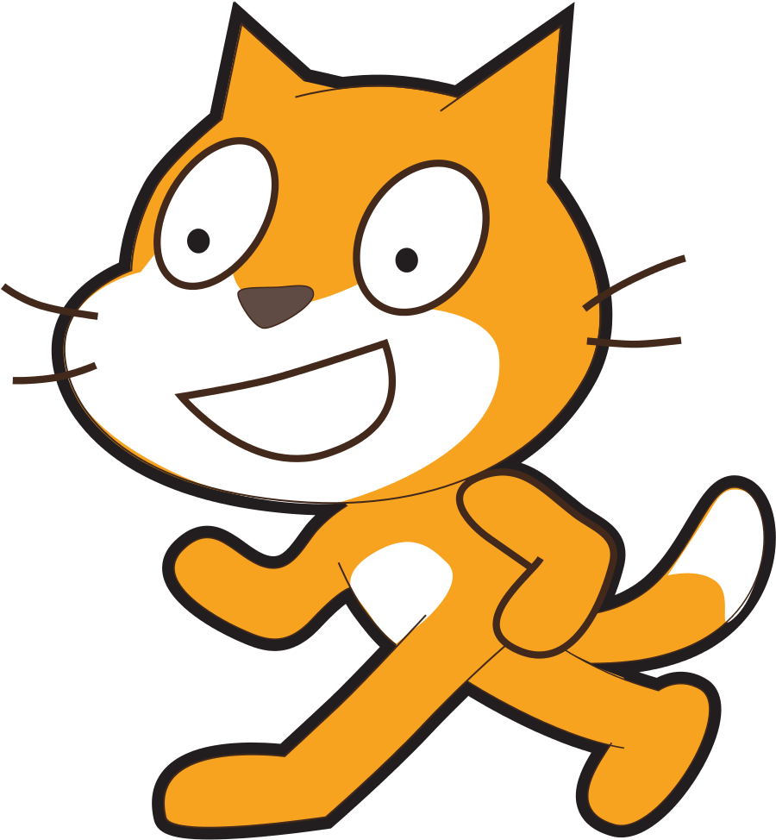
Scratch Teaching Plan For Samatha loops, events, variables and more…
Vanshika Mittal
Shivali Mittal
spellotype@gmail.com

Slide 2
Iteration
The process of repeating sections of a program.
It is used whenever a specific behaviour needs to be repeated.
Iteration is often referred to as 'looping', because when a program iterates it 'loops' to an earlier step.

Slide 3

01.
Lesson Introduction to loops
https://youtu.be/mkLlb9B_KRM

Slide 4
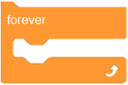
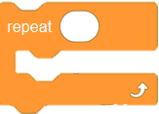
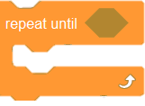
Types of loops
Infinite Loops
Allow us to run a program section again and again without stopping.
Count Controlled Loops
Allow us to repeat a program section a specific number of times.
Condition Controlled Loops
Allow us to repeat a program section until a specific condition is met.

Slide 5
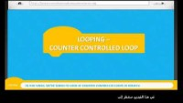
02.
Lesson repeat block – count controlled loops
https://youtu.be/OFAEs6CmSUo

Slide 6
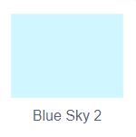
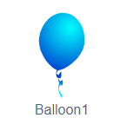
Activity 2 – popping balloon!!
02.
01.
We will use a loop to make a balloon inflate itself. The balloon pops when it doubles in size.
Our balloon will increase its size by 10 in every iteration of the loop, pause a fraction of a second. It will do that 10 times, until it gets bigger and bigger, and then disappears and plays a pop sound.
Choose backdrop
Choose sprite

Slide 7
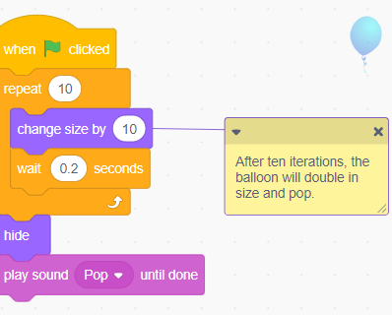
03.
Activity 2 contd.
Add code
https://scratch.mit.edu/projects/670183705/

Slide 8
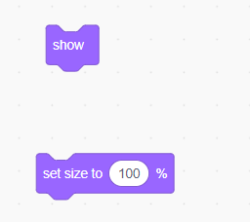
Activity 2 contd.
Note that when we click the green flag again, nothing happens. The balloon is still hidden, so we need to add “show” block at the beginning to show it again.
We’ll also use a “set size” block to set the balloon back to its original size. Now, every time we click the green flag, it will reappear in its original size..
https://scratch.mit.edu/projects/670183705/

Slide 9
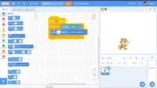
03.
Lesson repeat until block – condition controlled loops
https://youtu.be/vkl2TwfMGyA

Slide 10
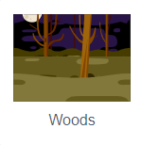
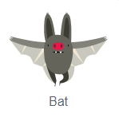
Activity 3 – gliding bat!!
01.
02.
Our “bat” will keep moving to random positions until it touches the edge.
Once it touches edge, it will come back to starting position.
Choose backdrop
Choose sprite

Slide 11
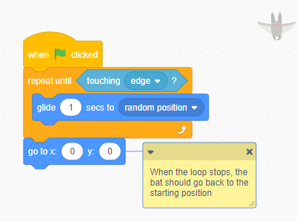
03.
Activity 3 contd.
Add code
https://scratch.mit.edu/projects/677114396/

Slide 12
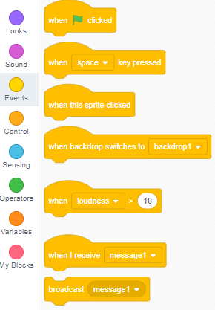
Events
Events are triggers to make an action/sequence of actions happen.
Events in Scratch are represented by the yellow codes including: when flag clicked, when sprite clicked, when key pressed, broadcast and more.

Slide 13
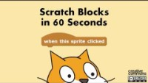
04.
Lesson When this sprite clicked block
https://youtu.be/BYeb1Udkpc8

Slide 14

Activity 4 – drum kit!!
We’ll choose a few instruments, “Drum-snare”, “Drums Conga”, and “Drum-cymbal”, and arrange them on our stage for Drum Kit.
For each of them, we’ll add the “when this sprite clicked” block from the Events category, and a “play sound” block from the Sound category:
We’ll do this for each instrument, with a different sound that matches each one.
Now, we have a “drum kit” that we can play by clicking on any of these sprites.

Slide 15
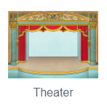
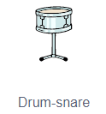
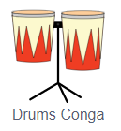
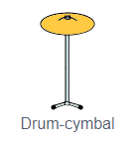
01.
02.
Activity 4 contd.
Choose backdrop
Choose sprites

Slide 16
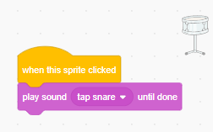
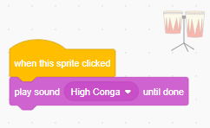
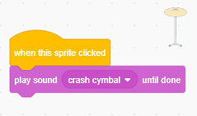
03.
Activity 4 contd.
Add code
For Drum-snare
For Drums Conga
For Drum-cymbal
https://scratch.mit.edu/projects/677118435/

Slide 17
05.
Lesson broadcasting messages
https://youtu.be/BYeb1Udkpc8

Slide 18
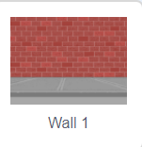
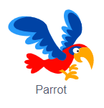
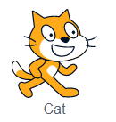
Activity 5 – Flying parrot!!
01.
02.
In our animation, there are two sprites, one cat and one parrot flying.
Whenever you press ‘Space’ button, the cat will say “Fly Parrot”, then the Parrot will reply “Ok Cat” and will pick a random location in the sky and fly there.
Choose backdrop
Choose sprites

Slide 19
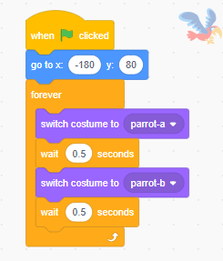
03.
Activity 5 contd.
Add code
We will first add the script for the parrot to fly. When the program starts, the parrot will first go to the coordinate (-180, 80) (where X coordinate is -150 units and Y coordinate is 80 units) using glide block from Motion tab. Then the parrot will start flying, To make the animation, we will change its costume after every 0.5 seconds forever.

Slide 20
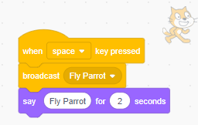
Activity 5 contd.
Now you have to make the cat send a message to parrot when you press ‘Space’. The cat will also use a “say” block so that we know what is going on in the animation.

Slide 21
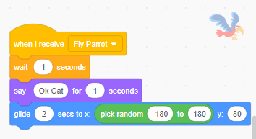
Activity 5 contd.
When the parrot receives a message from the cat it has to go to a random position on the X axis. Use ‘Pick random’ block to get a random number between -180 to 180, and glide to that location using glide block.
https://scratch.mit.edu/projects/679144850/

Slide 22
Variables
A variable is a container of sorts that can hold one piece of information at a time, like a word or a number.
Being able to hold this bit of information allows us to reference and manipulate it at many different places in a program.
This ability makes variables incredibly useful!

Slide 23
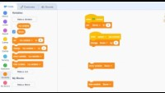
06.
Lesson Variables
https://youtu.be/JPeGqzX9eUI

Slide 24
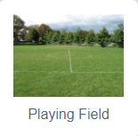
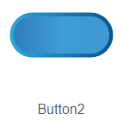
Activity 6 – Counting cat!!
01.
02.
Our counting cat will count the number of times it is clicked.
It will also have a reset button which when pressed, the count will be reset to 0 and the cat will start counting from 1 again.
Choose backdrop
Choose sprites

Slide 25
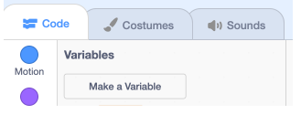
03.
Activity 6 contd.
Add code
In the Variables section of blocks we see this button labeled “Make a Variable”:
When we click this, we are asked for the name of the variable, so we’ll type in “count”, since we want to use it to store a count.
We can also decide whether this variable is available for all sprites to use or change, often called a global variable. Or, we could make this variable available only for this sprite, also called a local variable. We’ll choose “For all sprites” for this “count” variable.

Slide 26
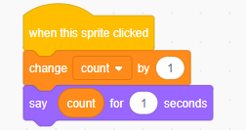
Activity 6 contd.
Now, we see an oval “count” block available, with a check box to its left. The check box will tell Scratch to show the value, or what’s stored inside our variable, on the upper left of the stage. We can uncheck it so that the value is hidden on the stage.
We can add blocks for our cat to count the number of times it is clicked:
The “change” block will increase the value of the “count” variable by 1.
Then, our cat will say the value of the variable.

Slide 27
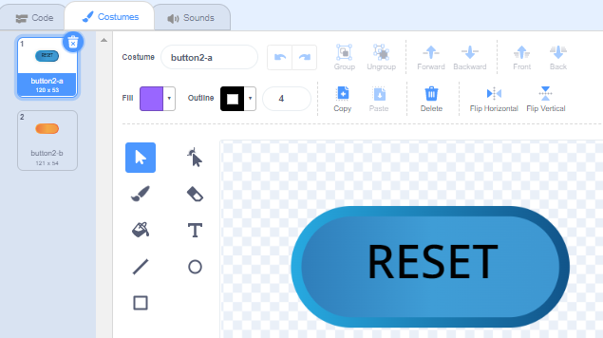
Activity 6 contd.
We can add another sprite, “Button2”, which will be a button we can use to set the count back to 0. We’ll use the Costumes tab to add text to our button, so it’s labeled “Reset”:

Slide 28
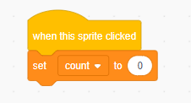
Activity 6 contd.
We’ll add these blocks for the reset button:
Now, when this button is pressed, the value of 0 will be placed inside the “count” variable, replacing whatever was there before.
https://scratch.mit.edu/projects/674335513/

Slide 29
Make It Fly
Project 1
Choose any character and make it fly.
For step by step instructions, use document “Scratch-Loops-makeItFly.pdf” provided with this kit for reference.
https://scratch.mit.edu/projects/671275302/

Slide 30
Lost in space
Project 2
Make your own space animation using different types of loops.
For step by step instructions, use document “Scratch-Loops-lostInSpace.pdf” provided with this kit for reference.
https://scratch.mit.edu/projects/672121189/

Slide 31
Catch the bus
Project 3
Code sprites to walk or fly to the bus before it drives off.
For step by step instructions, use document “Scratch-Loops-catchTheBus.pdf” provided with this kit for reference.
https://scratch.mit.edu/projects/676217773/

Slide 32
Make It jump
Project 4
Choose any character and make it jump over moving obstacles.
For step by step instructions, use document “Scratch-Loops-jumpingGame.pdf” provided with this kit for reference.
https://scratch.mit.edu/projects/677442115/

Slide 33
Broadcasting spells
Project 5
Use a magic wand to choose spells and broadcast spell messages to turn sprites into toads, and grow and shrink them.
For step by step instructions, use document “Scratch-Loops-broadcastingSpells.pdf” provided with this kit for reference.
https://scratch.mit.edu/projects/678035535/

Slide 34
Resources
Scratch Wiki - https://en.scratch-wiki.info/wiki/Scratch_Wiki:Table_of_Contents/Program
Scratch Blocks in 60 seconds - https://youtube.com/playlist?list=PL0-84-yl1fUki_zQ1ouwGN8t3spCTLnpS
Scratch Basics Playlist - https://youtube.com/playlist?list=PLSgUBfi51uldLxNsADEYyXoXMuBTuR7om

