Slide 1
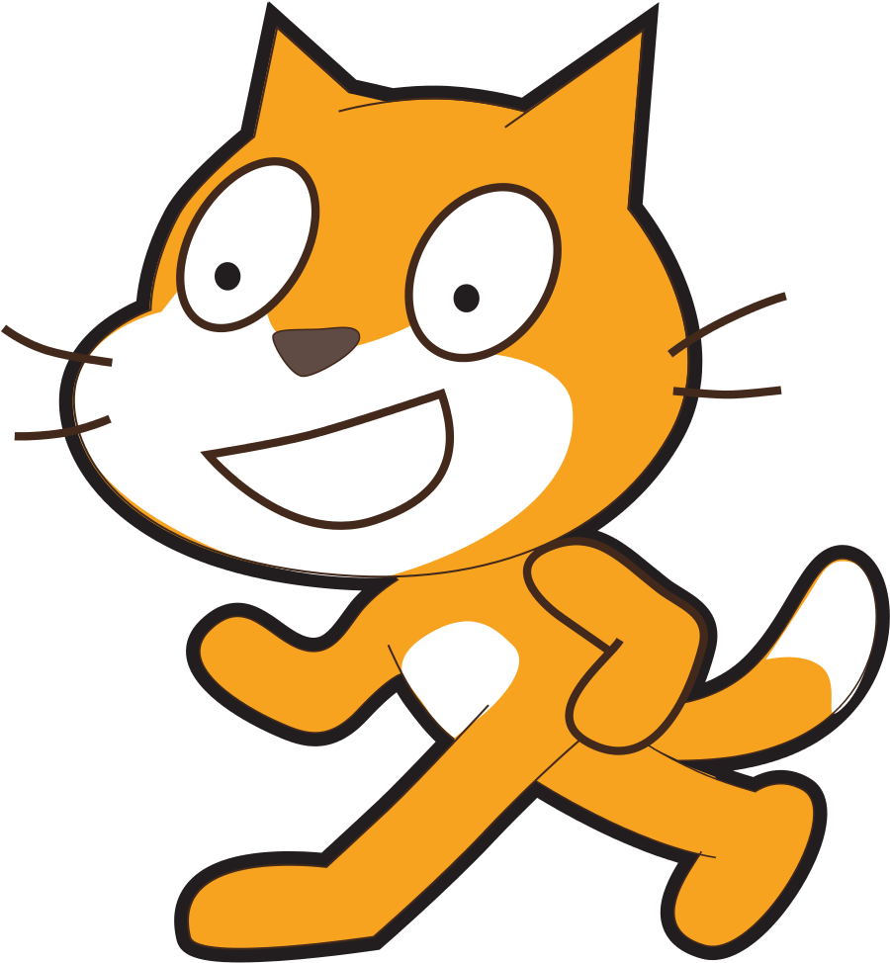
Scratch Teaching Plan For Samatha Sprites, backdrops, motion and more…
Vanshika Mittal
Shivali Mittal
spellotype@gmail.com

Slide 2
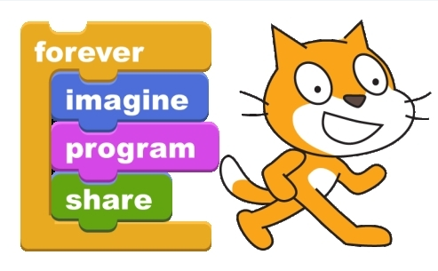
Hello Scratch!!
We will learn problem solving and programming skills using Scratch.
Scratch is a programming language that makes it easy to create your own interactive stories, animations, games, music, and art.

Slide 3

What is Scratch
Scratch is a free programming language developed by MIT that makes it easy to create interactive stories, animations, games, music, and art, and share your creations on the web.
Scratch can run from within a modern web browser or can be downloaded as an app.
https://youtu.be/RMDPfjclIYc

Slide 4

Set up Your Account
To create an account, visit the Scratch website at scratch.mit.edu and click "Join Scratch" in the top right hand corner. Follow the video linked on the left.
https://youtu.be/fga_QV1fGnU

Slide 5
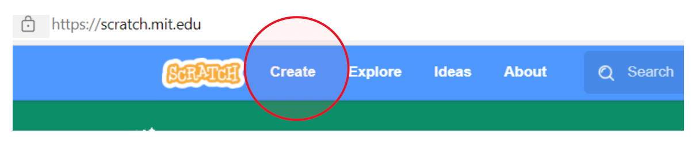
Getting Started
Go to the Scratch website at scratch.mit.edu.
Login to your account
Click on Create tab at the top of the home page, and within seconds, you’ll be in the code builder where all the magic happens.

Slide 6
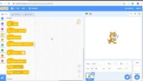
01.
Lesson Introduction to scratch working environment
https://youtu.be/NqMd44Oi2l4

Slide 7
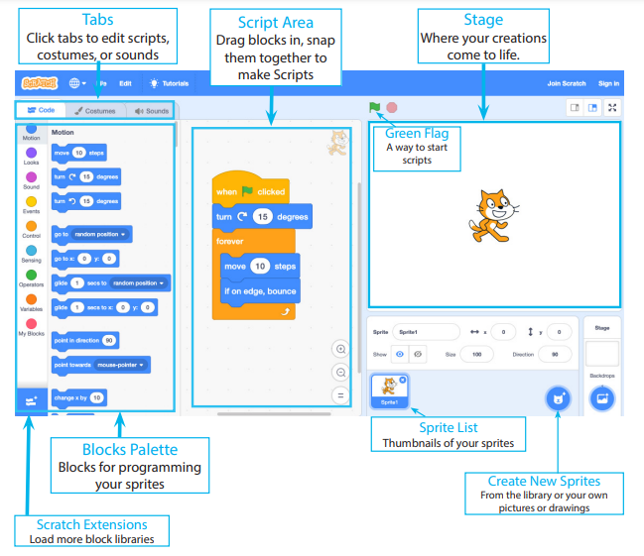
Scratch interface

Slide 8
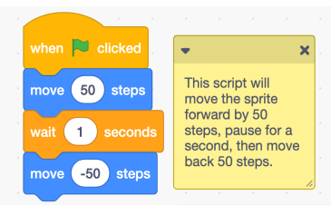
Activity 1
Create a new Scratch project.
Add some blocks for the “cat sprite” such as those shown on the left.
Press the green flag and see what happens.
You can experiment with different values in “move block” and “wait block”
https://scratch.mit.edu/projects/619604763/

Slide 9

02.
Lesson naming and saving scratch projects
https://youtu.be/2USOkqi1VGM

Slide 10
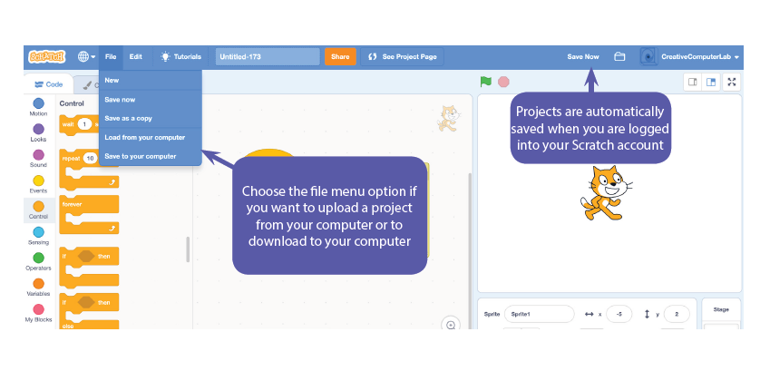

Slide 11
Activity 2
Recreate the project as in “Activity 1”.
Give it a name and save it to your account.
You should be able to open the project from “My Stuff”.
Modify and verify that changes are saved.

Slide 12
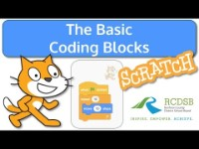
03.
Lesson scratch coding blocks
https://youtu.be/gHykc6-eID0

Slide 13
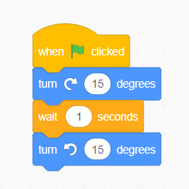
Activity 3
Create a new Scratch project.
Add some blocks for the “cat sprite” such as those shown on the left.
Press the green flag and see what happens.
You can experiment with different values in “move block” and “wait block”
https://scratch.mit.edu/projects/619936959/

Slide 14
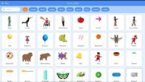
04.
Lesson Deleting a Sprite, Adding a Sprite & Adding a Backdrop
https://youtu.be/R-QuPKDAADE

Slide 15
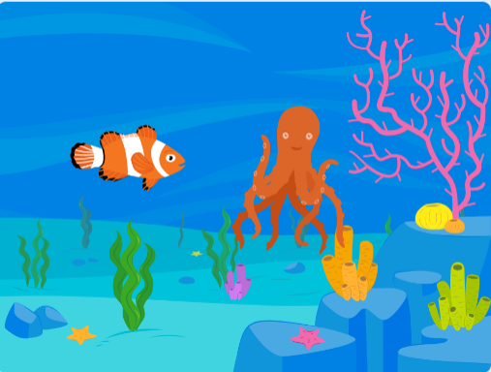
Activity 4
Create a new Scratch project.
Delete the “cat sprite” that comes by default.
Create an underwater world like the one shown on the left.
You can use “underwater” background.
Add a “fish sprite” and an “octopus sprite”.
Experiment and create more worlds.
https://scratch.mit.edu/projects/619939142/

Slide 16
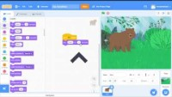
05.
Lesson make your Sprite say something
https://youtu.be/lTVpjvPGrAE

Slide 17
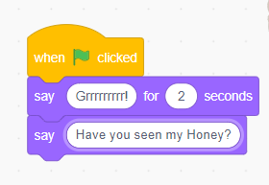

Activity 5
Create a new Scratch project.
Delete the “cat sprite” that comes by default.
Choose a “forest” backdrop and add “Bear sprite”.
Make the bear say “Grrrrrrrr” for 2 seconds.
Then use just the say block to make the bear say “Have you seen my honey?”
The say block is used for a message that doesn’t go away.
https://scratch.mit.edu/projects/620046947/

Slide 18

06.
Lesson create a dialogue between two sprites
https://youtu.be/k3mlyBtZ6HU

Slide 19
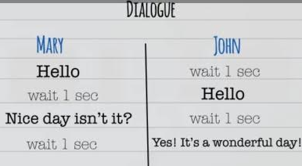
Activity 6
Create a new Scratch project.
Create a dialogue between two people Mary and John.
The flow of dialogue is explained on the left.
Use your creativity for the background and sprites.
You can increase time to 2 seconds if the conversation is very difficult to follow.
A sprite once selected can be renamed in the sprite pane.
A sprite can be flipped horizontally to change it’s orientation..
https://scratch.mit.edu/projects/620343279/

Slide 20
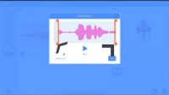
07.
Lesson adding a sound
https://youtu.be/hKXqfHr4Vfs

Slide 21
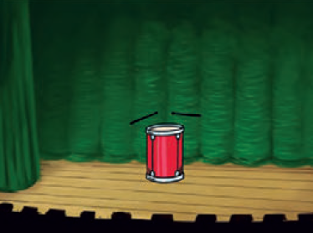
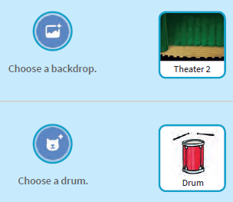
Activity 7.1
01.
02.
Press key to play drum
Get Ready

Slide 22
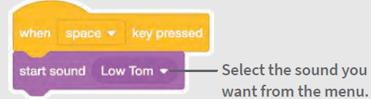
Activity 7.1 contd.
03.
Add code
https://scratch.mit.edu/projects/620793282/

Slide 23
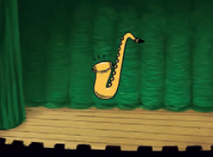
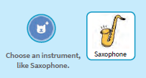
Activity 7.2
01.
02.
play A Series of notes
Get Ready

Slide 24
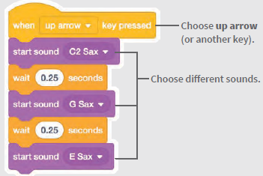
Activity 7.2 contd.
03.
Add code
https://scratch.mit.edu/projects/621052116/

Slide 25
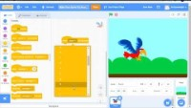
08.
Lesson Make your sprite fly around
https://youtu.be/aB--g5bAlS8

Slide 26
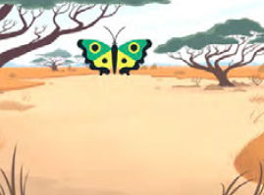
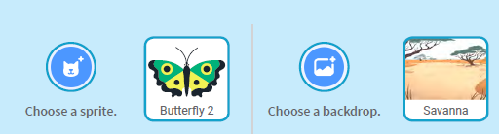
Activity 8
01.
02.
Press space key to glide
Get Ready

Slide 27
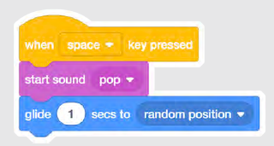
Activity 8 contd.
03.
Add code
The “pop” sound” is built into the butterfly sprite.
https://scratch.mit.edu/projects/621056141/

Slide 28
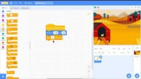
09.
Lesson gliding from one point to another
https://youtu.be/DaCoAFweD_k

Slide 29

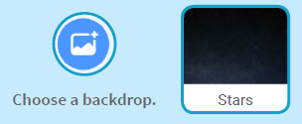
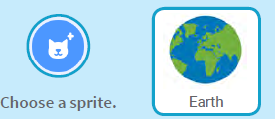
Activity 9.1
01.
02.
Glide from point to point
Get Ready

Slide 30
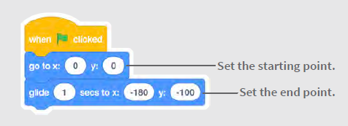
Activity 9.1 contd.
03.
Add code
https://scratch.mit.edu/projects/621188434/

Slide 31
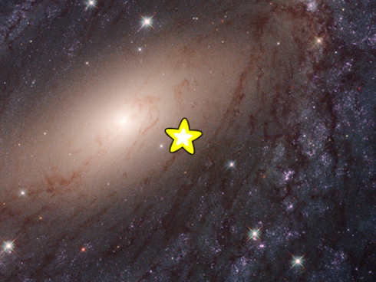
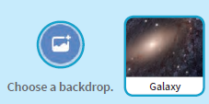
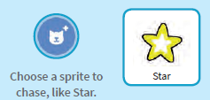
Activity 9.2
01.
02.
Keep Gliding randomly
Get Ready

Slide 32
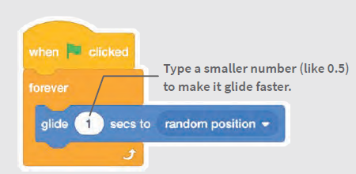
Activity 9.2 contd.
03.
Add code
https://scratch.mit.edu/projects/621189805/

Slide 33
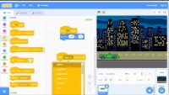
10.
Lesson Make your sprite move left and right
https://youtu.be/VCDflCmb0z0

Slide 34
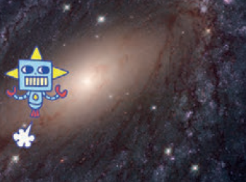
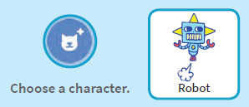
Activity 10
01.
02.
Get Ready
Use arrow keys to Move left & right

Slide 35
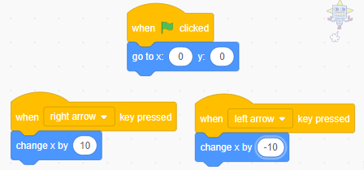
Activity 10 contd.
03.
Add code
https://scratch.mit.edu/projects/621244958/

Slide 36
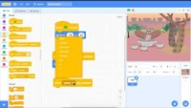
11.
Lesson Make your sprite move UP and Down
https://youtu.be/_ULx04G7CTo

Slide 37
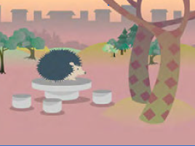
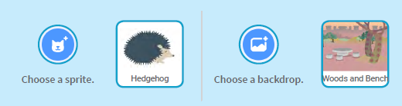
Activity 11
01.
02.
Get Ready
Use arrow keys to Move up & down

Slide 38
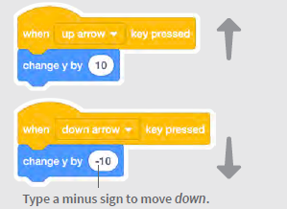
Activity 11 contd.
03.
Add code
You can even use “green flag pressed event” and “go to x, y” block to set initial position of the hedgehog.
https://scratch.mit.edu/projects/621247914/

Slide 39
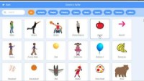
12.
Lesson coding costume changes
https://youtu.be/v5fbSSxTBI4

Slide 40
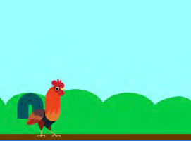
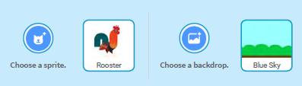
Activity 12.1
01.
02.
Get Ready
Animate a sprite when you click it

Slide 41
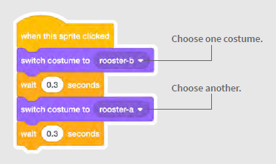

Activity 12.1 contd.
03.
Add code
You can make it more interesting by adding sounds. Use
before coding costume changes.
https://scratch.mit.edu/projects/621410987/

Slide 42
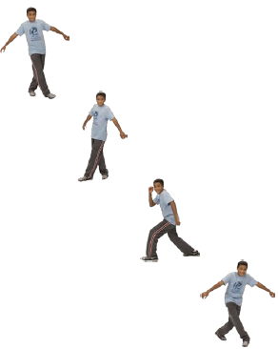
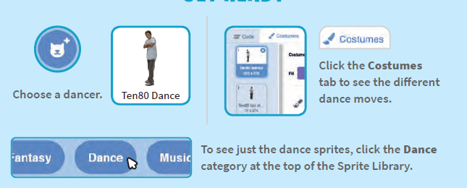
Activity 12.2
01.
02.
Make an animated dance
Get Ready

Slide 43
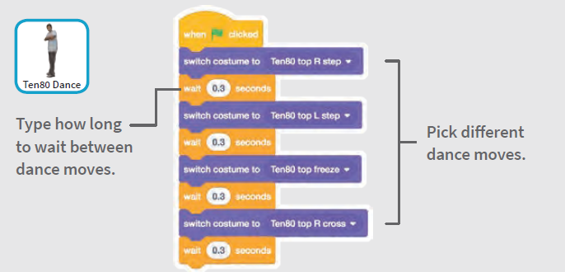
Activity 12.2 contd.
03.
Add code
https://scratch.mit.edu/projects/621414084/

Slide 44
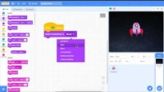
13.
Lesson coding backdrop changes
https://youtu.be/iNiHjm05jjA

Slide 45
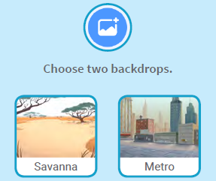



Activity 13
01.
02.
Get Ready
Change scenes by switching backdrops

Slide 46

Activity 13 contd.
03.
Add code
https://scratch.mit.edu/projects/622082312/

Slide 47
Make A chase game
Project 1
Make a simple chase game where you chase a character for fun.
Use document “Scratch-Basics-chaseGame.pdf” provided with this kit for reference.

Slide 48
Animate a character
Project 2
Make animated characters that can jump, switch poses, or glide.
Use document “Scratch-Basics-animate.pdf” provided with this kit for reference.

Slide 49
Animate a name
Project 3
Animate the letters of your name, initials, or favorite word.
Use document “Scratch-Basics-nameCards.pdf” provided with this kit for reference.

Slide 50
Resources
Scratch Wiki - https://en.scratch-wiki.info/wiki/Scratch_Wiki:Table_of_Contents/Program
Scratch Blocks in 60 seconds - https://youtube.com/playlist?list=PL0-84-yl1fUki_zQ1ouwGN8t3spCTLnpS

