Slide 1
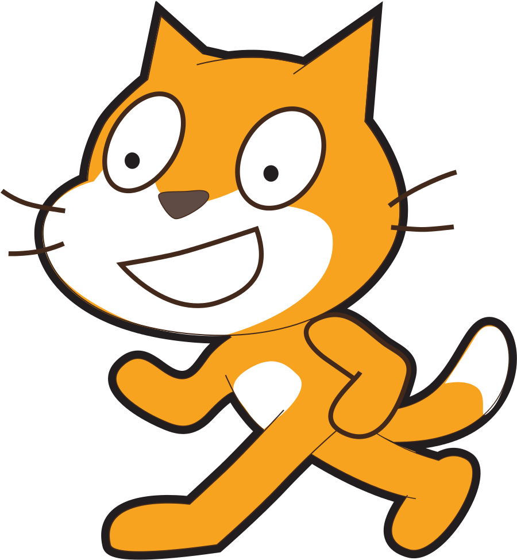
Scratch Teaching Plan For Samatha Sensing, conditionals and more…
Vanshika Mittal
Shivali Mittal
spellotype@gmail.com

Slide 2
01.
Lesson Sensing – Ask & answer blocks

Slide 3
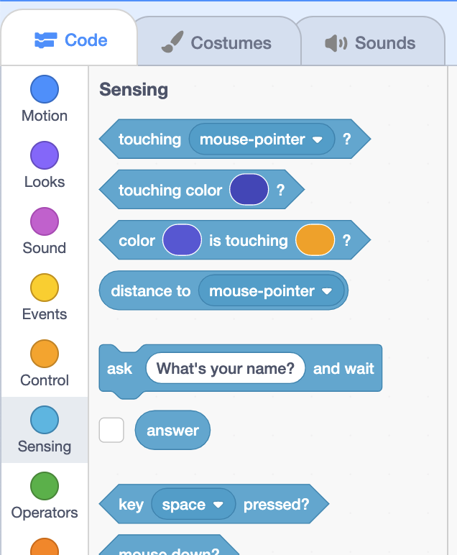
In the Sensing section, we see a block, “ask what’s your name? and wait”. The oval indicates an input to the function block, and in this case, “What’s your name?” tells the block to use that as the question.
It turns out that this block also has an output, or return value, that comes back after we run it.
We see that underneath this block, there is an oval “answer” block that will be the value of whatever the user types in as a response to this question:

Slide 4
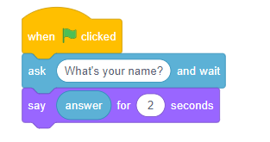
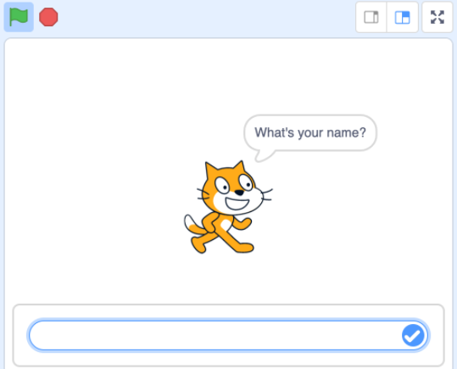
Let’s build a program called “Hello”
Now, when we run our program, our cat will ask the question and wait for us to type in a response before continuing:

Slide 5
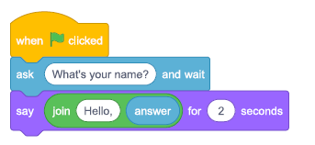
We can make our cat a little more friendly by using the “join” block from the “operators pallete”. The “join” block is used to put two characters or phrases or words together. In our case, it’s the phrase “Hello” and our name in the block called “answer”
The “ask and answer” blocks can be used to get user input for some very interesting activities:
Making chatbots
Setting preferences — coordinates, color, and so on
https://scratch.mit.edu/projects/659443422/

Slide 6
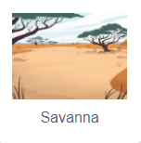
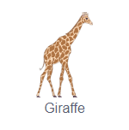
Activity 1 – turning giraffe !!
02.
01.
We will make the giraffe turn based on user input.
Choose backdrop
Choose sprite

Slide 7
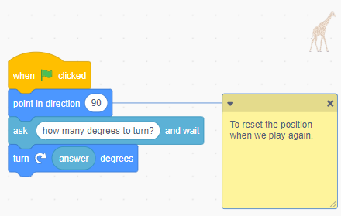
03.
Activity 1 contd.
Add code
https://scratch.mit.edu/projects/659042622/

Slide 8
02.
Lesson Forever Block

Slide 9
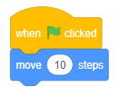
Till now, we have used different blocks to make our programs do interesting things.
But every time we ran our code, whether we pressed the green flag or pressed a key or clicked, each script could only run one time, from top to bottom.
Now, we’ll tell our programs to loop, or repeat some blocks multiple times.
Walking Cat
We’ll start with a Walking Cat example with our cat moving 10 steps when the green flag is clicked:

Slide 10
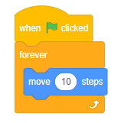
We’ll use the “forever” block in the Control section of blocks, to make our cat move over and over:
Now, our cat will move until it reaches the edge, where it can’t move any further. It will still be trying to move.
We can click the stop sign at the top of the stage, next to the green flag, and drag the cat back to the left side of the stage.
We’ll add another block that will tell our cat to bounce, or turn around, if it reaches the edge:

Slide 11
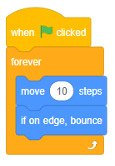
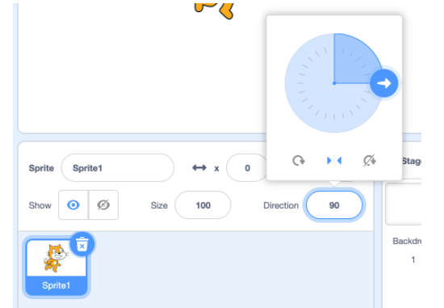
Now, our cat is upside-down when it turns around at the edge, but we can change the rotation style by clicking on the Direction dial in the Sprite panel, and selecting the second option:

Slide 12
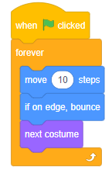
The legs of our cat aren’t moving, though, and it turns out we can make an animation, with images moving quickly enough that it gives the illusion of movement.
It turns out that our cat has two costumes, with its legs in slightly different positions. So we can use a “next costume” block to alternate between the two:
We’ll if it reaches the edge:

Slide 13
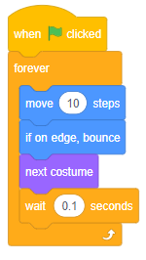
Our cat seems to be moving a bit too fast, so we’ll slow down its movement.
Now, our cat will move, bouncing if it’s at the edge, changing to the next costume, and then wait just a fraction of a second. And it will repeat all of these blocks over and over again, until we press the stop sign.
We’ll if it reaches the edge:
https://scratch.mit.edu/projects/658965370/

Slide 14
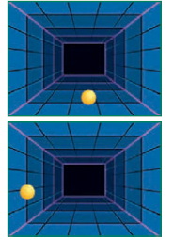
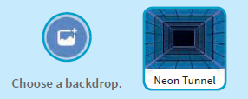
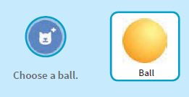
Activity 2.1
02.
01.
Get Ready
Make a ball move around the stage continuously

Slide 15
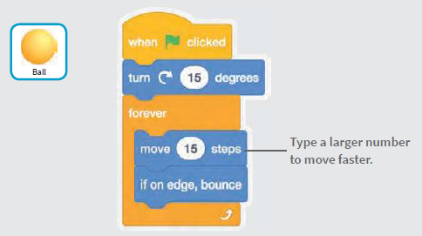

Activity 2.1 contd.
03.
Add code
The “turn 15 degrees” block causes the ball to bounce in all directions rather than just in a straight line.
https://scratch.mit.edu/projects/658963956/

Slide 16
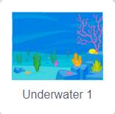
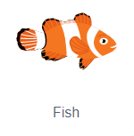
Activity 2.2 – swimming fish !!
02.
01.
We will make a fish appear to be swimming continuously. Our fish will follow the mouse pointer, and the backdrop will continuously play the wave sound.
Choose backdrop
Choose sprite

Slide 17
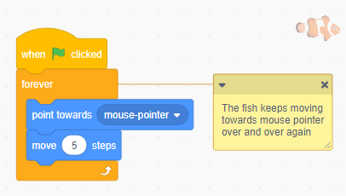
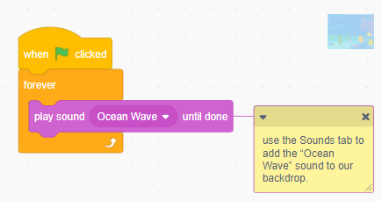
03.
Activity 2.2 contd.
Add code
For the fish sprite
For the backdrop
https://scratch.mit.edu/projects/665775553/

Slide 18
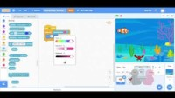
03.
Lesson sensing – touching blocks
https://youtu.be/FILthhZG5Dk

Slide 19
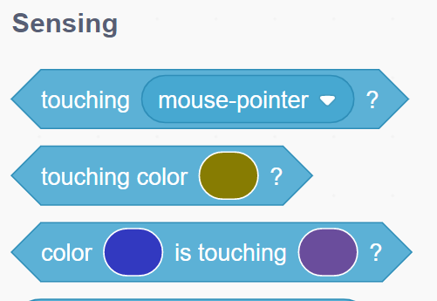
Blocks learnt

Slide 20

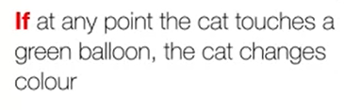
Activity 3 – balloon party!!
Let's suppose that the cat is currently at a party in a room full of balloons of different colors.
We want the cat to constantly be moving and to change its looks depending on the color of the balloon it's touching at any point.
More particularly,

Slide 21
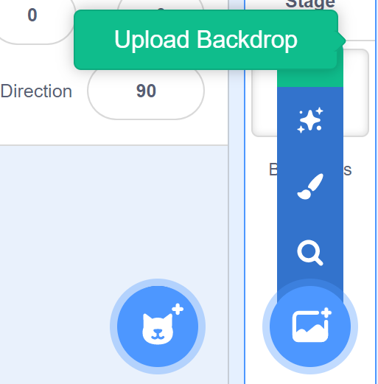

02.
01.
Activity 3 contd.
Choose backdrop
Choose sprite
cat
Upload file balloons.png

Slide 22
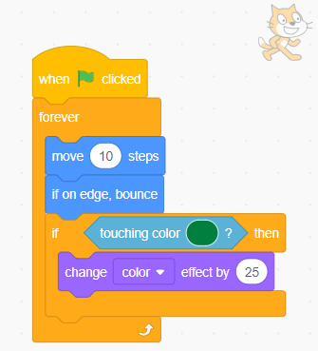
03.
Activity 3 contd.
Add code
https://scratch.mit.edu/projects/655979671/

Slide 23

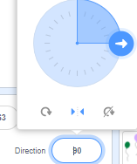
Activity 3 contd.
Note that the cat may considerably change its looks and position every time you run the program. In order to bring it to its original looks, we need to add extra blocks before the forever loop.
A clear graphic effects block to reset the color
A go to block to reset position.
Change rotation of cat to left-right
https://scratch.mit.edu/projects/655979671/

Slide 24
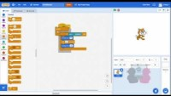
04.
Lesson conditionals – if-then & if-then-else blocks
https://youtu.be/Ux16AWWQuj0

Slide 25
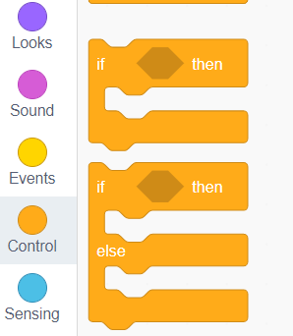
Blocks learnt
The hexagon shaped region is a placeholder for blocks that represents the question we want to ask, which can be answered with a “yes” or “no”, or equivalently, “true” or “false”.
In the Sensing section and Operators section of blocks, we have a few blocks with a hexagon shape that can be inserted here to answer those questions.

Slide 26
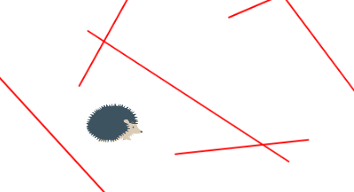
Activity 4.1 – Hedgehog maze !!
Let’s build a game where a hedgehog needs to navigate a maze.
For this program we need our backdrop to be a maze.
Our hedgehog will navigate the maze with arrow keys.
If at any point it touches a wall, in this case a line with color red, it will automatically go to a random position.

Slide 27
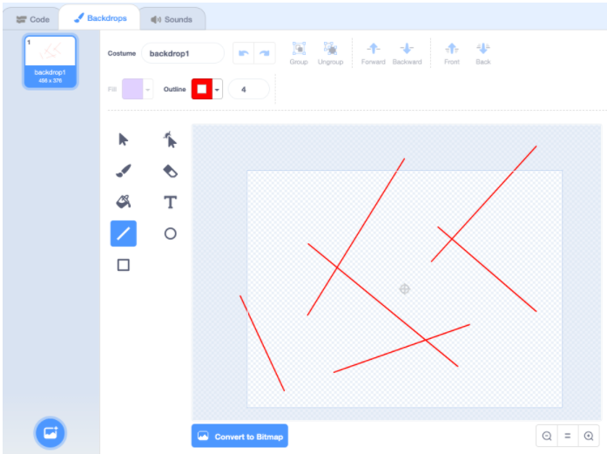
01.
Activity 4.1 contd.
Choose backdrop
We’ll click on the Stage panel in the bottom right, and use the Backdrops section to draw lines on the backdrop, like a maze.
We’ll select the line tool, and change the Outline to red, and use our mouse to draw a few lines around the backdrop.

Slide 28
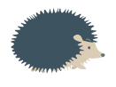
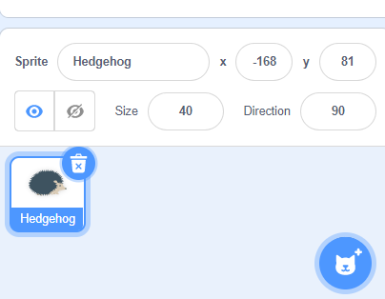
02.
Activity 4.1 contd.
Choose sprite
Now, we’ll change the size of our hedgehog to 40
Hedgehog

Slide 29

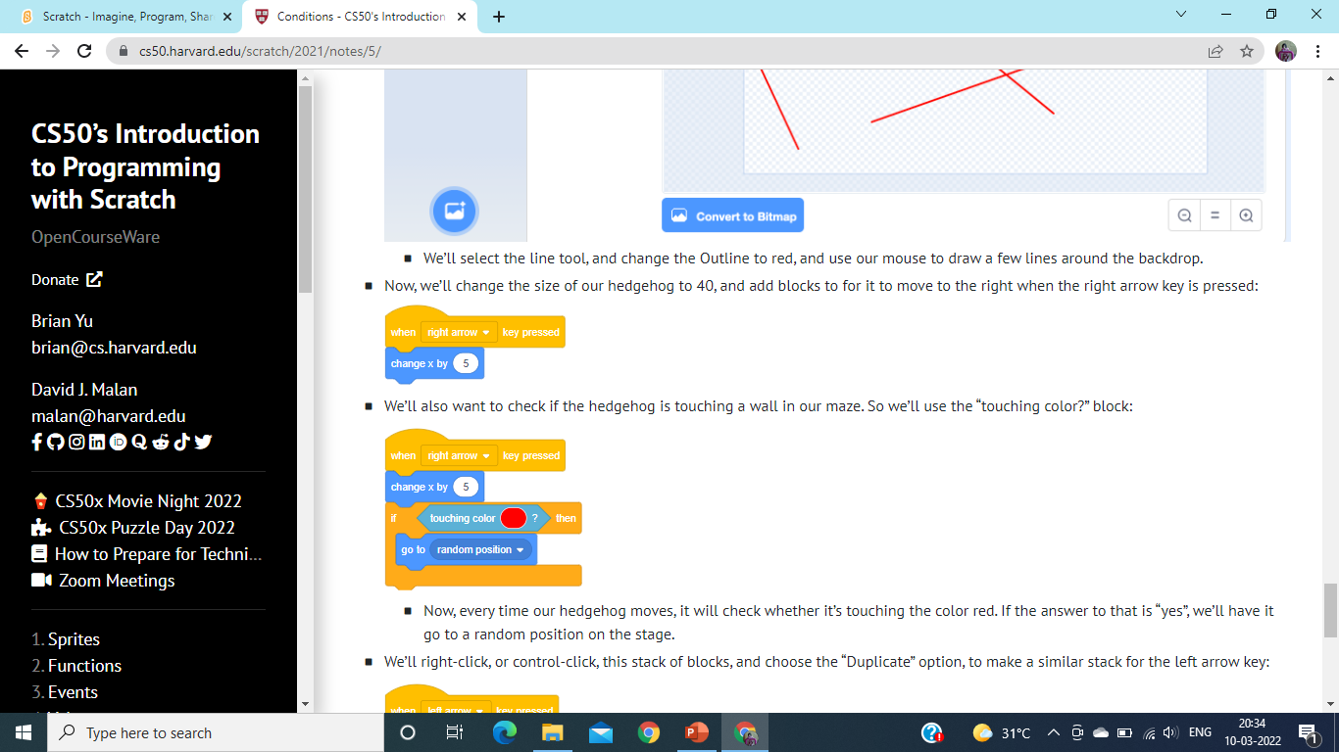
03.
Activity 4.1 contd.
Add code
Add blocks for the hedgehog to move to the right when the right arrow key is pressed.
At any step, if it “touches color red”, we’ll have it go to a random position on the stage.

Slide 30
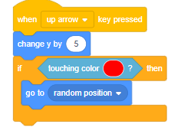
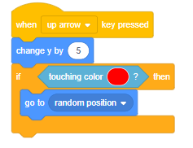
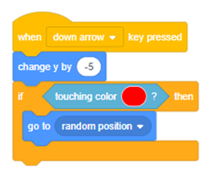
Activity 4.1 contd.
Make a similar stack for the left arrow key. Notice that we move to the left by changing the x-value by negative 5.
Repeat this for the up and down arrows, using the “change y” blocks.
https://scratch.mit.edu/projects/657389148/

Slide 31

Activity 4.2 – Blow the clouds away!!
Picture a cloudy day. What if you could blow the clouds away? Let's make an interactive animation to do that.
We will use a background with a sunny sky, and a sprite for the cloud.
We want the cloud to initially be over the sun so it's hiding it completely from view.

Slide 32


Activity 4.2 Contd.
Whenever we blow over the microphone, it will move the cloud away from the sun, towards the right.
To detect a blow, we will use the “loudness” block from sensing palette.
The loudness should be higher than a certain value. We’ll use a greater than block from the operators palette. And insert a number for the loudness to be more than, such as 50. This value can be adjusted later.

Slide 33
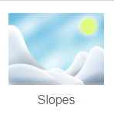
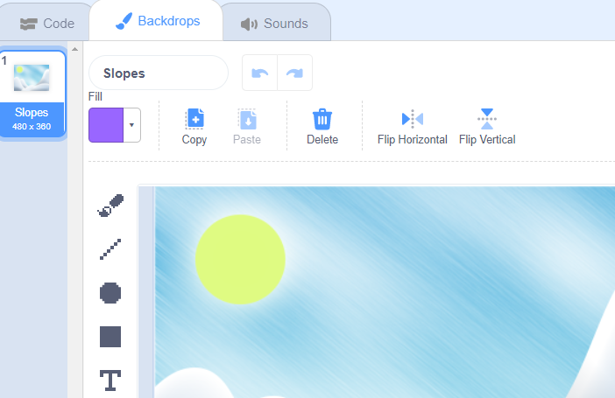
01.
Activity 4.2 contd.
Choose backdrop
Select the backdrop from the stage panel. Go to the backdrops tab and flip background horizontally, so that sun is on the left.

Slide 34

02.
Activity 4.2 contd.
Choose sprite

Slide 35
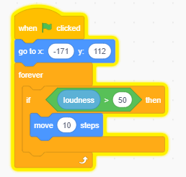
03.
Activity 4.2 contd.
Add code
https://scratch.mit.edu/projects/655659010/

Slide 36
Make A PONG game
Project 1
Make a bouncing ball game and score points to win.
For step by step instructions, use document “Scratch-Conditionals-pongGame.pdf” provided with this kit for reference.
https://scratch.mit.edu/projects/660682499/

Slide 37
Make A Catch game
Project 2
Make a game where you catch things falling from the sky.
For step by step instructions, use document “Scratch-Conditionals-catchGame.pdf” provided with this kit for reference.
https://scratch.mit.edu/projects/660699655/

Slide 38
Make A Chatbot
Project 3
Make a chatbot
For step by step instructions, use document “Scratch-Conditionals-catchGame.pdf” provided with this kit for reference.
https://scratch.mit.edu/projects/656851793/

Slide 39
Resources
Scratch Wiki - https://en.scratch-wiki.info/wiki/Scratch_Wiki:Table_of_Contents/Program
Scratch Blocks in 60 seconds - https://youtube.com/playlist?list=PL0-84-yl1fUki_zQ1ouwGN8t3spCTLnpS
Ask and Answer block - https://en.scratch-wiki.info/wiki/Ask_()_and_Wait_(block)
Wait Until block - https://en.scratch-wiki.info/wiki/Wait_Until_()_(block)

