Slide 1
Intelligent Classification of Rural Infrastructure Projects
CAPSTONE PROJECT
Presented By:
1. Vanshika Pundir-Graphic Era University-Btech CSE

Slide 2
OUTLINE
Problem Statement (Should not include solution)
Proposed System/Solution
System Development Approach (Technology Used)
Algorithm & Deployment
Result (Output Image)
Conclusion
Future Scope
References

Slide 3
Problem Statement
The Pradhan Mantri Gram Sadak Yojana (PMGSY) is a key rural infrastructure program launched to ensure all-weather road connectivity to unconnected villages across India. Over time, the program has expanded into multiple schemes such as PMGSY-I, PMGSY-II, and RCPLWEA, each with unique objectives, funding patterns, and technical specifications.
With thousands of road and bridge construction projects spread across different states and phases, manually classifying each project into its corresponding PMGSY scheme is a time-consuming and error-prone process. This manual approach poses challenges in monitoring progress, allocating budgets efficiently, and evaluating the long-term impact of each scheme.

Slide 4
Proposed Solution
Develop a machine learning model that automatically classify each road or bridge project into the correct PMGSY scheme based on its physical and financial details. This will save time, reduce human errors, and make it easier for government officials and planners to monitor projects, allocate budgets accurately, and improve overall decision making.
Data Collection: Use the AI Kosh PMGSY dataset
Data Preprocessing: Handle missing values, duplicate records, and outliers
Machine Learning Algorithm: Train a classification model (e.g. XGB Classifier, Random Forest or SVM)
Evaluation: Evaluate model performance using accuracy, precission, recall, and confusion Matrix

Slide 5
System Approach
The "System Approach" section outlines the overall strategy and methodology for developing and implementing the rental bike prediction system. Here's a suggested structure for this section:
System requirements:
IBM Cloud (mandatory)
IBM Watson Studio for model development and training
IBM Cloud Object Storage for dataset handling

Slide 6
Algorithm & Deployment
Algorithm Selection:
XGB Classifier (or Random forest based on performance)
Data Input:
The input data includes physical and financial details of road and bridge projects.
Training Process:
Supervised learning using labelled scheme types
Prediction Process:
Model deployed on IBM Watson Studio with API endpoint for real-time predictions

Slide 7
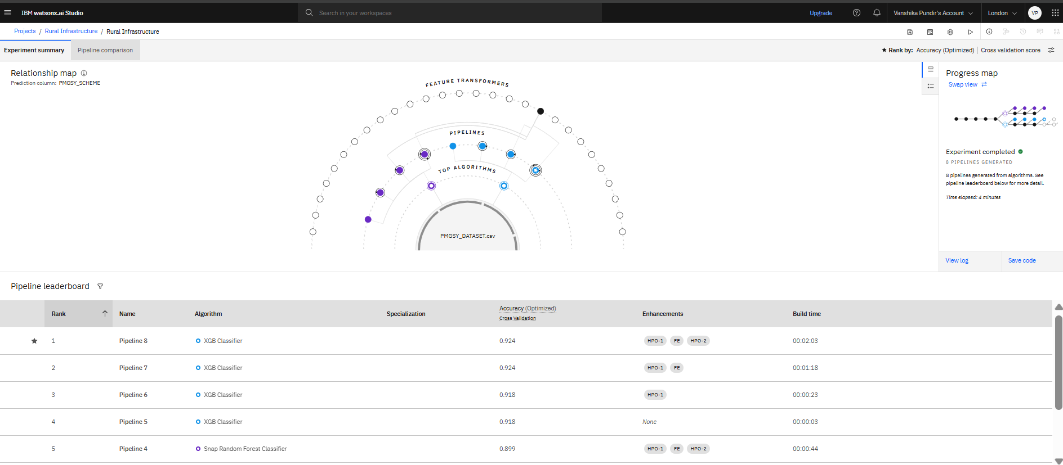
Result

Slide 8
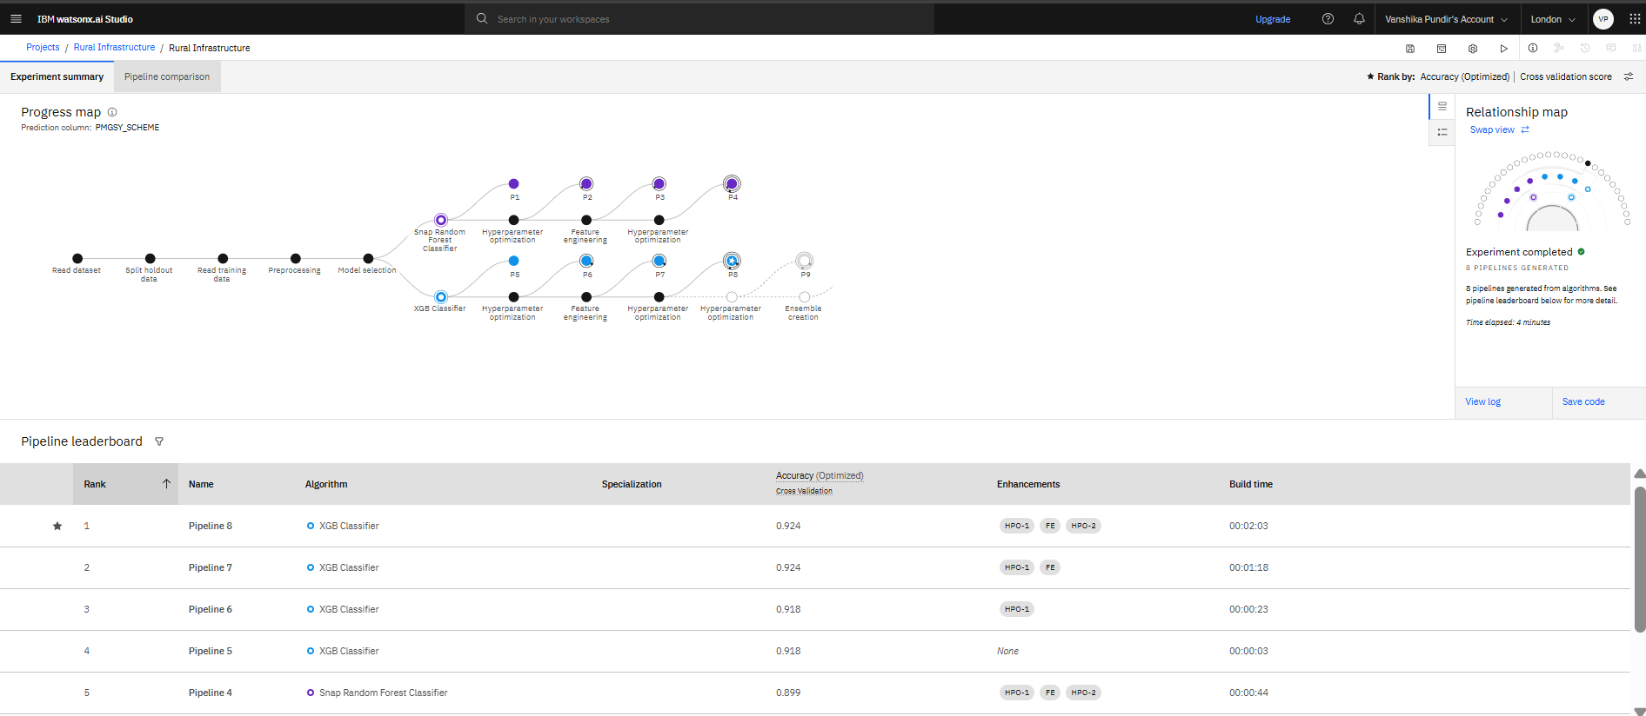
Result

Slide 9
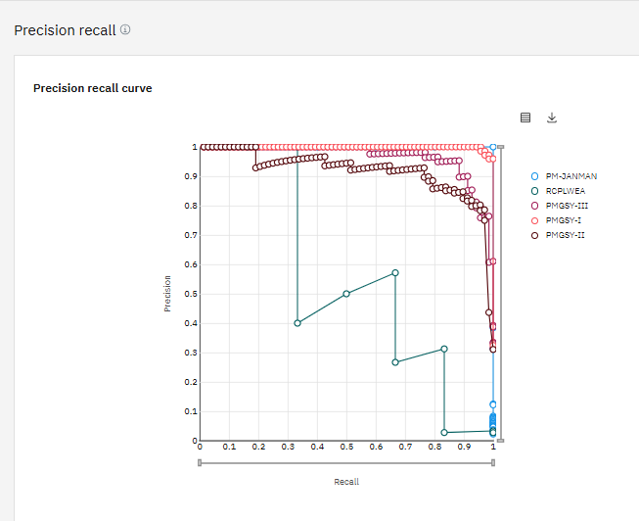
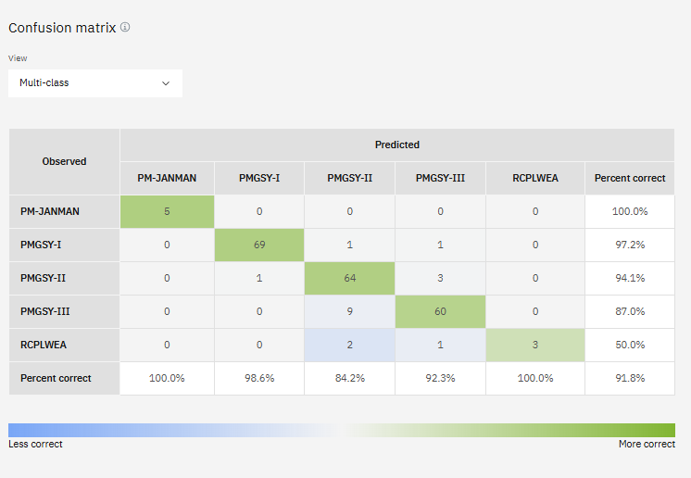
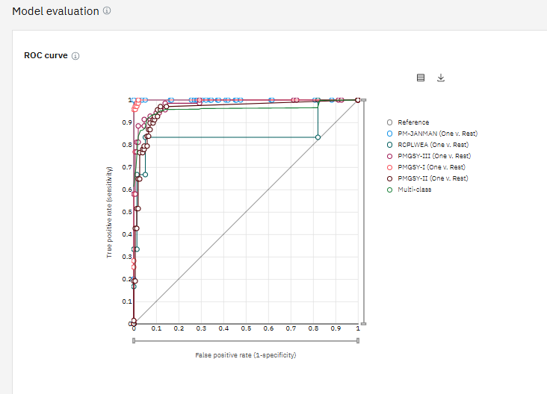
Result
Confusion Matrix
Precision Recall Curve
ROC Curve

Slide 10
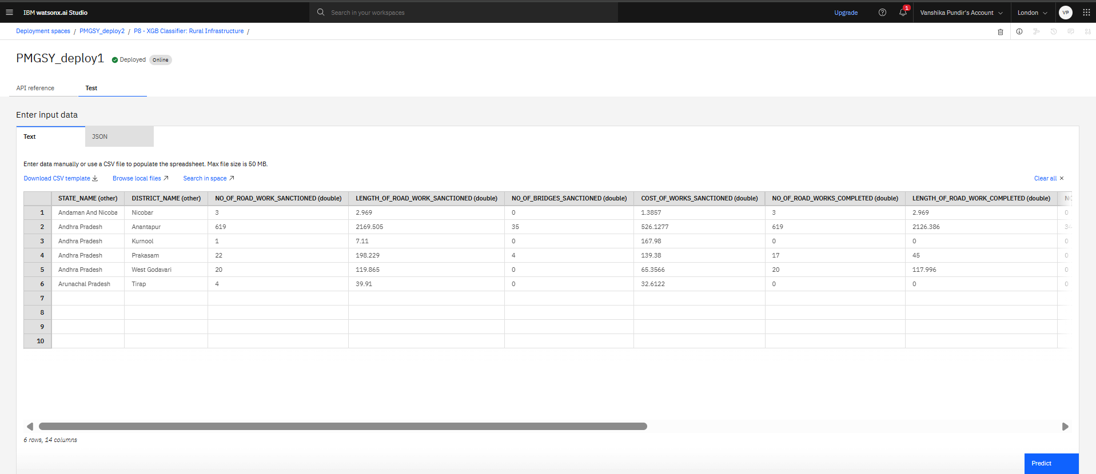
Result

Slide 11
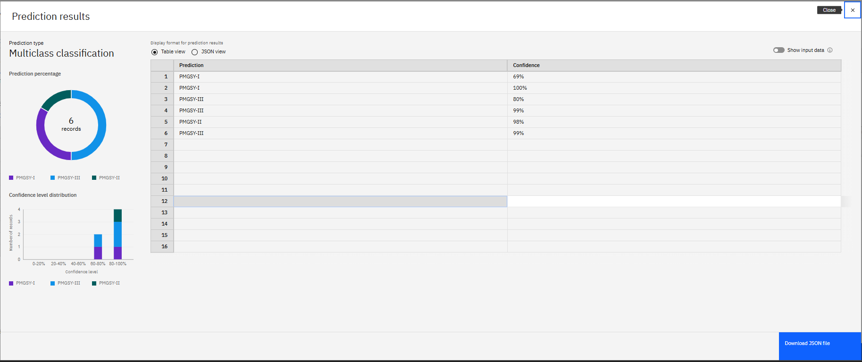
Result

Slide 12
Conclusion
This project presents an AI-driven solution to automatically classify PMGSY road and bridge projects into their respective schemes based on physical and financial characteristics. By using machine learning on historical data from AI Kosh and deploying the model on IBM Cloud Lite, the solution reduces manual workload, minimizes errors, and improves the speed and transparency of project classification, enabling more efficient infrastructure planning and policy evaluation.

Slide 13
Future scope
Integration with Real-Time Dashboards for government monitoring and reporting
Inclusion of Satellite and GIS Data to enhance classification accuracy
Extension to Predict Project Delays or Cost Overruns using similar inputs
Support for Multi-language Interfaces for use by local administrative bodies
Scalability to Other Government Schemes beyond PMGSY for automated classification and analysis

Slide 14

IBM Certifications

Slide 15

IBM Certifications

Slide 16
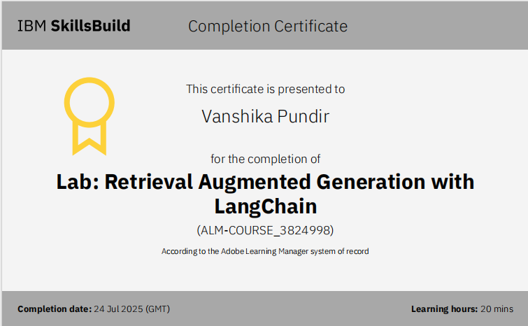
IBM Certifications

Slide 17
THANK YOU

