Slide 1

Development of Face Mask detection technique using Machine Learning
Project Presentation
Supervisor Name
Ravi Mishra(1851110077) Mr. Sanjiv Agrawal
Vanshika Agrawal(1851110114)

Slide 2
Introduction
COVID-19, a pandemic is currently affecting the entire world (SARS-CoV-2)[1] According to the world health organization ,COVID-19 is primarily transmitted from person to person by respiratory droplets. We observed even after vaccination has started in India then too corona virus cases are increasing. According to the World Health Organization's Corona virus situation survey, over 124 million people are infected with the disease in 213 countries, killing over 2.73 million people worldwide as of March 23, 2021
Observing the global crisis, a new need for face mask identification has emerged. It is one of the technologies capable of detecting and checking the identity of an individual wearing a mask. [4] This report presents a accurate face mask detection system using Deep Learning. It can specify whether a person on real time video captured by webcam is wearing face mask or not.

Slide 3
Objective
To develop face mask detection technique using python .
To identify whether the person on video stream is wearing a face mask or not with the help of computer vision.
To implement this system at Cement Industries, Chemical Plants, Hospitals where chance of spread of disease .
To Implement alarm system and Email Notification system to notify administrator.
My aim is to classify whether the person on video stream is wearing a face mask or not with the help of computer vision and deep learning. If the camera captures a face without mask an Email notification will be sent out to the administrator and system alarm will ring.

Slide 4
Mechanism
The project Face mask detection has been achieved by adopting Deep Learning technique and MobileNetV2 Architecture. We have designed our project into three phases:
Data Preprocessing
Training face mask detector
Implementing face mask detector.

Slide 5
Data Preprocessing
We have divided our dataset into two parts
With mask -1915
Without mask-1918
Looping over the image path
Resizing the input images uniformly to 224*224
All the images in dataset are visualized as with mask or without mask
Converted images into list by using img_to_array
Converting them into NumPy array

Slide 6
Training
Mobile Net
Max Pooling
Mobile Net
Input
Output
Image Processing

Slide 7
Methodology Adopted
Train Face Mask
Classifier with Keras/TensorFlow
Serialize face mask
Classifier to Disk
Load Face Mask
Dataset
Load face mask classifier from Disk
Detect face in Video
Stream
Extract Each Face ROI
Mask
Apply Face Mask Classifier To each face ROI To Determine “Mask”Or “No Mask”
Notification
No Mask

Slide 8
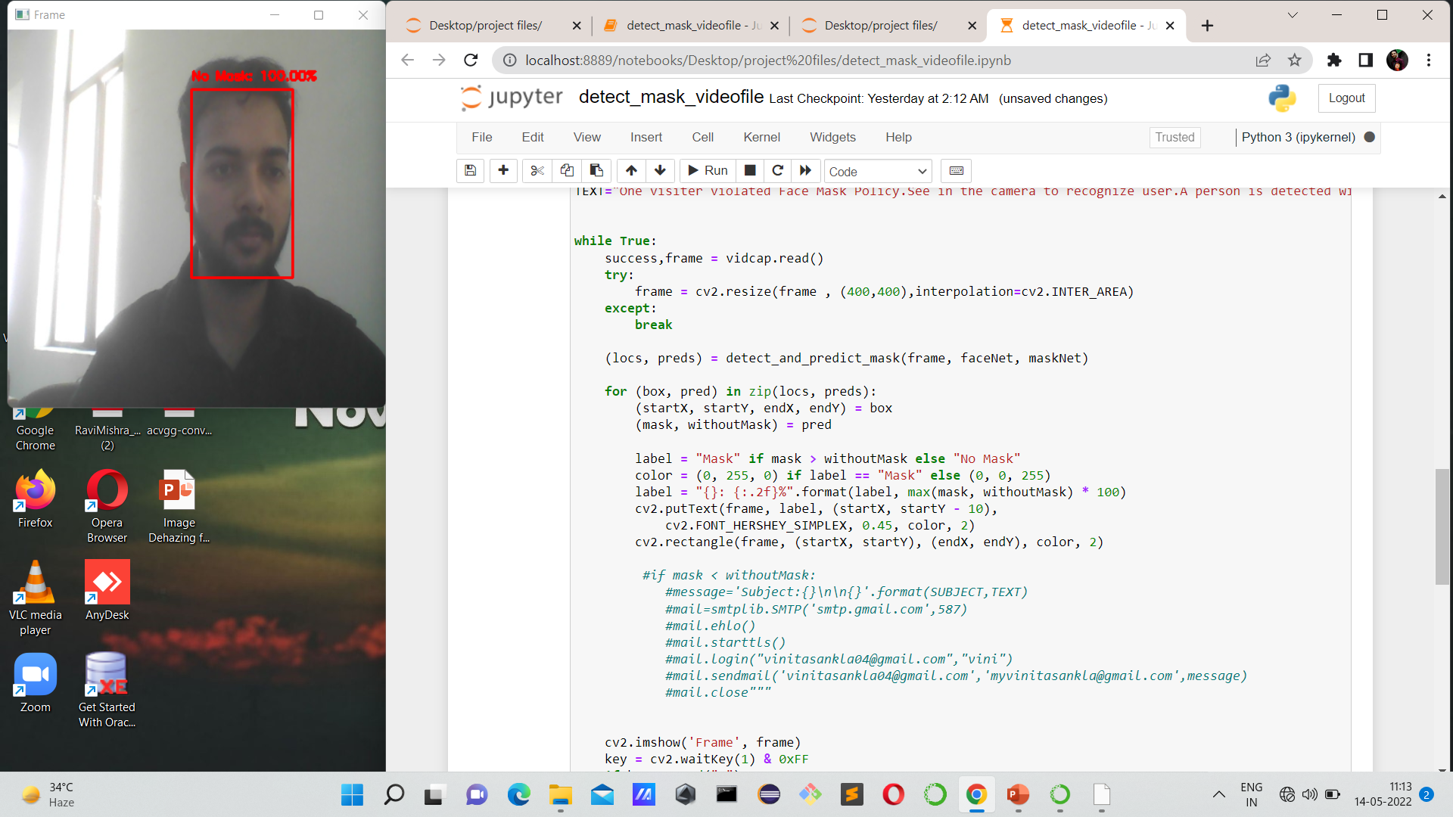
Project Outcome
After successfully training, implementing and testing the code following output was obtained.
Analyzing the results of test photograph with a probability of 100% , revealed that Mask was not worn.

Slide 9
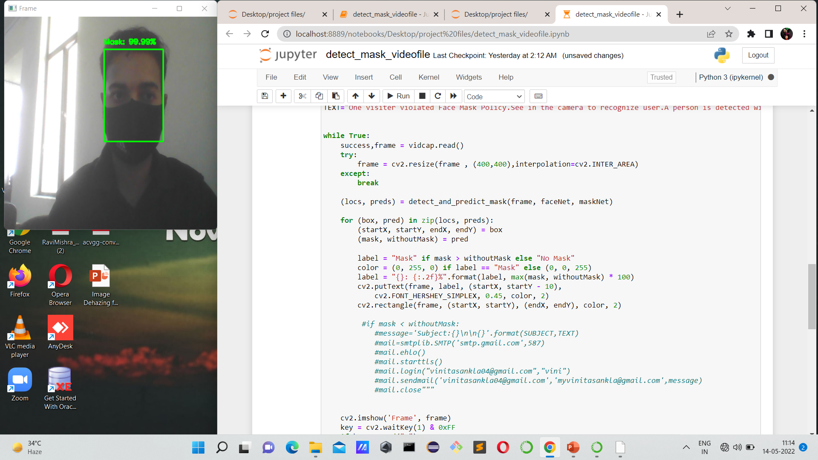
Analyzing the results of test photograph with a probability of 100% , revealed that Mask was worn.

Slide 10
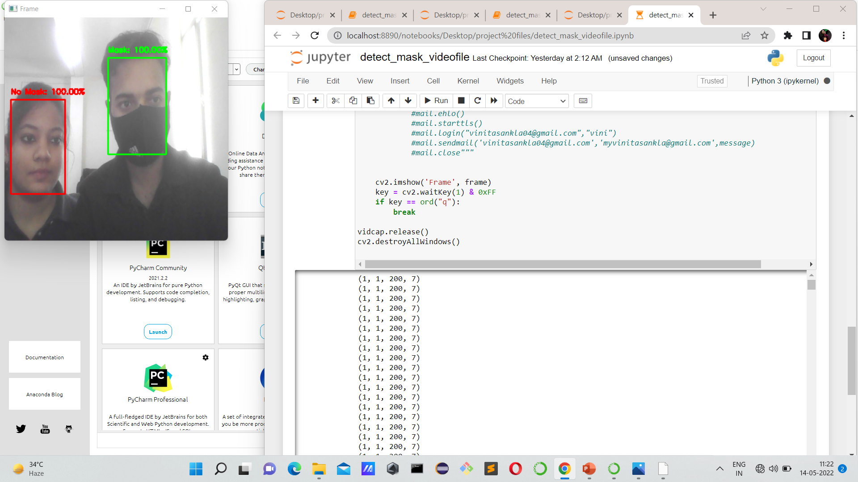
Analyzing the results of test photograph for mask and without mask at same time.

Slide 11
Literature Review
Sr. No | Author | Journal Name
1. | Arjya Das | Image-based approach
2. | Rohini Basak | Feature-based approach
3. | Sammy V. Militante, Nanette V. Dionisio | Deep Learning Implementation
4. | Kinjal Goswami , A.M Sowjanya | Detecting Face Mask Through Machine Learning
5. | Madhura Inamdar Ninad Mehandale | Real-time face mask identification using Face Mask net deep Learning network

Slide 12
References
[1] M. S. Oberste ,P. A. Rota, S. S. Monroe, W. A. Nix, R. Campagnoli, S. Penaranda, B. Bankamp, J. P. Icenogle,K. Maher, M.-h. Chenet al., “Characterization of a novel coronavirus associated with severe acute respiratorysyndrome,”science, vol. 300 , no. 5624, pp. 1394–1399, 2003
Arjya Das, Mohammad Wasif Ansari, Rohini Basak, “Covid-19 Face Mask Detection Using Tensorflow, Keras and OpenCV”,2020
Sammy V. Militante, Nanette V. Dionisio ,“Deep Learning Implementation of Facemask and Physical Distancing Detection with Alarm Systems” , 2020
Bosheng Qin, Dongxiao Li, “Identifying Facemask- Wearing Condition Using Image Super –Resolution with Classification Network to prevent COVID -19”, sensors , 2020,20,5236
Vinitha.V1, Velantina.V2, “ COVID-19 FACEMASK DETECTION WITH DEEP LEARNING AND COMPUTER VISION”, Vol . 07, 2020.
Kinjal Goswami , A.M Sowjanya, “ DETECTION FACE MASK THROUGH MACHINE Learning” , Vol.02
,2020.

Slide 13
Thank You

