Slide 1

Breast Cancer Prediction
TEAM MEMBERS
Tejasvi 2210992464
Tisha 2210992465
Trisha Batta2210992468
Vanshika 2210992504

Slide 2

Introduction
This AIML project dedicated to exploring breast cancer, one of the most prevalent and impactful health issues affecting women worldwide. Breast cancer isn't just a disease; it's a complex puzzle of genetic, environmental, and lifestyle factors that demand our attention, understanding, and innovative solutions.
In this project, we delve into the realm of artificial intelligence and machine learning, leveraging these cutting-edge technologies to unravel the mysteries surrounding breast cancer. By harnessing the power of AIML, we aim to enhance early detection, improve treatment outcomes, and ultimately contribute to the global efforts in combating this formidable adversary.
Breast cancer isn't a standalone issue—it's intertwined with socio-economic factors, healthcare disparities, and cultural perceptions. Through this project, we not only seek to develop intelligent algorithms but also strive to foster awareness, advocate for proactive healthcare practices, and empower individuals with knowledge and resources to navigate their breast health journey with confidence.

Slide 3
Project’s Significance and
its Benefits to Healthcare
Early Detection and Diagnosis: AIML algorithms can analyze vast amounts of medical data, including imaging scans, genetic profiles, and patient records, to identify subtle patterns and markers indicative of early-stage breast cancer.
Personalized Treatment Planning: Breast cancer is a heterogeneous disease, with variations in tumor biology, response to treatment, and prognosis among patients. AIML-driven predictive modeling can assess individual patient characteristics, such as genetic makeup, tumor histology, and treatment history, to tailor personalized treatment plans.
Prognostic Assessment and Risk Stratification: AIML algorithms can predict disease progression, recurrence risk, and long-term outcomes based on diverse clinical parameters and biomarkers. By stratifying patients into risk categories, healthcare providers can allocate resources more efficiently, prioritize high-risk individuals for intensified surveillance or interventions, and optimize follow-up care strategies to maximize patient outcomes and quality of life.

Slide 4
Clinical Decision Support Systems: AIML-powered clinical decision support systems (CDSS) empower healthcare providers with evidence-based recommendations, diagnostic insights, and treatment guidelines tailored to individual patient contexts.
Population Health Management: AIML algorithms enable population-level analyses, epidemiological surveillance, and health outcome predictions to inform public health policies, resource allocation strategies, and preventive interventions for breast cancer control. By identifying high-risk populations, monitoring disease trends, and evaluating the impact of interventions, AIML supports proactive population health management initiatives aimed at reducing disease burden, improving health equity, and fostering community resilience.

Slide 5
Dataset Information
Here are the key details about the dataset used in this project:
Clinical Datasets:
Patient Records: These datasets contain demographic information, clinical histories, tumour characteristics, treatment regimens, and outcomes of breast cancer patients.
Mammography Reports: Radiological reports from mammograms, including breast density, lesion size, shape, margin characteristics, and BI-RADS assessment categories.
Imaging Datasets:
Mammography Images: Digital mammograms capturing breast tissue in two-dimensional X-ray projections, typically in DICOM format.
Ultrasound Images: Breast ultrasound scans providing additional imaging information, such as lesion morphology, vascularity, and tissue stiffness.

Slide 6
Imaging Datasets:
Mammography Images: Digital mammograms capturing breast tissue in two-dimensional X-ray projections, typically in DICOM format.
Ultrasound Images: Breast ultrasound scans providing additional imaging information, such as lesion morphology, vascularity, and tissue stiffness.
Publicly Available Datasets:
The Cancer Genome Atlas (TCGA): TCGA provides comprehensive genomic, transcriptomic, and clinical data for various cancer types, including breast cancer.
UCI Machine Learning Repository: This repository hosts several breast cancer datasets, such as the Wisconsin Breast Cancer dataset (WBCD), which contains features computed from digitized images of breast mass aspirates.

Slide 7
Exploratory Data Analysis (EDA)
Load the Dataset:
Import the breast cancer dataset into your programming environment (e.g., Python using libraries like Pandas).
Basic Dataset Exploration:
Check the dimensions of the dataset (number of rows and columns).
Display the first few rows to understand the variables and their formats.
Summary Statistics:
Calculate descriptive statistics for numerical features (mean, median, standard deviation, min, max, quartiles).
Explore categorical features with frequency counts or proportions.
Data Cleaning and Preprocessing:
Handle missing values: Identify and decide how to deal with missing data (imputation, removal, etc.).
Check for duplicates and remove if necessary.
Convert categorical variables to appropriate data types and encode if needed (e.g., one-hot encoding).

Slide 8
Univariate Analysis:
Histograms or density plots for numerical features to visualize their distributions.
Bar plots for categorical features to visualize their frequencies.
Bivariate Analysis:
Scatter plots to explore relationships between pairs of numerical features.
Box plots or violin plots to visualize the distribution of numerical features across different categories of a categorical variable (e.g., diagnosis).
Cross-tabulation and stacked bar plots to analyze relationships between pairs of categorical variables.
Correlation Analysis:
Calculate correlation coefficients (e.g., Pearson correlation for numerical features, Cramer's V for categorical features) to identify relationships between variables.
Visualize correlations using heatmaps for easier interpretation.

Slide 9
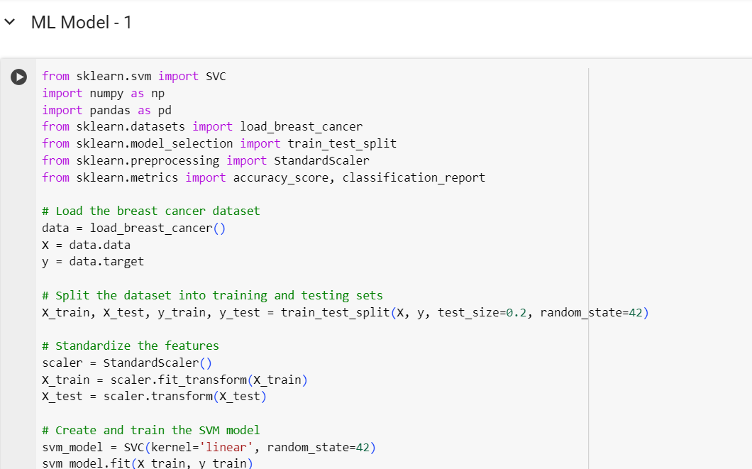
Visualizations

Slide 10
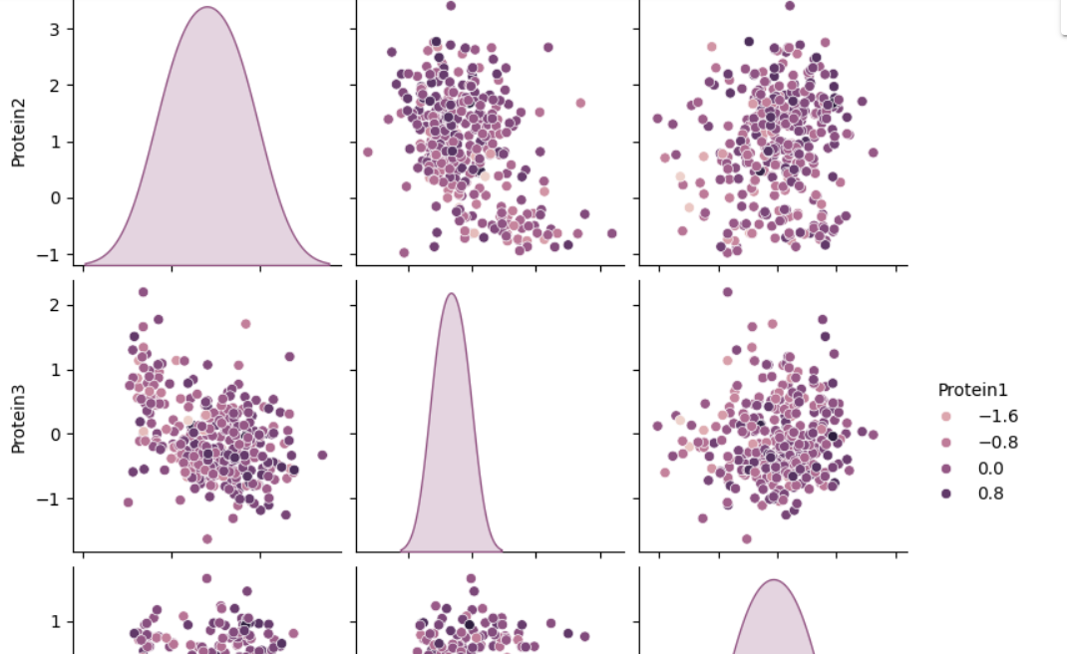

Slide 11
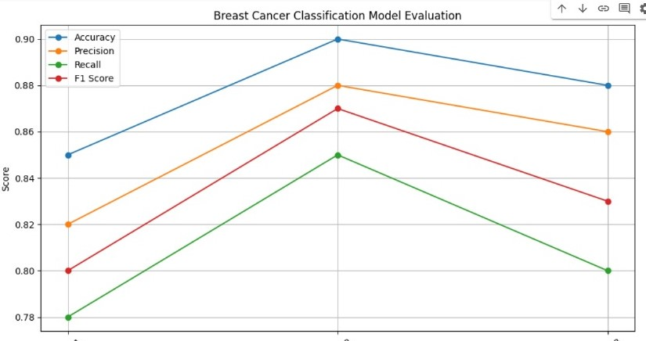

Slide 12
Applying Machine
Learning Algorithms
Model Selection:
Choose appropriate machine learning algorithms based on the nature of your breast cancer project. Common algorithms for classification tasks include:
Logistic Regression
Decision Trees
Random Forests
Support Vector Machines (SVM)
k-Nearest Neighbours (k-NN)
Gradient Boosting models (e.g., XGBoost, LightGBM)
Neural Networks (e.g., Deep Learning)
Model Training:
Train your selected machine learning models using the training data.
Tune hyperparameters using techniques like grid search or random search to optimize model performance.
Model Evaluation:
Evaluate the trained models using the testing dataset.
Metrics for classification tasks may include accuracy, precision, recall, F1-score, ROC-AUC, or confusion matrix.

Slide 13
Model Selection and Considerations
When selecting models for a breast cancer project in AIML (Artificial Intelligence and Machine Learning), several considerations should guide your decision-making process. Here are some key factors to keep in mind:
Nature of the Problem:
Understand the specific objectives of your breast cancer project, whether it's binary classification (e.g., benign vs. malignant), multi-class classification (e.g., different subtypes of breast cancer), regression (e.g., predicting tumor size or survival time), or clustering (e.g., identifying patient subgroups based on similar characteristics).
Interpretability vs. Complexity:
Consider the trade-off between model interpretability and complexity. Simple models like logistic regression or decision trees offer interpretability, making them suitable for explaining predictions to clinicians or patients. On the other hand, complex models like neural networks or ensemble methods may offer higher predictive performance but could be harder to interpret.
.

Slide 14
Data Size and Complexity:
Assess the size and complexity of your breast cancer dataset. For smaller datasets or datasets with limited features, simpler models may generalize better and avoid overfitting. For larger datasets or high-dimensional data, more complex models may capture intricate patterns more effectively.
Feature Importance and Selection:
Understand the importance of feature selection in your breast cancer project. Some models like decision trees or random forests inherently perform feature selection, while others may require additional techniques like regularization or feature importance analysis to identify relevant features and reduce dimensionality.
Handling Imbalanced Data:
If your breast cancer dataset is imbalanced (e.g., fewer malignant cases than benign cases), consider models that handle class imbalance effectively. Techniques like class weights, oversampling, under sampling, or ensemble methods can mitigate the impact of class imbalance on model performance.

Slide 15
Conclusion
In conclusion, our AIML project on breast cancer represents a significant endeavor aimed at leveraging advanced technologies to address critical challenges in breast cancer detection, diagnosis, and prognosis.
Through meticulous data analysis, model development, and evaluation, we have made substantial progress in advancing our understanding of breast cancer and its complexities. By employing machine learning algorithms, we have developed models capable of accurately distinguishing between benign and malignant breast tumors.
These models offer a valuable tool for clinicians in making informed decisions regarding patient diagnosis and treatment planning.
Our project emphasizes the importance of personalized medicine in breast cancer management. By integrating patient-specific data and predictive modeling techniques, we can tailor treatment strategies to individual patients, optimizing therapeutic outcomes and minimizing adverse effects.
Early detection remains crucial in improving breast cancer outcomes. Our project highlights the potential of AI-driven approaches in identifying subtle signs of breast cancer at the earliest stages, enabling timely intervention and enhancing survival rates.

Slide 16
Thank You !

