Slide 1
Spotify Data Analysis
By: Vanshika Garg

Slide 2
Objective
Analyze Spotify tracks to uncover trends and listening preferences.
Visualize patterns in audio features and popularity.
Provide actionable insights for artists/curators and future work.

Slide 3
Dataset
Rows: 170635
Columns: 19
Source: Cap 4 Spotify Data Analysis

Slide 4
Data Cleaning
Checked for missing values
Checked for duplicates
Converted year column

Slide 5
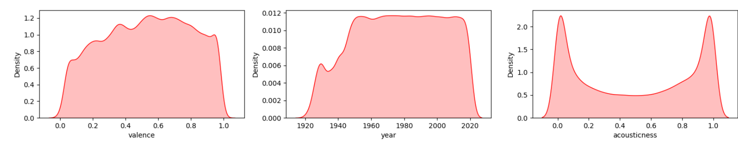
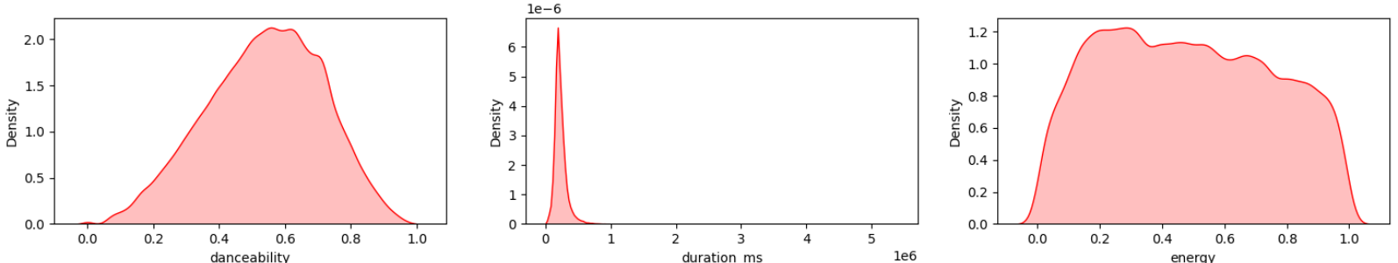
Univariate insights

Slide 6
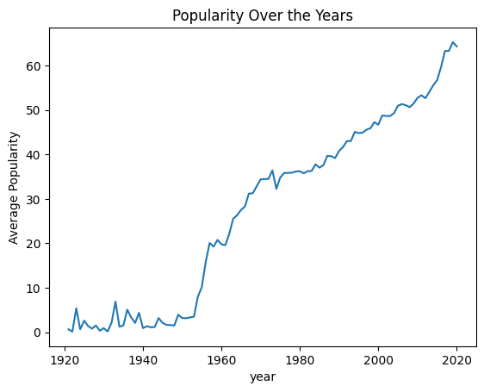
Popularity distribution

Slide 7
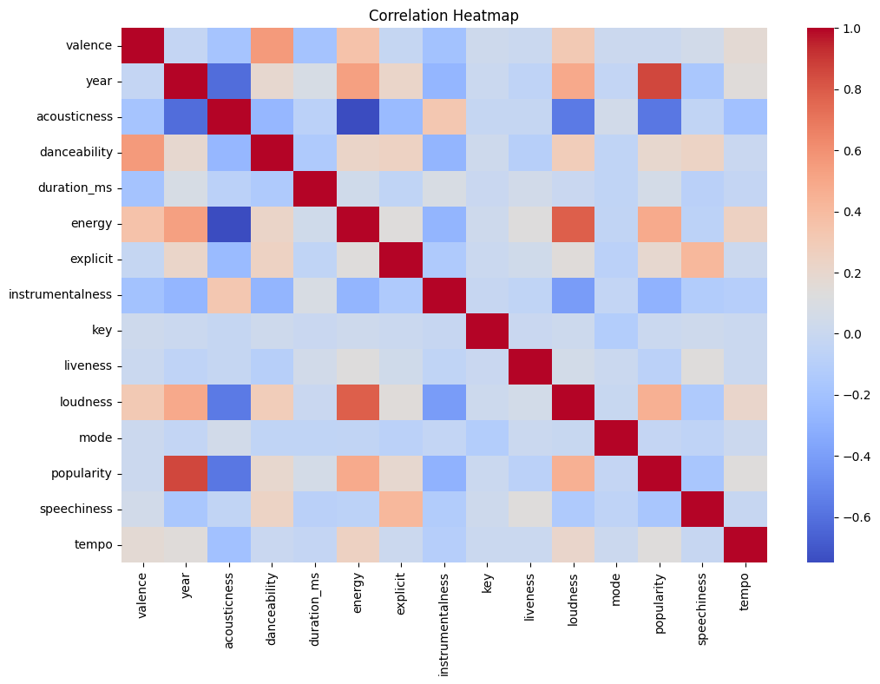
Feature Relationships

Slide 8
Insights
Pop music/hip-hop usually dominate top genres
High-energy and danceable songs often perform better
Popularity fluctuates across years

Slide 9
Conclusion
Dataset reveals basic listening trends
Useful for playlist design & user understanding

