Slide 1
Task 4
Dashboard Design
Design an interactive dashboard for business stakeholders

Slide 2
Project Objective
•To design an interactive sales dashboard for business stakeholders that highlights key sales metrics and trends.
•Enable data-driven decision-making using KPIs and visual analytics.
•Provide insights into regional performance, discounts, and top-selling products.

Slide 3
Dataset Overview
•The dataset includes key sales transaction fields such as:
Order Date, Ship Date, Sales, Quantity, Profit
Discount, Category, Sub-Category, Region
Profit Margin, Sales Category, Discount Band, Processing Time

Slide 4
KPI Cards - High-Level Metrics
•Four KPI cards provide an overview of:
•Total Sales
•Total Profit
•Total Orders
•Average Discount

Slide 5
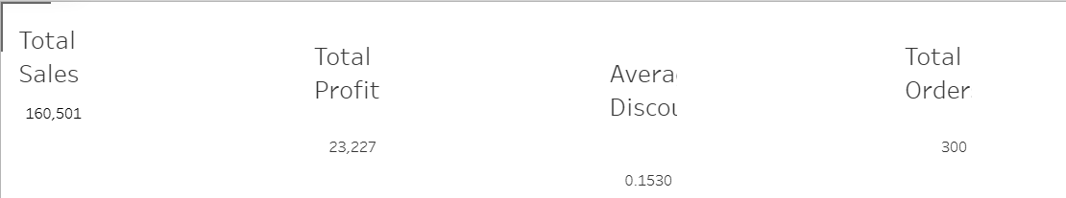

Slide 6
Key Visualizations
•The dashboard includes the following visual insights:
•Sales and Profit trend over time
•Discount vs Profit (by Region)
•Top 10 Products by Sales
•Sales performance across Discount Bands and Sales Categories

Slide 7
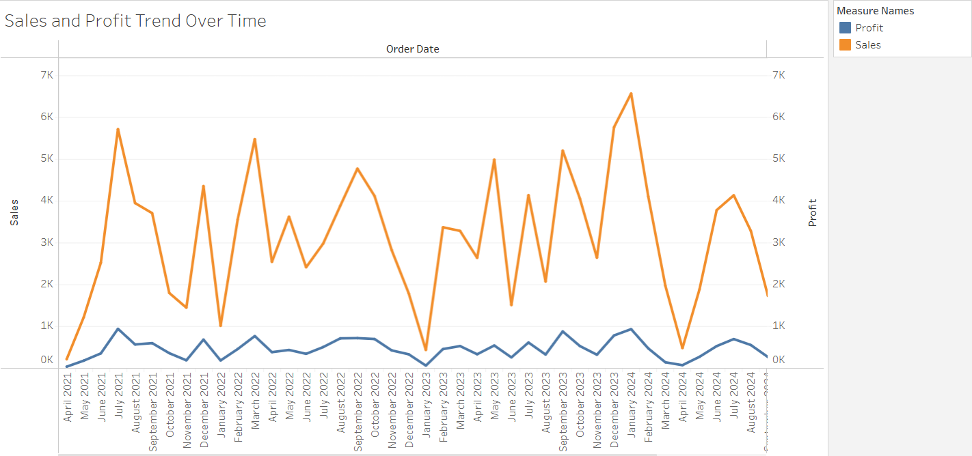

Slide 8
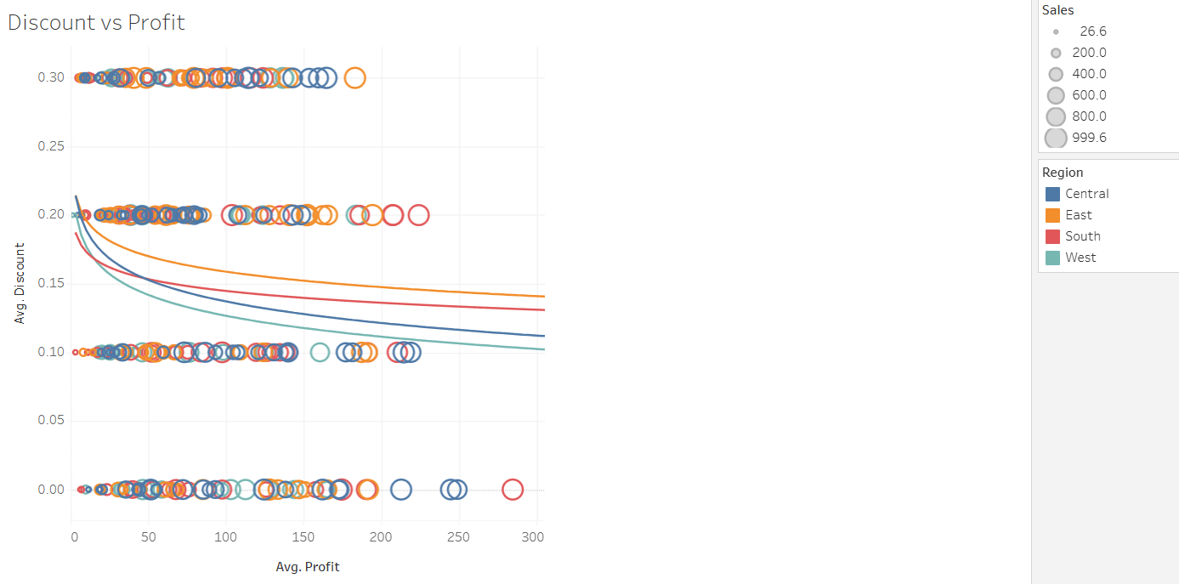

Slide 9
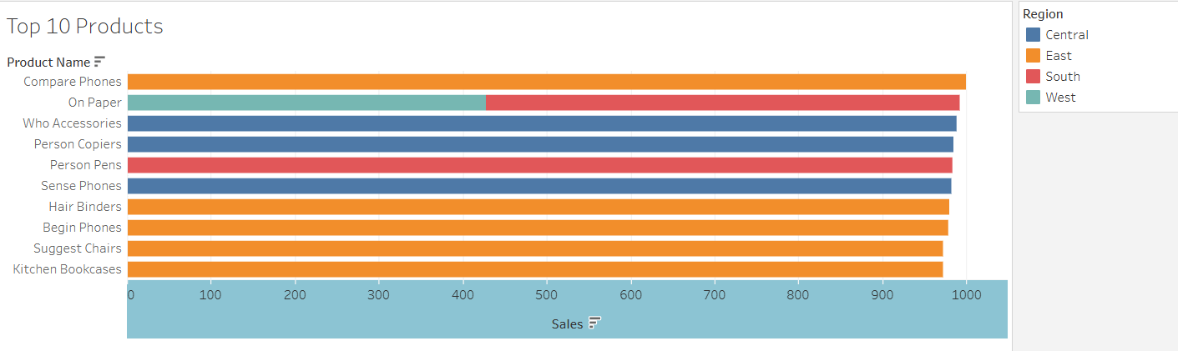

Slide 10
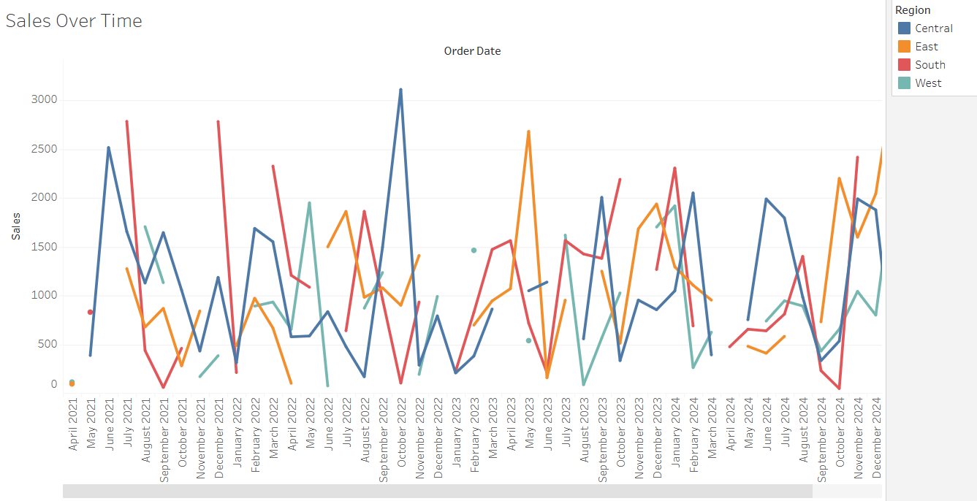

Slide 11
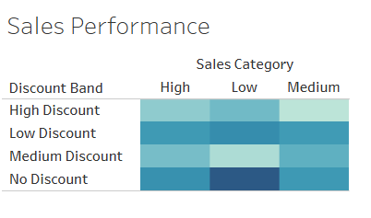


Slide 12
Conclusion
The interactive sales dashboard empowers stakeholders to:
Monitor KPIs in real-time
Analyze trends in sales, discounts, and profits
Compare regional performance
Identify top-performing products

