Slide 1

Project Report:- SECURE PASS VAULT
Vanshika Rani
2021220307
Yamuna Group Of Institutions

Slide 2
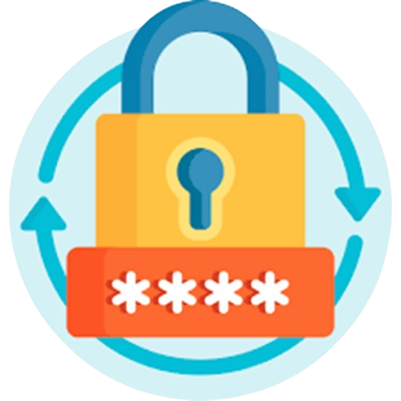
WHAT IS Secure Pass Vault ?
“Secure Pass Vault” is an Android application designed to provide a robust and efficient solution for online security and password management.
This Java-based application offers essential tools to generate strong, unique passwords, evaluate their strength, and manage them securely with ease.
With Firebase for encrypted storage and a sleek user interface designed in XML, Secure Pass Vault ensures seamless usability while prioritizing data privacy and security.

Slide 3
INTRODUCTION TO Secure Pass Vault
This innovative tool offers three key functionalities: Password Generation, Password Strength Evaluation, and Password Management perfectly integrated with a clear and user-friendly interface:-
The Password Generator feature enables users to create strong, random passwords that are virtually impossible for hackers to crack. By integrating a combination of letters, numbers, and special characters, it ensures maximum security for every online account.
The Password Strength Evaluation feature allows users to assess the robustness of existing passwords. By analyzing their composition, including length, complexity, and character variety, the tool provides feedback to help users improve weak passwords and enhance overall security.
The Password Management System serves as a secure, centralized repository for storing, organizing, and accessing login credentials across diverse digital platforms. By utilizing advanced encryption techniques, the application guarantees the confidentiality of stored passwords, reducing the risks associated of unauthorized access.
With the Password Generator and Manager, users can safely store all their passwords in one centralized location, accessible only through a Master Password.

Slide 4
The Essence of Password Generator
“Strong passwords don't grow on trees, but our generator can help them blossom.”
The Password Generator is a versatile and user-friendly tool for creating highly secure passwords with ease. It empowers users to generate complex passwords that are nearly impossible for hackers to crack. Whether it's for personal accounts, professional networks, or sensitive systems, this tool ensures that every password generated is strong, unique, and customized to meet specific security requirements.
The Password Generator offers additional functionality to enhance user convenience and security. Users can customize their passwords by specifying the desired length (minimum 8 characters, maximum 20 characters) and choosing character types, including:-
Lowercase Letters | Uppercase Letters
Numbers | Special Characters
Combination of All

Slide 5
The Essence of Password Manager
“Remembering passwords is a thing of the past. Manage them securely with Password Manager.”
Each password is encrypted and can only be accessed through a Master Password ensuring maximum security .
The Password Manager offers a seamless and intuitive user interface, guiding users through the process of creating accounts, generating strong passwords, and organizing them within secure vaults. In addition to these features, it allows users to Add, Edit, and Delete passwords effortlessly, providing complete control over their stored credentials.
The Password Manager represents a structured approach to safeguarding digital identities. By integrating sign-in and sign-up options, it not only acts as a secure repository for storing and organizing passwords but also serves as a guardian that ensures only authorized individuals can access these critical assets.

Slide 6
Objectives of Secure pass vault
Enhance Password Security: Ensure strong, unique, and encrypted passwords to protect user accounts from unauthorized access.
Offer Offline Access: Enable access to stored passwords without requiring an internet connection.
User-Friendly Interface: Provide a simple and intuitive design for effortless navigation and usability.
Simplify Password Management: Centralize storage, organization, and retrieval of passwords in one secure location.
Maintain User Privacy: Guarantee that user data is secure and inaccessible to unauthorized parties through robust encryption and privacy features.

Slide 7

Development Process
Frontend
The Secure Pass Vault application’s frontend is designed using XML (Extensible Markup Language), a versatile language known for structuring and defining user interfaces.
XML enables the creation of responsive and user-friendly layouts by organizing UI components like buttons, text fields, and layouts in a clear, hierarchical structure. It ensures that the app's design is adaptable to various screen sizes and devices.
Working seamlessly alongside Java, XML contributes to a functional and visually appealing application by integrating design and functionality effectively.

Slide 8

Development Process
2. Backend
The Secure Pass Vault application is developed using Java, a widely used, object-oriented programming language known for its portability, readability, and robustness.
Java ensures cross-platform compatibility and efficient performance, with features like modular design and code reusability, supporting key app functionalities such as password generation, strength evaluation, and secure management.
Its platform independence allows the code to run on any device with a Java Virtual Machine (JVM), making it adaptable and versatile for various environments.

Slide 9

Development Process
2. Backend
The Secure Pass Vault application uses Firestore Database, a cloud-hosted NoSQL solution by Firebase, known for its scalability and flexibility. Firestore ensures real-time synchronization, allowing data updates to be reflected instantly across all devices.
Firestore supports advanced querying and offers seamless data management, making it ideal for handling sensitive information such as passwords and user credentials. Its strong security features, including encryption and access control, protect user data from unauthorized access.
With its built-in security features, Firestore guarantees data confidentiality by implementing robust access control and encryption mechanisms, ensuring that user data is kept safe from unauthorized access.

Slide 10
USES OF XML:-
Mobile App Development:
XML is used to define layouts and user interfaces in Android apps, making it easy to organize UI components. It allows developers to separate design from code for better maintainability.
Web Development:
XML structures data for web services and APIs, enabling seamless data exchange between applications. It is widely used in SOAP and RESTful web services for platform-independent communication.
Data Storage:
XML is used to store configuration and preference files, providing a standardized format. It allows easy access, modification, and transfer of settings across different platforms.
Enterprise Applications:
XML facilitates data exchange and integration between systems in large enterprises. It ensures interoperability and smooth communication between various software applications.
Document Formatting:
XML is used in creating formats like XHTML and RSS for consistent web content presentation. It ensures compatibility and structure, making it easier to share and display content across devices.

Slide 11
USES OF JAVA:-
Mobile App Development:
Android, one of the world's leading mobile platforms, is primarily built using Java, making it a go-to language for Android app development.
Desktop application:
Java is used for creating desktop applications. It enables the development of GUI applications through libraries like Swing, AWT, ,providing a consistent user experience across different operating systems.
Web Development:
Java is widely used for creating dynamic and interactive web applications, leveraging frameworks like Spring and Java Server Faces (JSF).
Enterprise Applications:
Many large-scale enterprise applications, including customer relationship management (CRM) systems and financial software, are developed using Java.
Big Data and Cloud Computing:
Java is a preferred language for developing applications in big data processing and cloud computing, because of its scalability and performance.

Slide 12
USES OF MySQL:-
Real-Time Database:
Enables real-time data synchronization across devices for seamless and dynamic app experiences.
Authentication:
Simplifies user login and identity verification with built-in support for email, phone, and social media logins.
Cloud Firestore:
Provides a scalable, cloud-hosted NoSQL database for storing and querying structured data.
Crashlytics:
Identifies, tracks, and resolves app crashes to maintain stability and enhance user satisfaction.
Push Notifications:
Delivers personalized notifications to engage users and improve app retention effectively.

Slide 13
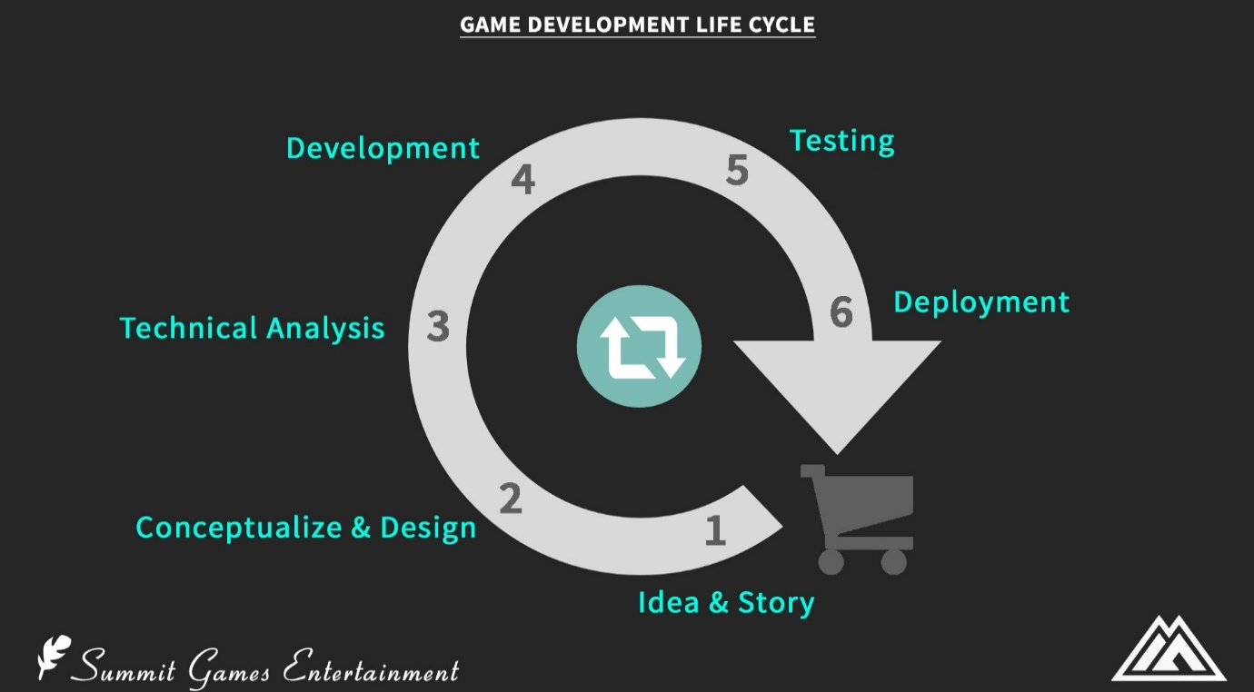
Project DEVELOPMENT LIFE CYCLE :-

Slide 14
XML GUI(Graphical User Interface):-
XML GUI refers to the visual design of user interfaces in Android applications, allowing users to interact seamlessly with the app. For Secure Pass Vault, the GUI screens were designed using XML layouts, providing an intuitive and visually appealing interface.
The layouts were built by either dragging and dropping UI components in Android Studio's Layout Editor or writing XML code to define UI elements like buttons, text fields, and edit text fields. This approach ensures a clean, user-friendly experience and effectively integrates the app's functionality, making password management simple and efficient.

Slide 15
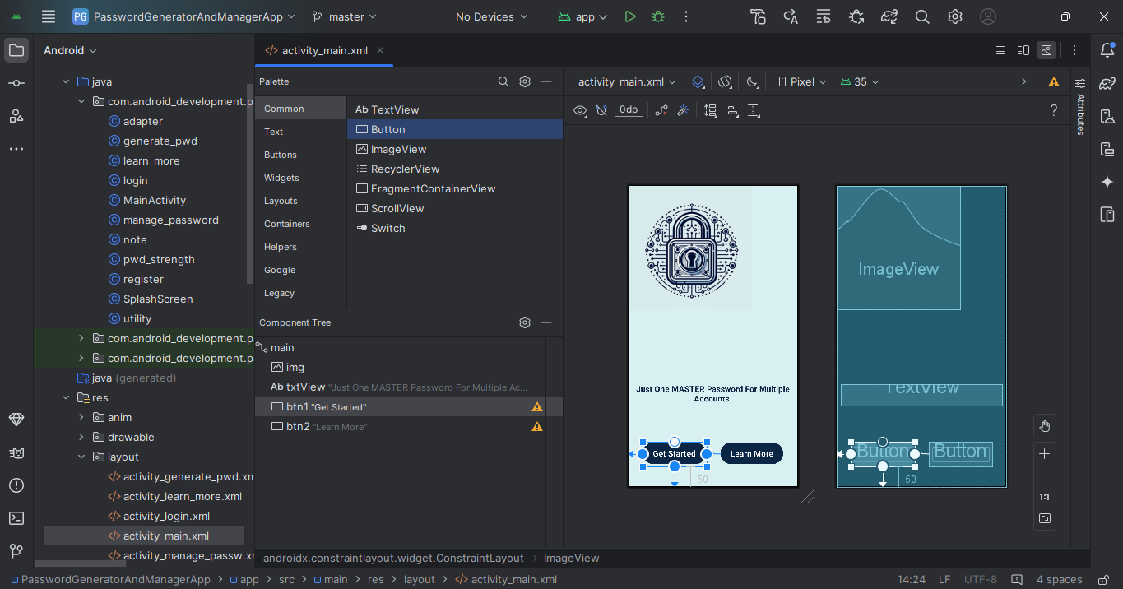
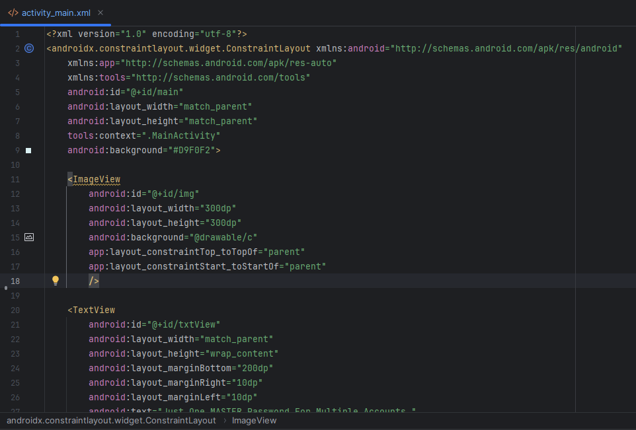
Designing the User Interface
Drag-and-Drop Layout Design
XML Code-Based Layout Design

Slide 16
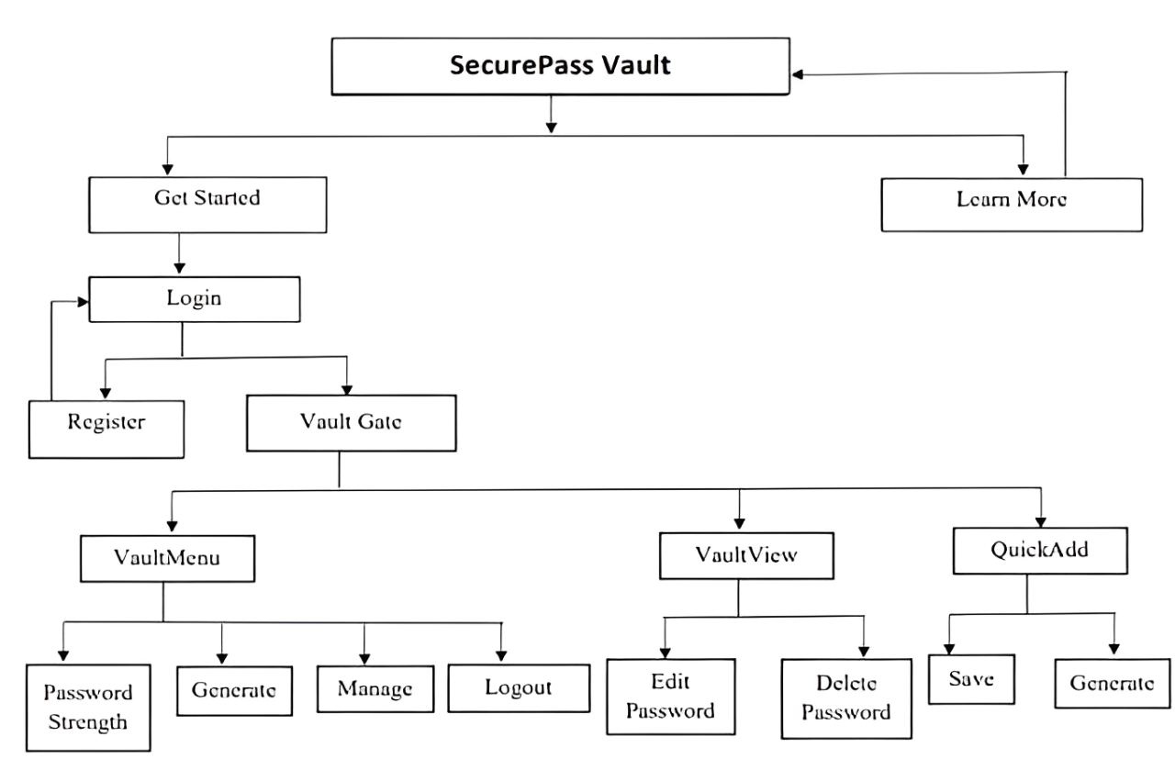
PROJECT OVERVIEW

Slide 17
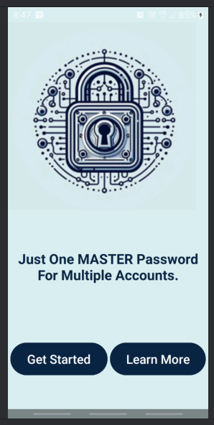
MainActivity Interface Design
The MainActivity screen serves as the starting interface for the Secure Pass Vault app, offering a clean and intuitive design for seamless navigation.
The layout includes two primary buttons, “Get Started” and “Learn More”, which allow users to access key functionalities.
“Get Started” button redirects users to the login screen, while
“Learn More” button provides detailed information about the app’s features.
The central ImageView adds a branding element, while the tagline, “Just One MASTER Password for Multiple Accounts”, emphasizes the app’s purpose, enhancing user engagement.

Slide 18
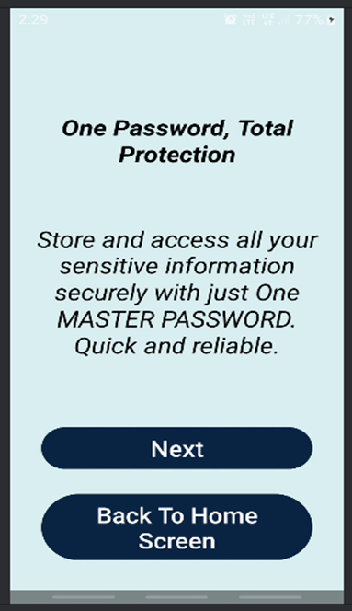
II. Learn More Interface Design
The Learn More screen in the Secure Pass Vault app provides users with an interactive and informative onboarding experience.
The interface features two TextViews that display dynamic titles and descriptions, educating users about the app's key features and security benefits.
The layout includes two navigation buttons:
“Next” Button: Cycles through feature details with smooth animations.
“Back to Home Screen” Button: Redirects users to the home screen, allowing easy navigation.
This design ensures an engaging, user-friendly experience while effectively communicating the app's purpose.

Slide 19
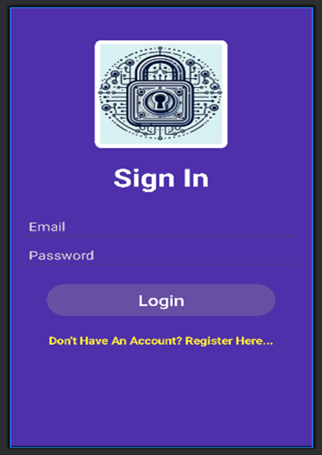
III. Login Page Design
The Login Page of Secure Pass Vault provides a secure and user-friendly gateway for account access using Firebase Authentication as the backend.
It features:
ImageView: A lock icon symbolizing trust and security.
TextView: A bold “Login” title clearly defining the page’s purpose.
EditText Fields:
Email: For registered email input.
Password: A masked field ensuring secure entry.
Login Button: Initiates authentication and navigates to the main dashboard.
Navigation TextView: “Don’t Have An Account? Register Here” for easy redirection to registration.
The design emphasizes simplicity, accessibility, and robust security for an intuitive user experience.

Slide 20
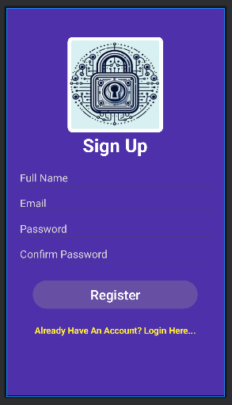
IV. Register Page Design
The Register Page of Secure Pass Vault enables new users to securely create an account for password management.
It includes:
ImageView: A lock icon that symbolizes security and trust.
TextView: “Sign Up” title to clearly indicate the purpose of the page.
EditText Fields:
Full Name: To personalize user accounts.
Email: For unique user identification.
Password: A secure, masked input field for privacy.
Confirm Password: Ensures accuracy of the entered password.
Register Button: Submits the registration details for account creation.
Navigation TextView: “Already Have An Account? Login Here” to easily navigate to the login screen.
The design is user-friendly, secure, and optimized for a smooth registration process.

Slide 21
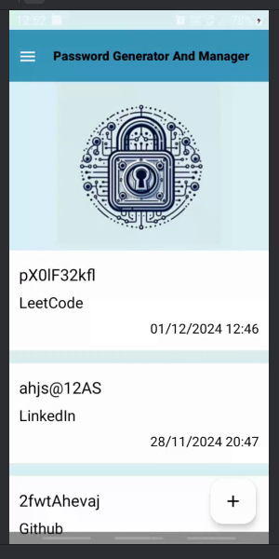
V. Home Screen Design
The Home Screen (Splash Screen) of Secure Pass Vault serves as an introductory page, offering seamless navigation through various features of the app.
It includes:
Toolbar: Displays "Password Generator And Manager," reinforcing the app's core functionality.
ImageView: A lock icon at the center, symbolizing trust and security.
RecyclerView: Dynamically shows a list of saved passwords and descriptions fetched from Firebase Firestore.
Additional components:
Floating Action Button (FAB): Positioned at the bottom-right, allowing users to quickly add new passwords.
Menu Button: Provides access to features like password power check, password generation, manages passwords, and logout.
The design integrates Firebase Firestore for data management and provides an intuitive, responsive user interface.

Slide 22
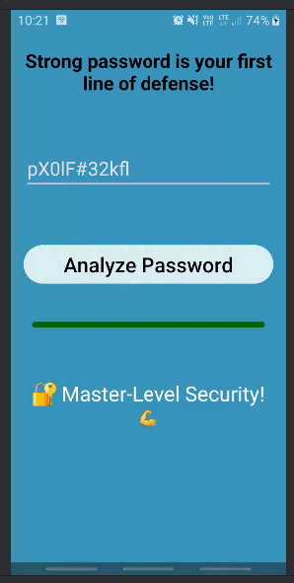
VI. Password Power Check
The Password Strength Analyzer screen helps users assess their password strength and provides real-time feedback on its security.
It includes:
Header TextView: A motivational message "Strong password is your first line of defense!" encourages users to prioritize security.
Password Input Field: A prompt to enter the password for analysis.
Analyze Button: Triggers the strength analysis and feedback.
Progress Bar: Indicates password strength using colors from red (weak) to dark green (strong).
Feedback TextView: Displays specific feedback based on the password strength level, such as "Master-Level Security!" for secure passwords.
The design focuses on dynamic feedback, clear visual cues, and enhancing user awareness of password security.

Slide 23
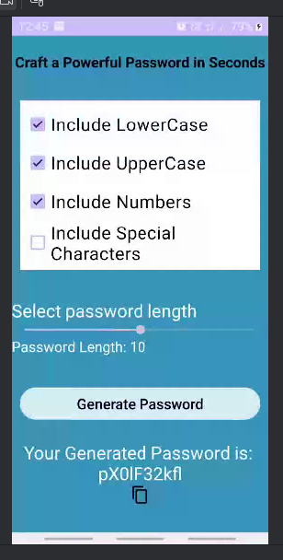
VII. Password Generator
The Password Generator in Secure Pass Vault helps users create strong, secure, and unique passwords based on customizable criteria.
It includes:
Customization Options: Select lowercase letters, uppercase letters, numbers, and special characters.
Adjustable Password Length: A slider allows users to choose lengths from 8 to 20 characters.
Generate Password Button: Creates a new, unique password each time it’s pressed.
Copy to Clipboard Icon: Easily copy the generated password for immediate use.
The feature enhances online security by generating complex, random passwords tailored to user needs.

Slide 24
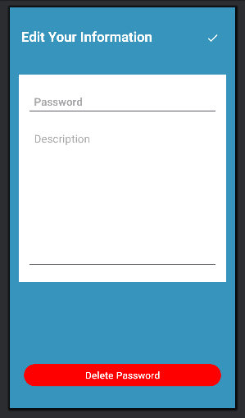
VIII. Password Manager
The Password Manager feature in Secure Pass Vault allows users to manage their passwords efficiently. It includes:
Add Password: Users can securely create a new password entry by entering the password and optional description.
Edit Password: Users can modify an existing password or description by selecting an entry and making the necessary changes.
Delete Password: Users can remove unwanted password entries from the vault, ensuring they have control over their stored data.
These functionalities ensure users can easily organize and manage their passwords securely.

Slide 25
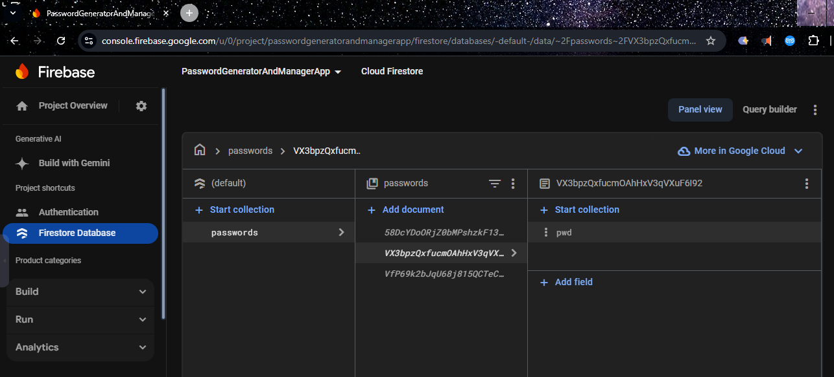
Database Overview
In the field of software development, effective database design is crucial for managing and securing sensitive information such as user credentials.
The Secure Pass Vault database is designed to serve as a centralized repository for storing user-related information and login credentials.
This database employs a structured approach, organizing data into collections and sub collections, each serving a specific purpose in the context of user identity management and password storage.
Firebase Firestore ensures real-time data synchronization, while Firebase Authentication handles secure user login and identity verification, providing robust security and efficient data management.

Slide 26
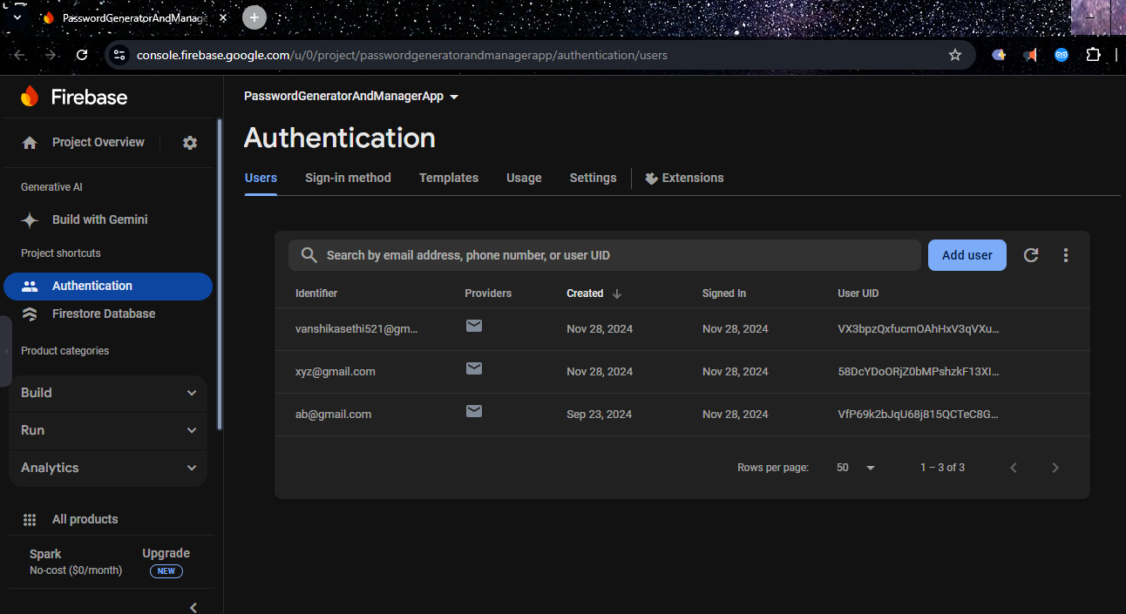
I. Authentication table
The Authentication system in Secure Pass Vault is responsible for managing user sign-ups and logins, ensuring secure access and identification of user-specific data.
Firebase Authentication plays a central role in this process, securely managing sensitive information such as user emails and unique identifiers.
Key Features of the Authentication System:
UID: Each registered user is assigned a Unique Identifier (UID) by Firebase Authentication, which acts as the primary key for linking user-specific data in the Firestore database.
Email: The registered email address is used for user authentication and serves as a critical identifier for account management.
Password Encryption: Passwords, including the Master Password required to access the project's functionality, are encrypted before being stored, ensuring the security of sensitive authentication credentials.

Slide 27
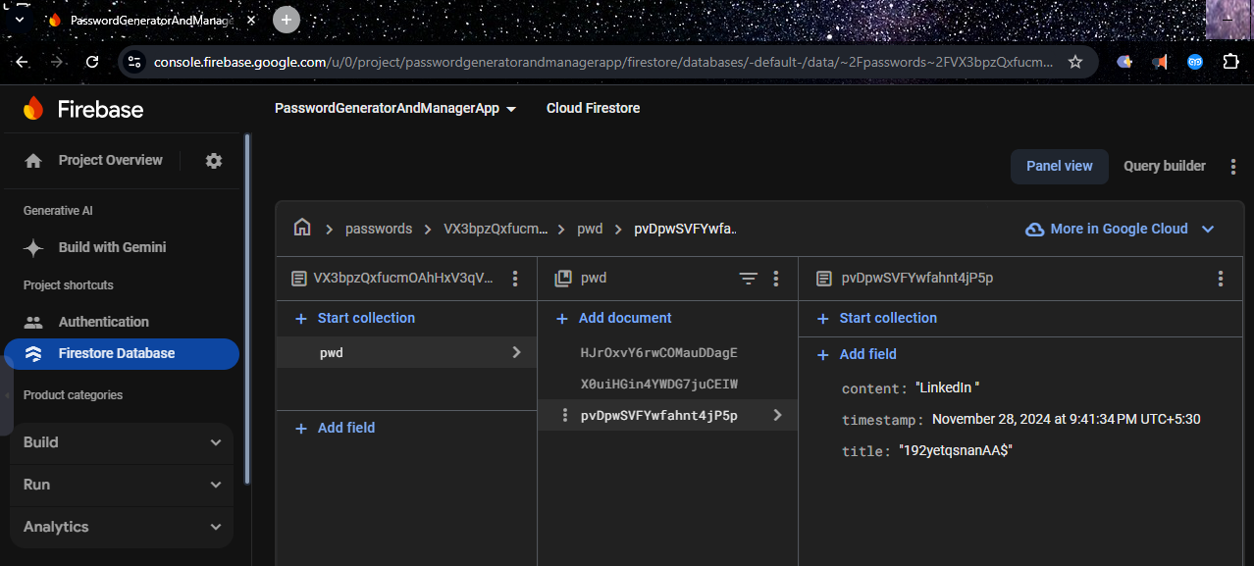
II. Password tble
The Firestore Database in Secure Pass Vault uses a hierarchical structure for secure and efficient management of user credentials.
Key Features:
Passwords Collection: Stores user data in documents named after their UIDs.
pwd Subcollection: Contains individual password entries under each user document.
Fields in pwd Subcollection:
Title: Name of the account.
Password: Encrypted account password.
Timestamp: Date of creation or last update.
Content: Description or additional details.
This structure ensures logical organization and secure storage of sensitive data.

Slide 28
FUTURE SCOPE
Enhanced Password Analysis
Biometric Authentication
Multi-factor Authentication
Cloud Integration
Password Sharing and Collaboration
Machine Learning and AI Integration
Cross-Platform Integration

Slide 29
Benefits of Secure Pass Vault
Enhanced Security:- Generates strong, unique passwords, reducing risks of breaches caused by weak or reused passwords.
Improved Convenience:- Simplifies password management by securely storing all passwords and enabling easy access with a single Master Password.
Increased Productivity:- Saves time with faster logins and eliminates the hassle of recalling or resetting forgotten passwords.
Customization:- Offers flexibility in password generation, allowing users to specify length, complexity, and character types.
Secure Password Storage:- Protects sensitive data with robust encryption, ensuring stored passwords remain safe from unauthorized access.
Skill Development:- Developing the app enhances knowledge of secure programming practices, encryption techniques, and modern app design.
Potential User Base:- Addresses the growing demand for secure and reliable password management, appealing to users who prioritize privacy and security.
Learning Opportunity:- Provides experience in UI/UX design and mobile app development, including the integration of advanced features like password evaluation and Firebase integration.

Slide 30
THANK YOU

