Slide 1
www.SeminarsTopics.com
Seminar
On
Smart Cards

Slide 2
Content
Introduction
History
What is a Smart Card?
Construction of Smart Cards
Examples of Smart Cards
Application
Types of Smart Cards
Parts of Smart Cards
Advantages
Disadvantages
conclusion

Slide 3
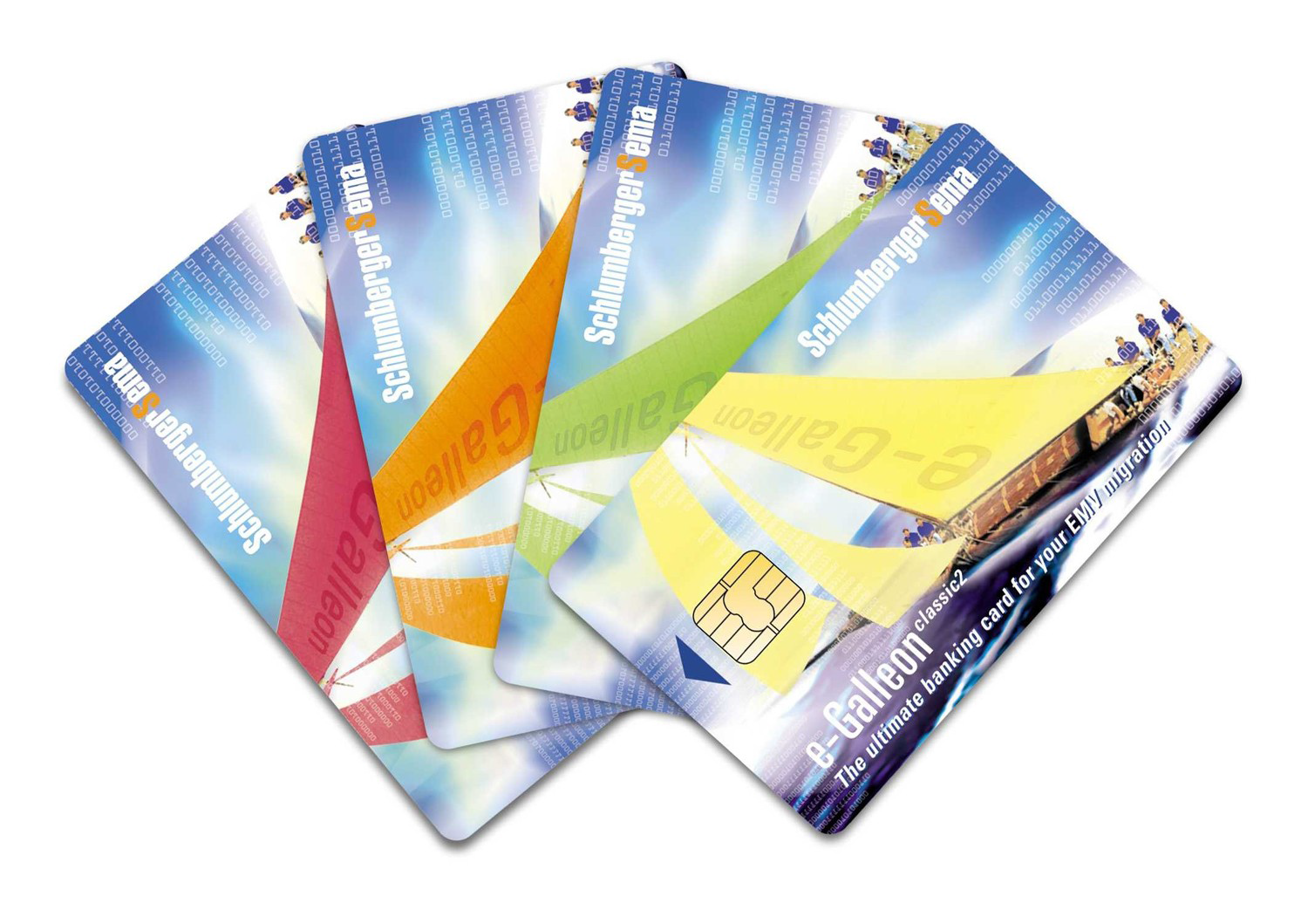
Introduction
In 1968 German inventors patent combination of plastic cards with micro chips.

Slide 4
History
1968
German inventor Jurgen Dethloff along with Helmet Grotrupp filed a patent for using plastic as a carrier for microchips.
1970
Dr. Kunitaka Arimura of Japan filed the first and only patent on the smart card concept
1974
Roland Moreno of France files the original patent for the IC card, later dubbed the “smart card.”
1977
Three commercial manufacturers, Bull CP8, SGS Thomson, and Schlumberger began developing the IC card product.

Slide 5
History
1979
Motorola developed first single chip Microcontroller for French Banking
1982
World's first major IC card testing
1992
Nationwide prepaid card project started in Denmark
1999
Federal Government began a Federal employee smart card identification

Slide 6
What is a Smart Card?
Standard credit card-sized with microchip embedded on it
Two types
Memory-only chips
Microprocessor chips

Slide 7
What is a Smart Card?
Can hold up to 32,000 bytes
Newer smart cards have math co-processors
Perform complex encryption routines quickly

Slide 8
Construction of Smart Cards

Slide 9

Construction of Smart Cards

Slide 10
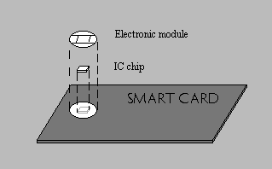
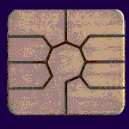
Construction of Smart Cards

Slide 11
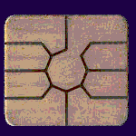
Construction of Smart Cards
Vcc
GND
Vpp
RST
CLK
RFU
RFU

Slide 12
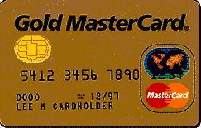
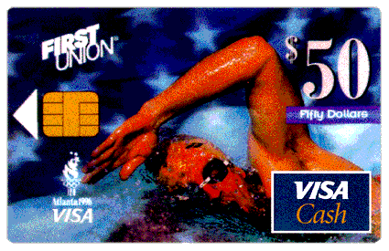
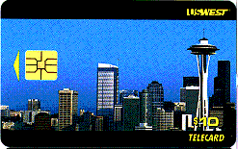
Examples of Smart Cards

Slide 13
Applications
Payment System
Smart Networking
National ID / Authentication
University Identification
Financial Applications
Retail & Loyalty
Communication Applications
Transportation

Slide 14

Payment System
A payment function is an integral part of most smart card applications because most services
accessible by smart cards must be paid one way or the other.

Slide 15

Smart Networking
Smart card technologies provide strong security through encryption as well as access control, based on identification technologies such as biometrics.

Slide 16
National ID / Authentication
In the wake of 9/11 attack a need has been felt in many countries for tamperproof ID cards and a secure authenticating device. Many countries all over the world are trying out, and implementing, the smart card option as a national identity card.

Slide 17
University Identification
The traditional student ID card can be replaced by an all-purpose chip-based student ID card, containing a variety of applications such as electronic purse for vending and laundry machines), and for use as a library card, and meal card.

Slide 18
Financial Applications
Smart cards are being used as an electronic purse, or epurse, to replace coins for small purchases in vending machines and over-the counter transactions. This area is growing rapidly in Europe and the U.S.

Slide 19
Retail & Loyalty
Smart cards are used to record the transactions of the customer, which are helpful in implementation of loyalty programs.
Consumer reward/redemption is tracked on a
smart loyalty card that is marketed to specific
consumer profiles and linked to one or more
specific retailers serving that profile set.

Slide 20
Communication Applications
The chip-based cards help secure the initiation of calls and the identification of callers (for billing purposes) on any Global System for Mobile Communications (GSM) phone

Slide 21
Transportation
Mass transit fare collection systems are using smart tickets, which are easy to load and redeem for a fare.

Slide 22
Types of Smart Cards
Contact Cards
Contactless Cards
Dual Interface / Combi cards

Slide 23
Contact Cards
The contact cards need to be in physical contact with the card reader in order for information to be exchanged. The integrated circuit on the chip is connected to a contact plate (typically a gold plate) on the surface of the card.
Contact cards make up 91.92% of the total smart card market as of 2002

Slide 24
Contactless Cards
Contact-less smart cards contain an embedded antenna, instead of contact pads attached to the chip, for reading and writing information contained in the chip's memory. Contact-less cards do not have to be inserted into a card acceptor device.
Student identification, electronic passport, vending ,parking and tolls are common applications for contact-less cards.

Slide 25
Dual Interface cards
In more recent developments, there are now cards with both a contact and a contact less interface (dual interface or combi-cards).
These may incorporate two non-communicating chips - one for each interface - but preferably have a single, dual interface chip providing the many advantages of a single e-purse, single operating architecture, etc.

Slide 26
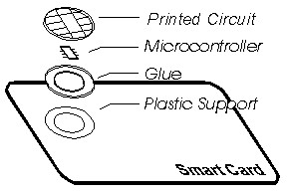
Parts of Smart Card
Generally, it is made up of three elements. The plastic card, a printed circuit or contact disc and an integrated circuit chip are embedded on the card.

Slide 27
Advantages
Flexibility
Security
Portability
Increasing data storage capacity
Reliability.

Slide 28
Disadvantages
NOT tamper proof
Can be lost/stolen
Lack of user mobility – only possible if user has smart card reader every he goes
Has to use the same reader technology
Can be expensive
Working from PC – software based token will be better
No benefits to using a token on multiple PCs to using a smart card
Still working on bugs

Slide 29
Why Smart Cards?
Enhanced security
Offline transactions
Multifunctional
Customization
Economical
Portable

Slide 30
Future
Health Services
Education
Transportation
Welfare
Entitlement Documents
Telecommunications

Slide 31
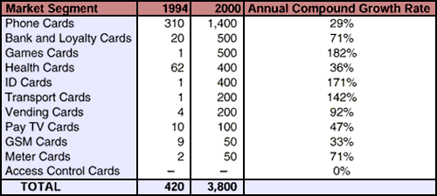
Future

Slide 32
Reference
www.google.com
www.wikipedia.com
www.SeminarsTopics.com

Slide 33
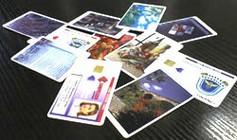
Thanks

