Slide 1

CHANDIGARH UNIVERSITY
DEPARTMENT OF COMPUTER APPLICATIONS
A PROJECT REPORT ON
USER & GROUP MANAGEMENT WITH ACCESS CONTROL
Submitted by: Vanshika
Under the Guidance of: Mr. Rajat Patial Assistant Professor Department of UIC Chandigarh University

Slide 2
CERTIFICATE
This is to certify that the project titled “User & Group Management with Access Control” has been successfully completed by Vanshika under the supervision of Mr. Rajat Patial, Assistant Professor, Department of Computer Applications, Chandigarh University.
This work is submitted in partial fulfillment of the requirements for the course in Linux Administration and System Management.
We hereby declare that this report represents original work carried out by the students under the mentioned guidance and has not been submitted elsewhere for any other academic purpose.
(Signature)
Supervisor: Mr. Rajat Patial Assistant Professor Department of UIC Chandigarh University

Slide 3
ACKNOWLEDGMENT
We take immense pleasure in expressing our sincere gratitude to our respected guide, Mr. Rajat Patial, Assistant Professor, Department of Computer Applications, Chandigarh University, for his constant support, valuable guidance, and encouragement throughout this project. His expertise and advice have been instrumental in the successful completion of our project.
We also wish to thank the Department of Computer Applications, Chandigarh University, for providing us with an excellent environment and facilities to carry out our project work. Finally, we extend our thanks to our friends and family members for their constant motivation and support during the entire project period.

Slide 4
INTRODUCTION
Linux operating systems have become the backbone of modern computing environments. It provides a secure, stable, and flexible foundation for servers, networks, and even personal devices. As organizations grow, managing user accounts, groups, and permissions becomes a critical task to ensure that only authorized personnel can access or modify system resources. This is not just about efficiency but also about protecting sensitive data. Through this project, we delve deeper into the system-level operations of Linux that control access rights, user privileges, and group management, highlighting the importance of following best practices in system administration and cybersecurity.
Linux is one of the most widely used operating systems in the world, known for its stability, flexibility, and open-source nature. One of the core responsibilities of a Linux system administrator is to manage users, groups, and permissions effectively. Proper management of users and access rights ensures that only authorized individuals can use system resources, preventing misuse and maintaining system integrity.
This project focuses on understanding and implementing the fundamental principles of Linux system administration — particularly, user and group management with access control. The tasks performed include creating and deleting users and groups, assigning permissions, and applying Access Control Lists (ACLs) for more granular permission management.

Slide 5
OBJECTIVE
This project aims to combine theoretical understanding with practical implementation of Linux user and group management. By completing this work, we intended to not only execute administrative commands but also comprehend their underlying functionality. Our objective also includes learning about system configuration files like /etc/passwd, /etc/shadow, and /etc/group, which store vital user-related information. Another objective was to explore how ACLs (Access Control Lists) extend traditional permission models, allowing administrators to set permissions at a more granular level, thus improving flexibility and security across the system.
The main objective of this project is to gain practical understanding of how to manage users, groups, and file permissions in Linux effectively. It aims to develop the ability to:
Add, modify, and delete users and groups.
Assign file and directory permissions based on organizational needs.
Implement Access Control Lists (ACLs) for fine-grained access management.
Ensure secure and efficient management of Linux systems.
Through this project, we intend to strengthen our knowledge of Linux commands related to system administration and security.

Slide 6
TASKS PERFORMED / PROCEDURE
In addition to the standard user and group operations, we experimented with permission scenarios to test system response. For example, we created users with restricted access to specific directories, tested file ownership transfers, and implemented group collaboration models. We also studied the differences between user ownership and group ownership of files, and how changing permissions can impact accessibility. Furthermore, we explored system logs to verify the actions performed, ensuring traceability and accountability in administrative tasks.
The following steps were performed to achieve the objectives of this project:
**User Creation:** Added new users using the `useradd` command and set passwords using
`passwd`.
**Group Creation:** Created groups with `groupadd` and assigned users to groups using
`usermod -aG`.
**User Modification:** Changed shell types, home directories, and passwords using
`usermod`.
**Permission Management:** Used `chmod` to assign read, write, and execute permissions for users, groups, and others.
**Ownership Changes:** Applied `chown` and `chgrp` commands to manage ownership of files and directories.
**Access Control Lists:** Implemented ACLs using `setfacl` and verified them with `getfacl`.
**Verification:** Checked the user and group configuration using `cat /etc/passwd` and `cat
/etc/group`.

Slide 7
COMMANDS USED
Alongside these commands, we also explored related utilities such as 'id' to display user identity, 'su' for switching users, and 'sudo' for executing administrative tasks securely. Understanding command syntax, flags, and real-world usage scenarios was an integral part of the learning process. We also ensured proper documentation of each command’s purpose and tested variations to observe their behavior.
Below is the list of key commands used during the project:
`useradd <username>` – Add a new user.
`passwd <username>` – Set or change a user's password.
`usermod -aG <group> <user>` – Add a user to a group.
`userdel <username>` – Delete a user.
`groupadd <groupname>` – Create a new group.
`groupdel <groupname>` – Delete a group.
`chmod <permissions> <file>` – Change file or directory permissions.
`chown <owner> <file>` – Change file ownership.
`chgrp <group> <file>` – Change group ownership.
`setfacl -m u:<user>:rwx <file>` – Set ACL permissions.
`getfacl <file>` – Display ACLs for a file or directory.
`ls -l` – List files with detailed permissions and ownership.

Slide 8
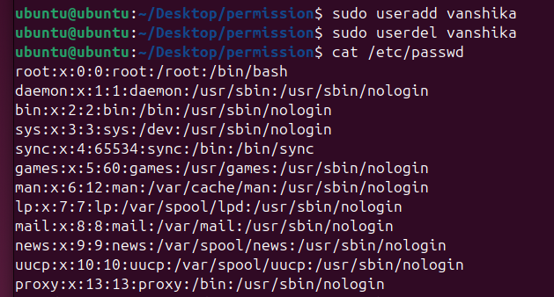
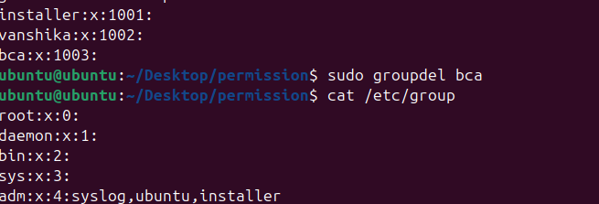
OUTPUT / SCREENSHOTS

Slide 9
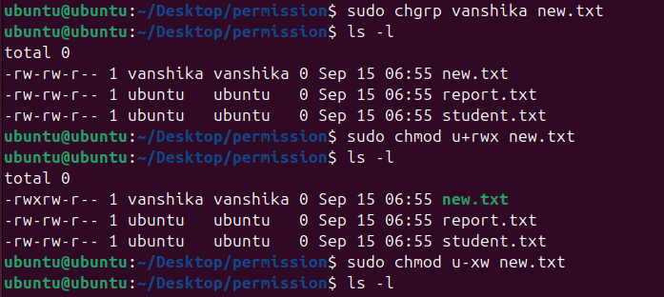
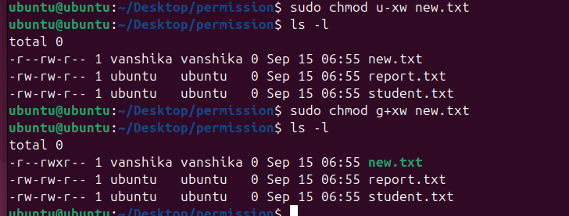
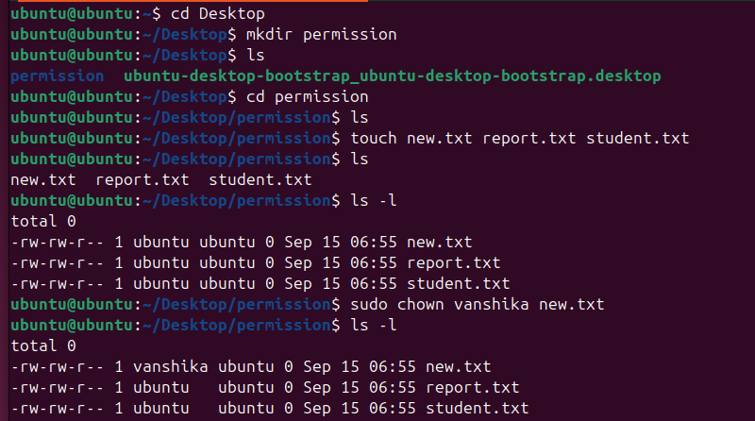

Slide 10
CONCLUSION
Through this project, we also developed problem-solving skills by encountering and resolving common system errors. It helped us understand user access hierarchies, privilege levels, and the concept of least privilege — a key principle in system security. The hands-on practice enhanced our confidence in handling Linux systems independently. We also recognized how these fundamental skills serve as the foundation for advanced topics such as server management, network security, and cloud system administration.
This project on 'User & Group Management with Access Control' provided us with practical experience in managing Linux users, groups, and file permissions. We learned how to ensure system security and integrity by setting appropriate access controls and applying ACLs for specific user-based permissions.
Through this project, we enhanced our understanding of the Linux command line interface and gained confidence in performing administrative tasks efficiently. The skills learned through this work are crucial for any future role involving system or network administration.
Linux is extensively used in enterprise servers, cloud deployments, and embedded systems. In this project, we not only practiced command usage but also examined real-world scenarios such as multi-user collaboration, permission inheritance, and mitigation of accidental data exposure. We discuss typical administrative workflows, including account lifecycle (creation, maintenance, and decommissioning), automated user provisioning considerations, and basic security practices such as enforcing strong passwords and limiting sudo privileges to trusted accounts.

Slide 11
During the lab sessions we simulated a departmental file share where different roles required different access levels. We created groups such as 'developers', 'testers', and 'admins' and mapped directory permissions accordingly. We also demonstrated how to revoke access cleanly, and how to use 'getfacl' output to audit who has access to sensitive files. Finally, we scripted common repetitive administration tasks (user creation with default home directories, assigning groups, and applying ACL templates) to highlight how automation reduces human error.
Examples with context:
Create a user with home directory and bash shell: useradd -m -s /bin/bash alice
Add user to multiple groups:
usermod -aG developers,sudo alice
Set a default ACL allowing 'developers' group full control on /srv/project: setfacl -m g:developers:rwx /srv/project
Remove a user and preserve their home directory for auditing:
userdel -r alice
We included these examples to show practical command usage and explain common flags. Sample output excerpts (formatted):
  /etc/passwd entry for 'alice': alice:x:1001:1001:Alice:/home/alice:/bin/bash

Slide 12
  getfacl /srv/project sample:
# file: /srv/project user::rwx group::r-x user:alice:rwx
group:developers:rwx mask::rwx
other::r--
These outputs validate that ownership and ACL entries were applied as expected.
Moving forward, recommended improvements include integrating centralized authentication (LDAP or Active Directory), regular permission audits, and role-based access control (RBAC) implementations for larger environments. Understanding these basics prepares administrators to manage more complex infrastructures and to adopt best practices that improve both security posture and operational efficiency.
APPENDIX A: Troubleshooting Notes
'Permission denied' while using sudo: ensure the user is in the 'sudo' group and that /etc/sudoers hasn't been modified incorrectly.
ACLs not taking effect: check the underlying filesystem supports POSIX ACLs (e.g., ext4 with acl enabled).
3.Home directory missing after userdel: use 'userdel -r' carefully; backups are recommended before removal.
.

Slide 13
APPENDIX B: Good Practices
  Enforce password policies with pam_pwquality.
  Use 'chage' to set password expiry policies.
  Keep an administrative log of user changes for auditability.
REFERENCES
Linux Documentation Project - Administrative Guides
man pages: useradd(8), usermod(8), userdel(8), chown(1), chmod(1), setfacl(1)
Official distribution admin guides (Debian, Ubuntu, CentOS) for filesystem and ACL specifics

