Slide 1
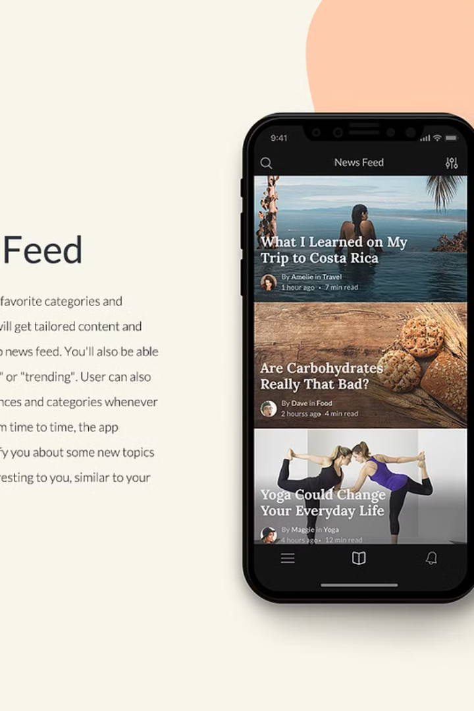
Introduction to Tux Blogging App

Slide 2
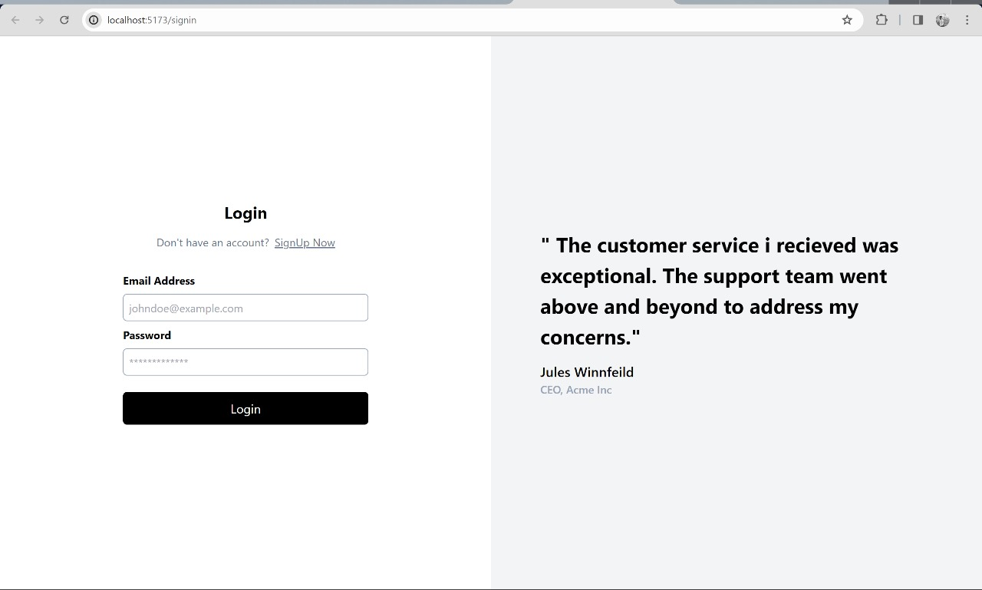
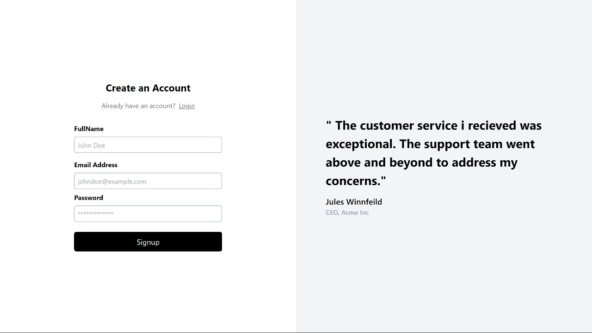
Overview of the login and sign up pages
Login Page
Sign Up Page
The login page provides a secure gateway for registered users to access the app's features.
The sign-up page allows new users to create accounts and join the blogging community.

Slide 3

Features of Tux Blogging App
1
Rich Text Editor
2
Community Engagement
Users can create visually stunning articles with the built-in editor.
Facilitates interactions and collaborations between members.

Slide 4

User interface and experience
1
Intuitive Design
The app's interface has been carefully designed for ease of use and navigation.
2
Personalization
Customizable options allow users to tailor their experience to their preferences.
3
Seamless Navigation
Smooth transitions and clear pathways ensure a hassle-free user journey.

Slide 5

Security measures implemented in Tux
End-to-End Encryption
Regular Security Audits
All data transmission undergoes rigorous encryption to safeguard user privacy.
Ongoing assessments ensure the app meets the highest security standards.

