Slide 1

Front End Engineering
Project Name: Task Tracker
Submitted By :
Submitted To:
Vanshika Bhatia
2110992260
G19
Mr. Rishik Gupta

Slide 2

Creating a Dynamic Task List with React
This React application allows users to manage tasks efficiently through actions like adding, deleting and editing tasks. Learn more about its functionality and styling options.

Slide 3

Introduction
Discover the purpose and functionality of the React application along with its dynamic nature that enables seamless task management.
Overview of the React application
Purpose of the application
Functionality of the task list

Slide 4

Adding and Deleting Tasks
Add Tasks
Effortlessly create new tasks with a simple user interface.
Delete Tasks
Easily remove completed or unnecessary tasks from the list.

Slide 5
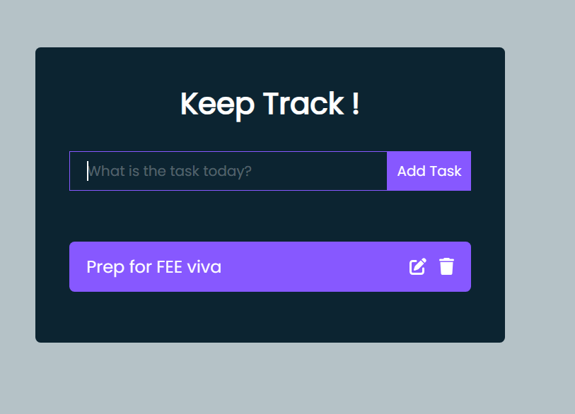
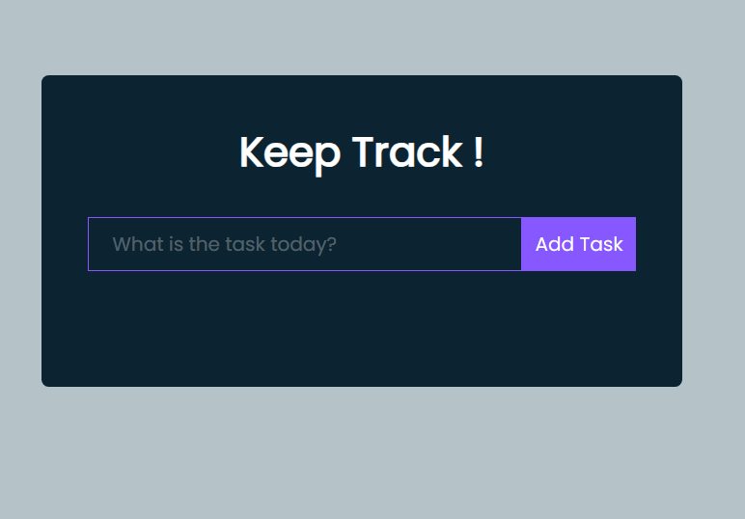
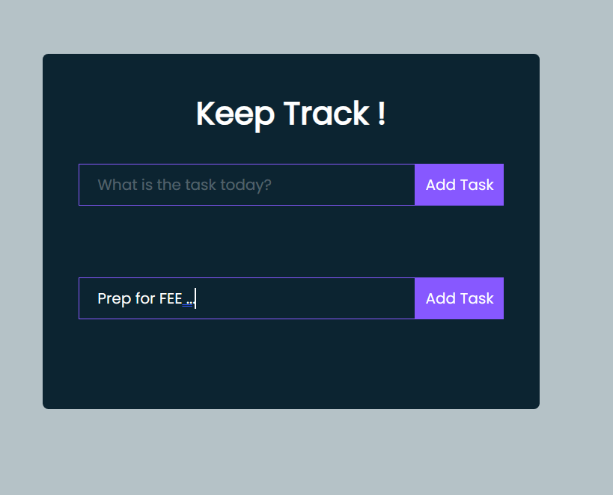
Completing , Editing and Deleting Tasks
Adding Task
Deleting Task
Editing Tasks
Mark tasks as complete to keep track of your progress.
Easily remove completed or unnecessary tasks from the list.
Edit task details or make modifications whenever needed.

Slide 6

❤️
External File Dependencies
1
Usage of External Files
Understand how external files contribute to the application's structure and functionality.
2
Styling and Additional Functionality
Learn how external CSS and JavaScript files enhance the user experience.

Slide 7
Child Components and User Interface
Overview of Child Components
Importance of Implementation
Explore the role of key components like Todo, TodoForm, and EditTodoForm.
Understand the significance of effective implementation for seamless task management.

Slide 8

Conclusion
Recap the key points and emphasize the dynamic nature of the task list that empowers users to efficiently manage their tasks.
Summary of key points
Emphasis on the dynamic nature of the task list

Slide 9
❤️
Thank You

