Slide 1
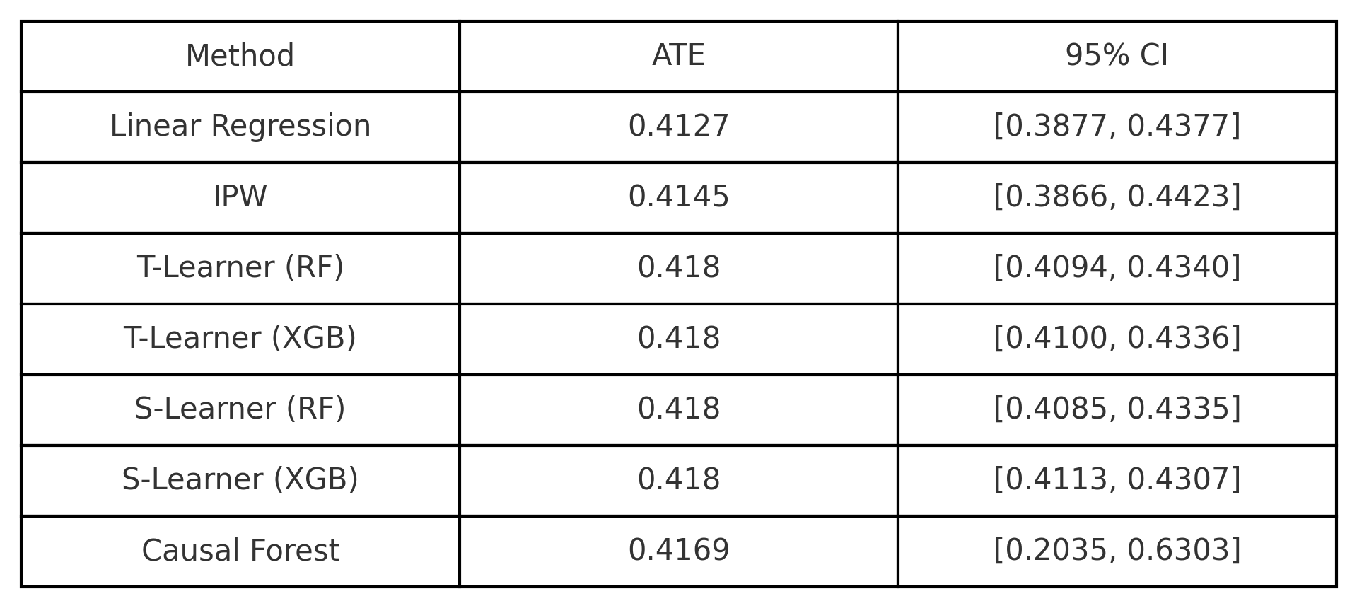
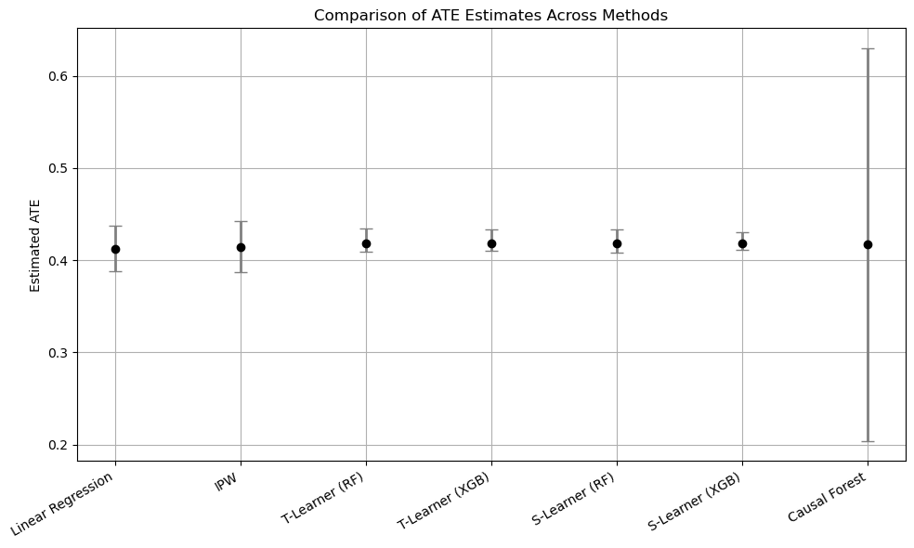
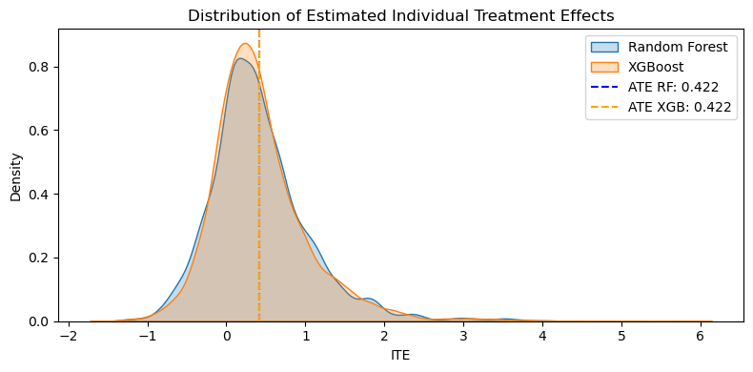
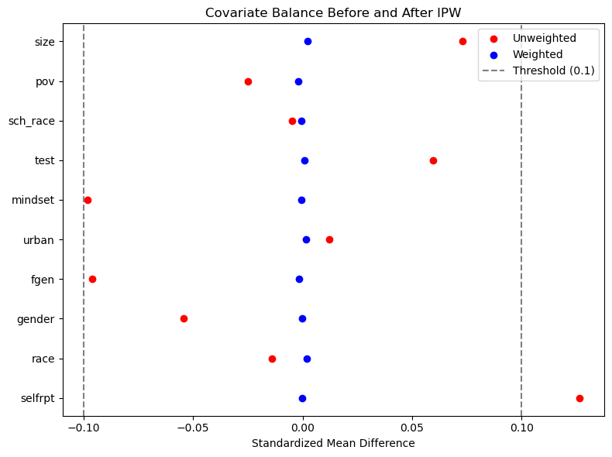
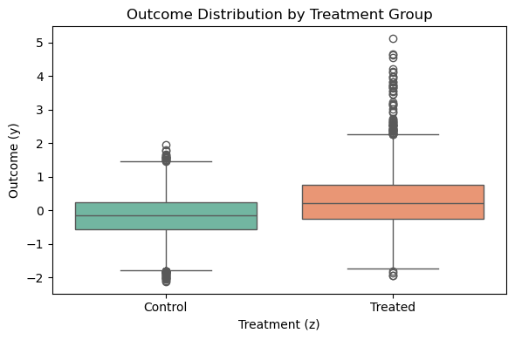
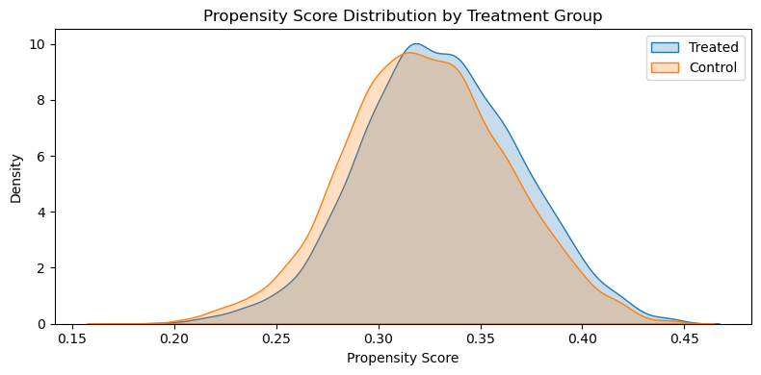
Causal Impact of a Growth Mindset Intervention on Student Achievement
Vanshika Ram Gurbani (vg460)
Introduction
Methods
Results
A growth mindset is the belief that intelligence can improve through effort. Promoting this belief has been shown to enhance student performance, particularly in academically challenging environments.
This project investigates the causal impact of a growth mindset intervention on student achievement using synthetic data modeled after the National Study of Learning Mindsets (NSLM).
Because the dataset is synthetic and observational, we apply multiple causal inference methods to estimate treatment effects while adjusting for confounding.
We used five causal inference methods to estimate the effect of the mindset intervention. Each method handles confounding differently and makes specific assumptions.
1. Linear Regression
Estimates the treatment effect by adjusting for covariates in a standard regression model. Assumptions:
All confounders are observed and included
The relationship between variables is linear
2. Inverse Probability Weighting (IPW)
Reweights observations based on the probability of treatment to simulate a randomized experiment. Assumptions:
No unmeasured confounding
Everyone has a non-zero chance of receiving treatment
Propensity model is correctly specified
3. T-Learner (RF/XGBoost)
Trains two separate machine learning models: one for treated and one for control. Estimates individual-level treatment effects by comparing predicted outcomes. Assumptions:
Models accurately capture outcome behavior
No unmeasured confounding
The graph shows how individual students were estimated to respond to the intervention using Random Forest and XGBoost models. Both models produced very similar treatment effect distributions centered around a positive value, indicating that most students benefited, though to varying degrees. This highlights the presence of treatment heterogeneity and the usefulness of machine learning in uncovering it.
4. S-Learner (RF/XGBoost)
Uses a single model with treatment as a feature to predict outcomes for both treated and untreated cases. Assumptions:
Treatment effect is learnable from observed data
No unmeasured confounding
5. Causal Forest
A machine learning method that estimates both individual- and group-level treatment effects and provides uncertainty via confidence intervals.
Assumptions:
No unmeasured confounding
Models for outcome and treatment are flexible and correctly tuned
All five causal inference methods consistently estimated the Average Treatment Effect (ATE) of the mindset intervention to be positive, ranging from 0.41 to 0.42.
Both regression-based and machine learning approaches yielded similar ATEs, indicating the robustness of the findings across model types. The Causal Forest method provided the most flexible estimation and yielded a statistically significant 95% confidence interval, reinforcing the credibility of the observed effect.
All methods produced consistent ATE estimates near 0.42. Causal Forest had a wider CI due to its nonparametric design, but its interval confirms a significant effect.
Data Exploration
Dataset: 10,391 students from 76 U.S. high schools.
Treatment (Z): Indicator for receiving growth mindset intervention.
Outcome (Y): Post-intervention academic achievement.
Covariates:
Student-level: selfrpt, gender, race, fgen
School-level: urban, mindset, test, sch_race, pov, size
The treatment and control groups are imbalanced (approx. 2:1). Covariate adjustment is necessary.
Both groups share similar ranges of propensity scores (supports positivity).
Figure 5: Comparisons of ATE Estimates Across Methods
Figure 4: Distribution of Individual Effects
(T-Learner)
Conclusion
Figure 1: Covariate Balance Before and After IPW
Figure 2: Outcome Distribution by Treatment Group
Across all causal inference methods — including regression adjustment, propensity weighting, machine learning learners, and causal forests — the growth mindset intervention showed a consistent, positive impact on student achievement.
The average treatment effects (ATEs) ranged from 0.41 to 0.42, with the Causal Forest providing a statistically significant 95% confidence interval.
These findings suggest that brief psychological interventions can have meaningful educational effects, even when analyzed in an observational, non-randomized setting.
The robustness of the results across diverse statistical approaches strengthens the credibility of the conclusion.
Figure 3: Propensity Score Overlap Between Groups

