Slide 1

Project 4 Option Pricing
Group 3
Madhurima Dutta (M22MA056)
Nisha Shaw (M22MA059)
Mansi(M22MA057)
Vanshika Kumawat(M22MA207)

Slide 2
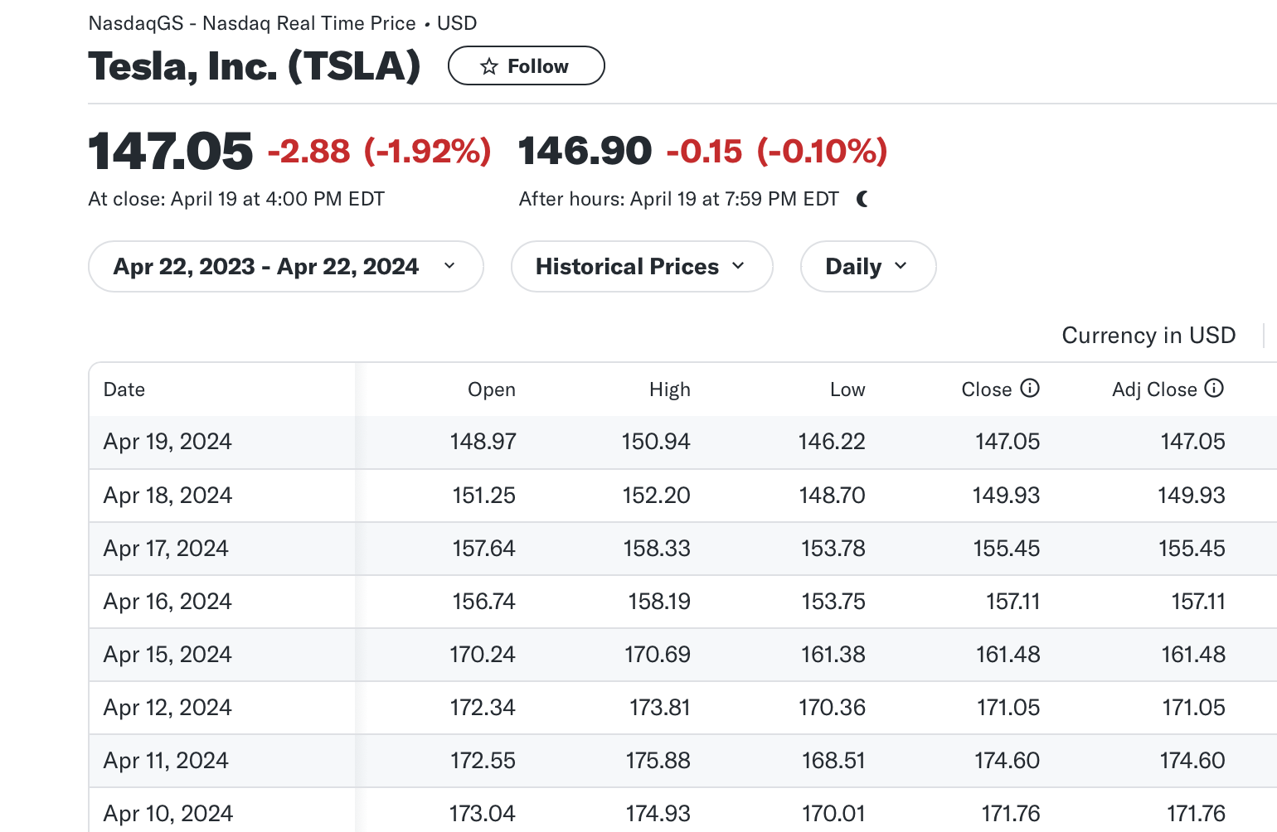
Stock of choice :

Slide 3
Rate of Interest
For rate of interest we have taken 10 Year US treasury rate as said:
4.62%
Volatility
We have got the volatility as 3.3% .

Slide 4
Options
A financial derivative that represents a contract sold by one party (option writer) to another party(option holder).The contract offers the buyer the right, but not the obligation, to buy (call) or sell (put) a security or other financial asset at an agreed-upon price (the strike price) during a certain period of time or on a specific date (exercise date).
Call Option
Option provide the holder the right (but not the obligation) to purchase an underlying asset at specified price (the strike price), for a certain period of time.
Put Option
Option give the holder the right to sell an underlying asset at a specified price (the strike price).

Slide 5
The binomial model
A discrete-time option pricing model, breaks time into intervals and calculates option values by considering all possible future price paths. It offers flexibility in handling various option types and is relatively easy to understand and implement. However, challenges arise with computational complexity as time intervals increase, and its accuracy relies on proper parameter estimation. Despite limitations in market assumptions, it finds extensive use in pricing vanilla and exotic options, as well as in risk management strategies. Black-Scholes Option Pricing Model (BSOPM), which views stock prices and option payoffs from a continuous time perspective. It portrays a probability distribution of future stock prices. It broadens the range of future stock prices.

Slide 6
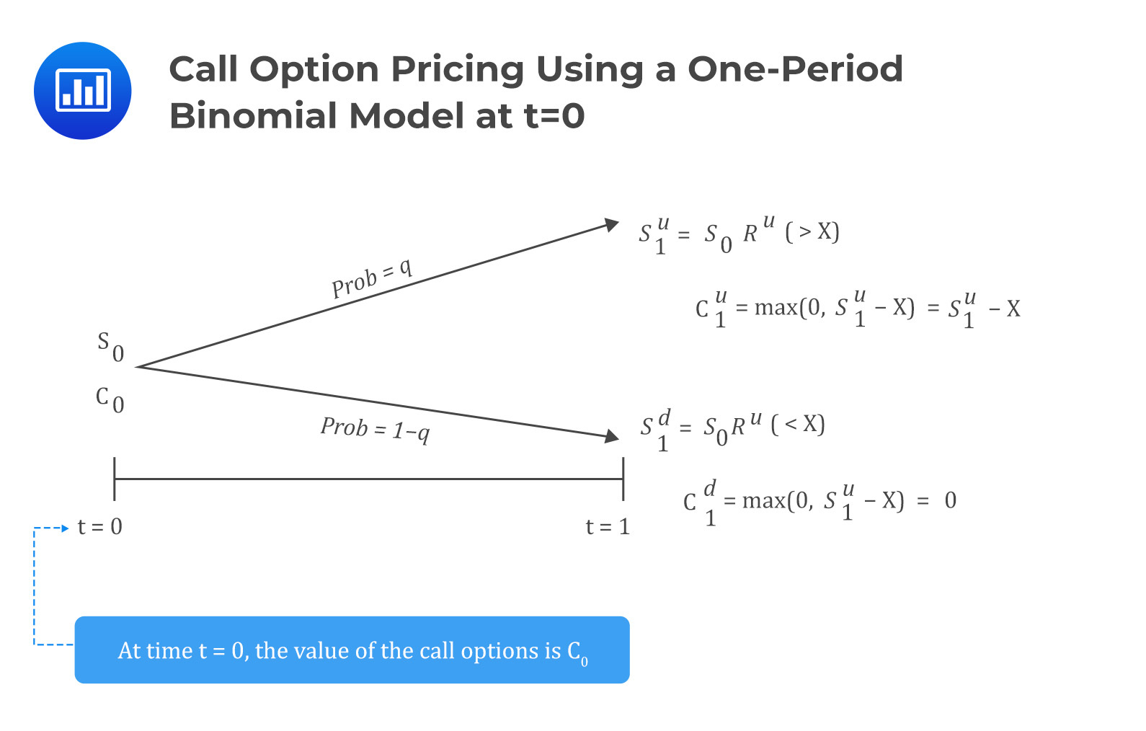
Binomial Option pricing Model
An iterative procedure, allowing for the specification of nodes, or points in time, during the time span between the valuation date and the option's expiry date.

Slide 7
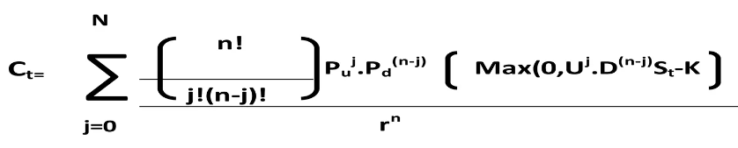
Binomial Option Pricing formula The above formula gives the present value of the expected payoffs at expiration where: Ct= Present value of call on expiration. n = total number of periods (not years) until expiration. A feature of the binomial model is that the stock can either go up or go down in each period. J = number of periods that the stock goes up. If it goes up j periods it goes down (n - j) periods. U = magnitude of upward movement. D = magnitude of downward probability Pu = Risk Neutral probability of upward movement. Pd = Risk Neutral probability of downward movement. St = Current stock price. K = Strike price r = discount factor for present value

Slide 8
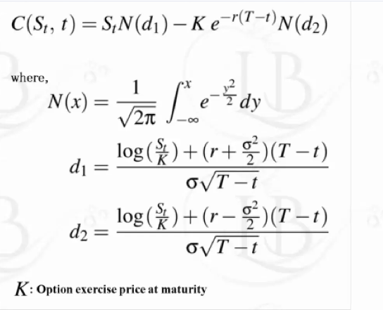
Black Scholes Model
The Black-Scholes model is a differential equation widely used to price options contracts.
The Black-Scholes model requires five input variables: the strike price of an option, the current stock price, the time to expiration, the risk-free rate, and the volatility.
The standard BSM model is only used to price European options, as it does not take into account that American options could be exercised before the expiration date.

Slide 9
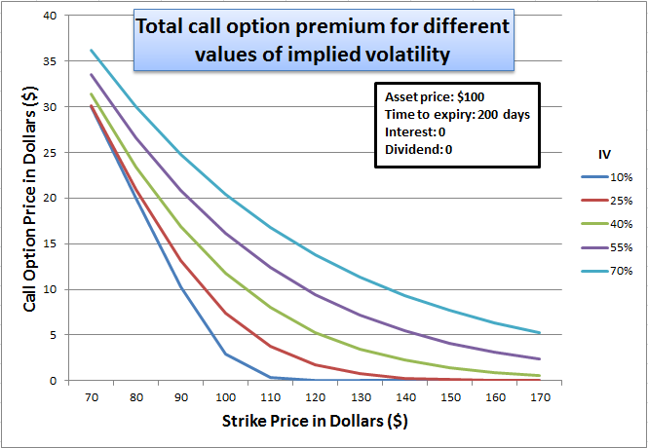
Graph
Call option price vs strike price graph
Time of expiry 1 year Interest rate 4.62 %

Slide 10
Delta Neutral Portfolio
A Delta-Neutral Portfolio evens out the response to market movements for a certain range to bring the net changes of the position to zero.
Perfectly hedged portfolio family has Family Delta =0
The delta value of a portfolio is calculated by multiplying the delta of each individual option position by the amount of contracts held.
Call options have a positive Delta between 0 and 1, while put options have a negative Delta between 0 and -1.
Delta neutral is a balanced approach to investing and can be used to delta hedge so that the account remains flat, regardless of fluctuations in the underlying markets, or to take advantage of changes in time value or volatility in an underlying asset.

Slide 11
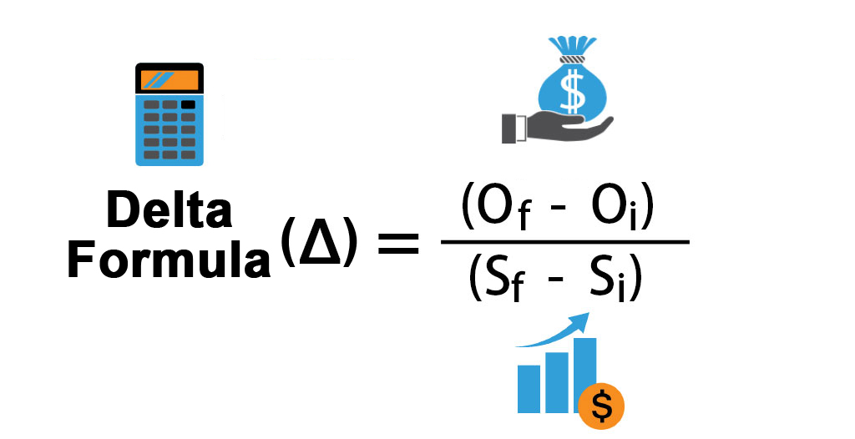
Delta: The amount an option value will change for every $1.00 change in the price of the underlying security
Gamma: The amount Delta will change for every $1.00 change in the price of the underlying security
Delta-neutral: The sum of all put, call and stock Deltas are equal to or near zero

Slide 12
Applications of Black Scholes Formula :
Option Pricing: The Black-Scholes model is primarily used for pricing European call and put options, providing a theoretical value for these derivatives based on various inputs such as the underlying asset price, strike price, time to expiration, risk-free rate, and volatility.
Risk Management: It aids in assessing and managing the risk associated with options positions in investment portfolios. Traders and investors use the model to hedge their option positions against adverse price movements in the underlying asset.
Corporate Finance: The model is utilized in corporate finance for valuing employee stock options (ESOs) and for making strategic decisions related to mergers, acquisitions, and investment projects that involve options.
Derivatives Trading: It serves as a foundation for various derivative trading strategies, such as option arbitrage and option spread trading, by providing insight into the fair value of options and potential profit opportunities.
Academic Research: The Black-Scholes model has significantly influenced academic research in finance and economics, providing a framework for studying option pricing, market efficiency, and the behavior of financial markets.

Slide 13
Limitation
Assumptions: The Black-Scholes model relies on several assumptions, including constant volatility, continuous trading, no transaction costs, and the efficient market hypothesis. These assumptions may not always hold true in real-world markets, leading to inaccuracies in pricing.
European Options Only: The model is designed specifically for European-style options, which can only be exercised at expiration. It does not accurately price American-style options, which can be exercised at any time before expiration.
Volatility Estimation: Volatility estimation is a critical input in the Black-Scholes model, and inaccuracies in volatility forecasts can lead to pricing errors. Historical volatility may not necessarily reflect future volatility, making this parameter challenging to predict accurately.
Market Frictions: Transaction costs, liquidity constraints, and market imperfections are not accounted for in the model, which can affect option prices in real-world trading environments.
Extreme Events: The Black-Scholes model assumes that asset prices follow a lognormal distribution and do not account for extreme market movements or rare events (e.g., market crashes), which can significantly impact option prices and risk management strategies.

Slide 14
THANK YOU

