Slide 1
Determining Mood from Facial Expressions
Submitted by –
Raman Shukla (181500554)
Ritika Agrawal (181500581)
Vanshika Mahle (181500781)
Vimal Mishra (181500792)
Under the Guidance of
Mrs. Gunjan Bhardwaj

Slide 2
ABOUT THE PROJECT
In this project, we use Convolution Neural Network (CNN), to classify each face based on the emotion shown in the facial expression into one of seven categories (0=Angry, 1=Disgust, 2=Fear, 3=Happy, 4=Sad, 5=Surprise, 6=Neutral).
Kaggle facial expression dataset (fer2013) with seven facial expression labels is used in this project.
Convolutional Neural Network achieve better accuracy with big data. The proposed method achieves 58.12 % accuracy and 0.68 precision on training dataset.
From the results our project it can be concluded that happiness and surprise can be easily expressed and identified than the other emotions.
Sadness, quite a common emotion, may end up being misclassified most often and the most notable ones may be anger, disgust, contempt and fear.

Slide 3
OVERVIEW AND MOTIVATION
Human facial expressions can be easily classified into 7 basic emotions: happy, sad, surprise, fear, anger, disgust, and neutral.
Image processing is the field of signal processing where both the input and output signals are images. One of the most important application of Image processing is Facial expression recognition.
Automatic recognition of facial expression plays an important role in artificial intelligence and robotics and thus it is a need of the generation.
Some application related to this include Personal identification and Access control, Videophone and Teleconferencing, Forensic application, Human-Computer Interaction, Automated Surveillance, Cosmetology and so on.
FER systems have broad applications in various areas, such as computer interactions, health-care systems and social marketing.

Slide 4
OBJECTIVE
Our aim is to develop a method of face mood detection from facial expressions that is fast, robust, reasonably simple and accurate with a relatively simple and easy to understand Machine Learning algorithms and techniques.
The key elements of face are considered for detection of face and prediction of expressions or emotions of face.
For detection and classification of different classes of facial expressions, machine learning algorithms are used by training of different set of images.

Slide 5
FACIAL EXPRESSION RECOGNITION
Facial expressions are a form of non-verbal communication that conveys emotional state of a person. The Facial Expression Recognition (FER) system is the process of identifying the emotional state of a person.
Facial Expression Recognition usually performed in four-stages consisting of pre-processing, face detection, feature extraction, and expression classification.
FER can be widely applied to various research areas, such as mental diseases diagnosis and human social/physiological interaction detection.
Also, FER systems have been developed to support real-world application scenes, instead of laboratory environments.
FER is an important and promising field of computer vision and artificial intelligence.

Slide 6
CNN
CNN is a type of neural network model which allows us to extract higher representations for the image content.
CNN takes the image’s raw pixel data, trains the model, then extracts the features automatically for better classification.
A convolution sweeps the window through images then calculates its input and filter dot product pixel values.
CNN uses max pooling to replace output with a max summary to reduce data size and processing time. This allows you to determine features that produce the highest impact and reduces the risk of overfitting.

Slide 7
DATASET
The dataset has been taken from an online source named Kaggle.com which was published on International Conference on Machine Learning (ICML) 5 years ago, to recognize the facial expression.
The data consists of 48x48 pixel grayscale images of faces.
The faces have been automatically registered so that the face is more or less centered and occupies about the same amount of space in each image.
This dataset consists of 35,887 images with various emotions 7 emotions.
Link for the dataset : https://www.kaggle.com/deadskull7/fer2013?select=fer2013.csv

Slide 8
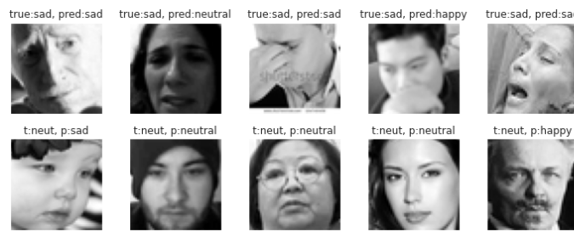
OUTCOME

Slide 9
CONCLUSION
In this project, a LeNet architecture based six layer convolution neural network is implemented to classify human facial expressions i.e. happy, sad, surprise, fear, anger, disgust, and neutral.
The system has been evaluated using Accuracy, Precision, Recall and F1-score.
The classifier achieved:
Accuracy of 58.12%
Precision of 0.68
Recall 0.67
F1-score 0.65

Slide 10
APPLICATIONS AND SCOPE
The scope of this system is to tackle with the problems that can arise in day to day life. Some of the scopes are:
The system can be used to detect and track a user’s state of mind.
The system can be used in mini-marts, shopping center to view the feedback of the customers to enhance the business.
The system can be installed at busy places like airport, railway station or bus station for detecting human faces and facial expressions of each person.
The system can also be used for educational purpose such as one can get feedback on how the student is reacting during the class.
This system can be used for lie detection amongst criminal suspects during interrogation.
This system can help people in emotion related -research to improve the processing of emotion data.

Slide 11
REFERENCES
https://www.kaggle.com/
https://github.com/
https://towardsdatascience.com/
Research Paper Link : https://s.docworkspace.com/d/AEggGVv16qUt0ezIyuSdFA
GitHub Repository Link: https://github.com/VanshikaMahle/mlproject2020

