Slide 1
DARK STORE
NETWORK INTELLIGENCE
Geospatial Optimization Analysis · Quick Commerce India · FY 2024
Blinkit
Zepto
Swiggy Instamart
501K
52
3
99.9%
Orders
Dark Stores
Cities
SLA Rate

Slide 2
THE BUSINESS PROBLEM & METHODOLOGY
01
The 10-Minute Promise
HOW THIS PROJECT WAS BUILT
Quick commerce lives or dies on delivering in under 10 minutes. Every SLA breach costs customer trust and triggers refunds.
1
Data Generation
501K synthetic orders across 3 cities using real neighbourhood coordinates + population density weights
2
Distance Mapping
02
The Placement Problem
Haversine formula computed across 501K × 52 store pairs using NumPy broadcasting
Stores too close = order cannibalization. Stores too far = SLA breach. There is no margin for imprecision in dark store placement.
3
K-Means Clustering
Optimal store placement computed with k = current store count; compared to actual positions
03
The Question
4
SQL Analysis
Are Blinkit, Zepto & Swiggy Instamart dark stores placed optimally across Bengaluru, Mumbai & Delhi NCR?
10 analytical queries - SLA breach risk, store load, zone opportunity scoring, monthly trends
5
Visualisation
Interactive Folium map + 5-chart Tableau dashboard with brand & city filters
TECH STACK · Python (NumPy · Pandas · Scikit-learn · Folium) · SQL / SQLite · Tableau Public · Jupyter Notebook

Slide 3
DATASET & SCOPE
501,000
52
3
₹18.7 Cr
Orders Analysed
Dark Stores Mapped
Cities Covered
Revenue Modelled
167K per city · Full year 2024
Blinkit · Zepto · Swiggy Instamart
Bengaluru · Mumbai · Delhi NCR
Avg order value ₹374
ORDERS DATASET
DARK STORE DATASET
→ 167,000 orders per city (Bengaluru · Mumbai · Delhi NCR)
Bengaluru
19 stores
8 Blinkit · 6 Zepto · 5 Instamart
→ Jan 2024 – Dec 2024 · realistic hourly demand weighting
Mumbai
18 stores
→ Fields: order_id · lat/lng · brand · value · timestamp
7 Blinkit · 5 Zepto · 4 Instamart
→ Values: ₹99 – ₹2,500 · log-normal distribution
Delhi NCR
15 stores
→ Generated using real ward-level neighbourhood coordinates
8 Blinkit · 5 Zepto · 4 Instamart
Source: Real store locations from Google Maps verification

Slide 4
KEY FINDINGS
What 501,000 orders revealed about quick commerce network efficiency
55.8%
CANNIBALIZATION RISK
Cannibalization Rate - Bengaluru
55.8% of Bengaluru orders fall within 2km of 2+ competing stores. Koramangala has 3 brand stores within 1.5km of each other. New stores here add cost, not coverage.
→ Recommendation: Freeze new openings in Koramangala & Bandra. Redirect investment to peripheral zones.
91%
LOCATION SENSITIVITY
Distance Increase from 500m Wrong Placement
Moving the Koramangala Blinkit store just 500m westward increases average delivery distance by 91% for its entire catchment area.
→ Recommendation: Site selection requires geospatial validation - a 'roughly right' location is not acceptable.
5 Zones
EXPANSION OPPORTUNITY
Flagged for Immediate Expansion
Greater Noida · Whitefield · Yelahanka · Thane West · Electronic City - each with 8K–15K orders/month and avg delivery distances above the network threshold.
→ Recommendation: Open next stores here. Opportunity scores 5.9–7.2.

Slide 5
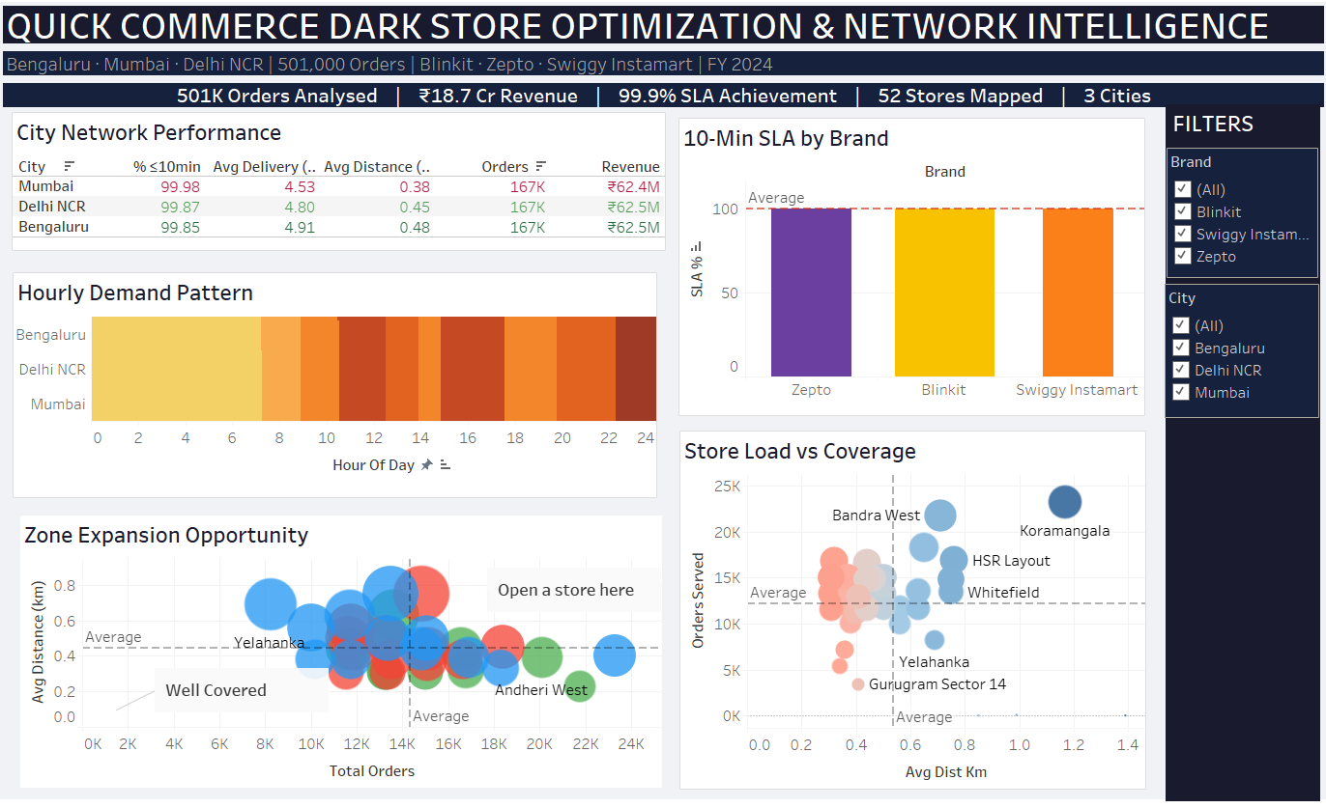
TABLEAU DASHBOARD & INTERACTIVE MAP
1
City Network KPI Table
Avg distance · delivery time · SLA % by city
2
10-Min SLA by Brand
Blinkit vs Zepto vs Swiggy Instamart comparison
3
Hourly Demand Heatmap
24-hour × 3-city order volume pattern
4
Store Load vs Coverage
Scatter: orders served vs avg delivery distance
5
Zone Expansion Opportunity
Bubble chart: demand vs coverage gap by zone
Interactive Folium Map
Project

Slide 6
RECOMMENDATIONS & BUSINESS IMPACT
What this analysis means for quick commerce expansion decisions
01
IMMEDIATE ACTION
PROJECT
IMPACT
Open stores in Greater Noida & Whitefield
Opportunity scores 7.20 & 7.13 - highest in the 3-city network. Each zone has 13K–15K orders/month with above-average delivery distances. Clear, data-backed expansion signal.
501K
Orders modelled
02
COST AVOIDANCE
₹18.7 Cr
Revenue analysed
Freeze expansion in Koramangala & Bandra
55.8% cannibalization rate in Bengaluru core. New stores here split orders without adding coverage. Redirect capex to peripheral zones for better ROI per store.
99.9%
Network SLA
03
STRATEGIC
5 Zones
Expansion targets
Implement monthly opportunity score monitoring
Peripheral zones become high-priority zones as population density grows. Rebuild this geospatial model monthly with live order data to track emerging demand pockets before competitors.
91%
Max sensitivity
0.545 km
Max gap found

