Slide 1
PROJECT TITLE
CAPSTONE PROJECT
Presented By:
Vanshika Nain
Chandigarh Engineering College, Jhanjeri, Mohali
Computer Science and Engineering

Slide 2
OUTLINE
Problem Statement
Proposed Solution
System Development Approach
Data Description
Univariate Analysis
Observations
Bivariate Analysis
Multivariate Analysis
Conclusion
Challenges

Slide 3
PROBLEM STATEMENT
In recent years, City Hotel and Resort Hotel have seen high cancellation rates. Each hotel is now dealing with a number of issues as a result, including fewer revenues and less than ideal hotel room use. Consequently, lowering cancellation rates is both hotels' primary goal in order to increase their efficiency in generating revenue, and for us to offer thorough business advice to address this problem. The analysis of hotel booking cancellations as well as other factors that have no bearing on their business and yearly revenue generation are the main topics of this report.

Slide 4
SYSTEM APPROACH
Pre-requirements: -
1.Internet Connection
2.Web browser to use Google Colab
Library required to build the Project:
1. Numpy (for mathematical calculations)
2. Pandas (for analysis and manipulation of data in data set)
3.Matplotlib ( to plot various kind of graphs)

Slide 5
DATA DESCRIPTION
Hotel:- Name of hotel ( City or Resort)
Is_canceled:- Whether the booking is canceled or not (0 for no canceled and 1 for canceled)
lead_time:- time (in days) between booking transaction and actual arrival.
stays_in_weekend_nights:- No. of weekend nights spent in a hotel
stays_in_week_nights:- No. of weeknights spent in a hotel
Meal:- Type of meal chosen
Country:- Country of origin of customers (as mentioned by them)
market_segment:- What segment via booking was made and for what purpose.
distribution_channel:- Via which medium booking was made.
is_repeated_guest:- Whether the customer has made any booking before(0 for No and 1 for Yes)
days_in_waiting_list:- No. of days on waiting list.
customer_type:- Type of customer(Transient, Group, etc.)
adr:- Average Daily Rate.
total_of_special_requests:- total no. of special request.

Slide 6
PROPOSED SOLUTION
The GDS distribution channel can be eliminated by hoteliers because bookings made through it are extremely low.
Hotels can cut costs by eliminating market segments such as complementary and aviation, as bookings through these segments are very low.
Only 3.86% of customers return to the hotel, so hotels can increase repeat bookings by offering the right repeat booking incentives.
Offer packages and promotions to promote bookings for the resort hotel.
Bookings for 3 and 8 parking spaces were rarely requested by customers, hotels can only keep bookings for 1 and 2 parking spaces to save money.
Almost 25% of customers cancelled their bookings. Hotels should implement a cancellation policy, discount on confirmed bookings, and send booking reminders to guests to reduce booking cancellations.
People typically book rooms for two people, so encourage family and group bookings to maximize revenue.

Slide 7
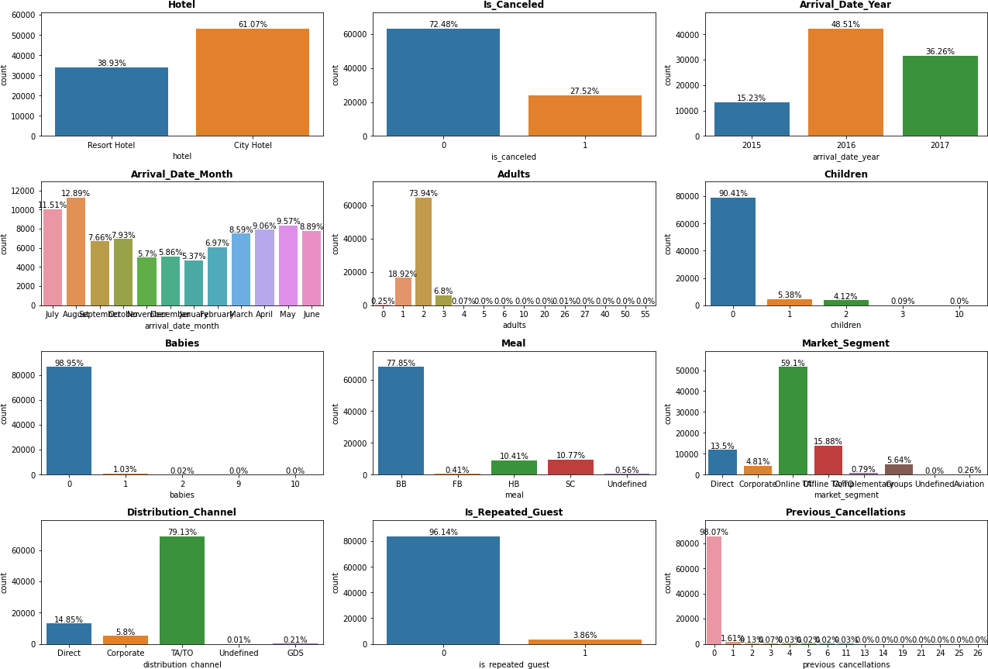
UNIVARIATE ANALYSIS

Slide 8
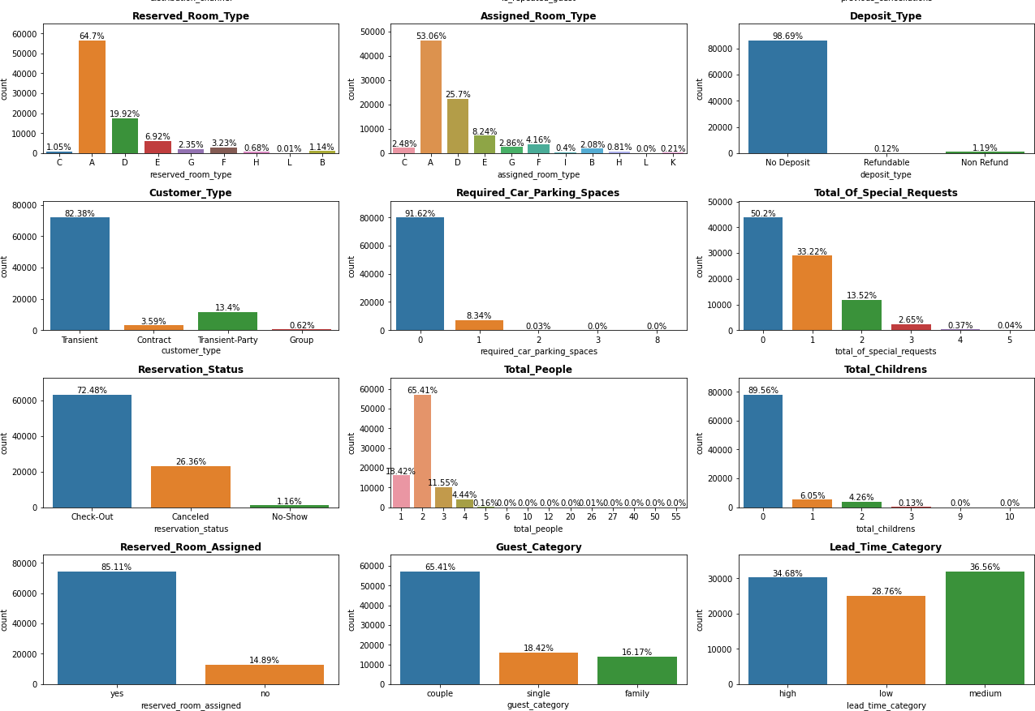
UNIVARIATE ANALYSIS(CONTD..)

Slide 9
OBSERVATIONS:
A city hotel was most preferred by 61.07 percent of customers over a resort.
72.48% of bookings are not cancelled. Almost one-third of all reservations are canceled.
Bookings increased by 33.28% in 2016 compared to 2015, but fell by 12.25% in 2017.
Customers make the most reservations in August, followed by July. Customers made the fewest reservations in November, December, and January. So we can make offers to customers in November, December, and January to maximise booking.
BB is the most requested food.
Most of the bookings are made through the online platform.
The top distribution channel is TA/TO, which is used to make most of the bookings.
The majority of hotel bookings are made by new customers. Very few customers (3.86%) visited again.
The customer's top preference is for Room A to be reserved.
Customers do not want to pay a pre-deposit for a reservation.
Most customers (80%) preferred to book a hotel for a short stay.
90% of people do not require parking spaces for their vehicles.
70% chance that bookings will not be cancelled by customers.
Reserved rooms were not assigned to 15% of customers. Ensure that customers receive
the rooms they have reserved.
Reservations were often made for two people. 10% or so of guests brought their families. Few bring their families with them. Offer family-friendly discounts to encourage reservations for family and business events.

Slide 10
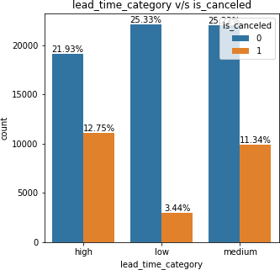
BIVARIATE ANALYSIS (CONTD..)
Question 1 : Is the high lead_time a reason for booking cancellations?
Less lead time means fewer cancellations. Customers who book hotels more than 15 days in advance are more likely to cancel their booking.
Booking cancellations are not caused by a
longer Lead time.

Slide 11
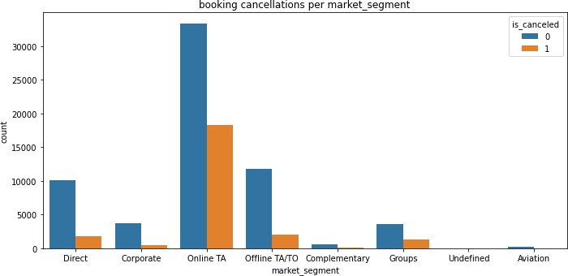
BIVARIATE ANALYSIS (CONTD..)
Question 2 : Which market segment is most used for booking hotels, and which market segment bookings are most canceled?
The majority of hotel reservations are made online, as are the majority of cancellations of reservations made by customers who made their reservations online.

Slide 12
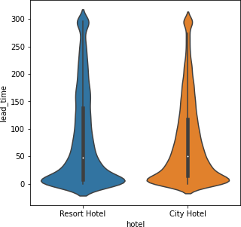
BIVARIATE ANALYSIS (CONTD..)
Question 3: Which hotel type has the most advanced reservations?
In comparison to city hotels, guests book resort hotels a little bit in advance.

Slide 13
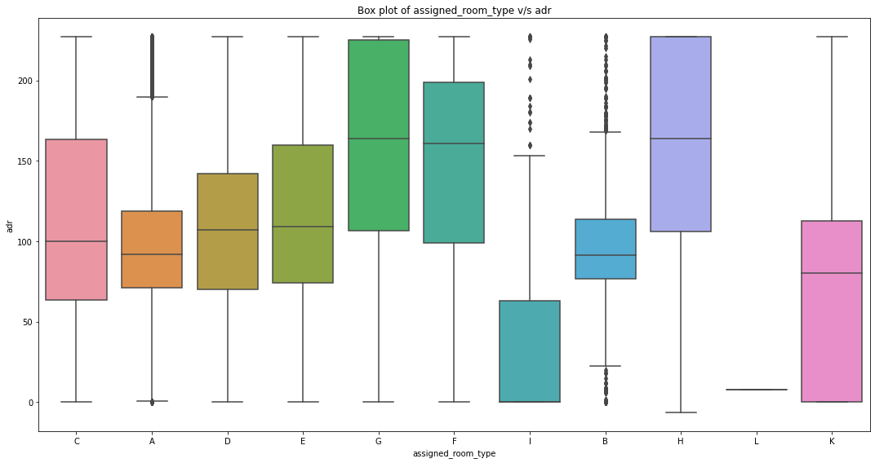
BIVARIATE ANALYSIS (CONTD..)
Question 4 : Which room generates a higher ADR?
Room types G, followed by H, generate high ADR. Room I has a very low ADR. The most popular room is A, but it has a lower ADR than other room types that are less popular with customers for bookings.
To maximize revenue, the hotel should increase the number of rooms in A, G and H.

Slide 14
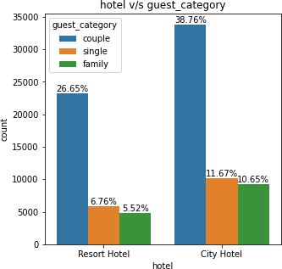
BIVARIATE ANALYSIS (CONTD..)
Question 5: How many people are reservations made for?
Most customers book hotels for two people (couples). Customers prefer city hotels over resorts for family bookings.
A city hotel is preferred when booking for a single person.

Slide 15
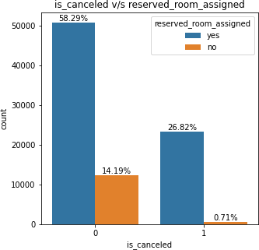
BIVARIATE ANALYSIS
Question 6: Is not having a reserved room assigned a reason for booking cancellations?
The inability to assign a reserved room to a customer is not grounds for cancellation.
Less than 1% of people who cancelled their booking when the reserved room was not assigned.

Slide 16
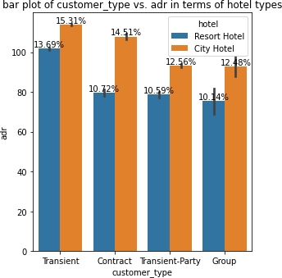
BIVARIATE ANALYSIS (CONTD..)
Question 7 : Which customer type generates more revenue in terms of hotel types and customer types?
City hotels generate more revenue (54.86%) than resort hotels (45.14%).
Transient customers who book rooms for a short period of time generate more revenue than other types of customers.

Slide 17
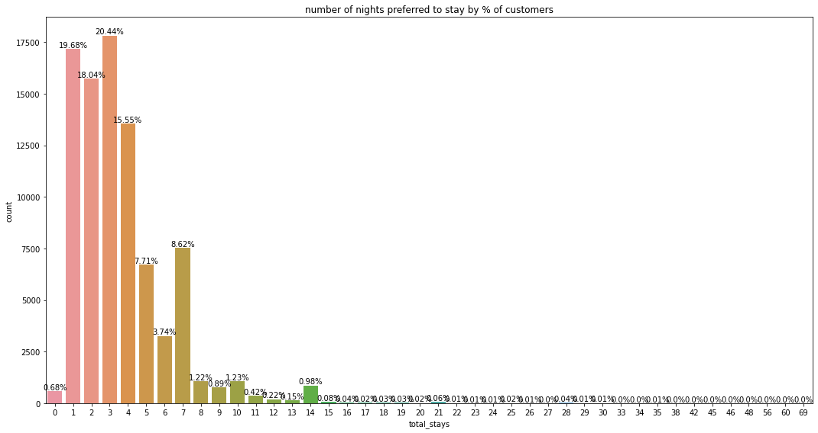
BIVARIATE ANALYSIS (CONTD..)
Question 8 : What is the most common number of nights booked by customers?
The majority of the guests are staying at the hotel for three nights. Customers who book hotels for more than one week are very rare. Most hotel bookings are for less than 7 nights.
The hotel should pay more attention to keeping reservations available for less than 7 nights to not lose customers and to generate more revenue.

Slide 18
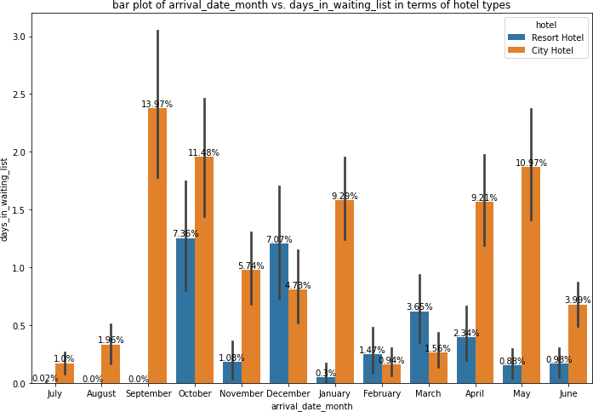
BIVARIATE ANALYSIS (CONTD..)
Question 9: Which month is the busiest for hotels?
Customers prefer city hotels over resort hotels for the New Year. The city hotel is busiest in October and September , which means that this month has the most bookings.
In the fourth quarter of the year, in December, resorts are busier than city hotels. Resort hotels are significantly less busy in the third quarter of the year than they are throughout the year.
In July there is no longer waiting period for bookings.

Slide 19
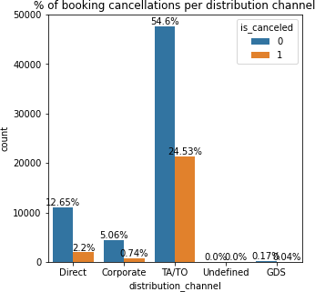
BIVARIATE ANALYSIS (CONTD..)
Question 10: Which distribution channels have the most cancellations of bookings?
The majority of canceled bookings were made through the TA/TO distribution channel.
Bookings made through the Direct, Corporate, and GDS distribution channels are extremely unlikely to be canceled.

Slide 20
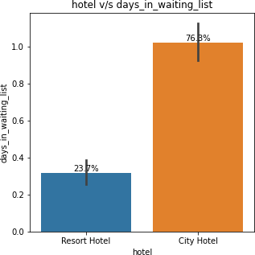
BIVARIATE ANALYSIS (CONTD..)
Question 11 : Which hotel type is the busiest?
A city hotel is busier than a resort.

Slide 21
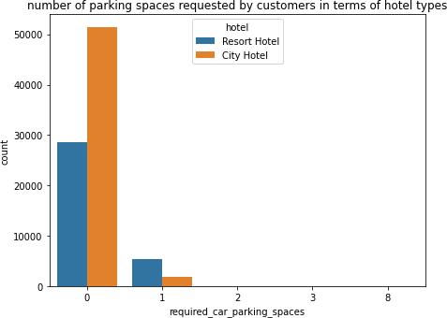
BIVARIATE ANALYSIS (CONTD..)
Question 12 : In terms of hotel types, how many parking spaces are most frequently requested by customers?
Most of the customers (91.63%) did not request any parking spaces. Only a few customers (8.31%) requested parking.
One parking space is most desirable to
customers.
The hotel can eliminate parking spaces 3 and 8 and concentrate on parking spaces 1 and 2, which will reduce the cost of providing parking spaces.

Slide 22
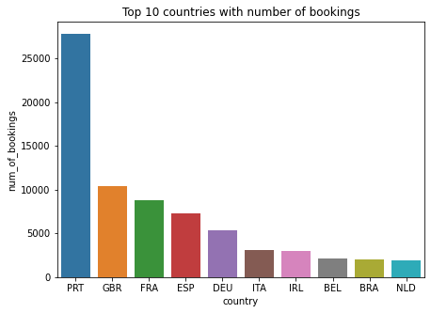
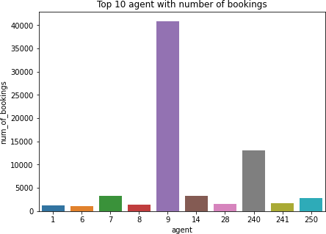
BIVARIATE ANALYSIS (CONTD..)
Question 13 : Which country makes the most reservations, and which agent makes the most bookings?
The majority of reservations are made through country PRT. Customers make the most bookings in the following top 5 countries: PRT, GBR, FRA, ESP, and DEU.
Agent number 9 made most number of bookings. 9, 240, 7, 14 and 250 are the
top 5 agents by number of bookings made.

Slide 23
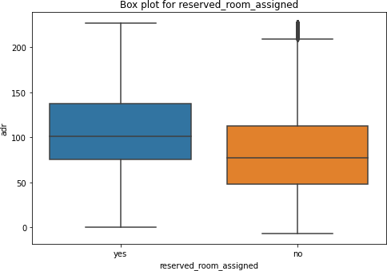
BIVARIATE ANALYSIS (CONTD..)
Question 14 : Is the ADR affected by the hotel not giving a reserved room?
There is no significant difference in ADR between reserved rooms assigned and not reserved rooms assigned.
Not assigning a reserved room does not affect ADR.

Slide 24
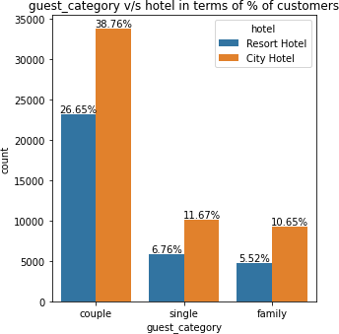
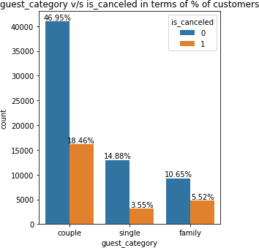
BIVARIATE ANALYSIS (CONTD..)
Question 15: The majority of bookings were made for how many people, and the majority of cancellations of bookings were made for how many people?
The majority of hotel reservations are made for couples. Couples' reservations are more likely to be canceled than singles' or families' reservations.
Bookings for single people are rarely canceled

Slide 25
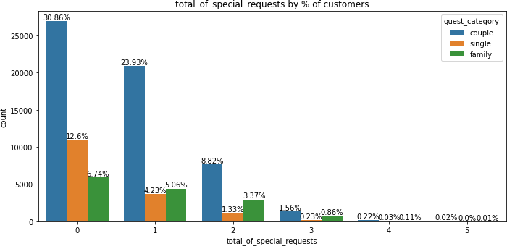
BIVARIATE ANALYSIS (CONTD..)
Question 16 : What is the most common number of special requests made by customers, and what kind of customer are they?
Approximately half of all customers do not make special requests. Customers frequently make one special request.
Couples make the majority of special requests.
Bookings made for single people are not more requested for special requests than those made for couples, followed by family and business events.

Slide 26
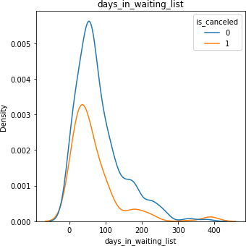
BIVARIATE ANALYSIS (CONTD..)
Question 17 : Does a longer waiting period cause the cancellation of bookings?
The majority of canceled bookings have a waiting period of less than 150 days, but those that are not canceled bookings by customers have a waiting period of less than 150 days, which has a higher density than the canceled bookings.
So a longer waiting period is not a reason
for booking cancellation.

Slide 27
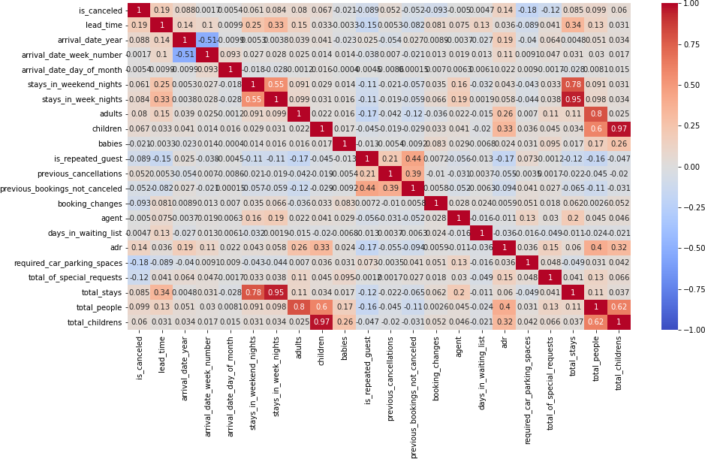
MULTIVARIATE ANALYSIS
1] CORRELATION HEATMAP

Slide 28
MULTIVARIATE ANALYSIS CONTD..
1] CORRELATION HEATMAP CONTD..
In the heatmap, we see some high correlation between a few variables because we created new variables total_stays, total_people, and total_children from existing variables and did not drop old variables.
The variables lead_time and is_canceled have weak relationships. The most likely reason for cancellation is a longer lead time.

Slide 29
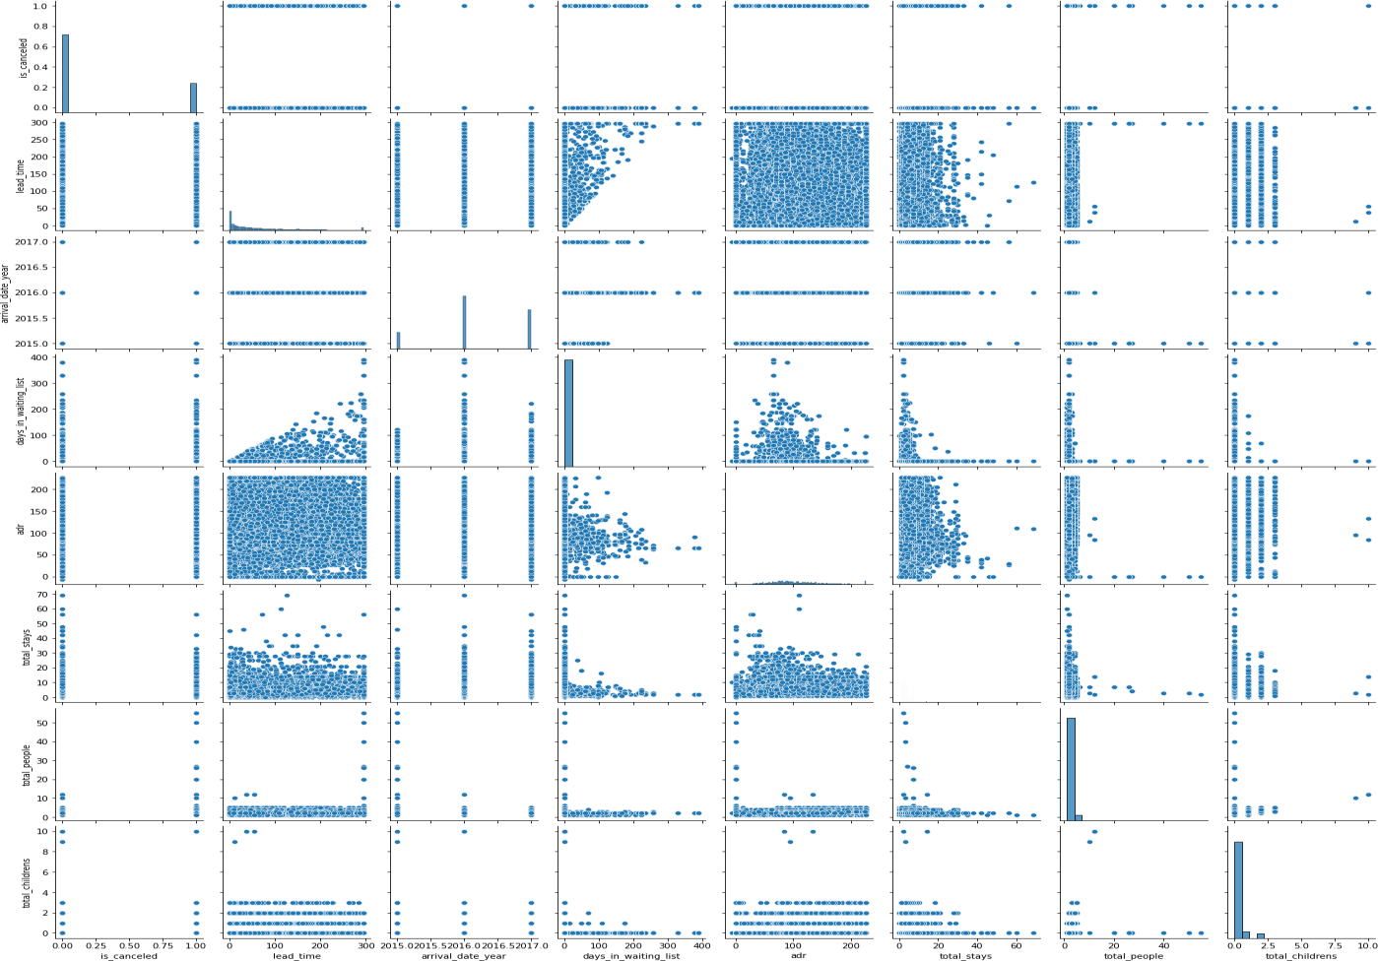
MULTIVARIATE ANALYSIS (CONTD..)
2] PAIR PLOT

Slide 30
MULTIVARIATE ANALYSIS (CONTD..)
2] PAIR PLOT (CONTD..)
We can conclude from the relationship between lead_time and is_canceled that a longer lead time does not result in cancellations.
We can conclude from the lead_time and arrival_date_year graphs that people were consistently interested in booking rooms in advance in 2015, 2016, and 2017.
According to the graph of arrival_date_year and days_in_waiting_list, 2016 had the
longest waiting period for room bookings.
We can conclude from the graph of ADR and days_in_waiting_list that a short minimum waiting period for bookings results in a high ADR.
From the graph of "is_canceled" and "days_in_waiting_list," we conclude that waiting
for bookings is not a reason for booking cancellation.

Slide 31
CONCLUSION
The top country with the most number of bookings is PRT, and the number one agent with
the most number of bookings is 9.
Customers favored city hotels more than resort hotels by a margin of 61.07 percent.
One of the four reservations is canceled.
The most popular food is BB.
The Online (internet) platform is used to make the majority of bookings.
The majority of the bookings are made using TA/TO, the leading distribution channel.
The vast majority of hotel bookings are made by new guests. Almost no consumers (3.86%) returned.
The customer wants Room A to be reserved the most.
Customers do not wish to make a bookings with a pre-deposit.
Customers (80%) favored making a hotel reservation for a short visit.

Slide 32
CONCLUSION
Only 10% of people require space to park their cars.
Most visitors are couples.
The inability to assign a reserved room to a customer is not grounds for cancellation.
Booking cancellations are not caused by a longer Lead time.
A city hotel is busier than a resort.
The busiest months for hotels are October and September. There isn't a
lengthy wait for reservations in July.
Not assigning a reserved room does not affect ADR.

Slide 33
CHALLENGES
The data contained a large number of duplicates.
The improper data type format was used for the data.
It was challenging to select the best visualization techniques.
The dataset contained a large number of null values.

Slide 34
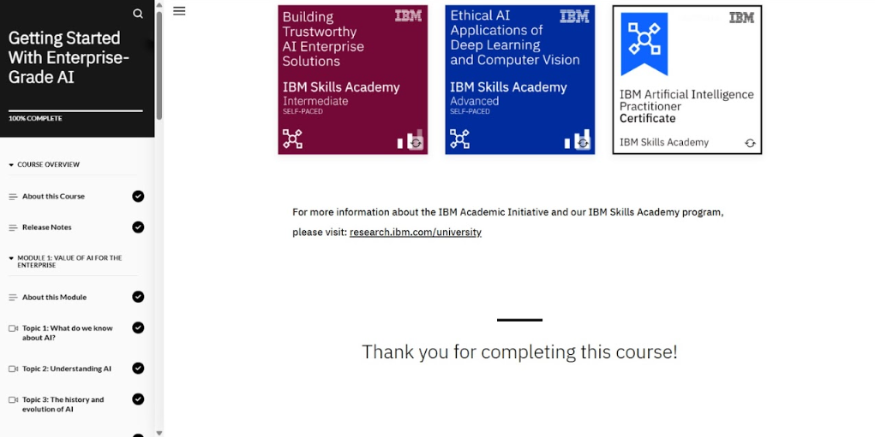
Certificate 1 ( Grade. A.I.)

Slide 35
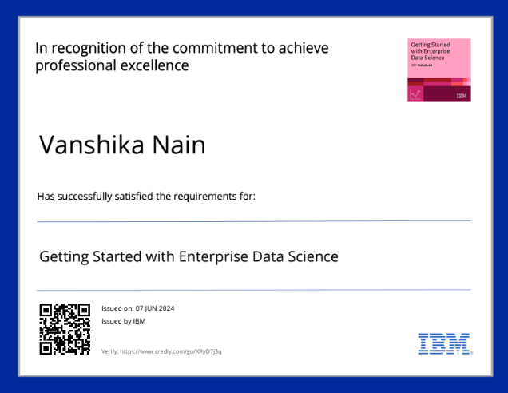
Certificate 2 ( Data Science)

Slide 36
THANK YOU

