Slide 1
Employee Data Analysis using Excel
STUDENT NAME: VANSHIKHAA. S
REGISTER NO : 312204640,78B06349EDF1E61A02F4F3B369E7EC0F
DEPARTMENT : COMMERCE
COLLEGE : K.C.S KASI NADAR COLLEGE OF ARTS & SCIENCE

Slide 2
PROJECT TITLE
Employee Expenditure And Savings Analysis

Slide 3


AGENDA
Problem Statement
Project Overview
End Users
Our Solution and Proposition
Dataset Description
Modelling Approach
Results and Discussion
Conclusion
3/21/2024 Annual Review

Slide 4

PROBLEM STATEMENT
To analyze the monthly expenditure and savings of employees, identify trends, and provide insights that can help improve financial management and planning within the organization.

Slide 5

PROJECT OVERVIEW
The goal of this project is to analyze employee expenditure and savings patterns using data in Excel. This analysis will help in understanding the spending behavior of employees, identifying trends, and providing insights into savings habits
Tables
Slicers
Pivot chart ( line chart, pie chart, bar chart)
Sum formulas

Slide 6

WHO ARE THE END USERS?
Human Resources (HR) Department
Finance Department
Executive Management
Employee Relations/Engagement Team
Financial Advisors or Consultants
Corporate Social Responsibility (CSR) Teams

Slide 7

Our Solution and It’s Value proposition
Comprehensive Data Management Advanced Analytical Tools Formulas and Functions Pivot Tables Visual Representation Used to analyse different situation

Slide 8
Dataset Description
Data Overview :
To create an overview for an employee expenditure and savings analysis in Excel, you should organize your data in a way that is easy to understand and analyze.
Data fields :
Employee Name
Gender
Age
Salary
Expenditure
Savings

Slide 9
MODELLING
Data cleaning .
Creating table.
Creating pivot chart .
Creating dashboard .
Inserting pivot chart in dashboard .
Inserting formulas in dashboard to make interaction .
Creating interactive dashboard by putting all together elements.
9

Slide 10
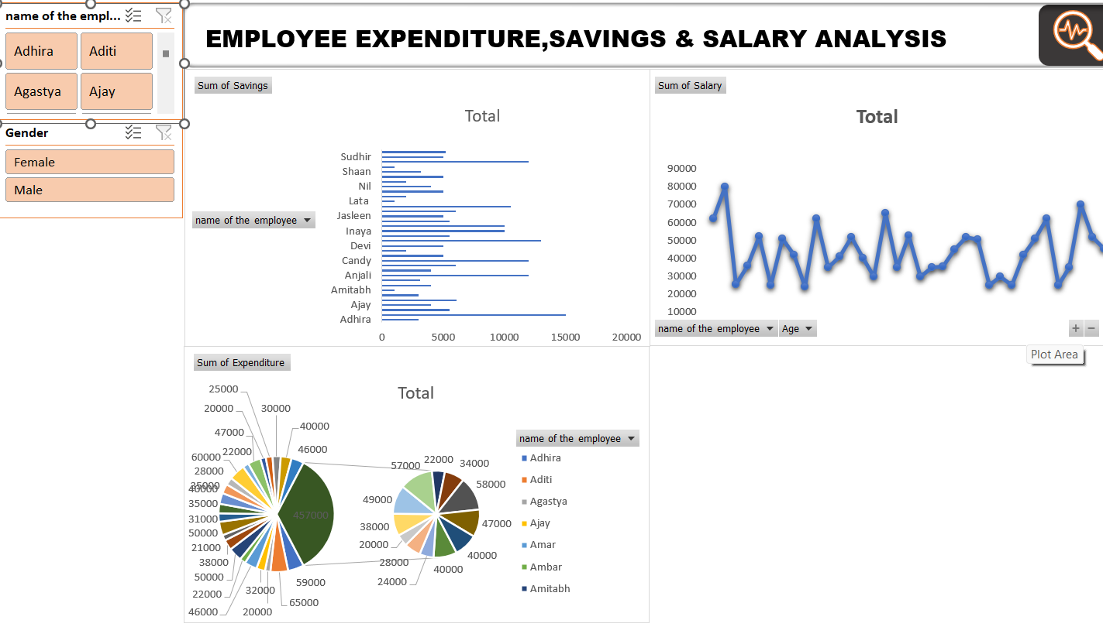
RESULTS
(Click to open file)
10

Slide 11
conclusion
The analysis of employee expenditures and savings using Excel provided valuable insights into the financial habits and overall financial health of our workforce. I identified the major categories where employees spend the most, This helps in understanding the financial burden or potential areas where employees might be overextending. The analysis revealed the average savings rate across different income brackets.

