Slide 1
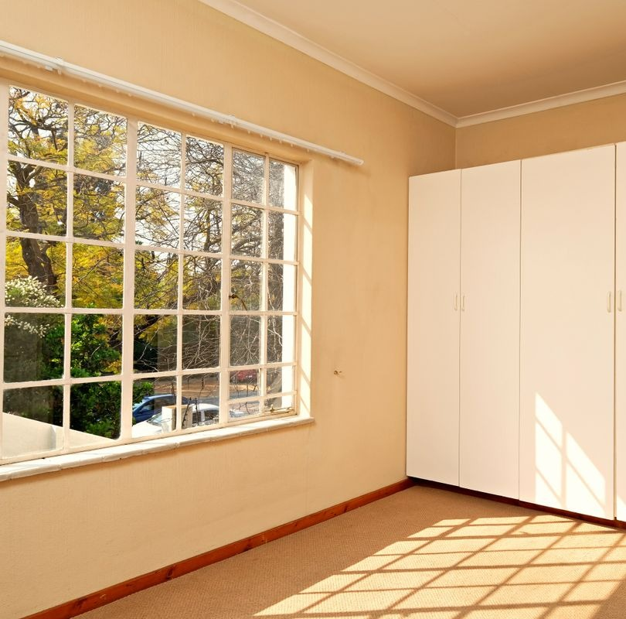

NIVORA
THE RENTAL LIVING ECOSYSTEM
Your next chapter starts at home.
Notes:
MAIN POINT: Introduce NIVORA and the one idea behind it: finding a place to live should feel connected, convenient and trustworthy.
SCRIPT (0:20):
Good morning, everyone. This is NIVORA, the rental living ecosystem.
Our idea is simple. Finding a place to live should feel connected, convenient and trustworthy. Right now it often doesn't.
In the next few minutes we'll show you the problem, the people we're starting with, what we've already built, and how we plan to turn it into a real service.
TRANSITION: Let's start with what renting actually feels like today.
CAVEAT — DO NOT OVERLOOK: Introduce the team only by details the team has confirmed. Don't use a team name, competition name or affiliation that hasn't been confirmed. The cover photo is an illustrative stock image (Pexels), not a NIVORA property.

Slide 2





Renting a home shouldn’t feel like solving a puzzle
THE PROBLEM
Finding a home is only the beginning. Renters often piece together information, checks and conversations across separate channels.
WHY IT MATTERS
2.17 crore
Search
Options are spread across portals, brokers, groups and word of mouth
urban households lived in rented homes
Compare
Location, budget and fit are judged from details that don’t line up
India · Census 2011
Verify
It’s hard to tell what, if anything, has actually been checked
71%
Coordinate
Calls, visits and follow-ups run through different channels
of renting households had no written rental agreement
India · NSSO data
Move
Agreement, deposit and move-in are handled separately again
Both figures as cited in Knight Frank & Khaitan & Co., “Institutionalising the Rental Housing Market in India” (2019). National figures, not Jaipur-specific.
Notes:
MAIN POINT: The problem isn't only finding a property. It's a chain of related decisions with no connected experience.
SCRIPT (0:45):
Picture a student arriving in a new city for college, or someone starting a new job.
Finding a home isn't one task. They search across portals, brokers, groups and word of mouth. They compare places whose details don't line up. They try to work out whether a listing is genuine. They arrange calls and visits on separate channels. Then come the agreement, the deposit and the move.
Every step happens somewhere else.
This is not a niche situation. The 2011 Census counted about 2.17 crore urban households living in rented homes. And NSSO data, cited in a 2019 Knight Frank and Khaitan & Co. report, found that 71 percent of renting households had no written agreement. Much of renting in India is still informal.
So the problem isn't just finding a property. It's getting through a whole set of decisions without one connected experience.
TRANSITION: So who feels this most, and where do we start?
CAVEAT — DO NOT OVERLOOK: The five stages describe the problem as we frame it. They are not survey findings. Both figures are national and dated (Census 2011, and NSSO data quoted in a 2019 report), so don't present them as Jaipur figures or current numbers. The 71 percent figure is about written agreements, not scams or fraud. Don't add statistics about scams, broker fees or time wasted.

Slide 3
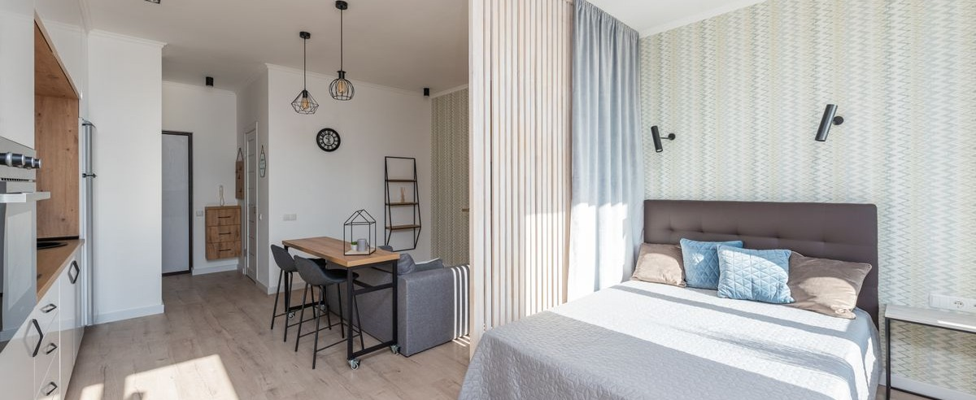
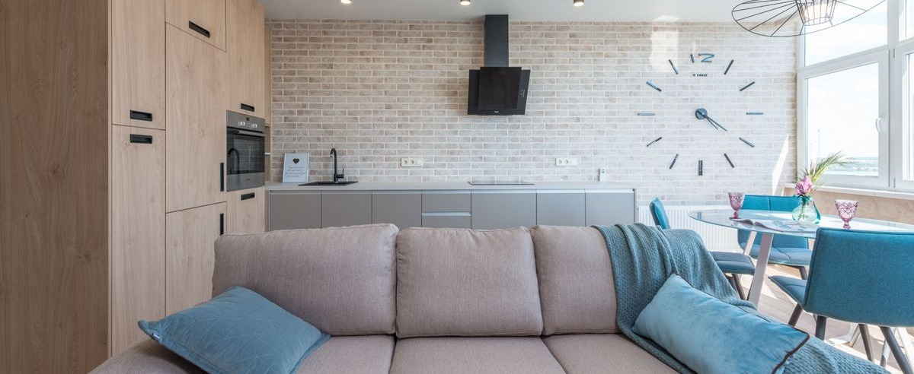


Built around the people who need a place to belong
WHO WE SERVE FIRST
Illustrative photo
Illustrative photo
Students
Working professionals
Looking for a room or flat near a college or university, balancing distance, budget, room type and everyday convenience.
Looking for a home within practical reach of the workplace, balancing location, budget and living requirements.
SEARCH ANCHOR · CAMPUS
SEARCH ANCHOR · WORKPLACE
SHARED NEEDS
Location fit
Budget fit
Suitable living preferences
Confidence in the listing
Proposed starting point: focused rental discovery around selected Jaipur college and office clusters. A launch strategy to test, not a proven demand result.
Notes:
MAIN POINT: We start with a focused audience whose search is tied to a specific place: students and working professionals.
SCRIPT (0:40):
We're not building for everyone on day one.
We start with two groups. Students, who need a place near their college or university and have to balance distance, budget, room type and everyday convenience. And working professionals, who want a home within practical reach of their workplace.
Both share the same core needs: the right location, the right budget, living preferences that suit them, and confidence that the listing is real.
Property owners are the other side of the platform. Every renter's journey depends on them, and we'll come to them in the business model.
Our proposed starting point is focused rental discovery around selected college and office clusters in Jaipur.
TRANSITION: Here's how NIVORA brings that journey together.
CAVEAT — DO NOT OVERLOOK: Jaipur is a proposed launch strategy, not proven demand. We have no user research, survey or interview results yet, so don't quote any. The photos are illustrative stock interiors, not real users or NIVORA listings. Expanding to other segments depends on validating this first use case.

Slide 4
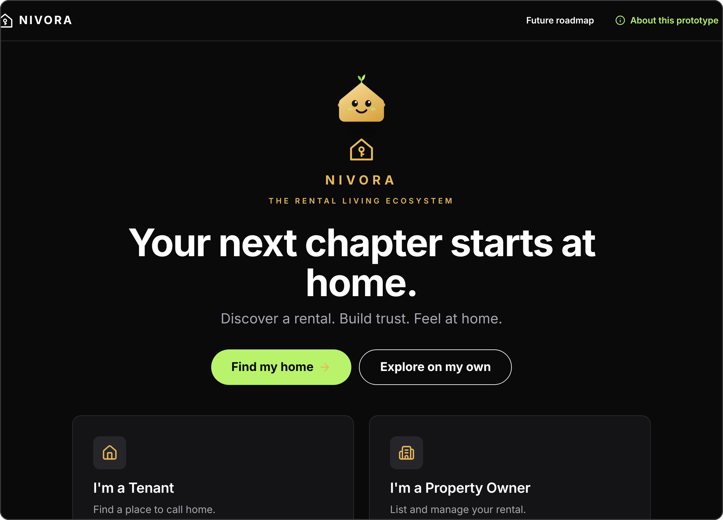



One connected experience for the rental journey
THE SOLUTION
DISCOVER
Explore rentals around a college, workplace or area, by radius, budget and preferences.
IN PROTOTYPE · DEMO HOMES
MAKE INFORMED CHOICES
See listing details and four separate trust checks, so it’s clear what has and hasn’t been checked.
IN PROTOTYPE · DEMO LABELS
CONNECT THE JOURNEY
Tenant and owner already share visit requests. Agreements and payments come only once built.
PARTLY IN PROTOTYPE · REST PLANNED
Being built beyond a directory of listings, toward a connected rental-living experience.
Actual prototype interface: the welcome screen
Notes:
MAIN POINT: NIVORA is designed as one connected experience, not just another directory of listings.
SCRIPT (0:40):
NIVORA brings the important parts of the rental journey into one experience. We think about it in three parts.
Discover: you search around a place that matters to you, such as a college or a workplace, within a radius you choose, and filter by budget and preferences.
Make informed choices: each listing shows its details and four separate trust checks, so you can see what has been checked and what hasn't.
Connect the journey: the tenant and owner views already share the same visit requests. Agreements, payments and move-in support will come only as we actually build them.
This is the welcome screen of our working prototype.
TRANSITION: Rather than describe it, let me show you the experience.
CAVEAT — DO NOT OVERLOOK: Be clear about what exists now and what doesn't. Discovery and trust labels run on fictional demo data. No real verification, payments, agreements or production backend exist. The screenshot is the real prototype interface.

Slide 5
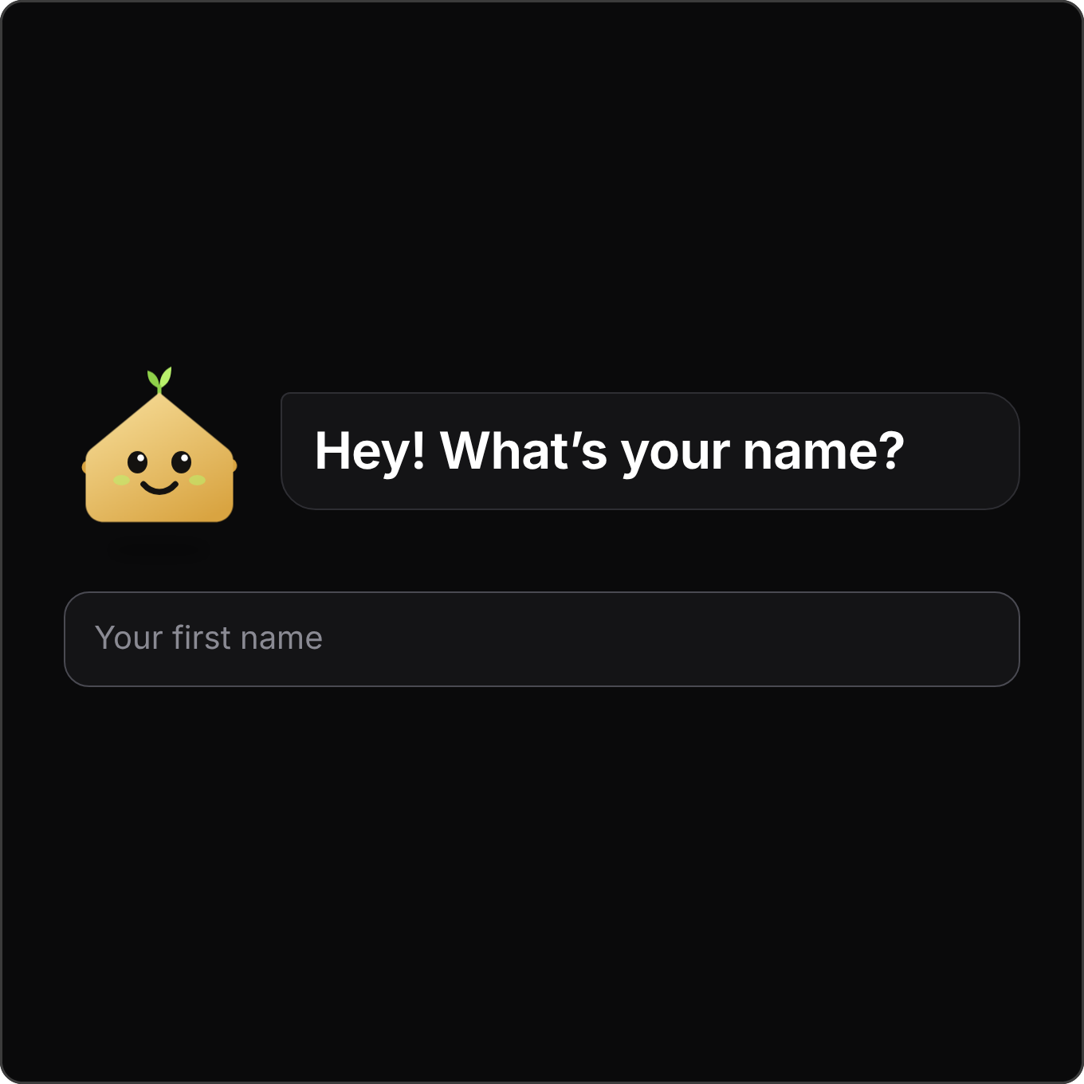
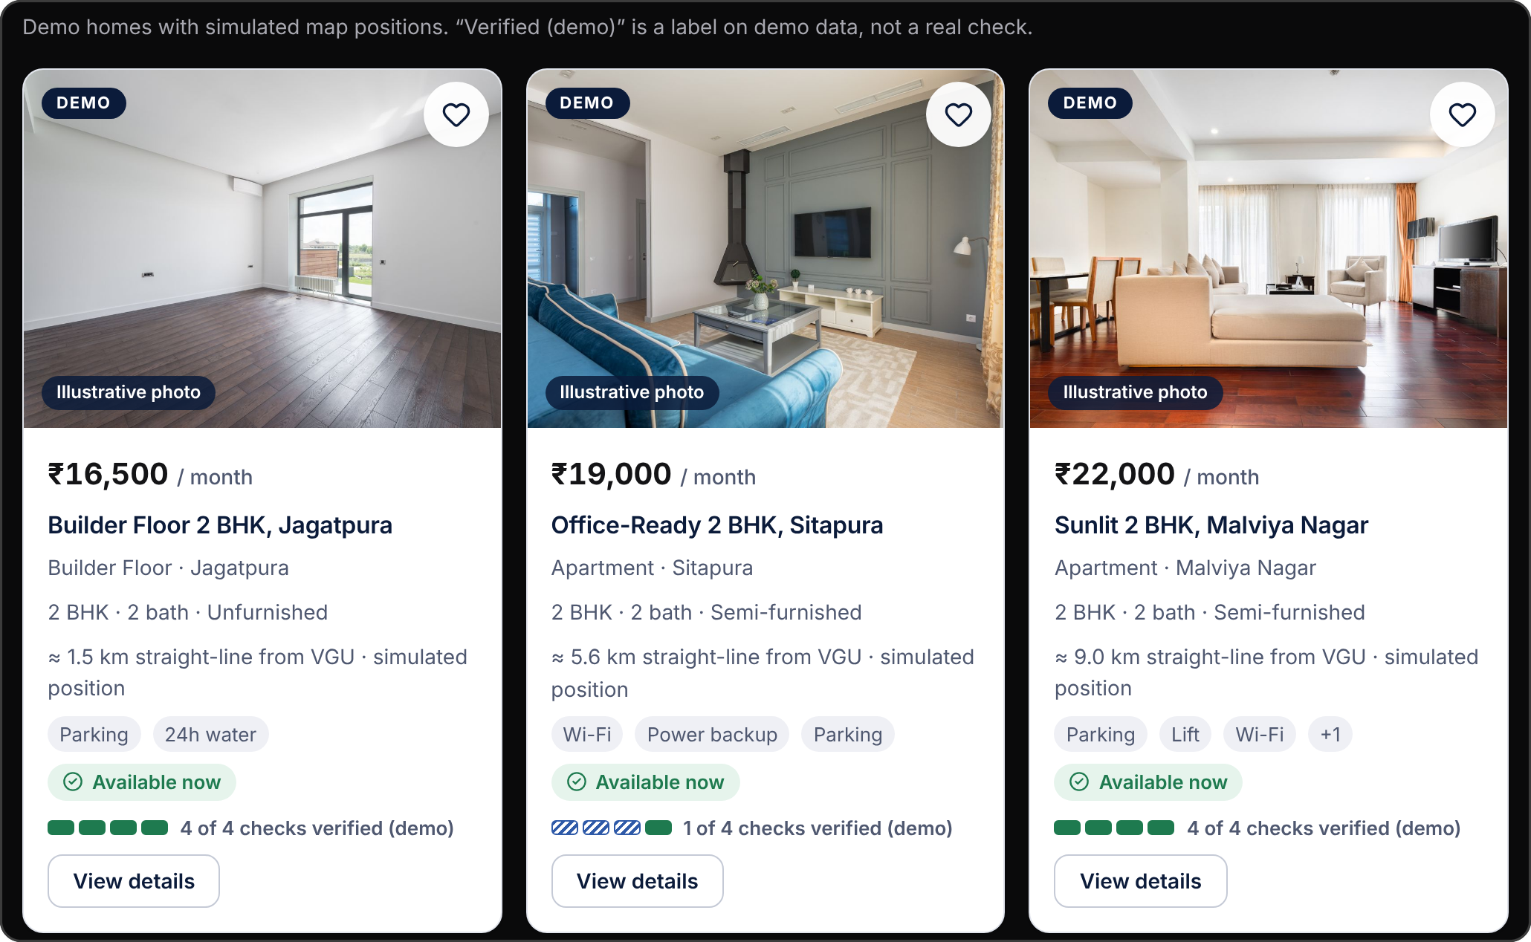
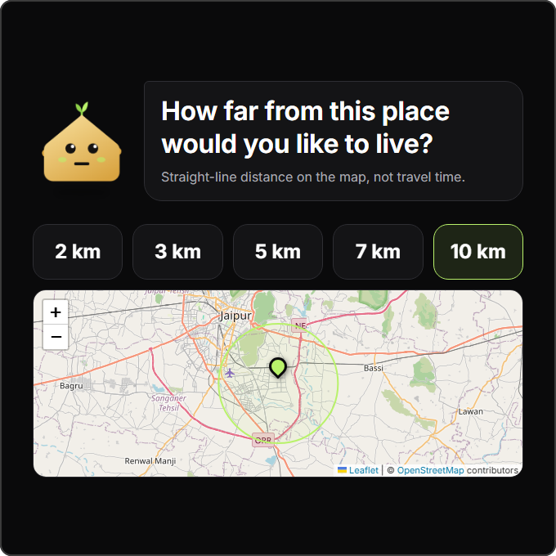
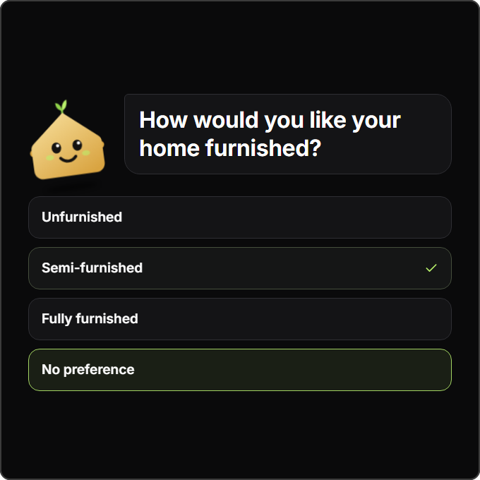
A more guided way to find your next home
THE PRODUCT
01
Meet Nivi
A guide that asks one question at a time
02
Choose a place and a radius
A college or office, then 2–10 km straight-line
03
Share preferences
Furnishing, budget, home type, rooms, must-haves
04 Explore matching homes, then open one to review it
PROTOTYPE DEMO · ILLUSTRATIVE LISTINGS · SIMULATED POSITIONS
Notes:
MAIN POINT: The working prototype makes the experience tangible: a guided, location-led search from first question to matching homes.
SCRIPT (0:50):
This is the prototype as it runs today.
First, you meet Nivi, our guide. She asks one question at a time, starting with your name.
Next, you choose where to search around. In this demo it's Vivekananda Global University, which we use as a test destination. Then you set a radius from 2 to 10 kilometres. It's straight-line distance on the map, and we say so on screen.
Then you share preferences: furnishing, budget, home type, bedrooms and must-haves.
Finally, you see the matching homes. Each card shows the distance from your destination and how many checks it has, and you can open any home to see its details and request a visit.
Every listing here is demonstration data, and we label it that way inside the product.
TRANSITION: That brings us to what we think makes NIVORA different, and to trust.
CAVEAT — DO NOT OVERLOOK: Listings, prices and owners are fictional. Map positions are simulated. Photos are illustrative stock images (Pexels), not the actual homes. Distances are straight-line, not travel time. VGU is a test destination at an approximate location, with no affiliation or endorsement. Don't call these results live availability. The radius and place screenshots come from the project's evidence folder (10 Oct 2026). The results screenshot was captured from the demo build on 12 Oct 2026 and cropped to the listing cards, because map tiles couldn't load in that environment.

Slide 6
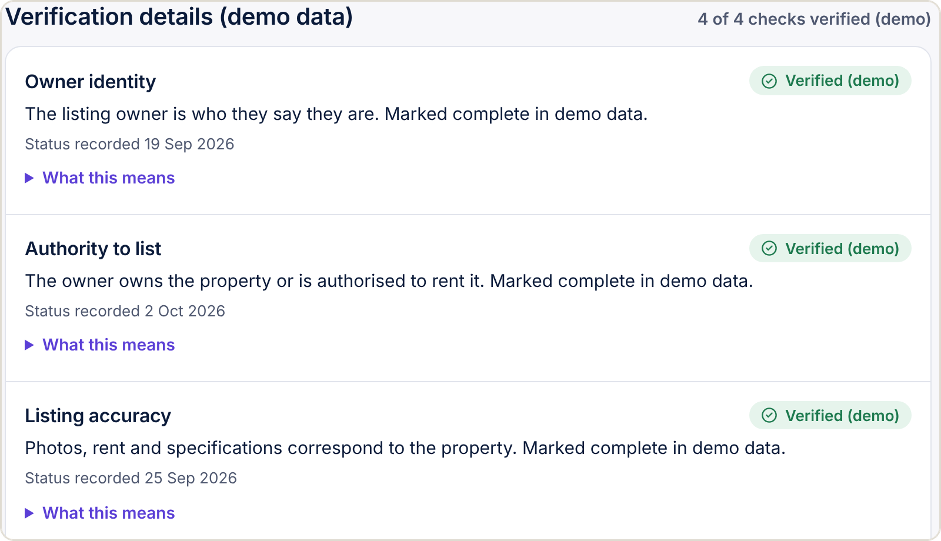

More than listings. A trust-aware rental experience
TRUST & DIFFERENTIATION
LOCATION-RELEVANT DISCOVERY
Search around a meaningful destination, such as a college or workplace, with a radius and personal preferences.
IN PROTOTYPE · ONE TEST DESTINATION
TRUST-CENTRED DESIGN
Four separate checks (owner identity, authority to list, listing accuracy, availability) instead of one vague badge.
DEMO IN PROTOTYPE · REAL CHECKS PLANNED
A CONNECTED RENTAL JOURNEY
Prototype screen: four separate checks, labelled (demo). Nothing is really verified.
Discovery, visit requests and owner follow-up in one shared flow, extended only as later stages become real.
WHAT A REAL CHECK WOULD REQUIRE
PARTLY IN PROTOTYPE · LIFECYCLE PLANNED
Defined procedures · supporting evidence · transparency for renters · clear ownership of the process
Notes:
MAIN POINT: Our difference is a strategy: location-relevant discovery, trust that is itemised and honest, and a journey that stays connected.
SCRIPT (0:45):
Where's the difference?
First, discovery starts from a place that matters to you, such as your college or office, not just a city name.
Second, trust is built in. A single 'verified' tick can hide a lot, so we split trust into four checks: who the owner is, whether they can rent the home, whether the listing is accurate, and whether it's still available. Each one shows its status separately.
To be clear, in the prototype these are demo labels. A real system would need defined checks, supporting evidence, transparency for renters, and someone accountable for the process. That is part of our roadmap.
Third, discovery, visit requests and owner follow-up already sit in one shared flow, and we'll extend it only as each stage becomes real.
TRANSITION: So how does this become a business?
CAVEAT — DO NOT OVERLOOK: We make no claims about what competitors lack. Present this as our strategy, not as superiority. Verification is simulated: nothing about a real person or property has been checked. Location search has one founder-designated test destination, and the wider location verification work isn't complete.

Slide 7


Creating value for both sides of the rental market
BUSINESS MODEL · PROPOSED
Tenants
Property owners
NIVORA
Relevant homes near the places that matter, clearer information and a guided search
Suitable enquiries, organised listings and visit requests in one place
connects both sides
REVENUE STREAM 1
REVENUE STREAM 2
Transaction-linked fee
Optional owner tools
A clearly disclosed fee tied to a completed rental, only if it proves legally appropriate and workable in practice.
Paid conveniences such as listing management or rent and maintenance tracking, only where owners see real value.
Validate before pricing: willingness to pay · unit economics · acquisition cost · cost of delivering verification. No prices or revenue are claimed.
Notes:
MAIN POINT: A proposed two-sided model with two possible revenue streams. It's a hypothesis to validate, not current revenue.
SCRIPT (0:40):
NIVORA sits between two groups. Tenants get relevant homes, clearer information and a guided journey. Owners get suitable enquiries and an organised way to manage listings.
We see two possible revenue streams.
One is a clearly disclosed fee linked to a completed rental, but only if it turns out to be legally appropriate and workable in practice.
The other is optional paid tools for owners, such as listing management or rent and maintenance tracking, but only where owners see genuine value.
We haven't set prices. Before we do, we need evidence on willingness to pay, unit economics, the cost of acquiring users, and the real cost of delivering verification.
TRANSITION: Which brings us to where we start, and how we earn the right to grow.
CAVEAT — DO NOT OVERLOOK: No pricing, take rate, revenue, projections or customer numbers exist, so don't give any. Rent and maintenance tracking exist in the prototype only as local demo records. Any fee model must be checked against applicable law and regulations.

Slide 8
Start focused. Validate locally. Expand with evidence
MARKET & GO-TO-MARKET
NATIONAL CONTEXT
PHASE 1
PHASE 2
PHASE 3
2.17 crore
Focused Jaipur pilot
Validation
Controlled expansion
urban households rented their home
Pick a few college or office clusters
Onboard real owners and legitimate listings
Test whether location-led search helps
Gather tenant and owner feedback
Measure relevance, enquiries and verification pass rate
Report only real pilot results
Add localities or clusters one at a time
Only with evidence of demand, listing quality and sustainable acquisition
Census 2011, via Knight Frank & Khaitan & Co. (2019)
4.33 crore
students enrolled in higher education
AISHE 2021-22, Ministry of Education (2024)
HOW WE WILL SIZE JAIPUR
Context only, not NIVORA’s addressable market. Figures differ in year and measure.
Map the chosen clusters → estimate renting students and professionals nearby → count listings we can genuinely onboard → measure reach during the pilot
Notes:
MAIN POINT: Start narrow in Jaipur, prove it works, then expand only with evidence.
SCRIPT (0:40):
The national picture shows renting and student mobility are significant. About 2.17 crore urban households rented their homes in 2011, and India had about 4.33 crore students in higher education in 2021-22.
But that is not our addressable market, and we won't pretend it is.
Our plan is to start small. Phase one is a focused Jaipur pilot: a few college or office clusters, real owners, and genuine listings. Phase two is validation: feedback from tenants and owners, and measuring things like listing relevance and completed enquiries. Phase three is controlled expansion, only once we have evidence of demand, listing quality and sustainable growth.
Sizing the Jaipur opportunity is itself part of the pilot. We'll do it cluster by cluster.
TRANSITION: Here's what it takes to make that plan real.
CAVEAT — DO NOT OVERLOOK: Both figures are national, from different years and different measures. Don't add them together or treat them as a TAM. No Jaipur market size has been estimated yet. No pilot has happened and there are no results.

Slide 9
From a working prototype to a validated rental platform
EXECUTION & ROADMAP
TODAY
Brand intro · guided onboarding with Nivi · radius search around a test destination · demo listings with itemised (demo) checks · tenant and owner views sharing visit requests · 520 automated tests passing
Working prototype
STAGE 1 · NEXT
STAGE 2
STAGE 3
Product & user validation
Trust & operational foundation
Controlled pilot & iteration
Refine the core tenant experience
Interview renters and property owners
Agree measurable pilot success criteria
Real owner and property verification procedures
Production backend, privacy and data handling
Support, dispute and legal groundwork
Onboard genuine listings
Run a limited pilot and gather feedback
Measure outcomes, improve, then expand
PROPOSED PILOT METRICS · TO BE MEASURED, NO TARGETS SET
Time to find suitable options
Genuine enquiry rate
Verification completion rate
Tenant and owner satisfaction
Completed rental journeys
Notes:
MAIN POINT: Be honest about what exists, what comes next, and how we reduce risk.
SCRIPT (0:45):
Here's where we honestly are.
We have a working prototype: the brand intro, guided onboarding with Nivi, radius search around a test destination, demo listings with itemised checks, and tenant and owner views that share the same visit requests. Its automated test suite passes.
What we don't have yet is the real-world operation, and the next three stages are about building it.
Stage one: validate. We'll refine the tenant experience, talk to renters and owners, and agree in advance what pilot success looks like.
Stage two: build the foundation. That means real verification procedures, a production backend, proper privacy and data handling, clear support responsibilities, and legal checks before we touch agreements or payments.
Stage three: a controlled pilot with genuine listings. We'll measure outcomes and improve before expanding.
These are the measures we'll track. We haven't set targets, because we don't yet have a baseline.
TRANSITION: Let me close where we started.
CAVEAT — DO NOT OVERLOOK: All three stages are proposed. Don't give dates, funding, partners or team capabilities that haven't been confirmed. The release-candidate report (11 Oct 2026) records 520 passing automated tests. It also says the prototype is not yet signed off as demo-ready until the founder's checks and a physical rehearsal are done. No pilot metrics have been measured.

Slide 10
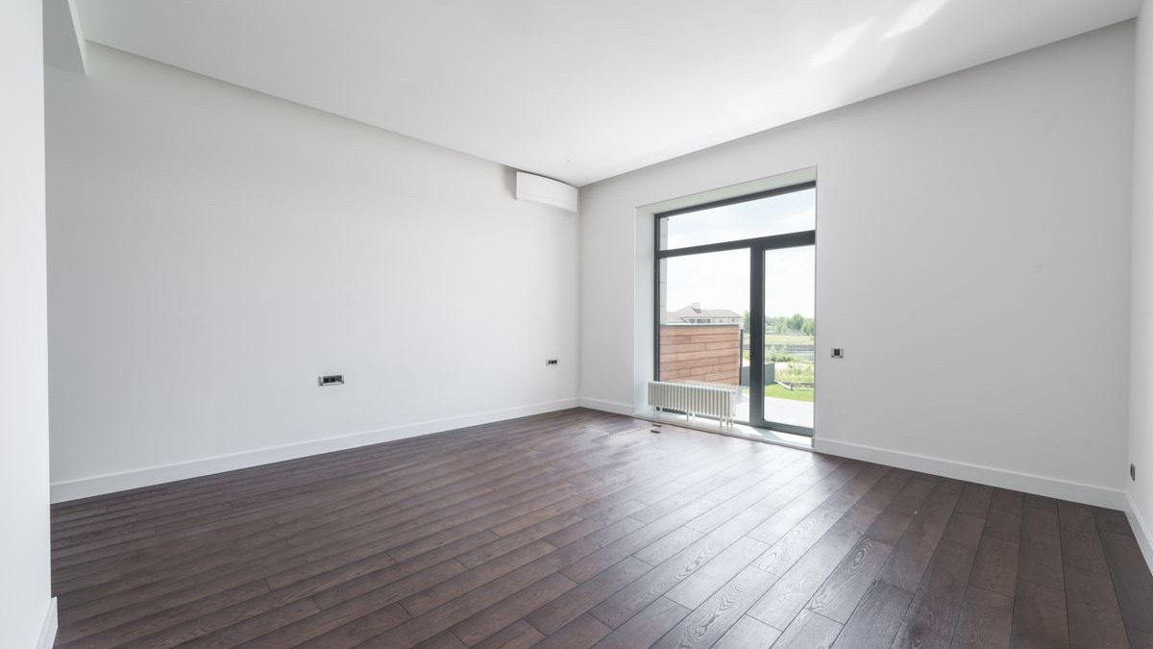

Your next chapter starts at home.
A more connected, considerate way to navigate rental living.
EXPERIENCE THE NIVORA PROTOTYPE →
NIVORA · THE RENTAL LIVING ECOSYSTEM
Notes:
MAIN POINT: End on the human idea, then invite the judges into the prototype.
SCRIPT (0:20):
For most people, a new home is the start of a new chapter: a new college, a new job, a new city.
NIVORA is our attempt to make that journey more connected, more considerate and more honest about trust.
Your next chapter starts at home.
Thank you. We'd love to show you the prototype.
(Pause.)
TRANSITION: Move to the live demo, if the format allows. Follow docs/DEMO_RUNBOOK.md and start from Reset demo data.
CAVEAT — DO NOT OVERLOOK: During the demo, say that the data is fictional and that nothing is verified, paid or sent. The closing photo is an illustrative stock image (Pexels).

