Slide 1
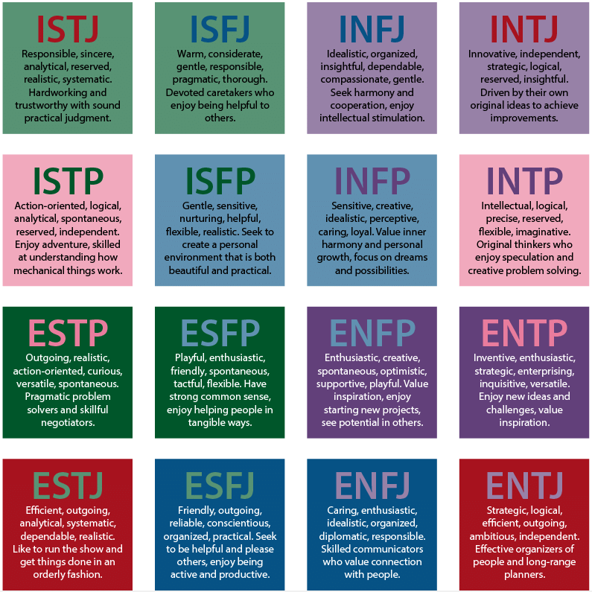
Predicting MBTI personality types and calculating HEXACO scores
Vansh Shan-20BCE1533 Rochak Shrivastav-20BCE1814
Pranay Pratik-20BCE1751

Slide 2
Introduction
The use of artificial intelligence and data science is revolutionising how technology is changing the world. Although machine learning has many applications that we may see in our daily lives, one of its most significant purposes is to classify individuals according to the traits that make up their personalities. Every person in the world is distinct and possesses a distinct personality. Large-scale high-dimensional data availability has paved the way for enhancing marketing campaigns' efficacy through customer targeting. The attraction and attractiveness of goods and services can be greatly enhanced by using such personality-based communications. As a result, there may be an increase in utilisation, customer happiness, and user acceptance.

Slide 3
OBJECTIVE
Build a classification model
Obtain HEXACO score
Predict the MBTI personality type
Hyper-Parameter Tuning of the classification model
Building a front-end
Integrating front-end with back-end

Slide 4
EXISTING SYSTEM
The system calculates the HEXACO scores of the interviewers based on the open ended question using NLP and machine learning methods.
It used data from over 46,000 job applicants who completed an online chat interview that also included a personality questionnaire based on the six-factor HEXACO personality model to self-rate their personality.
The accuracy score for the existing model is 87.83%.

Slide 5
PROBLEM DEFINITION
We need to create a model which predicts the HEXACO traits using a set of pre defined dataset, using NLP and machine learning models.
PROPOSED SYSTEM
The system would take a post as input in text format. It will calculate the HEXACO scores from the given input using Doc2Vec model and then predict the MBTI personality type of that person based on the obtained HEXACO scores using a hyperparameter tuned Random Forest Classifier.

Slide 6



ALGORITHM
ROI
NICHE MARKETS
SUPPLY CHAINS
Envision multimedia-based expertise and cross-media growth strategies
Visualize quality intellectual capital
Engage worldwide methodologies with web-enabled technologies
Pursue scalable customer service through sustainable strategies
Engage top-line web services with cutting-edge deliverables
Cultivate one-to-one customer service with robust ideas
Maximize timely deliverables for real-time schemas

Slide 7
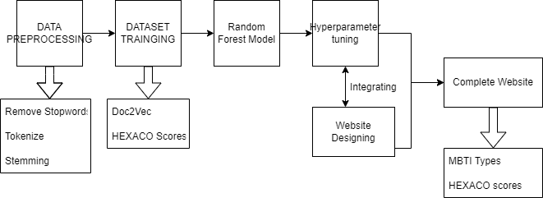
ARCHITECTURE DIAGRAM

Slide 8
CORPUS

Slide 9
THANK YOU

