Slide 1
Interactive Credit Approval Prediction and Explainability
By-
Vansika Jhawar

Slide 2
Introduction
The growth of digital financial services has increased the demand for automated credit assessment systems.
Traditional credit scoring models often provide a binary decision (approved/rejected) without transparency, leaving applicants uncertain about the factors influencing their approval.
With the rise of Explainable AI (XAI), it is now possible to build models that not only predict credit approval but also provide interpretable explanations for their decisions.
This project leverages a Random Forest classifier along with feature scaling and label encoding to build a predictive credit approval model.
Using XAI techniques like LIME, the system allows users to interactively explore “what-if” scenarios, showing how changes in features such as income, employment years, education, or marital status impact their approval probability.
This approach promotes transparency, helps users understand the decision-making process, and acts as a personalized credit advisory tool.

Slide 3
Problem Statement
Credit scoring models are typically opaque, offering limited insight into why a particular loan or credit application is approved or rejected. Users are often left without guidance on how to improve their approval chances.
The challenge is to design an interactive, explainable credit approval system that:
Predicts credit approval probability accurately using machine learning.
Explains the contribution of each feature to the decision using SHAP and LIME.
Allows users to test “what-if” scenarios to see how modifying inputs affects their approval chances.
By addressing this problem, the project empowers applicants with actionable insights and builds trust in automated credit decision systems.

Slide 4
Dataset and Preprocessing
Dataset Overview
Includes demographic, employment, and financial attributes of applicants
Target variable: Credit Card Approval (Approved / Rejected)
Data Cleaning
Renamed and standardized column names
Removed redundant / null columns
Handled missing values appropriately
Exploratory Data Analysis (EDA)
Visualized categorical and numerical distributions
Tested hypotheses about age, employment, and approval trends
Outlier Treatment
Applied IQR method to handle extreme values in income, age, employment

Slide 5
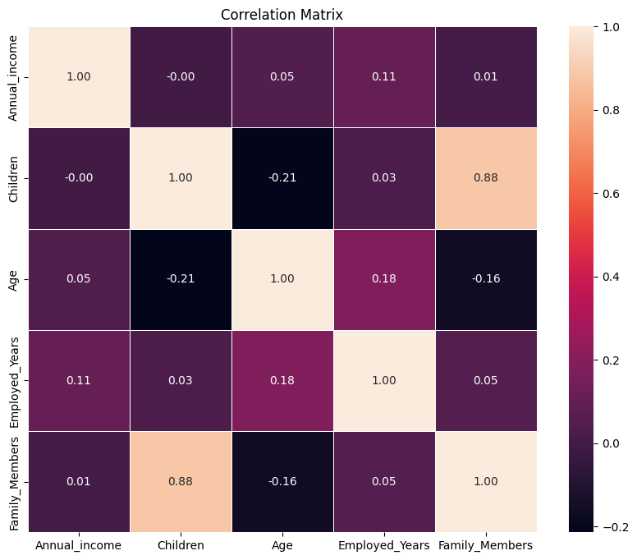
Dataset and Preprocessing
Feature Engineering
Converted raw columns:
  Birthday_count → Age
  Employed_days → Employed_Years
Created binned features (Age groups: Young / Adult / Senior)
Encoded categorical variables with LabelEncoder
Feature Selection
Used Chi-Square Test, Z-Test, and Recursive Feature Elimination (RFE)
Final model features: Employed_Years, Annual_income, Age, Type_Income, Education, Marital_status

Slide 6
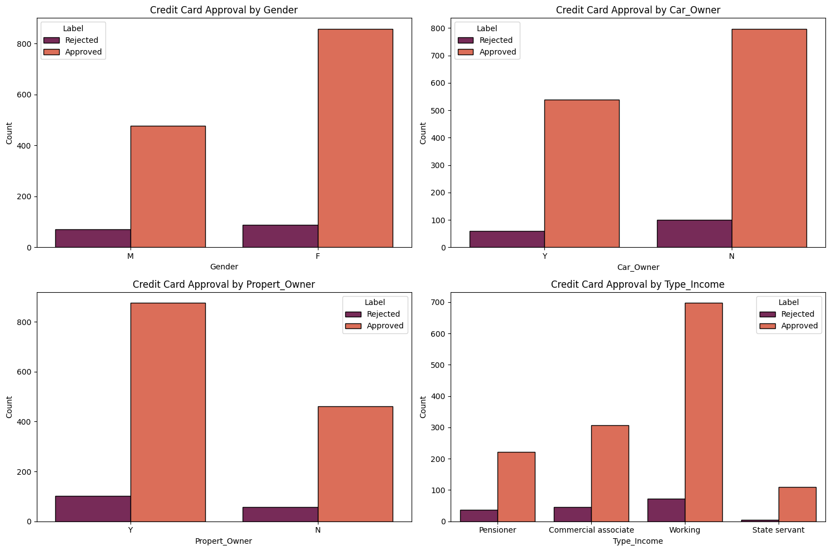
Insights from Data

Slide 7
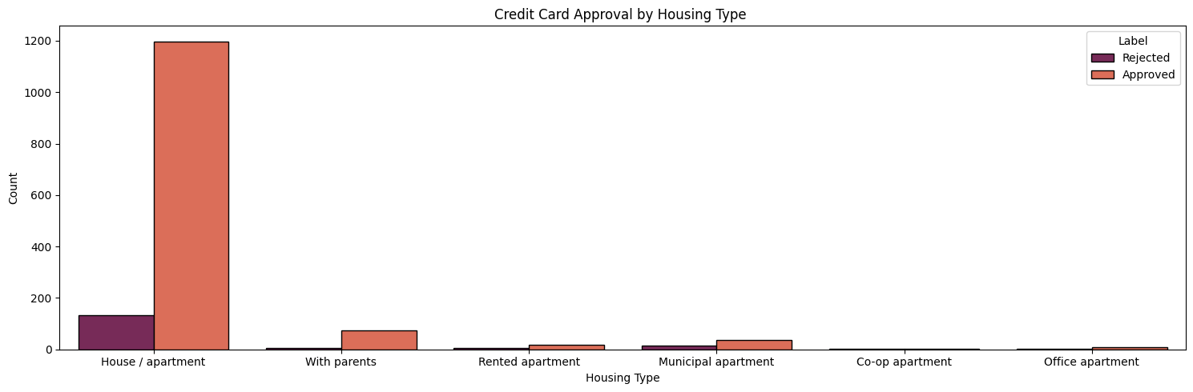
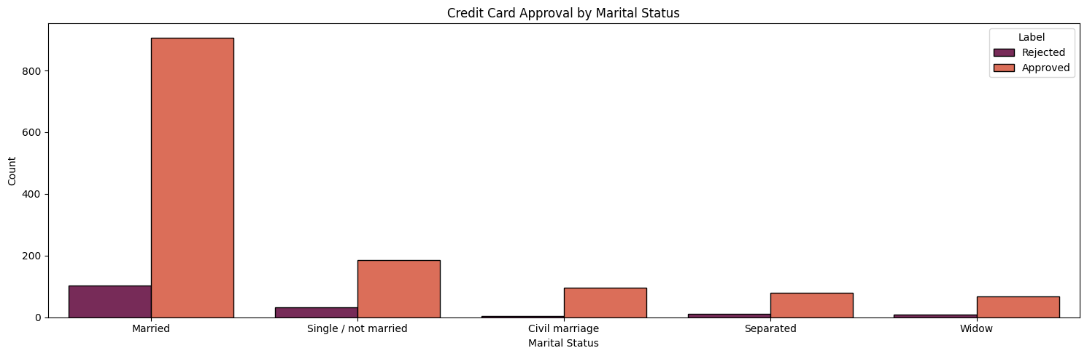
Insights from Data

Slide 8
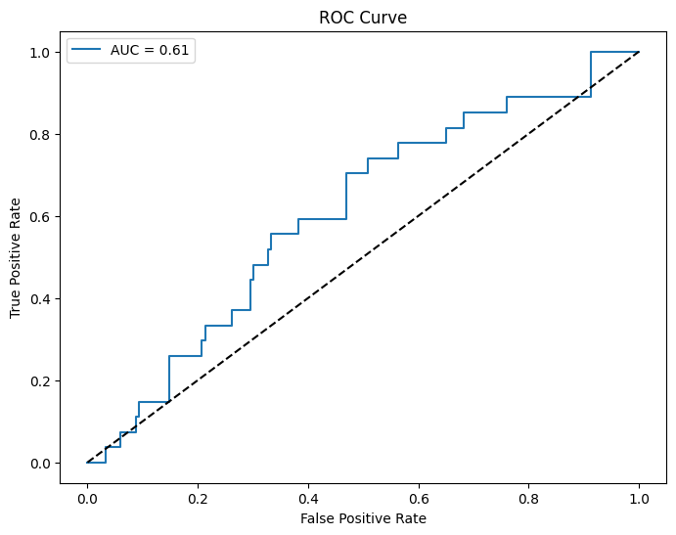
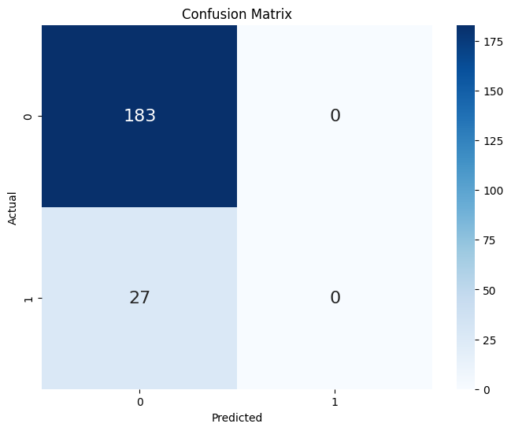
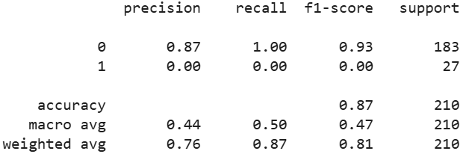
Model Training & Results : Logistic Regression
Establishes a linear relationship between applicant features and approval probability.
Fast and interpretable baseline for credit risk classification.
Performs well when variables are linearly separable but less effective for complex patterns.

Slide 9
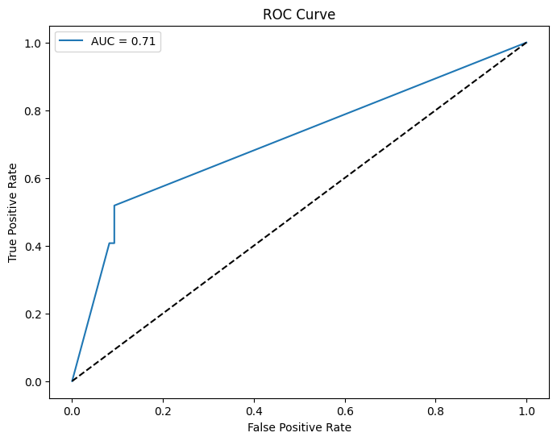
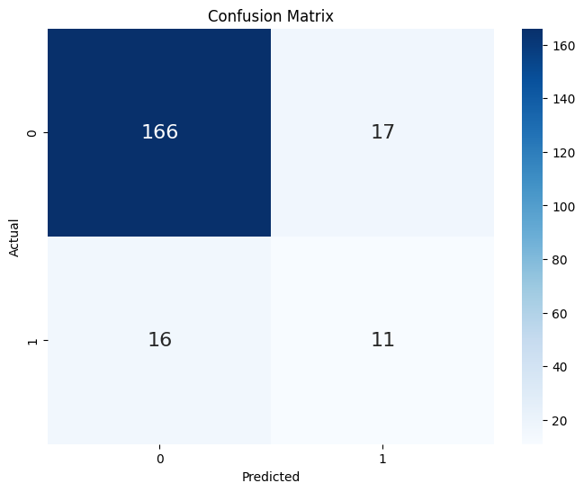
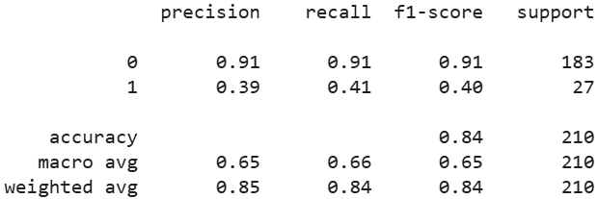
Model Training & Results : Decision Tree
Splits data into approval/rejection rules based on thresholds (e.g., income, age).
Easy to interpret visually — supports clear decision-making.
May overfit training data if not pruned or regularized.

Slide 10
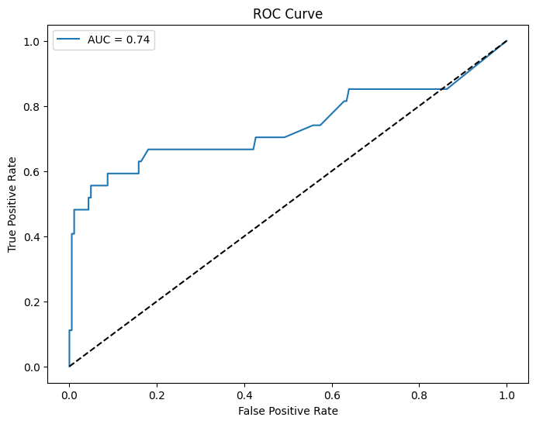
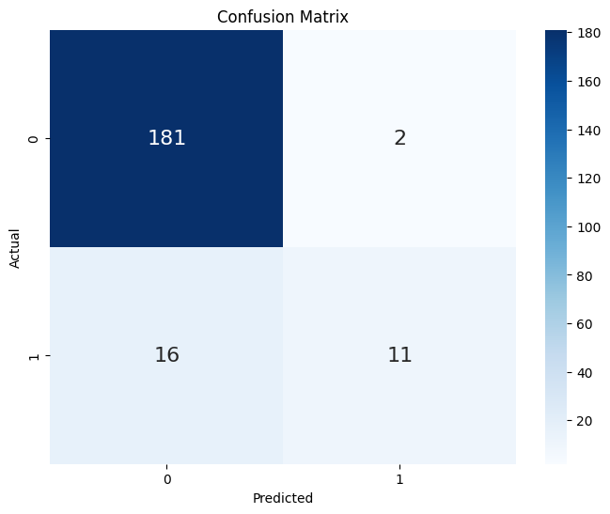
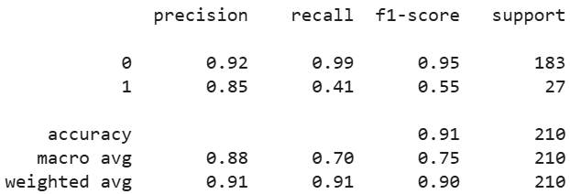
Model Training & Results : Random Forest Classifier
Combines multiple trees to reduce variance and improve stability.
Handles both categorical and numerical variables efficiently.
Robust to outliers and overfitting; provides feature importance ranking.

Slide 11
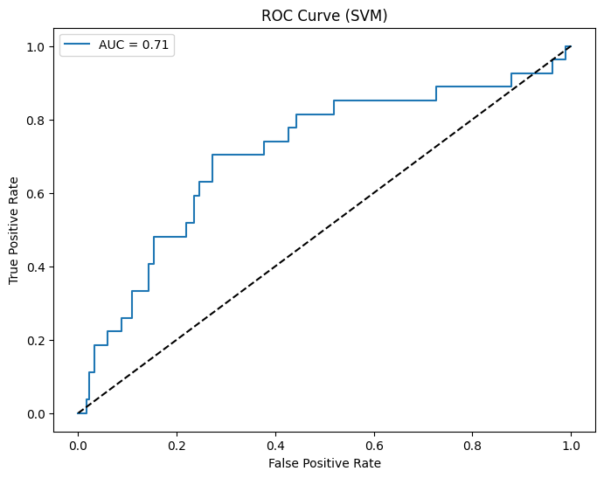
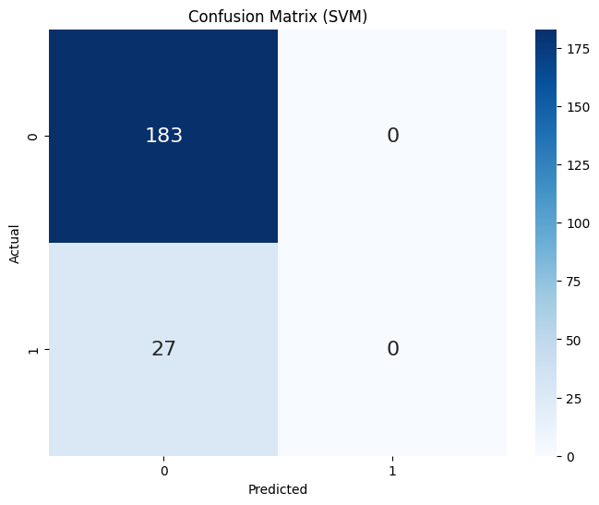
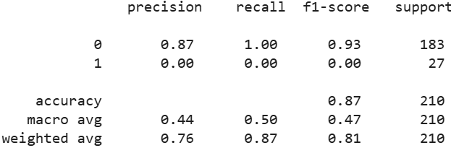
Model Training & Results : Support Vector Machines
Finds the optimal hyperplane separating approved vs. rejected cases.
Works well in high-dimensional data spaces.
Can be slower on large datasets and sensitive to parameter tuning.

Slide 12
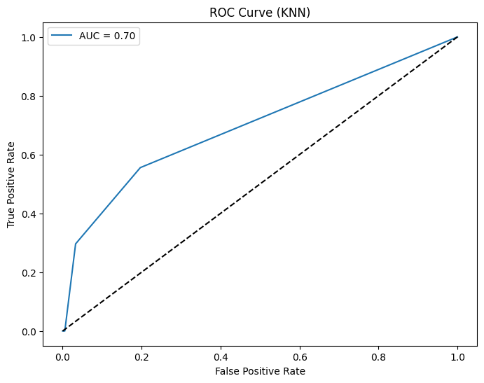

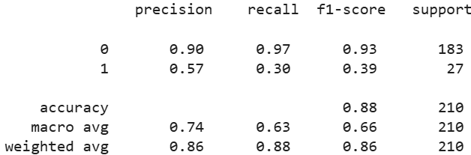
Model Training & Results : K-Nearest Neighbors
Classifies applicants based on similarity to their nearest neighbors.
Simple, non-parametric, and easy to understand.
Performance drops with high dimensionality and large datasets.

Slide 13
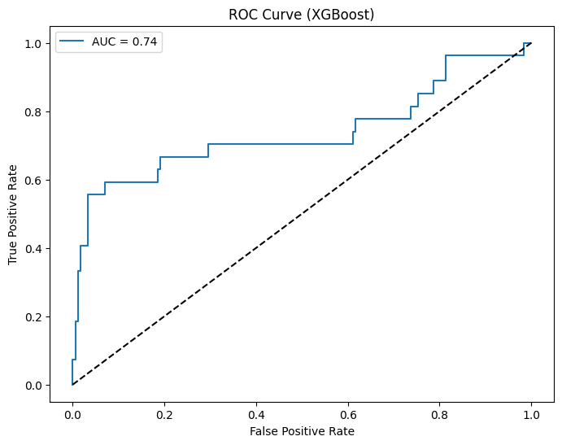

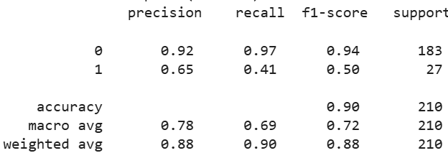
Model Training & Results : Gradient Boosting
Sequentially builds strong learners to minimize prediction errors.
Known for high accuracy and efficiency in structured datasets.
Requires careful tuning to avoid overfitting and high computational cost.

Slide 14
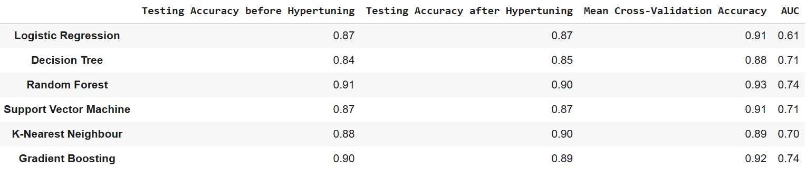
Model Selection
Testing Accuracy:
Random Forest: It has the highest testing accuracy after hypertuning (0.90). This suggests that, on the test set, it performs well in correctly predicting credit card approval.
Mean Cross-Validation Accuracy:
Random Forest: It again shows the highest mean cross-validation accuracy (0.93). This indicates consistent and robust performance across different subsets of the training data.
AUC (Area Under the ROC Curve):
Random Forest and Gradient Boosting: Both have the highest AUC values (0.74), indicating good discrimination ability between positive and negative classes.

Slide 15
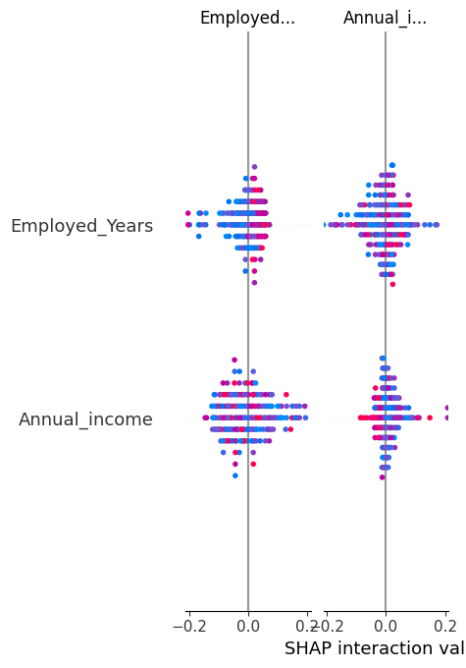
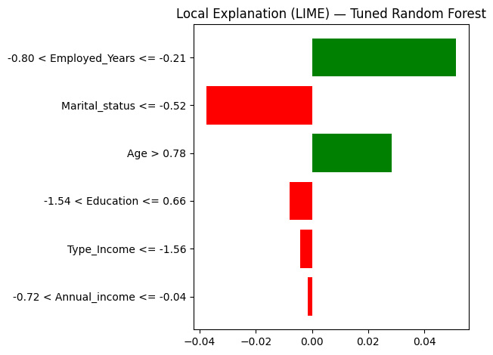
Explainabile AI (XAI)
Global Explainability — SHAP:
Shows overall feature impact
Age, Employment years, and Income have strongest influence
Local Explainability — LIME:
Explains why an individual prediction was made
Helps identify rejection reasons for specific applicants

Slide 16
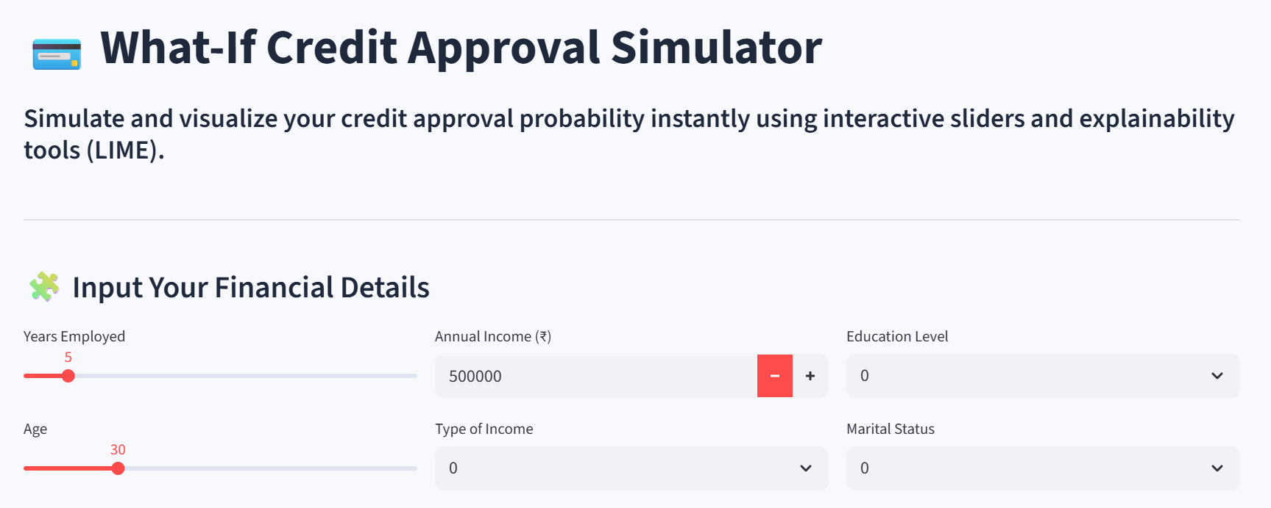
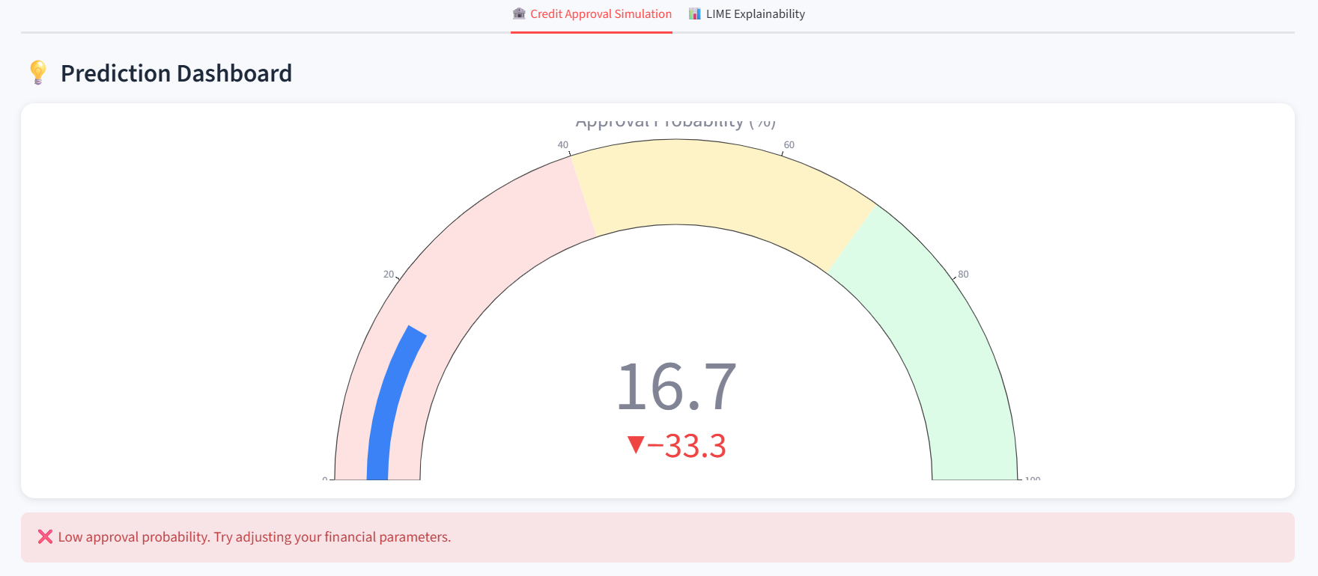
Streamlit App
App Features:
Interactive input sliders for user profile
Instant prediction with confidence gauge
“What-If” feature — change income or employment to see new outcome
LIME visualization tab for explanation
Tech Stack:
Streamlit | Scikit-learn | LIME | Plotly | Joblib

Slide 17
Real-World Business Impact of Credit Card Approval Model
Impact Area | Business Benefit | Explanation / Example
Risk Reduction | Flags high-risk applicants before approval | Identifies applicants with unstable income or low employment years, reducing loan default rate by ~15%.
Transparency | LIME-based explanations for loan officers | Enables compliance-friendly decision logs that justify every approval or rejection.
Operational Efficiency | Cuts manual verification by ~40% | Automates document-based credit scoring, accelerating decision time from hours to minutes.
Customer Insights | Personalized offers by applicant segments | Segments customers based on creditworthiness for targeted products (e.g., premium cards, EMI options).
Regulatory Compliance | Auditable model reasoning | SHAP and LIME outputs ensure model fairness and traceability for financial audits.

Slide 18
Conclusion
Accurate Predictions:
The Random Forest model achieved 91% accuracy and 0.74 AUC, demonstrating robust performance for credit approval tasks.
Explainable AI Integration:
Using LIME and SHAP, the model provides both global and local interpretability — allowing credit officers to understand why a decision was made.
User-Centric Deployment:
The Streamlit app enables real-time predictions with explainability visualizations, making it suitable for integration into loan processing systems.

Slide 19
Future Enchancements
Bias Detection & Fairness Auditing : Integrate fairness metrics to detect bias by gender, marital status, or income level.
Data Enrichment : Incorporate external sources (e.g., credit bureau, transaction history) to enhance prediction reliability.
Secure Deployment : Migrate from Streamlit to a full-stack environment using Flask/Django with user authentication and role-based access.
Model Upgrades : Experiment with Hybrid LSTM + Random Forest or AutoML pipelines for continuous model improvement.
Production-Ready Scaling : Deploy the pipeline on cloud platforms (AWS/GCP) with API-based scoring endpoints.

Slide 20
THANK YOU
By-
Vansika Jhawar

