Slide 1
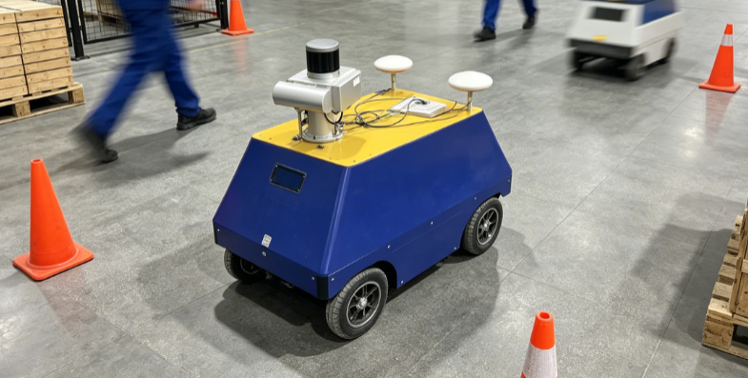


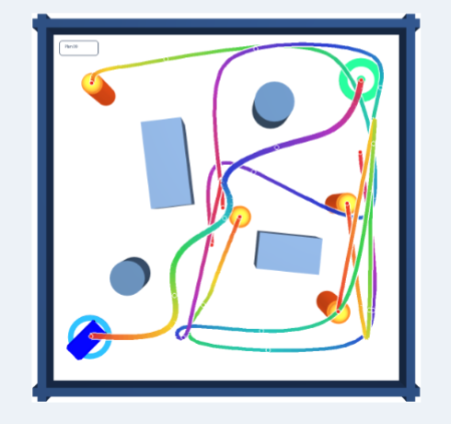



Risk-constrained Safety Filtering
4WIS Action and Mode Mapping
$$e_{t}$$
+
Safe Body Action
=[$v_{x}$,$v_{y}$,$ω$]
…
…
LiDAR
Origin Action
AVO Shield
:obstacles
Deployment
Original LiDAR Input
LiDAR MLP-GRU
[Goal,Velocity,Mode]
=
[$g_{t}$,$v_{t}$,e($m_{t}$)]
Policy Network (Actor)
Policy Update
…
…
Training
Internal States
State MLP
Value Network (Critic)
Simulation Training Environment
Embeddings

Slide 2




















(a)
Dual Dynamic Obstacle Scenario
(b)
VO / PVO
(c)
AVO (Ours)
$$o_{1}$$
*Steering/speed changes
lead to curvature in the future occupancy region
$$v_{rel,y}$$
$$v_{rel,y}$$
$$ℛ_{1,η}$$
$${∆v}_{safe}$$
$${VO}_{1}^{T}$$
$${∆v}_{PVO}$$
$${\hat{v}}_{o_{1}}$$
$$o_{2}$$
$$v_{t}^{safe}$$
$$v_{t}^{∗}$$
$${\hat{v}}_{o_{2}}$$
$$v_{t}^{cand}$$
$$v_{t}^{cand}$$
$$v_{r}$$
$${VO}_{2}^{T}$$
$$ℛ_{2,η}$$
：instantaneous velocity
$$v_{rel,x}$$
$$v_{rel,x}$$
：future trajectory
$${VO}^{T}={VO}_{1}^{T}∪{VO}_{2}^{T}$$
$$ℛ_{η}=ℛ_{1,η}∪ℛ_{2,η}$$

