Slide 1
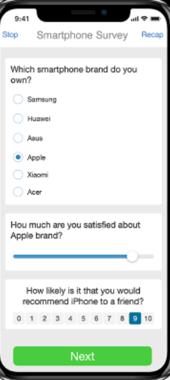

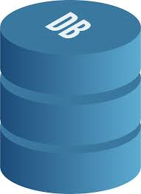


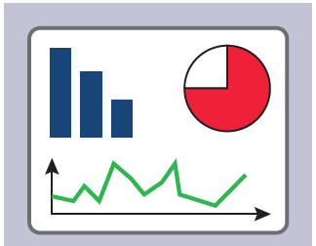
Online Monitoring
Notification Database
CAPI Collection
RAP
Notification Dashboard
SQLite Database
HIS Database

