Slide 1
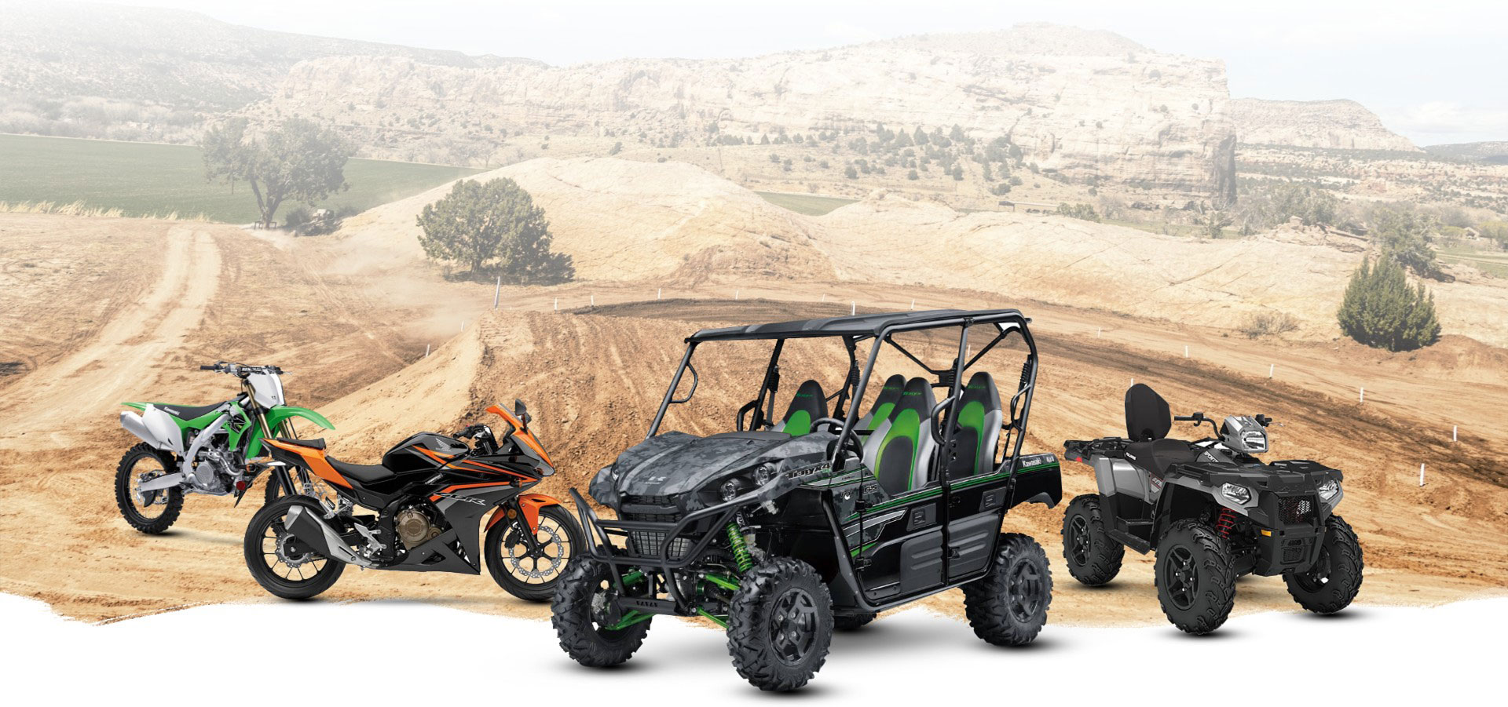

PowerX
CASE STUDY
PowerX October 2022
October 2022
SELF ASSESSMENT – RIDHIMA SAWHNEY

Slide 2
PowerX is a one of the leading global manufacturer of power sports and adventure vehicles including off-road all-terrain vehicles, snow mobiles, super bikes, boats, defense vehicles and associated parts and accessories. PowerX operates across 75+ countries with 10000+ employees globally and sells 20+ vehicle brands in the segment accounting for about 25% of global power sports industry market share. Their sales and service is managed through a network of dealers spread across the breadth of the country.
Client
PowerX
Services
Power sprots and adventure vehicles manufacturer
Accessories and parts manufacturer
Multiple brands
25% market share
Industry
Sports and adventure

Slide 3
The imperative for change
Their current business model is very traditional in nature, typical of any automotive OEM, focusing on Research, Product Development & Design, Manufacturing, Sales and Service. Their sales and service in managed through a network of dealers spread across the breadth of the country
Owning the power sports vehicles is a luxury for most of the customers as they are rarely used only during holidays, but cost to the upwards of $25,000 -$30,000 and storing & maintaining them is also an expensive affair.
Customers in the proximity of metro areas choose other entertainment options over Power sports as they face multiple challenges in getting access to the Power sports experience:
Moderate, regular use is too expensive for consumers
Hard to get access to multiple vehicles and types at once
Transportation is difficult for consumers without trailers
Storage can be a problem for customers in the cities
Maintenance is difficult and a pain to manage and expensive
Additional expenses for insurance
Hunt
Ignite
Build & scale
Shape
Incubate
Ignite the case for DBT
Hunt for value-creating opportunities
Shape ideas into value propositions
Incubate solution candidates
Build & Scale turning value propositions into real outcome

Slide 4
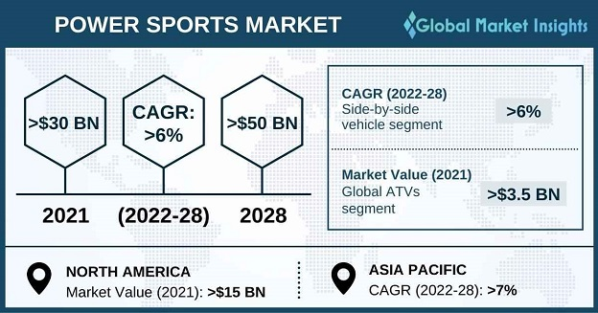
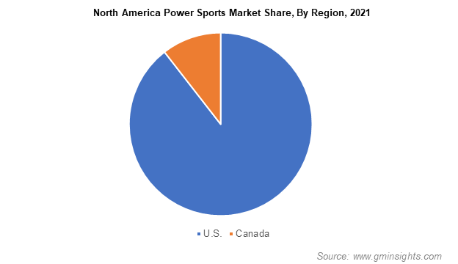
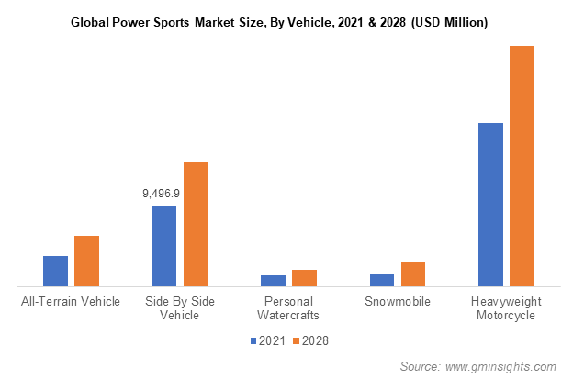
Market Research & Competitors
Industry Trends
Power Sports Market size exceeded USD 30 billion in 2021 and is expected to grow at over 6% CAGR from 2022 to 2028. Growing demand for high-performance power sports vehicles for leisure activities is driving the industry growth.
Market Size Value in 2021 | 2028 Value Projection: | Forecast Period 2022 to 2028 CAGR: | Regional scope | Country scope
30 Billion (USD) | 50 Billion (USD) | 6% | North America; Europe; Asia Pacific; Latin America; MEA | US, UK, Canada, Germany, France, Italy, Australia, Russia, China, Japan, South Korea, Saudi Arabia, Brazil, Argentina

Slide 5
Market Research & Competitors (contd.)
Competitors
Polaris Inc- Auto Industry’s lead with Power Sports manufacturing & subscriptions.
Offer Monthly membership program in powersports industry for renting the vehicles.
Bombardier Recreational Products (BRP)- Manufacturer of snowmobiles, all-terrain vehicles, motorcycles, and personal watercraft.
Launches new pilot project with Uncharted Society who offer more than 40 expertly curated experiences using powersports vehicles in US.
Key Features of Polaris Inc Subscription Model:
First-ever monthly membership program in the powersports industry.
Allows members to rent vehicles without the cost and long-term commitment of ownership.
Tailor-made for new & current riders with flexible riding options & access to a variety of vehicles.
Pay-by-the-month membership plans. Can use credits to book adventure.
Membership starts at $149 per month.
Vehicles can be reserved for pick-up, delivered directly to the rider’s home or reserved for an on-trail, on-road, on-water experience hosted through a Polaris Adventure Outfitter.
Fuel, safety equipment, insurance and maintenance are all included.

Slide 6
User Personas
Persona 1
Persona 2
Name: John Bradley
Age: 30
Type: Powersport Enthusiast
Wants to access multiple vehicles & types at once as he is keen & has won awards in powersports adventures.
Wants to own the vehicle but finds expensive.
Goals:
PowerX will provide rental service for powersports with reasonable costs.
Flexible riding options.
Subscription plans will offer additional benefits.
Name: Chris Cooper
Age: 45
Type: Regular Powersport User
Wants to ride the vehicle daily and able to buy.
Transportation is difficult as he stays far from the cities.
Maintenance is difficult and a pain to manage and expensive.
Goals:
Through PowerX, vehicles can be reserved for delivery directly to home and pick-up from home.
24x7 expert vehicle maintenance & repair. Hassle-free customer service.

Slide 7
Value Acceleration Model
Value Pool:
Current business model is very traditional like typical automotive OEM.
Owning a power sport vehicle is luxury for most of the customers.
Customers in the proximity of metro areas choose other entertainment options over Power sports as they face multiple challenges in getting access to the Power sports experience.
New revenue streams.
IGNITE/HUNT:
Value Propositions:
Transform the current business to a Subscription Business Model.
Provides direct-to-customer digital service which gives flexible access to products & services as ‘Adventure as a Service’ model.
Aims to increase the market share and overall engagement of customers.
Customer value proposition prioritization by performing Design Thinking.
Develop bigger customer base by offering additional features & attractive subscription plans.
SHAPE:

Slide 8

Our Proposal
Launch Subscription Model for PowerX Customers to maximize the benefits from the seasonal nature of the service- A subscription model is a revenue model that charges a recurring fee for access to a product or service.
Offer below subscription Plans
Base Plan ($149/month)
All services included
No buying vehicle option
8 Credits
Plus Plan ($300/month)
All services included
No buying vehicle option
Vehicle accessories & apparels
15 Credits
Premium Plan ($400/month)
All services included
Vehicle accessories & apparels
Buying vehicle option. (Cost of Vehicle is excluded from the plan cost)
15 Credits

Slide 9
Application of Design Thinking Principles
Empathize
Thorough market Research
Customer Research
Define
Understand the problem areas
Identify the opportunities
Ideate
Suggest subscription Model
Define MVP
Prototype
Test
Follow Agile to build the MVP
Go through cycles of test and learn .
Update based on feedback

Slide 10
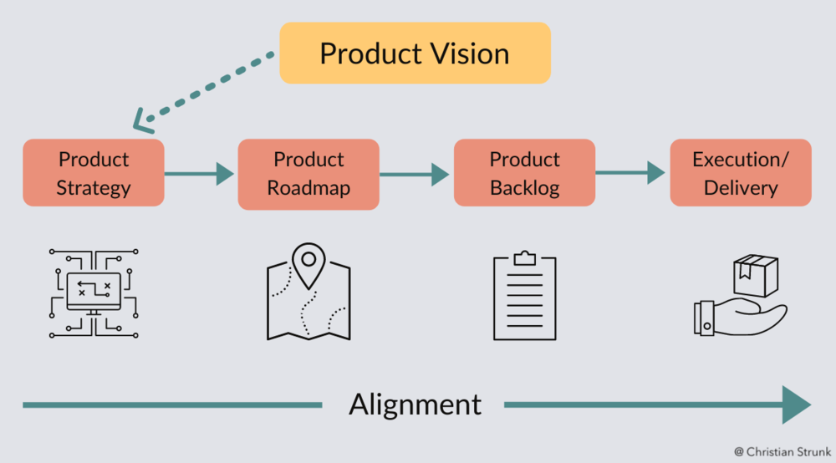
Product Vision
“FOR our powersports adventure seekers WHO need consistent, convenient, flexible, seamless and value-added services, THE PowerX “Adventure as a Services: is a subscription business model THAT will provide rental vehicles access, more benefits and build a closer relationship with our customers”

Slide 11




Product Strategy – MVP
PowerX- Adventure as a Service.
A subscription business model that provide rental vehicles with flexible services at reasonable cost.
Offer limited options to start with.
Vehicles can be reserved for direct delivery & pick up from home.
Offers proper secured storage of vehicles for customers.
24x7 expert vehicle maintenance & repair with hassle free customer service.
Performance upgrade with insurance coverage.
People aged between 2- to 40+ years who are adventure seekers in powersports.
Customers who cannot own the vehicles.
Customers for whom storage can be a problem in cities.
Maintenance is difficult with insurance.
Region- North America
Country- US
Community- Awareness in riding regions through billboards, radio, TV etc.
Digital Marketing- Social media platforms, Ads, Paid Ads, Influence marketing.
Build mobile application in the future to develop bigger customer base in comparison to competitors by offering additional features & attractive subscription plans & prices.

Slide 12








Customer Journey – Front stage and backstage
Front Stage:
Choose a powersport vehicle & plan
Complete application and make payment with auto-debit option
Get the vehicle delivered to your home and enjoy your ride
Upgrade/Own or return the vehicle
Back Stage:
Check vehicle availability in store locations and confirm
Prepare the vehicle with necessary pre-checks
Transport the vehicle if opted for home delivery
Provide 24x7 service/assistance when needed
Pick-up the vehicle once the plan ends or Upgrade the vehicle with necessary requirements

Slide 13

Roadmap
Milestone 5- Mobile App
Milestone 4- Implement Yearly & Premium subscription Plans
Milestone 3- Feature Addition
Milestone 2- Mitigate the f/b & improve the current features
Milestone 1- Launch MVP

Slide 14
Detailed Milestones
Milestone 1- MVP product development
Develop only web-based application.
Implementation of the MVP features.
Introduce just the Base & Plus plans with only monthly subscription.
Expected Outcome:
The application should receive +ve feedback.
The targeted customers (regular & occasional powersports users) should be availing these subscription plans.
Track the performance, feedback & market data metrics.
Product revenue should increase by 10%
Milestone 2- Mitigate the f/b & improve the current features
As per customer f/b, improve & update the existing features.
Improve the performance of the website.
More marketing methods.
Milestone 4- Implement Yearly & Premium subscription Plans
Introduce the Premium plan with buying powersports option.
Offer yearly subscription option.
Expected Outcome:
Customers should be happy to buy the vehicles.
Product revenue should increase by 30%
Capture customer journey with personas.
Should be able to achieve in having more primary customer base who are reliable & promising.
Milestone 5- Mobile App
Implement both Android & iOS-based applications with all the features.
Expected Outcome:
Gain more customers with new personas.
Provide on-the-go services.
Product revenue should increase by 50%
Milestone 3- Feature Addition
Storage of vehicles for customers who has storage issues.
Offer Insurance coverage.
Offer Tuning, performance upgrade for vehicles.
Expected Outcome:
Product should be stable.
Product revenue should increase by 20%
Milestone 6- Enhancements
Training model with both digital & in-person training options.
Curated Experience service.
Expected Outcome:
Should make PowerX product stand up in the market and solve the customer issues & their needs.
Q1
Q2
Q3
Q4

Slide 15
Team Structure
Product Owner
Engineering
Marketing
UX
Quality
Core Team
Research
Legal
Business Operations
Business Development
Public Relations
Extended Team

Slide 16

Objectives & Key Results (OKRs)
Spread the business across all the targeted regional areas.
Aim to have ~500 customers by Q3 by enhancing the loyalty.
Improve the social engagement.
Improve the SEO aspects of the application during Q4.
Should reduce the high initial costs of power sports vehicles.

Slide 17
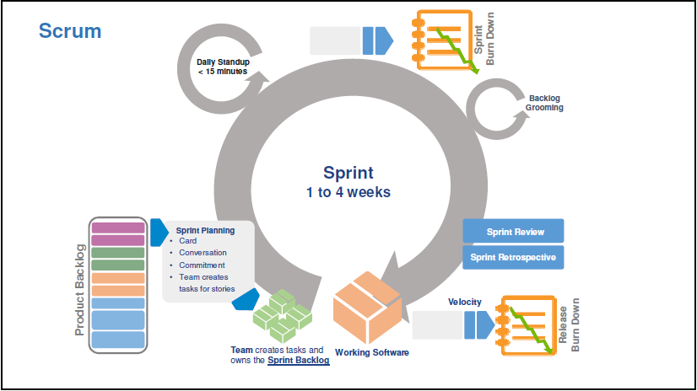
Agile Methodology & Sprint Cadence
Scrum Cycle:
Sprint Review/Demo:
Scrum Ceremony | Typical Duration
Sprint Review | 2 hrs. (2-week sprint)
Participants | PO, Scrum Master, Dev. Team and Stakeholders
Frequency | End of sprint
Output | Work completed during sprint
Sprint Retrospective:
Daily Stand-Up Meeting:
Scrum Ceremony | Typical Duration
Sprint Review | 2 hrs. (2-week sprint)
Participants | PO (optional), Scrum Master, Dev. Team and Stakeholders
Frequency | End of sprint/Last day of sprint
Output | What went well over the last sprint? What didn’t go so well? What could we do differently to improve?
Scrum Ceremony | Typical Duration
Daily Scrum/Stand-up | <=15min
Participants | PO, Scrum Master & Dev. Team
Frequency | Daily
Output | What did you do yesterday? What will you do today? Are there any impediments in the way?

Slide 18
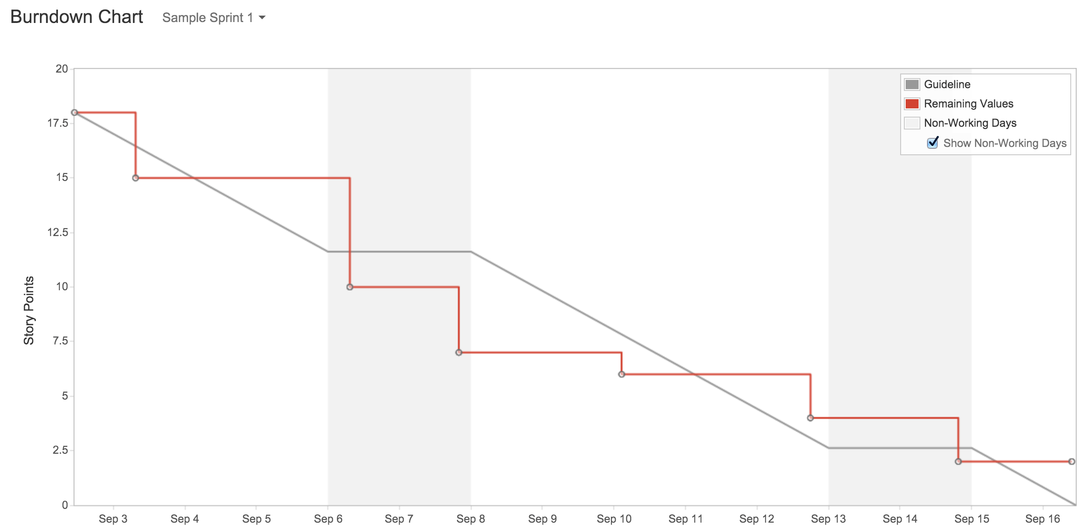
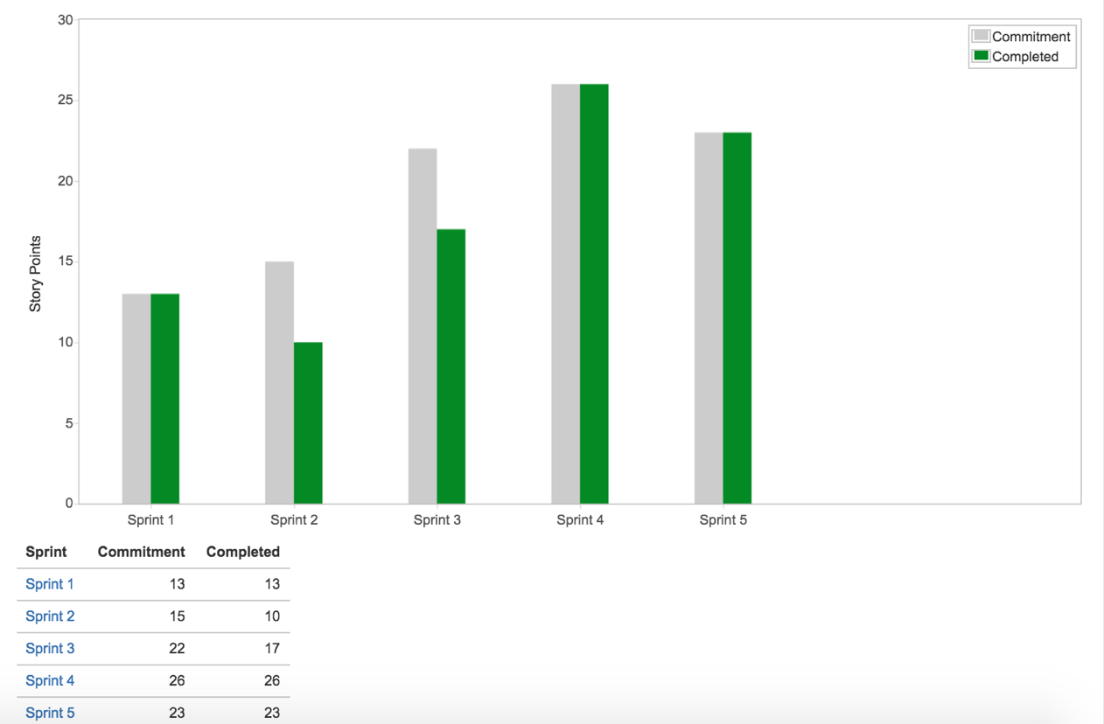
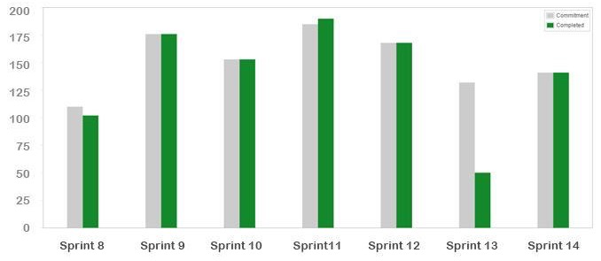
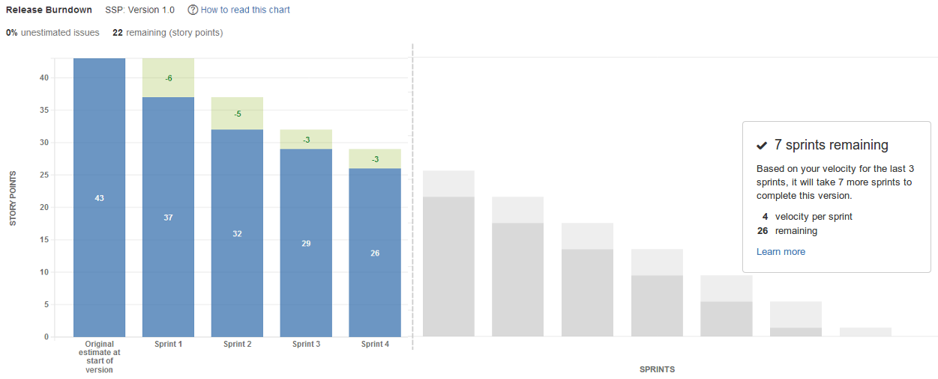
Agile Methodology & Sprint Cadence
Velocity:
Sprint Burndown chart:
Release Burndown chart:

Slide 19
Reference Links
https://adventures.polaris.com/select-membership-program/
https://www.thedetroitbureau.com/2022/04/polaris-following-auto-industrys-lead-with-power-sports-subscriptions/
https://www.parksandrecbusiness.com/articles/brp-launches-new-pilot-project
https://www.redchalk.com/industry/automotive/monthly-mobility-vehicle-subscription-business-model/
https://www.gminsights.com/industry-analysis/power-sports-market
https://theinsightpartners.com/reports/powersports-market#:~:text=Before%20the%20COVID-19%20pandemic,size%20was%20US%24%2093%2C703.64%20million.
https://www.globenewswire.com/en/news-release/2022/09/19/2518613/0/en/Car-Subscription-Market-Size-is-projected-to-reach-USD-15-56-Billion-by-2030-growing-at-a-CAGR-of-23-1-Straits-Research.html

Slide 20
Thank You

