Slide 1
COVID-19 Hospitalization Rates by County

Slide 2
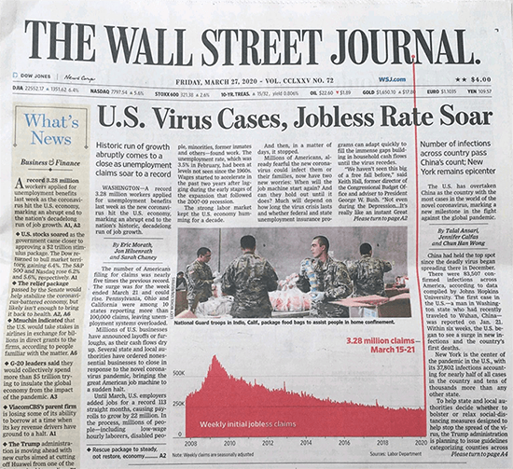
COVID-19 Impact
3+ Million people dead
Worldwide Pandemic
Shortages in medical care, as a result

Slide 3
Problem: Hospitals Overcrowded
Rising COVID cases and severity of symptoms have led to sharp increases in hospital admittance.

Slide 4

Approach
Using New York Times Coverage of COVID-19
Provides County-by-County data
Features: hospitalization and vaccination rates
Predicting Daily Case Change

Slide 5
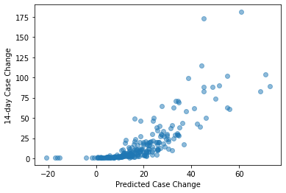
Model
The prediction and test values look almost exponential.
Models’ performance fluctuated
Chose ridge regression

Slide 6
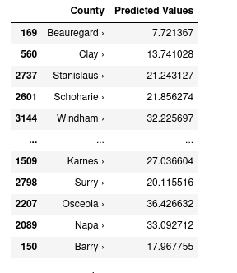
Results
Some predicted values for counties across the US.
Mean: +21.1
Std. Dev: 19.4

