Slide 1
Home Loan Default Risk Prediction
Team Name
Rebooting Rebels
Team Members
IMT2020048 - Varad Badhe
IMT2020059 - Manas Agrawal

Slide 2
Problem Understanding
Having insufficient or no credit histories makes it difficult for many people to obtain loans and so unreliable lenders frequently take advantage of this.
Home Credit aims to increase the unbanked population's financial inclusion by offering a satisfying and secure borrowing experience.
The problem is to predict the repayment abilities of client depending on transactional, telco, demographic and other information.

Slide 3
Data Pre-processing
Training Data Description:
Number of Rows/Data Points in Dataframe: 184506
Number of Columns/Features in Dataframe: 121
Steps followed for data pre-processing:
Handling Null Values and Duplicate Rows
Dropping columns which have high correlation using correlation matrix
One-Hot Encoding of Categorical columns

Slide 4
Handling Null Values
Columns with less than 5% null values:
Replaced null values with mode if occurrence of mode > 80%
Dropped rows otherwise
Columns with greater than 50% null values are dropped
Columns with null values between 5% and 50%:
Categorical Columns:
Replaced null Values in categorical columns with mode
Numeric Columns:
Replaced null values in numeric columns with mode if occurrence of mode > 80%
Replaced null values with mean otherwise

Slide 5
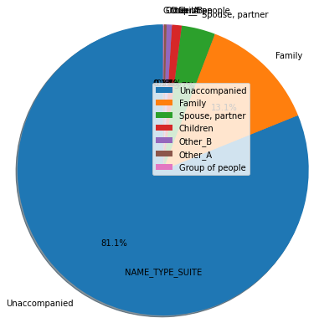
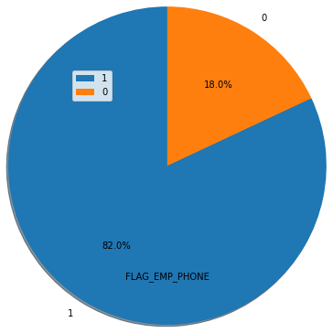
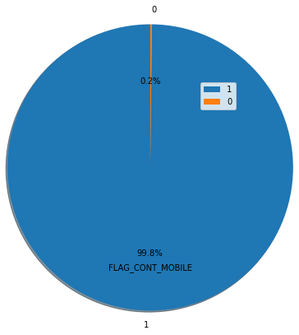
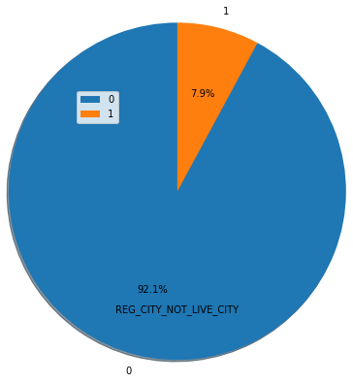
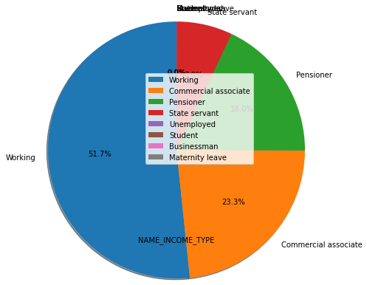
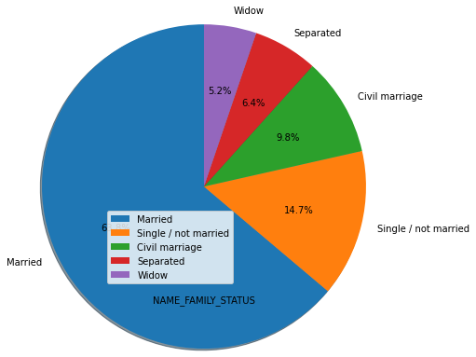
Plots for Mode

Slide 6
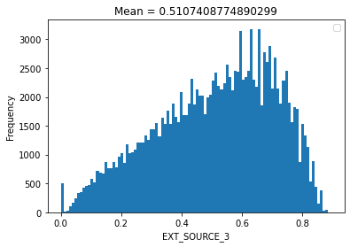
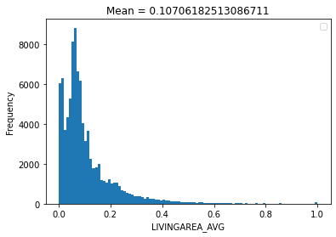
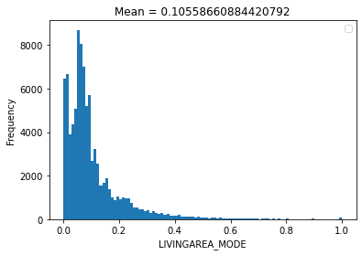
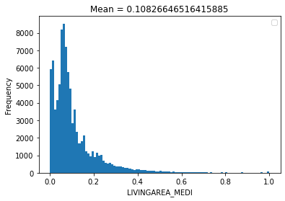

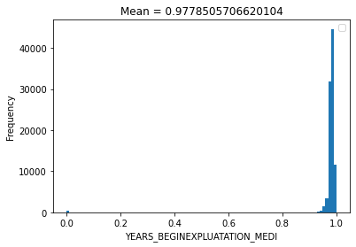
Plots for Mean

Slide 7
Calculating Correlation Matrix
Correlation Matrix is calculated using corr()
Columns with correlation > 95% are dropped
Training Data Description after Dropping:
Number of Rows/Data Points in Dataframe: 183286
Number of Columns/Features in Dataframe: 74
One-hot encoding of categorical columns

Slide 8
Future Plans
Handling null values in a better way
Implement more models for binary classification:
Random Forest
Perceptron etc.

Slide 9
Thank You

