Slide 1

Basic Details of the Team and Problem Statement
Ministry/Organization Name/Student Innovation: Ministry of Electronics and Information Technology (MEITY).
PS Code: PK854
Problem Statement Title: Identifying the Dyslexia, Dyscalculia, Dysgraphia, Dyspraxia, Autism or ADHD in school going children.
Team Name: Data Pirates_
Team Leader Name: Ronit Bhamere
Institute Code (AISHE): C-34048
Institute Name: K. J. Somaiya Institute of Engineering and Information Technology, Sion, Mumbai
Theme Name: MedTech / BioTech / HealthTech

Slide 2
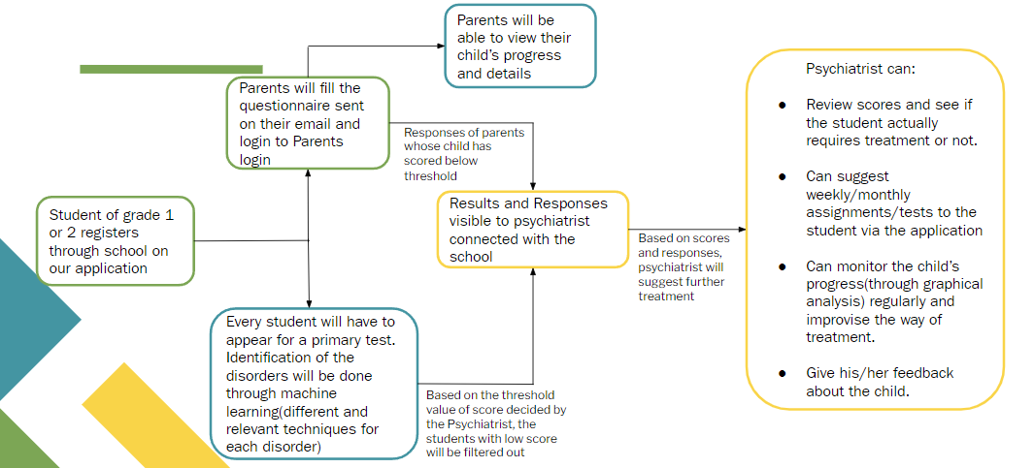
Idea/Approach Details
Flow Diagram

Slide 3
Idea/Approach Details
Unique Selling Point (USP)
Existing applications offer diagnosis through aptitude tests and do not have any methods for treatment for the disorders.
However, our solution provides diagnosis using AI. Our application does not completely depend on the AI model, it considers the expertise of psychiatrists, psychologists and parents as well.
Tech Stack
Front End – HTML5, CSS3, JavaScript
Back End – Flask Python
JavaScript for Test Calculation
Database – MySQL
Speech Recognition Module for identification of dyslexia
SMTP Module for Mails
Google Sheets API Integration
Face Recognition module for identification of ADHD

Slide 4
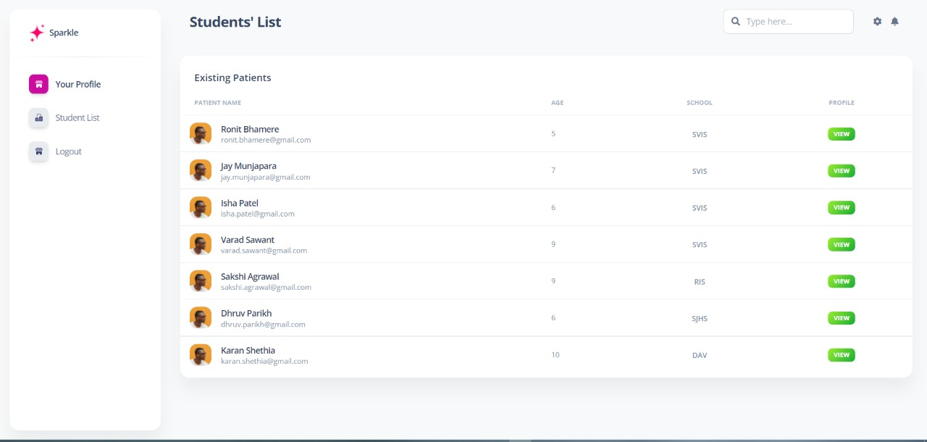

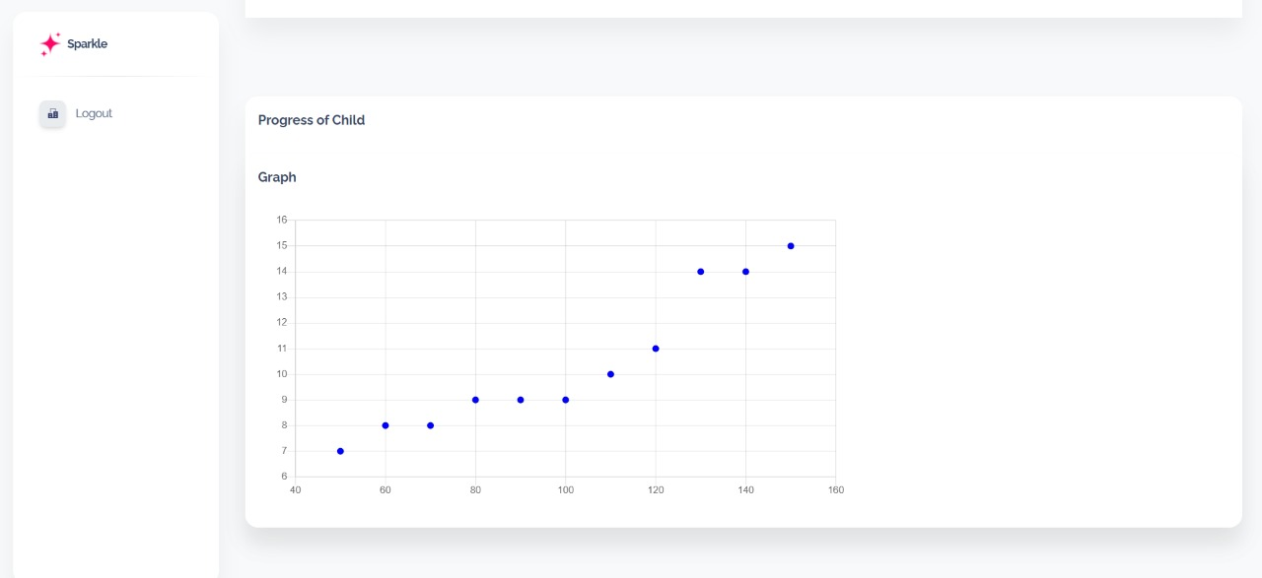
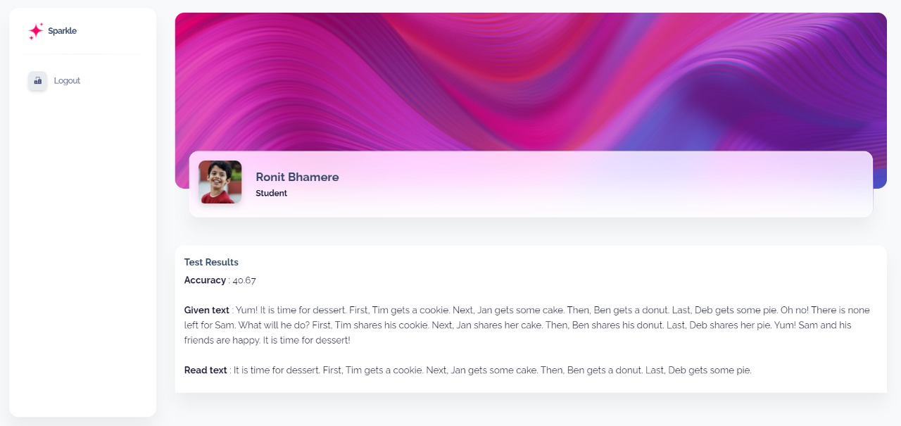

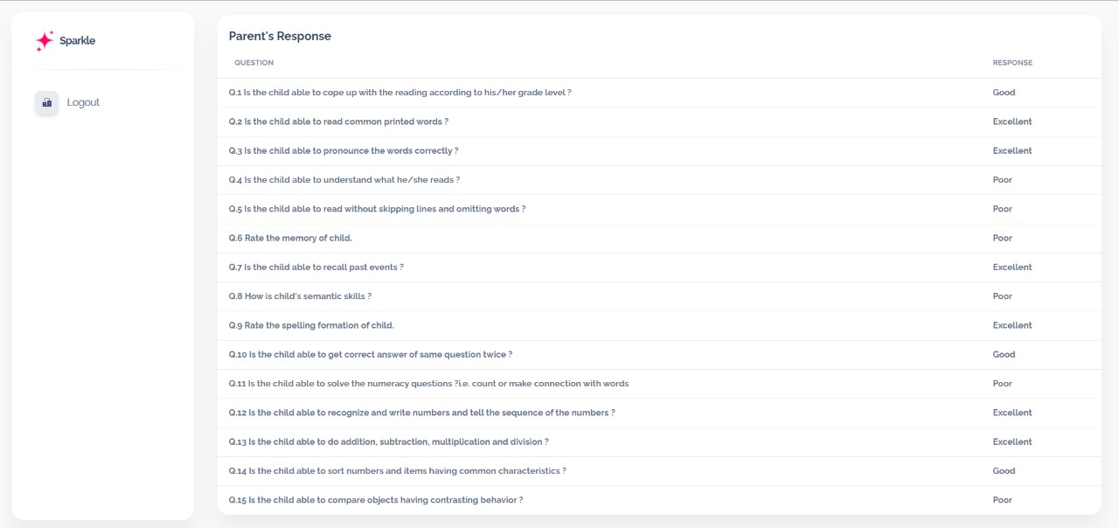
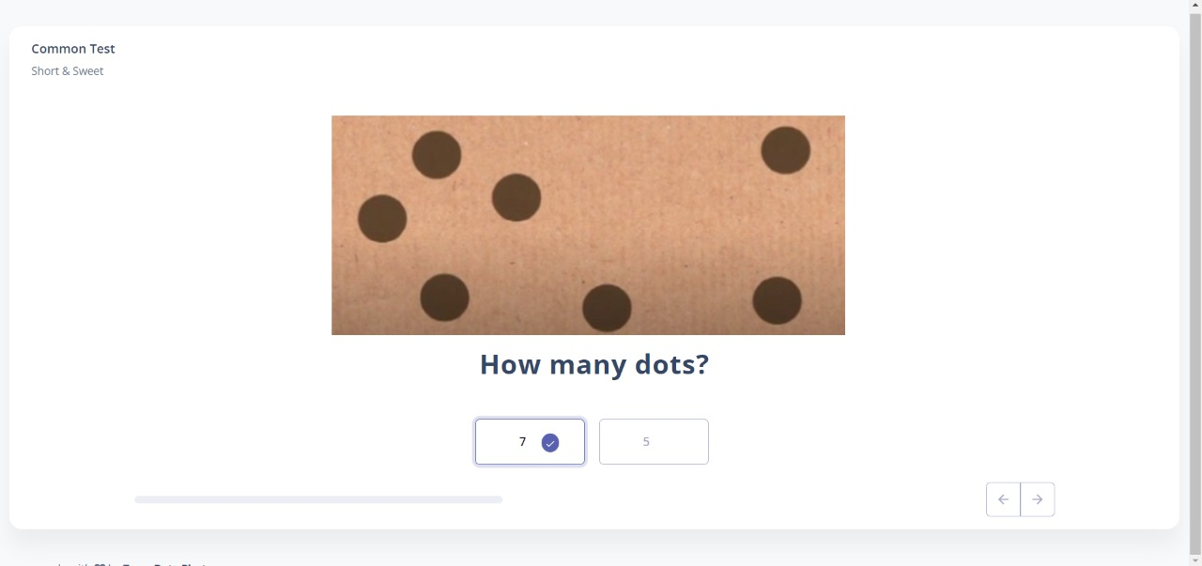
App Screenshots

Slide 5
Business Model Canvas
Sparkle | for you made with ❤
Key Partners
Key Activities
Value Proposition
Customer Relationship
Customer Segments
- Schools
- Diagnosis for earlier detection of disease.
-Save patient’s time.
Doctor:
-Monitors the growth and results of child
- Clinical specialists
- Early detection and treatment of disease beneficial for students and his/her parents
Key Resources
Channels
- NGO’s
- Technical knowledge
- Healthcare database
server
- Web-App
- Website
Student:
- Attempts tests and gets diagnosed for disease.
- Special Schools which deal with such kids
Cost Structure
Revenue Streams
- Developing server.
- Website and program maintenance.
-Extracting models
- Technical and health expert incentives.
- Marketing
- Patients- App will be free
- Schools / Clinics - Tie up incentives
- Advertisements

Slide 6
Team Member Details
Team Leader Name: Ronit Bhamere
Branch : B.Tech Stream : CSE Year : III
Team Member 1 Name: Isha Patel
Branch : B.Tech Stream : CSE Year : III
Team Member 2 Name: Jay Munjapara
Branch : B.Tech Stream : CSE Year : III
Team Member 3 Name: Varad Sawant
Branch : B.Tech Stream : CSE Year : III
Team Member 4 Name: Dhruv Parikh
Branch : B.Tech Stream : CSE Year : III
Team Member 5 Name: Sakshi Agrawal
Branch : B.Tech Stream : CSE Year : III
Team Mentor Name: Prof. Nisha Vanjari
Category : Academic Expertise : Machine Learning Domain Experience : 13 Years

