Slide 1


SUBJECT- Project Review
Department:- Computer Engineering
A
Seminar presentation
on
“Bitcoin Price Prediction And Real Time Deployment”
Prepared By
Mr./Ms. Student full name : Swapnali Haribhau Gaikwad
Sakshi Chandrakant Biradar
Shivani Babasaheb Jadhav
Guided by
Prof. Bharti Jadhao
PCET’S & NMVPM’S
NUTAN MAHARASHTRA INSTT. OF ENGG. & TECH. Pune
Academic Year 2023-24

Slide 2
SUBJECT- Seminar and Technical Communication
Department:- Computer Engineering
Contents
Project Title
Problem Domain
Existing System
Problem Statement
Project Scope & Objective
Literature Survey
Review Papers(in descending order latest to older)
Proposed System(Algorithm, Methodology, Mathematical Model, Architecture )
System Design
Flowchart
Basic UML Diagrams(Use Case Diagrams, Class Diagram, Activity Diagram, Component Diagram, Sequence Diagram)
Project Implementation(Module wise design and module wise output)
Advantages
Disadvantages
Application
Conclusion
Future Scope
References & annexure(Published Papers & Certificates)
Academic Year 2022-23

Slide 3
SUBJECT- Project Review
Department:- Computer Engineering
Existing System
In existing system user predict Bitcoin price by selecting the input features such as
macroeconomics
global currency ratios
and block chain information.
Based on above analysis they invest in bitcoin
Academic Year 2023-24

Slide 4
SUBJECT- Project Review
Department:- Computer Engineering
Problem Statement
To develop a model which can help us to predict the price of the crypto currency used (in this case: Bitcoin), with low error rate and a high precision of accuracy.
Academic Year 2023-24

Slide 5
SUBJECT - Project Review
Department:- Computer Engineering
Project Scope & Objective
To Implement linear regression and Long Short-Term Memory ( LSTM) models for bitcoin price prediction.
To predict prices for Bitcoin using Machine learning techniques for the next day and prepare a strategy to maximize gains for investors.
We also aim to find out if there is a correlation between fluctuating Bitcoin prices and related news
Academic Year 2023-24

Slide 6
SUBJECT- Project Review
Department:- Computer Engineering
Literature Survey
Sr.No. | Title of Paper | Year | Author | Key Points
1. | Bitcoin Price Prediction | 2023 | S. Nithiya | The work proposed in [4] makes use of Bayesian Neural Networks (BNNs) by analyzing the time series of Bitcoin process which describes fluctuation in a timeseries format.
2. | Bitcoin Price Prediction Using Machine Learning | 2022 | Siddhi Velankar | The authors suggest the scope that the time series data can be modeled by predicating price of the bitcoins using LSTM algorithm.
3. | Bitcoin Price Prediction Using Machine Learning and Deep Learning Algorithms | 2022 | Mareena Fernandes | It gives an insight about the backend processing of bitcoins followed by the use of a rolling window LSTM and empirical study for price prediction
Academic Year 2022-23

Slide 7
SUBJECT- Project Review
Department:- Computer Engineering
Proposed System
To predict bitcoin price with maximum efficiency using LSTM.
To compare between ARIMA and LSTM to find which is the best efficient algorithm for predicting bitcoin price.
To ensure less risk and more profit for investors.
Academic Year 2023-24

Slide 8
SUBJECT- Project Review
Department:- Computer Engineering
Proposed System
The proposed model implements a machine learning algorithm to build the model to predict the price of Bitcoin based on a historical dataset available on an online database.
The Bitcoin price prediction can be done using the LSTM (Long Short Term Memory). The procedure to be followed for the proposed system is given as follows:
• First, collect the data set using the Rest-API to collect the historic of the Bitcoin prices from the online database.
• Arrange the data into the data frame according to the problem definition, to get the analysis correct and produce the results which are efficient to meet the goals of the system. • Then the rows of the dataset which are outdated for analysis/prediction to build a model and in order to feed the relevant data to the model extra columns are removed and stored in a CSV file.
• Then data-preprocessing is performed to missing values for the attributes, this is done to reduce the noise and inconsistency in the data.
• Then we build the model for the data-set using the LSTM (RNN) algorithm to predict the values of bit-coin on daily basis.
• Test the predictions with different layers of the RNN Model.
Academic Year 2023-24

Slide 9
SUBJECT- Project Review
Department:- Computer Engineering
Algorithm
LSTM :
The LSTM algorithm is well adapted to categorize, analyze, and predict time series of uncertain duration.
There are three gates –
Forget Gate: The information that is no longer useful in the cell state is removed with the forget gate. The resultant is passed through an activation function which gives a binary output.
2. Input gate: The addition of useful information to the cell state is done by the input gate.
3. Output gate: The task of extracting useful information from the current cell state to be presented as output is done by the output gate. First, a vector is generated by applying tanh function on the cell.
Academic Year 2023-24

Slide 10
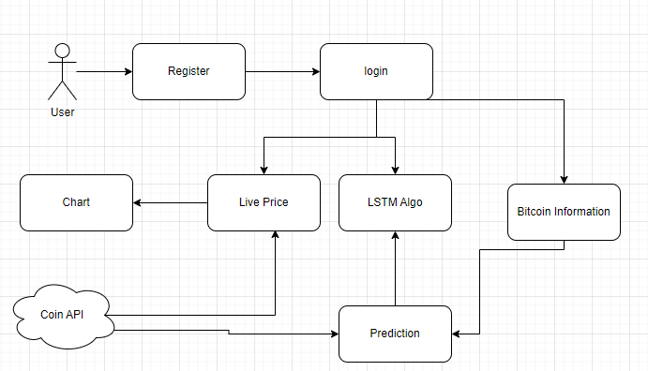
SUBJECT- Project Review
Department:- Computer Engineering
System Design
Academic Year 2023-24

Slide 11
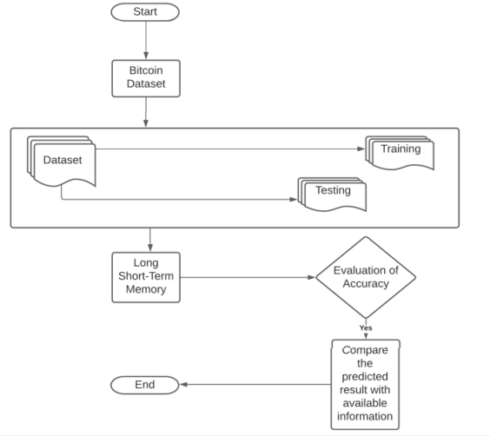
SUBJECT- Project Review
Department:- Computer Engineering
Flowchart
Academic Year 2023-24

Slide 12
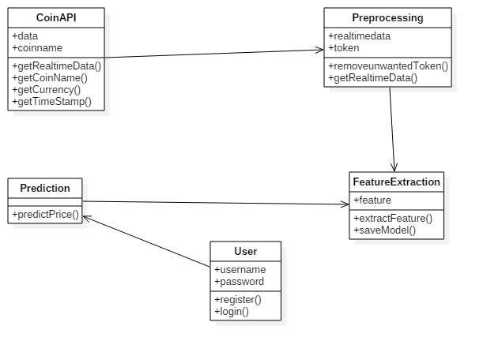
SUBJECT- Project Review
Department:- Computer Engineering
Class
Academic Year 2023-24

Slide 13
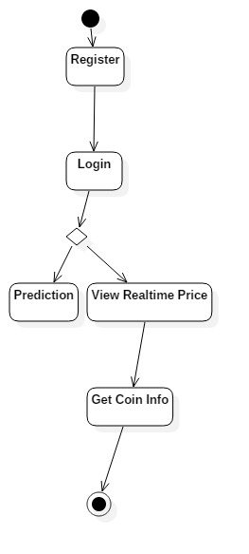
SUBJECT- Project Review
Department:- Computer Engineering
Activity
Academic Year 2023-24

Slide 14
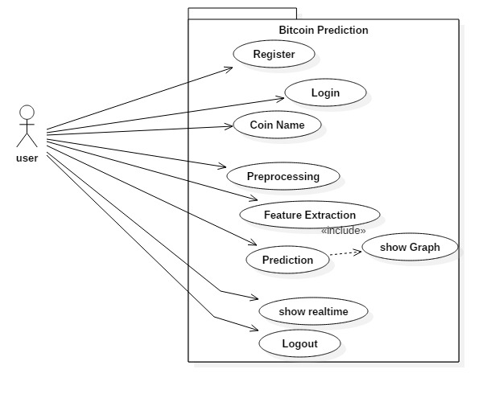
SUBJECT- Project Review
Department:- Computer Engineering
Use case
Academic Year 2023-24

Slide 15
SUBJECT- Project Review
Department:- Computer Engineering
Testing
Sr.No | Test Case ID | Test Case Objective | Pre-condition | Steps | Test Data | Expected Result | Actual Result | Status
1 | TC 1 | Registration | Website should open | 1.Open URL 2.Fill Form | First name Last Name Email id etc | Registration should be done | Registration is done | Test to Pass
2 | TC 2 | Login | TC 1 is done | 1.Open URL 2.Fill emaild and password | Username password | Username and password will validated. If correct open product list page | Bitcoin list is open | Test to Pass
3 | TC 3 | Login | TC 1 is done | Open URL Fill Email id and incorrect password | emailid | Login page will open with incorrect password msg | Login page is opened with login invalid msg. | Test to Pass
4 | TC 4 | View Bitcoin Prediction | TC 2 is done | Select coin Bitcoin Digicoin etc | TC 3 | Graph of prediction can be seen | Price chart is visible | Test to Pass
Academic Year 2023-24

Slide 16
SUBJECT- Project Review
Department:- Computer Engineering
Advantages
Bitcoin is the most accepted cryptocurrency in the world, which makes it attractive for investors and traders.
However, the challenge in predicting the Bitcoin exchange rate is its high volatility. Therefore, the prediction of its behavior is of great importance for financial markets.
Academic Year 2023-24

Slide 17
SUBJECT-Project Review
Department:- Computer Engineering
Disadvantages
The disadvantages of cryptocurrencies include their price volatility, high energy consumption for mining activities, and use in criminal activities.
Academic Year 2023-24

Slide 18
SUBJECT- Project Review
Department:- Computer Engineering
Application
Once we modify dataset below things will be predicted
Bitcoin trading
Stock Trading
Commodity trading
Academic Year 2023-24

Slide 19
SUBJECT- Project Review
Department:- Computer Engineering
Conclusion
The LSTM model which we are going to implement here, is a basic model that takes into consideration only a all features that affect the Bitcoin price.
We will try to create model which is accurate when predicting the future prices.
However, to increase the efficiency of the model we will take live prices of bitcoin.
Academic Year 2023-24

Slide 20
SUBJECT- Project Review
Department:- Computer Engineering
Future scope
We can create a android app for price prediction
Bitcoin trading can also added
News flash
Academic Year 2023-24

Slide 21
SUBJECT- Project Review
Department:- Computer Engineering
Reference
[1] M. Briaere, K. Oosterlinck, and A. Szafarz,Virtual currency, tangible return: Port- folio diversification with Bitcoins, Tangible Return: Portfolio Diversification with Bitcoins , 2013.
[2] S. Nakamoto, ”Bitcoin: A Peer-to-Peer Electronic Cash System”, Available at: https://Bitcoin.org/Bitcoin.Accessed on 2008.
[3] McNally, Sean & Roche, Jason & Caton, Simon. (2018). Predicting the Price of Bitcoin Using Machine Learning. 339343. 10.1109/PDP2018.2018.00060.
[4] H. Jang and J. Lee, "An Empirical Study on Modeling and Prediction of Bitcoin Prices With Bayesian Neural Networks Based on Blockchain Information," in IEEE Access, vol. 6, pp. 5427-5437, 2018
[5] Hota HS, Handa R & Shrivas AK, “Time Series Data Prediction Using Sliding Window Based RBF Neural Network”, International Journal of Computational Intelligence Research, Vol.13, No.5, (2017), pp.1145-1156
Academic Year 2023-24

Slide 22
SUBJECT- Seminar and Technical Communication
Department:- Computer Engineering
Thank You
Academic Year 2023-24

