Slide 1
Computer Graphics and Design (202045611)
Projection Transformation
Presented by :
Stavan Shah (12202130501085)
Vacha Buch (12202130501087)
Guided by : Prof. Tejas Patel
Department of Computer Engineering
G H Patel College of Engineering & Technology
Vallabh Vidyanagar (Gujarat)

Slide 2
Contents
Introduction
Types of projections
Center of projection
Parallel projection
Perspective projection
Conclusion
2

Slide 3
Introduction
Representing an n-dimensional object into an n-1 dimension is known as projection.
It is process of converting a 3D object into 2D object, we represent a 3D object on a 2D plane {(x,y,z)->(x,y)}.
It is also defined as mapping or transforming of the object in projection plane or view plane.
When geometric objects are formed by the intersection of lines with a plane, the plane is called the projection plane and the lines are called projections.
3

Slide 4
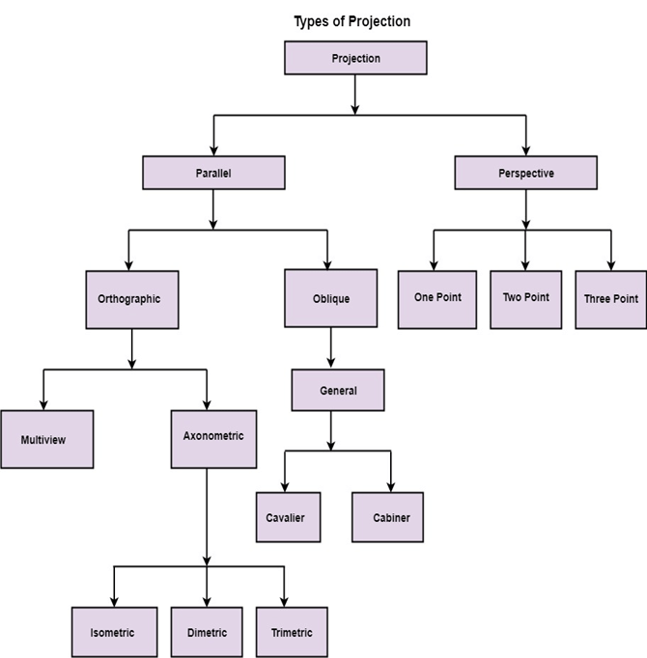
Types Of Projections
4

Slide 5
Center Of Projection
It is an arbitrary point from where the lines are drawn on each point of an object.
If c.o.p is located at a finite point in 3D space , Perspective projection is the result.
If the c.o.p is located at infinity, all the lines are parallel and the result is a parallel projection.
5

Slide 6
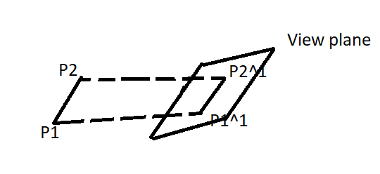
Parallel Projection
A parallel projection is formed by extending parallel lines from each vertex of object until they intersect plane of screen.
A parallel projection preserves relative proportion of objects, accurate views of the various sides of an object are obtained with a parallel projection.
It is used in drafting to produce scale drawings of 3D objects.
This is not a realistic representation, the point of intersection is the projection of the vertex.
6

Slide 7
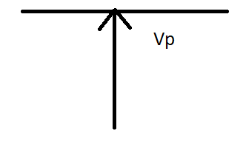
Orthographic Projection
Orthographic parallel projections are done by projecting points along parallel lines that are perpendicular to the projection line.
In orthographic projection the direction of projection is normal to the projection of the plane.
Orthographic projections are most often used to procedure the front, side, and top views of an object.
Engineering and architectural drawings commonly employ these orthographic projections.
7

Slide 8
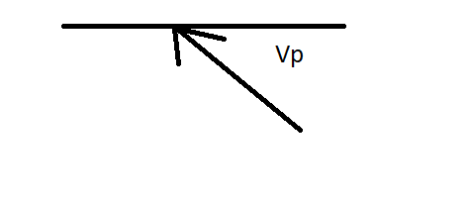
Oblique Projection
Oblique projections are obtained by projectors along parallel lines that are not perpendicular to the projection plane.
An oblique projection shows the front and top surfaces that include the three dimensions of height, width and depth.
The front or principal surface of an object is parallel to the plane of projection.
8

Slide 9
Perspective Projection
A perspective projection is the one produced by straight lines radiating from a common point and passing through point on the sphere to the plane of projection.
Perspective projection is a geometric technique used to produce a three dimensional graphic image on a plane, corresponding to what person sees.
Any set of parallel lines of object that are not parallel to the projection plane are projected into converging lines. A different set of parallel lines will have a separate vanishing point.
Coordinate positions are transferred to the view plane along lines that converge to a point called projection reference point.
The distance and angles are not preserved and parallel lines do not remain parallel.
9

Slide 10
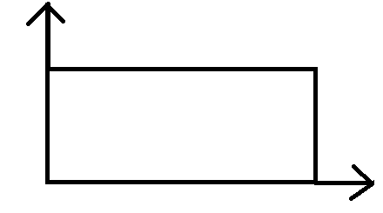
Perspective Projection
One point perspective projections:
In this, principal axis has a finite vanishing point. Perspective projection is simple to draw.
10

Slide 11
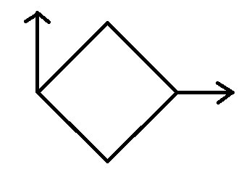
Perspective Projection
Two point perspective projections:
Exactly 2 principals have vanishing points. Perspective projection gives better impression of depth.
11

Slide 12
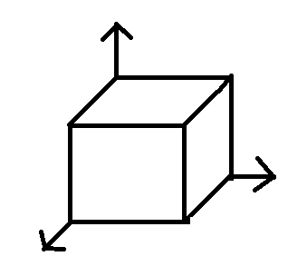
Perspective Projection
Three point perspective projections:
All the three principal axes have finite vanishing point. Perspective projection is most difficult to draw.
12

Slide 13
Conclusion
Projection transformations are essential in computer graphics, providing a bridge between 3D models and 2D display screens.
By understanding different types of projections, such as parallel and perspective, and concepts like the center of projection, we gain the tools to represent realistic views of 3D objects.
While parallel projections maintain object proportions, perspective projections create depth by mimicking how we see objects in the real world.
Together, these methods form the foundation of rendering, enabling designers and developers to control how scenes appear from various viewpoints, enhancing the realism and functionality of digital graphics.
13

Slide 14
Thank
You!
14

