Slide 1
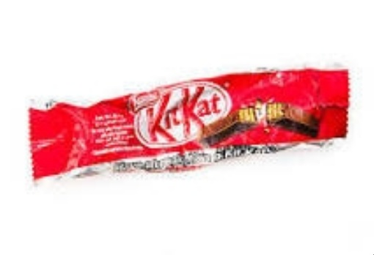
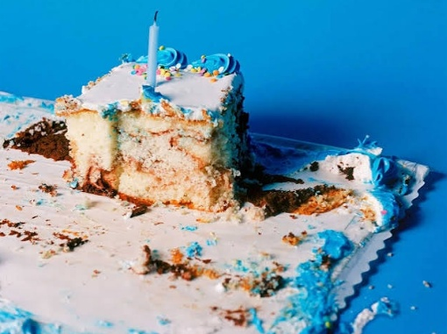
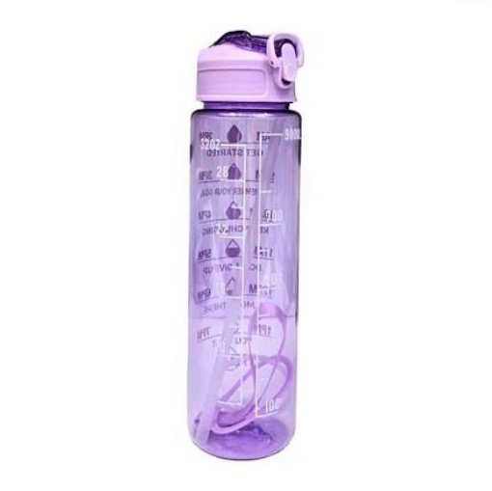
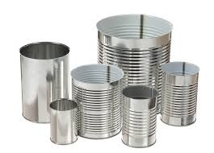
PROBLEM & INTENDED USERS
Binzy
One wrong item contaminates the whole bin
The problem
• A campus cafeteria produces mixed waste: paper, plastic, metal, food scraps and non-recyclables
• Students decide in ~2 seconds and often guess - wrappers, paper cups, tetra packs and leftovers are confusing
• Wrong-bin disposal contaminates recycling and forces sanitation staff to re-sort by hand
• Goal: photo of any item → the right bin + how to dispose of it, and an honest 'not sure' when needed
Intended users
• Students & faculty at the bin (phone or kiosk camera)
• Cafeteria / housekeeping staff and the campus sustainability team
VIT AI Innovate-A-Thon · Q6 Smart Waste Segregation Assistant · 1/7

Slide 2
PROPOSED IDEA & INNOVATION
Binzy
A waste sorter that understands any item - and knows when it doesn't
Open vocabulary
Three experts, one vote
Honest safety net
Google SigLIP compares the photo with 202 written descriptions (chocolate wrapper, leftover cake, clay kulhad, tetra pack…) - recognises items never in any training set.
SigLIP zero-shot + SigLIP with a trained head + fine-tuned ConvNeXt, fused with weights 0.5/0.1/0.4 tuned on validation data.
'Not waste' concepts reject selfies, phones, scenery. Low confidence or high entropy → 'check the label, retake, ask staff', plus a manual bin picker.
Item-specific advice
Fast & private
Stress-tested
Bin + target + steps + item tips: multi-layer wrappers, greasy pizza boxes, batteries to e-waste.
~90 ms per photo on a laptop GPU, live auto-scan from the camera, nothing stored or sent to a cloud.
Live lighting / glare / occlusion / blur simulator and measured robustness curves.
VIT AI Innovate-A-Thon · Q6 Smart Waste Segregation Assistant · 2/7

Slide 3
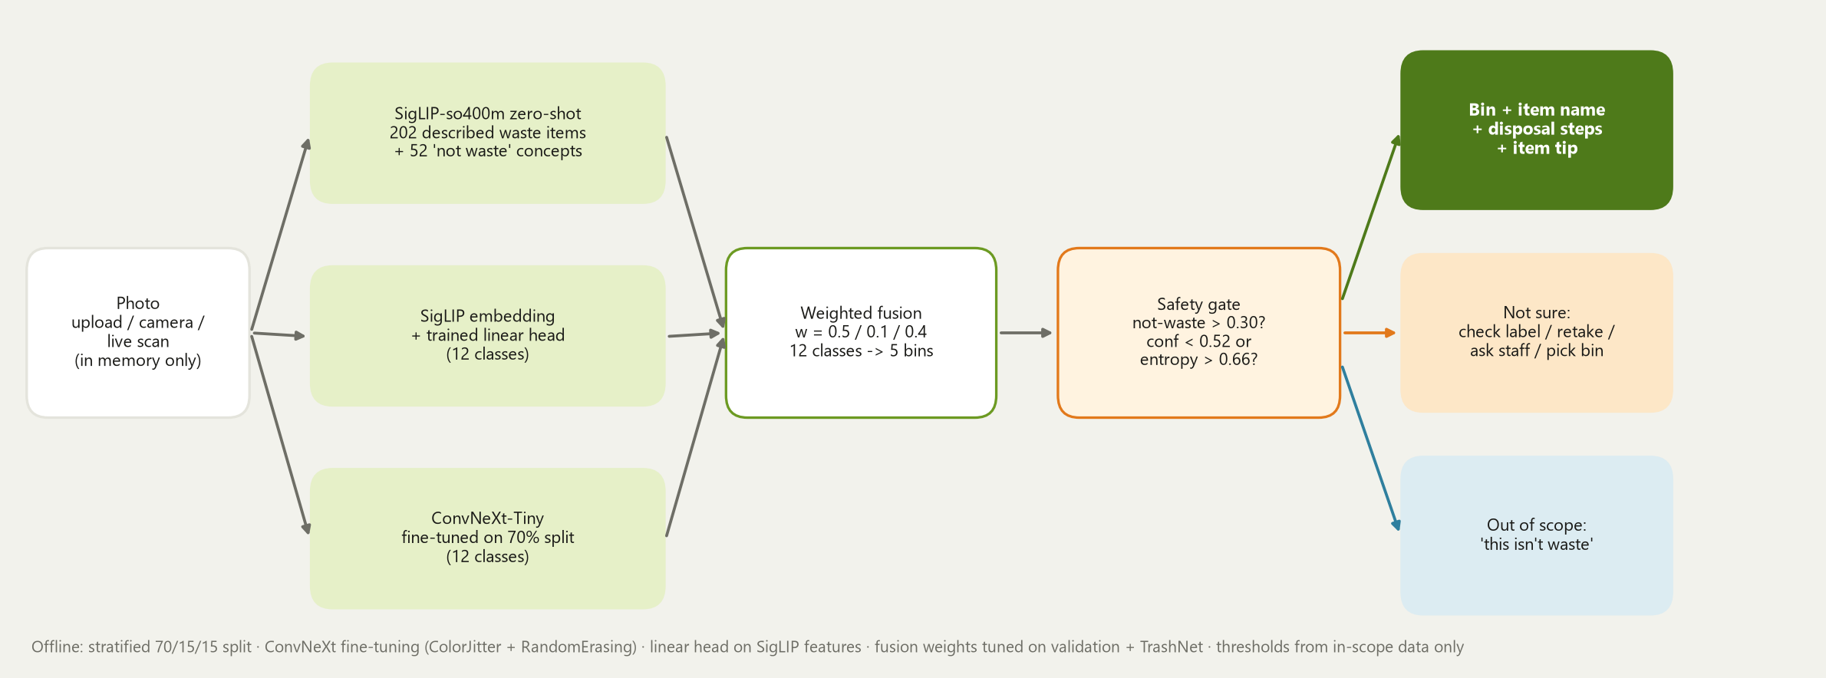
SYSTEM ARCHITECTURE & TECHNICAL APPROACH
Binzy
Three experts → fusion → safety gate
Data: 15,520 images, 12 classes, stratified 70/15/15 (10,864 / 2,328 / 2,328), seed 42 · Stack: PyTorch, Hugging Face Transformers (SigLIP), torchvision (ConvNeXt), scikit-learn, FastAPI, vanilla-JS web app
VIT AI Innovate-A-Thon · Q6 Smart Waste Segregation Assistant · 3/7

Slide 4
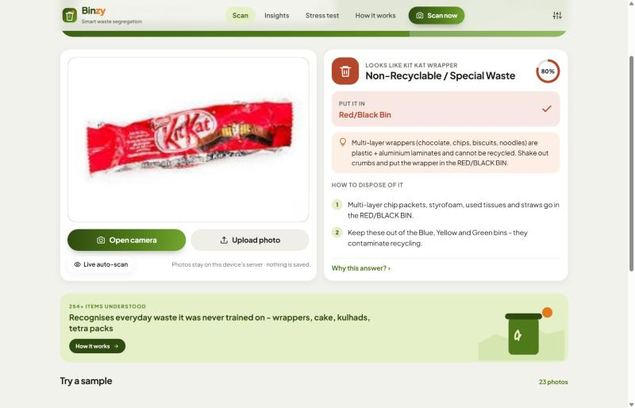
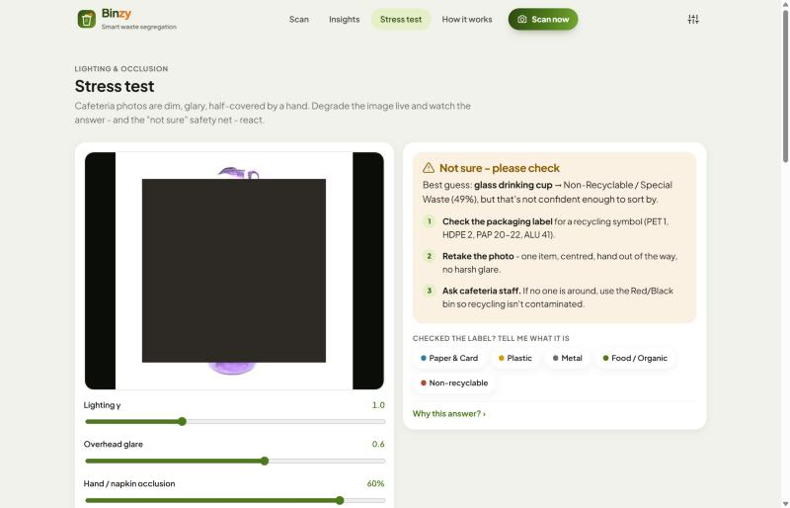
PROTOTYPE DEMONSTRATION & USER WORKFLOW
Binzy
Snap → bin → done (or 'not sure, please check')
Live demo
• run_app.bat → http://localhost:8000
• Scan: camera, upload, drag-drop, paste, live auto-scan
• Result: bin, target, item name, steps, tip, 'why this answer'
• Insights: split, metrics, external datasets, failures
• Stress test: lighting / glare / occlusion / blur sliders
Script
• Water bottle → Yellow bin · leftover cake → Green bin
• Chocolate wrapper → Red/Black (multi-layer tip)
• Battery → e-waste box
• Dog / noise photo → 'this isn't waste'
• Occlusion slider to 60% → 'not sure - please check'
VIT AI Innovate-A-Thon · Q6 Smart Waste Segregation Assistant · 4/7

Slide 5
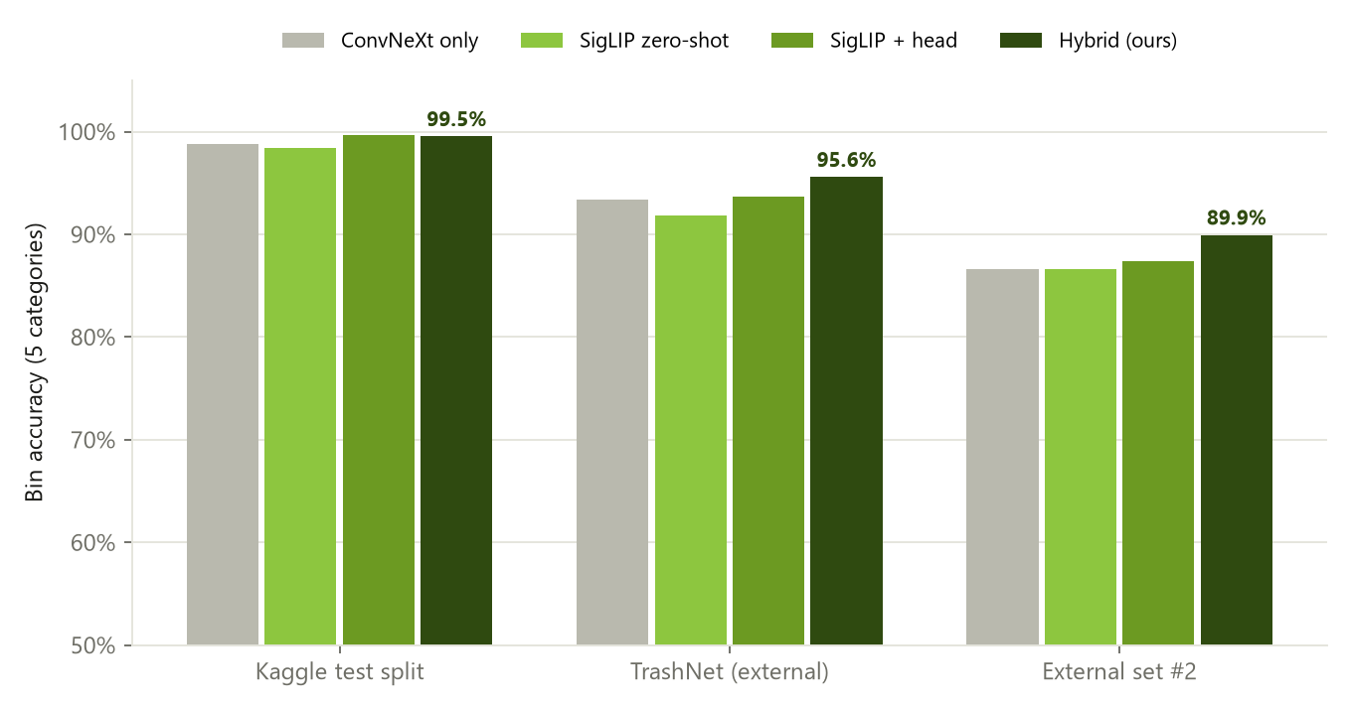
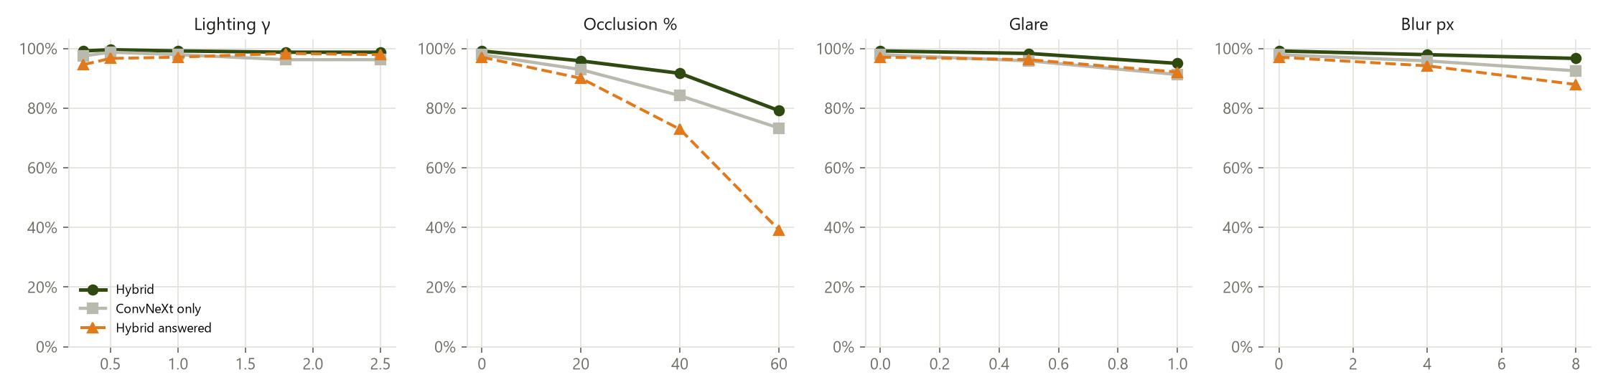
TESTING, EVALUATION RESULTS & LIMITATIONS
Binzy
Measured on images the models never trained on
Dataset | n | ConvNeXt only | Hybrid
Kaggle test split | 2328 | 98.8% | 99.5%
TrashNet (external) (tuning) | 2527 | 93.4% | 95.6%
External set #2 | 397 | 86.6% | 89.9%
Non-waste photos refused | 1000 | 68.7% | 93.0%
• Kaggle test: macro-F1 98.9%, answers 97.2% of photos with 99.9% accuracy
• External set #2: hybrid 89.9% vs ConvNeXt 86.6%
• Limits: one item per photo; occlusion > 40% hurts most; cluttered trays and local items not in training data
VIT AI Innovate-A-Thon · Q6 Smart Waste Segregation Assistant · 5/7

Slide 6
RESPONSIBLE AI & SDG ALIGNMENT
Binzy
Private, honest, and built for a greener campus
Privacy
Bias & domain shift
Responsible consumption
SDG 12.5
Cleaner streams → more material actually recycled
Photos processed in memory on the local machine, never saved or uploaded; session stats are counts only.
Training photos are clean single items from outside India; the open-vocabulary expert covers local items, but real cafeteria accuracy will be lower than test scores.
Sustainable cities
SDG 11.6
Better campus waste management, less manual sorting
Human oversight
Safety & accessibility
Uncertain / out-of-scope photos never get a bin decision; users check the label, ask staff or pick the bin.
Batteries and broken glass always go to staff. Icons + text, plain language, phone-friendly, dark mode.
Climate action
SDG 13
Food scraps to compost/biogas, not landfill → less methane
VIT AI Innovate-A-Thon · Q6 Smart Waste Segregation Assistant · 6/7

Slide 7
CONCLUSION
Binzy
Implemented today · what comes next
Implemented (working now)
Next steps
• Hybrid recogniser - 99.5% bin accuracy on 2,328 held-out test photos, 89.9% on an unseen external dataset
• Open vocabulary: 202 everyday waste items incl. Indian cafeteria waste
• Camera, upload and live auto-scan web app (Ghumzy design language)
• 5 bins, item tips, 'not waste' + 'not sure' safety net with manual override
• Documented split, external-dataset tests, failure gallery, robustness study
• Collect & label photos in the VIT cafeteria; fine-tune on them
• Multi-item tray detection (YOLO + TACO dataset)
• Edge box at the bin: ONNX / INT8, LED ring light, lid that opens the right bin
• Contamination dashboard for the sustainability team
• Hindi / Tamil labels and voice prompts
VIT AI Innovate-A-Thon · Q6 Smart Waste Segregation Assistant · 7/7

