Slide 1
Autonomous Carrier
Team CLEVR

Slide 2
Members
Varad Mahajan
Ayan Prakash
Jalaj Kumar Singh

Slide 3
The challenge
How can we transfer files (hardcopies) from one cubicle to another?
Can you guys guess?

Slide 4
The classical solution
Well, mostly by personally delivering those files… Right?
What about the time wasted while delivering these files?
All those distractions that one gets while going to the second cubicle.
What about the loss of efficiency?
What if the time wasted there had been out to some good use? Well the profits of the company will obviously rise

Slide 5
Another one
Take the case of waiters
Do you ‘techno-nerds’ think that the people in this profession choose to be in this menial service position?
Each one of them wanted to become a something more in their life. Just like us.
What if we as a society could use their skills and knowledge for a better purpose than waitering?
We can give them a second chance at education and at work

Slide 6
Solutions
Think of a system that will come to your cubicle so that you can give it your files and it can take the hard copies to the other cubicle while you can keep working on that brilliant idea of yours…
Now coming back to the waiters –
We can have a system that delivers you your food in a restaurant to your table after you have ordered it from your table.

Slide 7
Similarities
Both of these systems seem pretty straightforward and similar, don’t they?
So, we decided to make one system that can work as both a clerk and a waiter
We call this system an autonomous carrier.

Slide 8
About the system
At it’s basic most level, it would be just a simple bot with a compartment for ‘stuff’ powered with some of the blooming technologies such as IoT

Slide 9
Into the details
Well, it contains a NodeMCU microcontroller with wifi module and IR sensors for path finding and motors with wheels for locomotion
We can also use an ultrasound sensor to detect obstacles

Slide 10
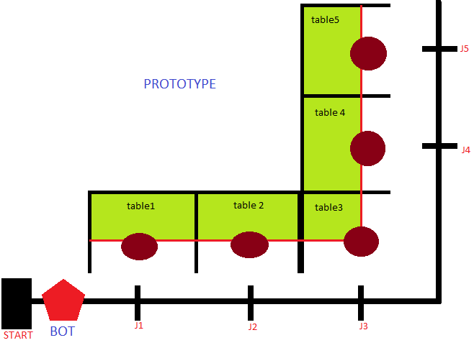

Slide 11
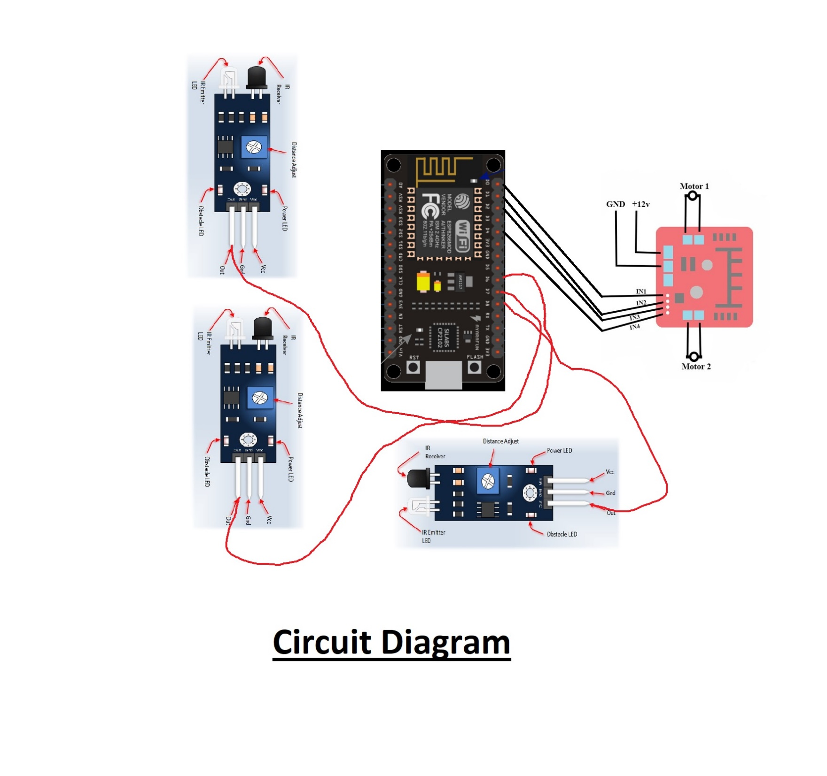

Slide 12
components
We used a NodeMCU 12E (ESP8286)
A L298N motor driver
3 IR sensors

Slide 13
We have connected two 150 rpm motors with the L298N(Motor driver) which is in turn connected to the NodeMCU
The motion of the motors is governed by the IR sensors
One IR sensor is connected to the front to stay on the path and two on either side of the bot to figure out where to turn and where to stop at the particular junction

Slide 14
ANY Questions?

Slide 15
Thank you

