Slide 1
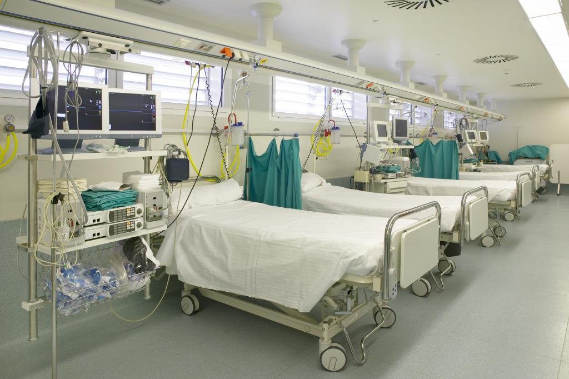
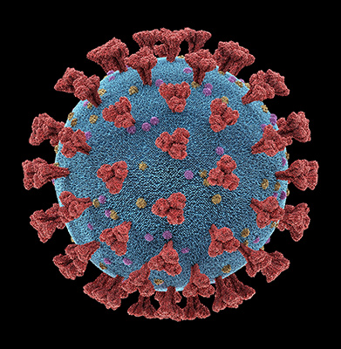
Monte-Carlo Simulation of Hospital Capacity
During COVID-19 Pandemic
Varad Deshpande | Rohit Sanvaliya | Tanya Gupta

Slide 2

Introduction
The COVID-19 pandemic has been a major test of the capabilities and capacities of hospitals with respect to anticipating and treating in the times of global crisis.
Current all the major cities are facing crunch accommodating patients of COVID-19
In these trying times, we have attempted to develop a robust model that can help hospitals in planning and allocating resources based on the population they are dealing with and the resources available.
We have model similar to SEIR pandemic model to predict the time in which health system will no longer will be able to accommodate new patients.

Slide 3

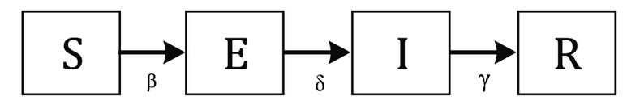

Model
Susceptible:
100% of the population is Susceptible to COVID-19
Exposed: Number of people who has contracted the virus. We considered the social distancing and incubation rate (5%) of the Exposed
Infection: Total population exposed to the virus and got Infection
Result: Patients who has vacated the hospital bed either by recovery or death
Our overall model is similar to the SEIR (Susceptible-Exposed-Infectious-Recovered) model which depicts the COVID-19 situation aptly.
Our model replaces the R depicting ‘Recovered’ with ‘Result’ which takes into account the state of recovery as well as death from COVID-19.
We have fit suitable variables in the model and altered the calculations for each transitional variable to get accurate results.

Slide 4

Starting Point
In our model, we have assumed the following things at starting state:
Fixed number of hospital beds
Fixed population around the hospital
Zero COVID-19 patients in the hospital
Hospital can accommodate any arrival rate
Social distancing is followed at its fullest
Testing kits used are 100% accurate
Recovered patients are not getting re-infected

Slide 5

Variables
The variables we have taken into consideration are:
Infectious rate
Incubation rate
Recovery rate
Arrival rate of people to be tested
Probability of people testing positive for COVID-19
Service time distribution of testing kits
Time to Outcome

Slide 6

Transitional Variables Definition
Infectious Rate (𝛽) = 𝑅_1* 𝛾 [𝑅_1 – Reproduction Rate when social distancing is followed, 𝛾 – Recovery Rate]
Incubation Rate (𝛼) = 1/Incubation Period[Incubation Period – The duration after which the patients show symptoms after being exposed]
Recovery Rate (𝛾) = 1/Infectious Period[Infectious Period – The duration in which the patient is capable of spreading COVID-19]
Arrival Rate of people to be tested – The rate at which potential infected people are arriving in the hospital
Probability of people testing positive for COVID-19 – Positive specimens out of the total specimens tested
Service time distribution of testing kits – The time taken to receive test results for COVID-19

Slide 7


Compartment Definition
Each compartment in the our model gives the number of people in that compartment
Our inspired model has the following compartment definitions –
${\text{Susceptible}}_{n}$ = ${\text{Susceptible}}_{n−1}$ - ($β$*${ \text{Infected}}_{n−1}$* ${\text{Susceptible}}_{n−1}$)
${\text{Exposed}}_{n}$ = ${\text{(}\text{Exposed}}_{n−1}$- $(α$* ${\text{Exposed}}_{n−1}$))*0.05 #
${\text{Infected}}_{n}$ = (Arrival Rate of people to be tested* Probability of people testing positive for COVID-19* ${\text{Exposed}}_{n}$)
${ \text{Hospitalized}}_{n}$ = 0.17*${ \text{Infected}}_{n}$ #
${ \text{Result}}_{n}$ = $γ$*${ \text{Hospitalized}}_{n}$
# - The value 0.05 is the probability that people will come in contact with each other despite social distancing
The value 0.17 is the probability of the total infected people being hospitalized
These values are found through precise research

Slide 8

Hypothesis
Hypothesis 1: - If the number of hospital beds is doubled, there will never be an overflow.
Hypothesis 2: - If 25% of the total population is strictly asked to follow a lockdown, 50% of the total hospital beds will become vacant.

Slide 9
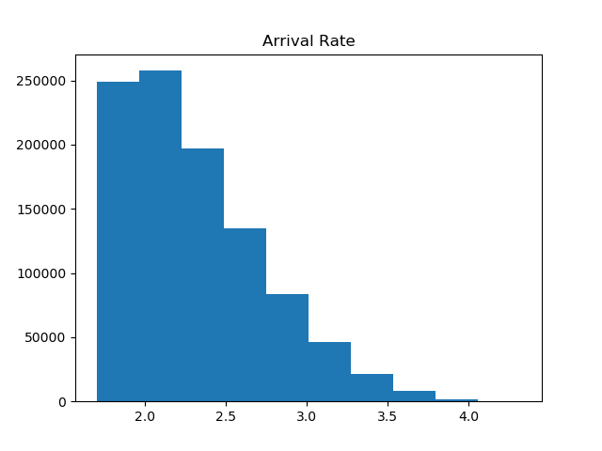
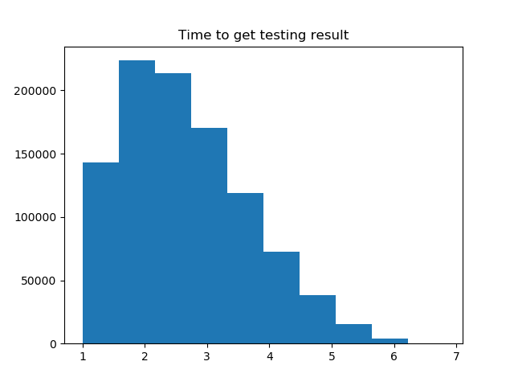
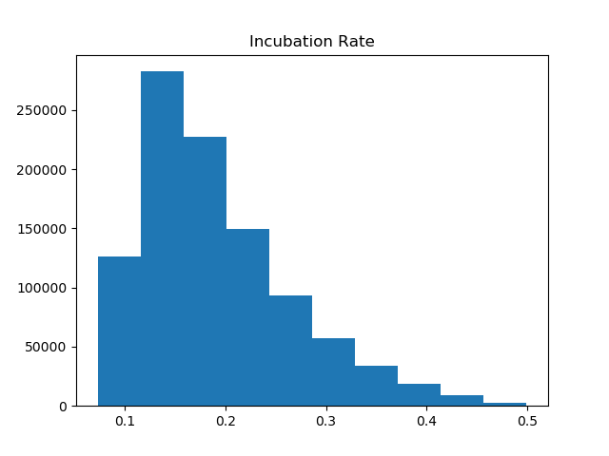
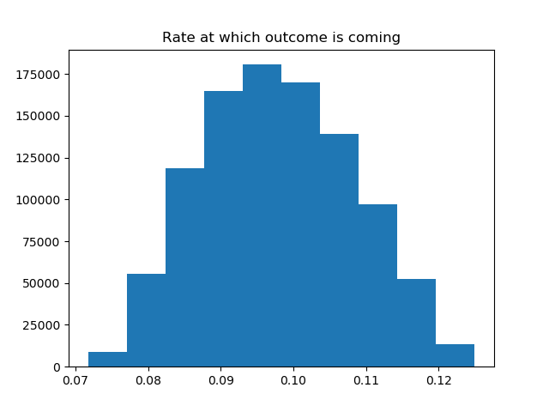
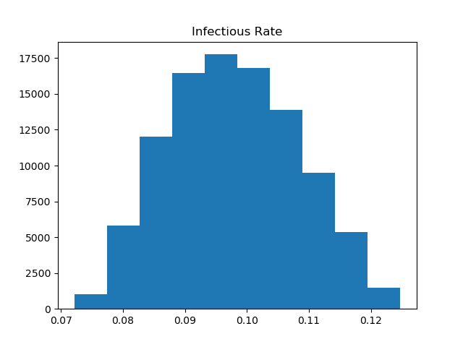
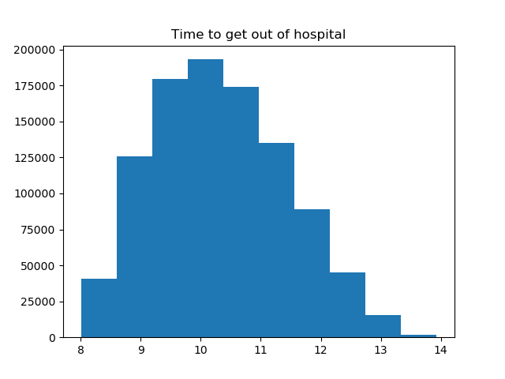
Distributions

Slide 10
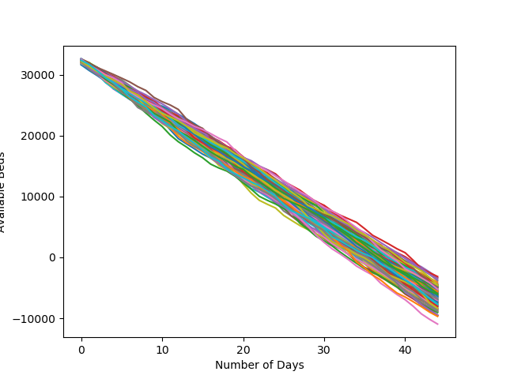
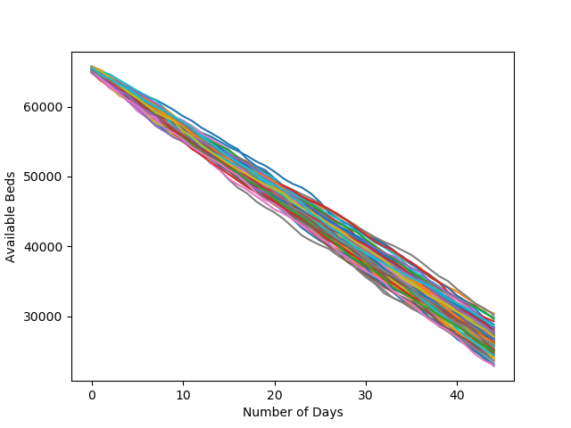
Hypothesis - 1

Slide 11



