Slide 1

M.TECH THESIS DEFENSE
Design and Verification of a Lightweight RISC-V-Based IoT Security Processor with Iterative Hardware-Reusable AES 128
Varada Inamdar | MIS 712438020
Guide: Dr. Ashwini Kulkarni
VLSI Design · Department of Electronics and Telecommunication Engineering
COEP Technological University, Pune | 2024–26
Iterative AES research → processor integration → end-to-end secure telemetry

Slide 2
MOTIVATION
Why edge security is difficult
Vehicle telemetry needs protection under tight area, power, and timing budgets.
!
SECURITY PRESSURE
µ
EDGE CONSTRAINTS
SENSOR
RAW DATA
A
P
T
IMU · speed
visible on link
AREA
POWER
TIME
small FPGA / ASIC
limited activity
real-time response
READ
REPLAY
ALTER
One false or exposed record can affect trust in downstream decisions.
Security cannot consume the resources needed by the sensing task.
DESIGN NEED
Hardware security with controlled area and activity
COEP Technological University
M.Tech Thesis Defense
02

Slide 3
CONTRIBUTION
One research path, three engineering layers
01
02
03
Reusable AES-128
RISC-V integration
Layered verification
One round datapath reused for 10 rounds
MMIO + custom ISA + sensor/UART/DMA
Directed + random + UVM + Full-SoC
Research paper
M.Tech thesis system
Evidence and reproducibility
COEP Technological University
M.Tech Thesis Defense
03

Slide 4
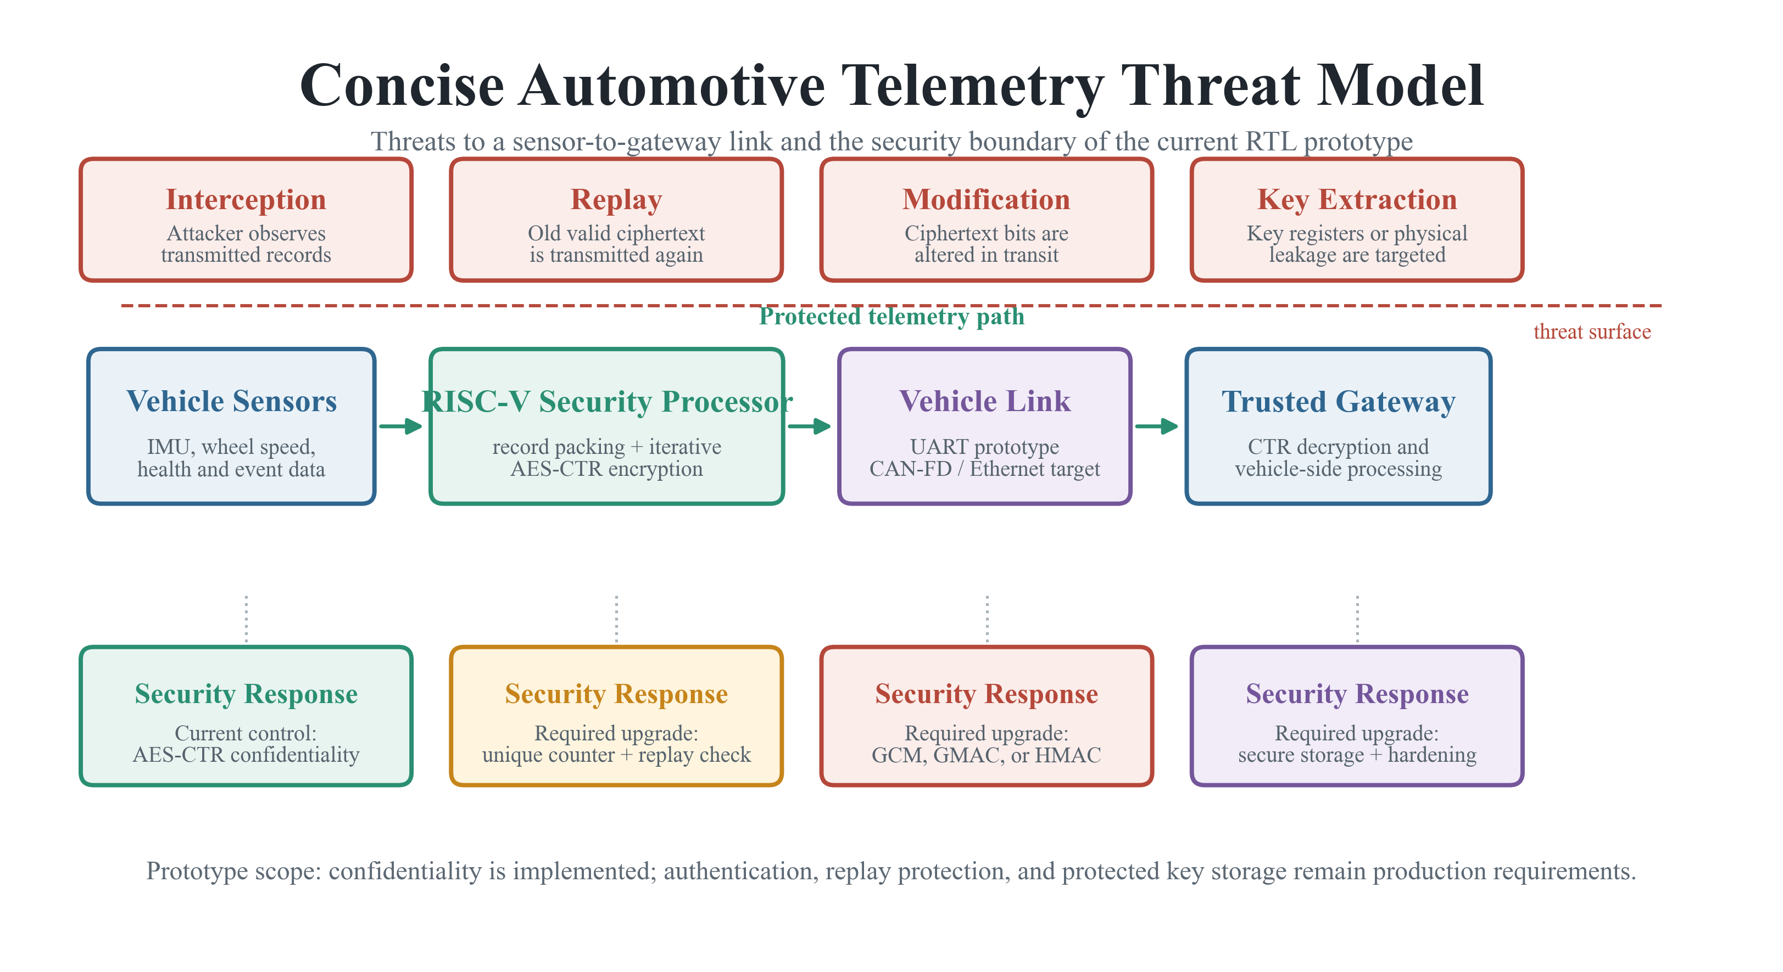
THREAT MODEL
Security scope: what is protected, and what is not
Implemented now
AES-CTR confidentiality Unique counter progression Hardware/software observability
Production additions
Authentication / integrity Replay protection Protected key storage Side-channel hardening
COEP Technological University
M.Tech Thesis Defense
04

Slide 5
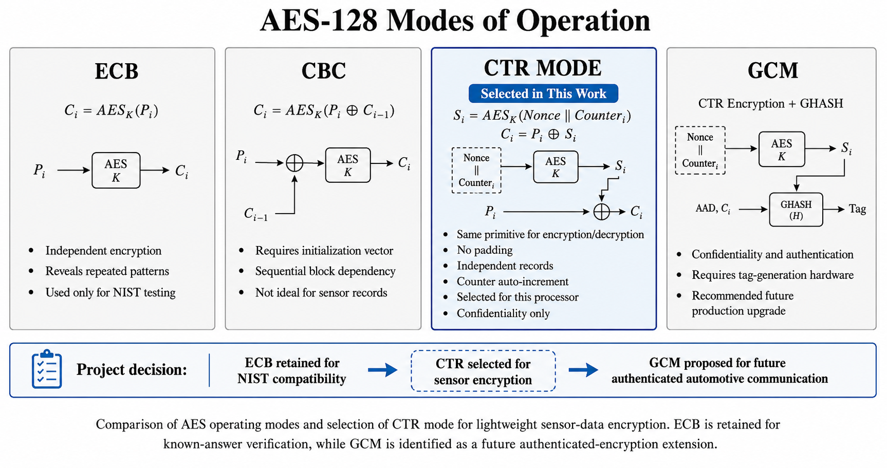
CRYPTOGRAPHY
AES-128 primitive, CTR for streaming records
Kᵢ = AESₖ(N ∥ CTRᵢ)
Cᵢ = Pᵢ ⊕ Kᵢ
✓
Same primitive
encrypt + decrypt
✓
No padding
record friendly
✓
Parallelizable
independent blocks
ECB retained only for NIST compatibility
COEP Technological University
M.Tech Thesis Defense
05

Slide 6
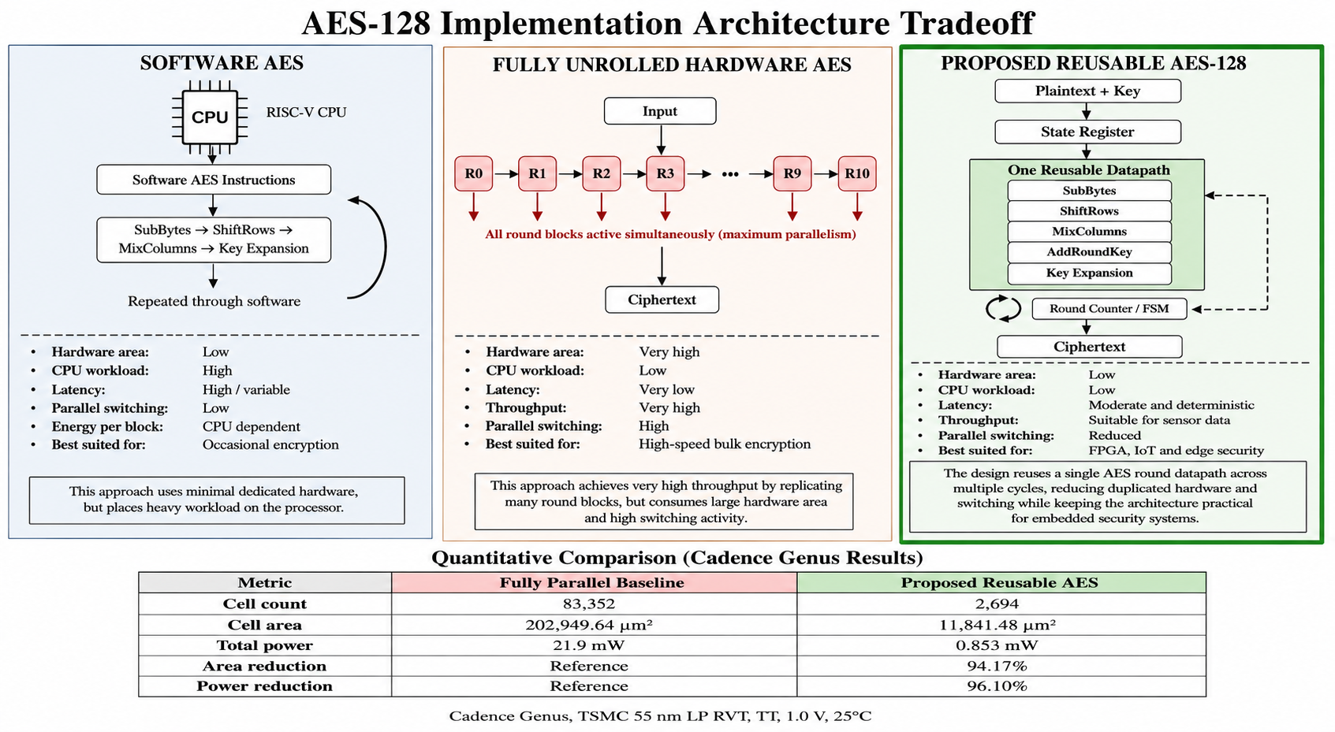
AES MICROARCHITECTURE
Why iterative hardware reuse?
Proposed balance
1×
round datapath
10
controlled rounds
Tradeoff
Lower area and activity for higher block latency
COEP Technological University
M.Tech Thesis Defense
06

Slide 7
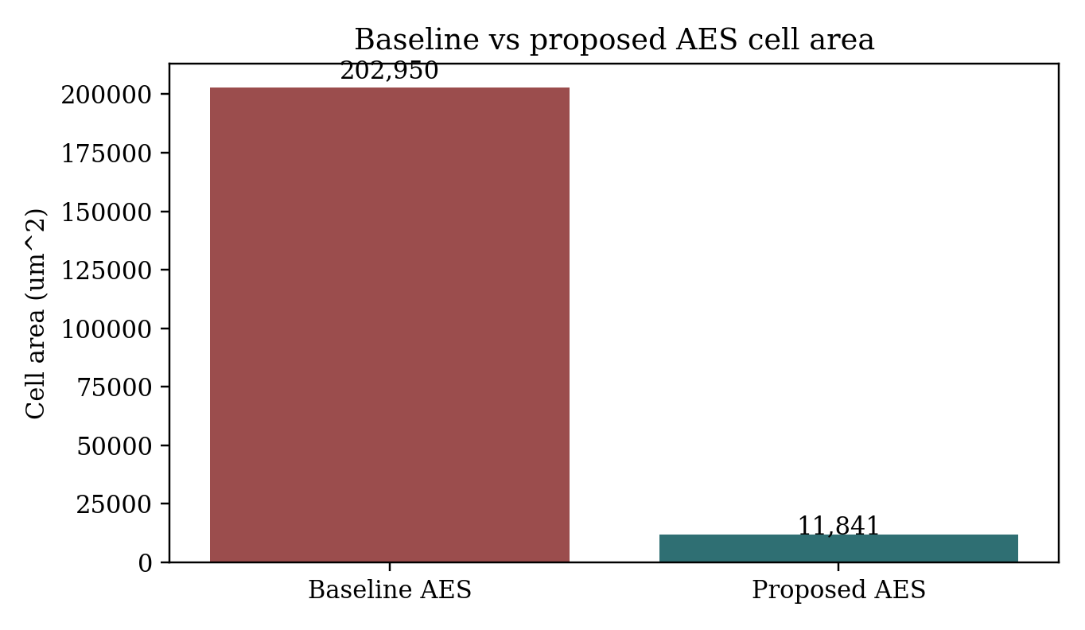
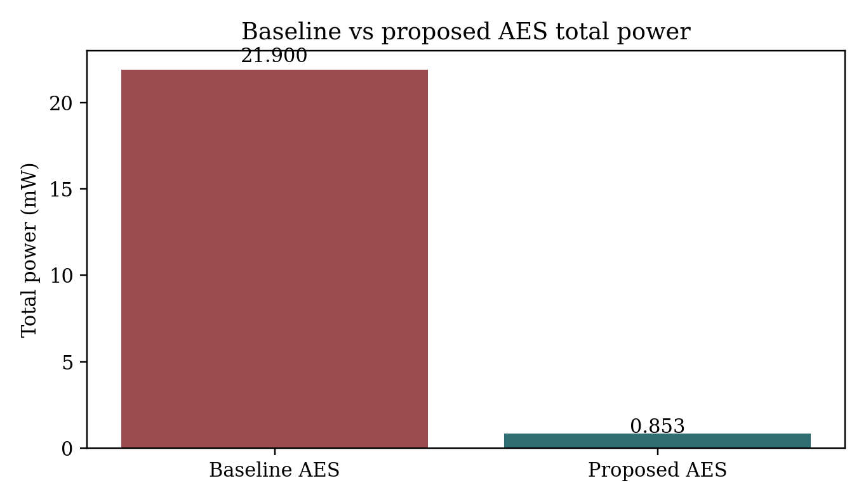
CADENCE GENUS · 55 NM · AES ONLY
Standalone AES: the reuse benefit is measurable
96.77%
94.17%
96.10%
+6.806 ns
fewer cells
lower cell area
lower total power
setup slack at 10 ns
83,352 → 2,694
202,949.64 → 11,841.48 µm²
21.9 → 0.853 mW
critical data path 3.102 ns
COEP Technological University
M.Tech Thesis Defense
07

Slide 8
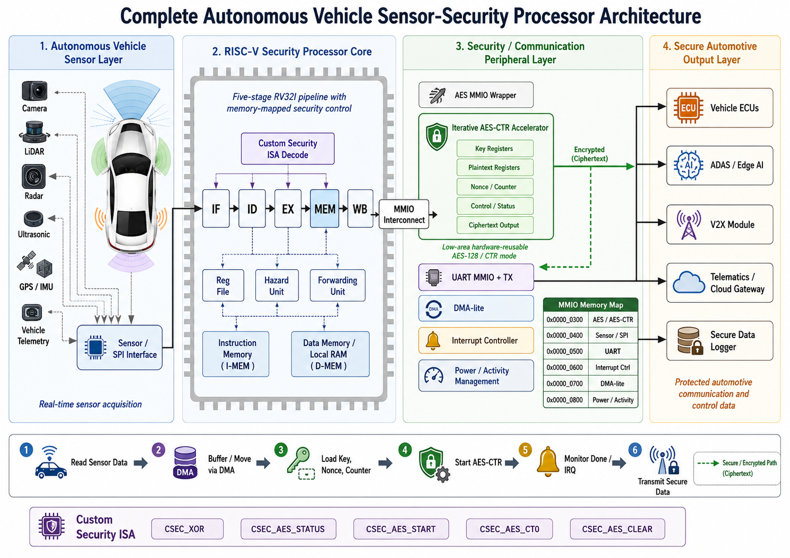
SYSTEM ARCHITECTURE
From cryptographic block to security processor
COEP Technological University
M.Tech Thesis Defense
08

Slide 9
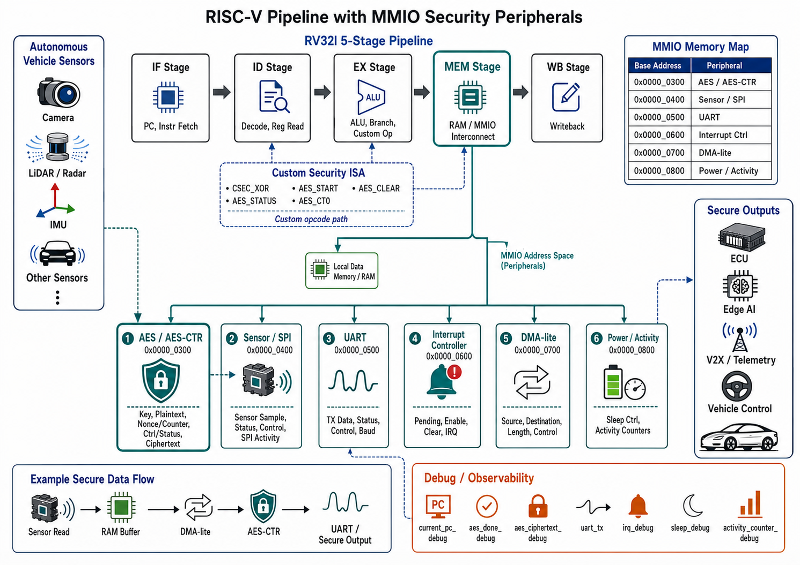
RISC-V INTEGRATION
The MEM stage becomes the internal security interconnect
Address windows
0x300
AES / CTR
0x400
Sensor / SPI
0x500
UART
0x600
Interrupts
0x700
DMA-lite
0x800
Power
COEP Technological University
M.Tech Thesis Defense
09

Slide 10
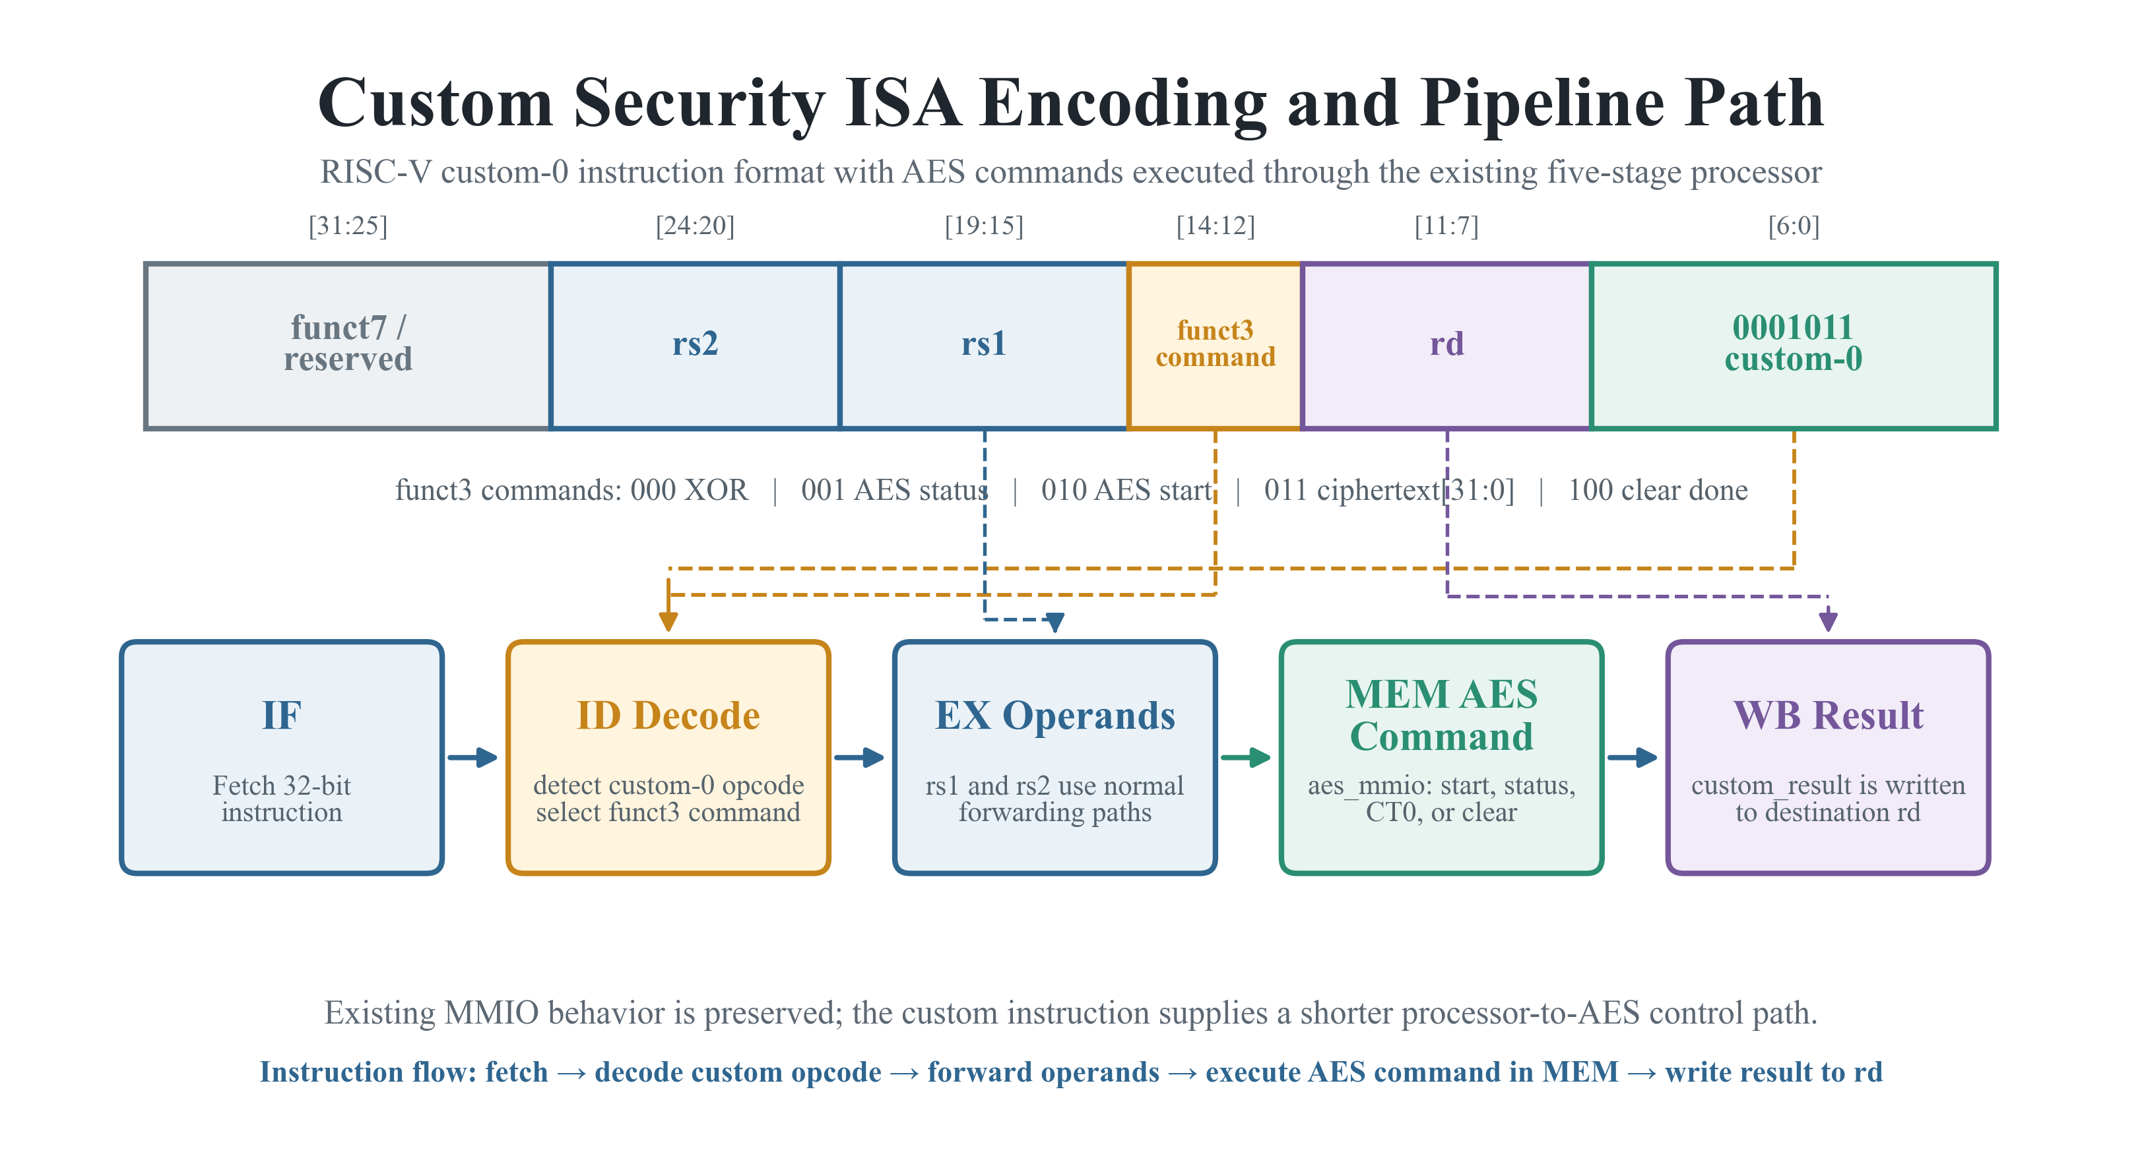
CUSTOM-0 OPCODE
Custom security ISA: lower software control overhead
0001011
RISC-V custom-0 opcode
CSEC_XOR
AES_STATUS
AES_START
AES_CT0
AES_CLEAR
MMIO remains available
COEP Technological University
M.Tech Thesis Defense
10

Slide 11
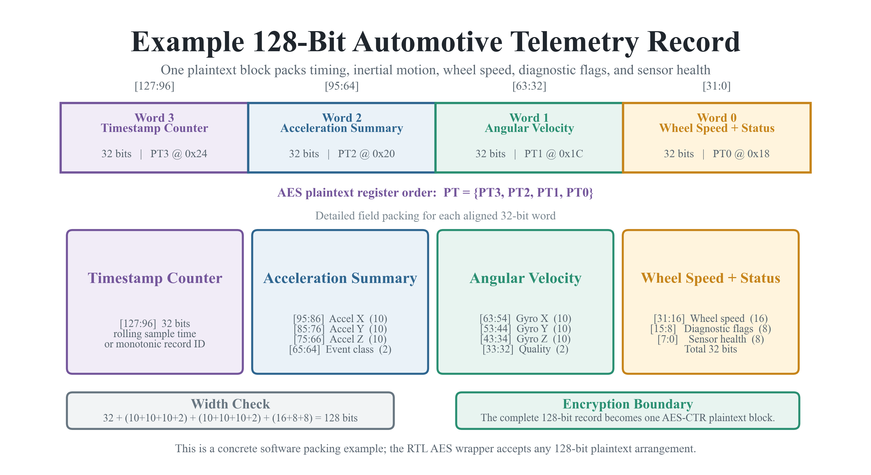
AUTONOMOUS VEHICLE SCENARIO
One 128-bit vehicle record, protected end to end
1
Read sensor / SPI
2
Stage record with DMA
3
Encrypt using AES-CTR
4
Transmit ciphertext
5
IRQ → counters → sleep
Receiver regenerates keystream and XORs
COEP Technological University
M.Tech Thesis Defense
11

Slide 12
VERIFICATION METHODOLOGY
Verification grows from primitive to application
Confidence increases with integration
7
6
Full-SoC
sensor → UART → sleep
5
Coverage
114 planned bins
4
UVM + C-DPI
independent reference model
3
Random smoke
changing values and addresses
2
Peripheral directed
MMIO + custom commands
1
CPU directed
RV32I-style behavior
AES KAT
NIST primitive correctness
COEP Technological University
M.Tech Thesis Defense
12

Slide 13
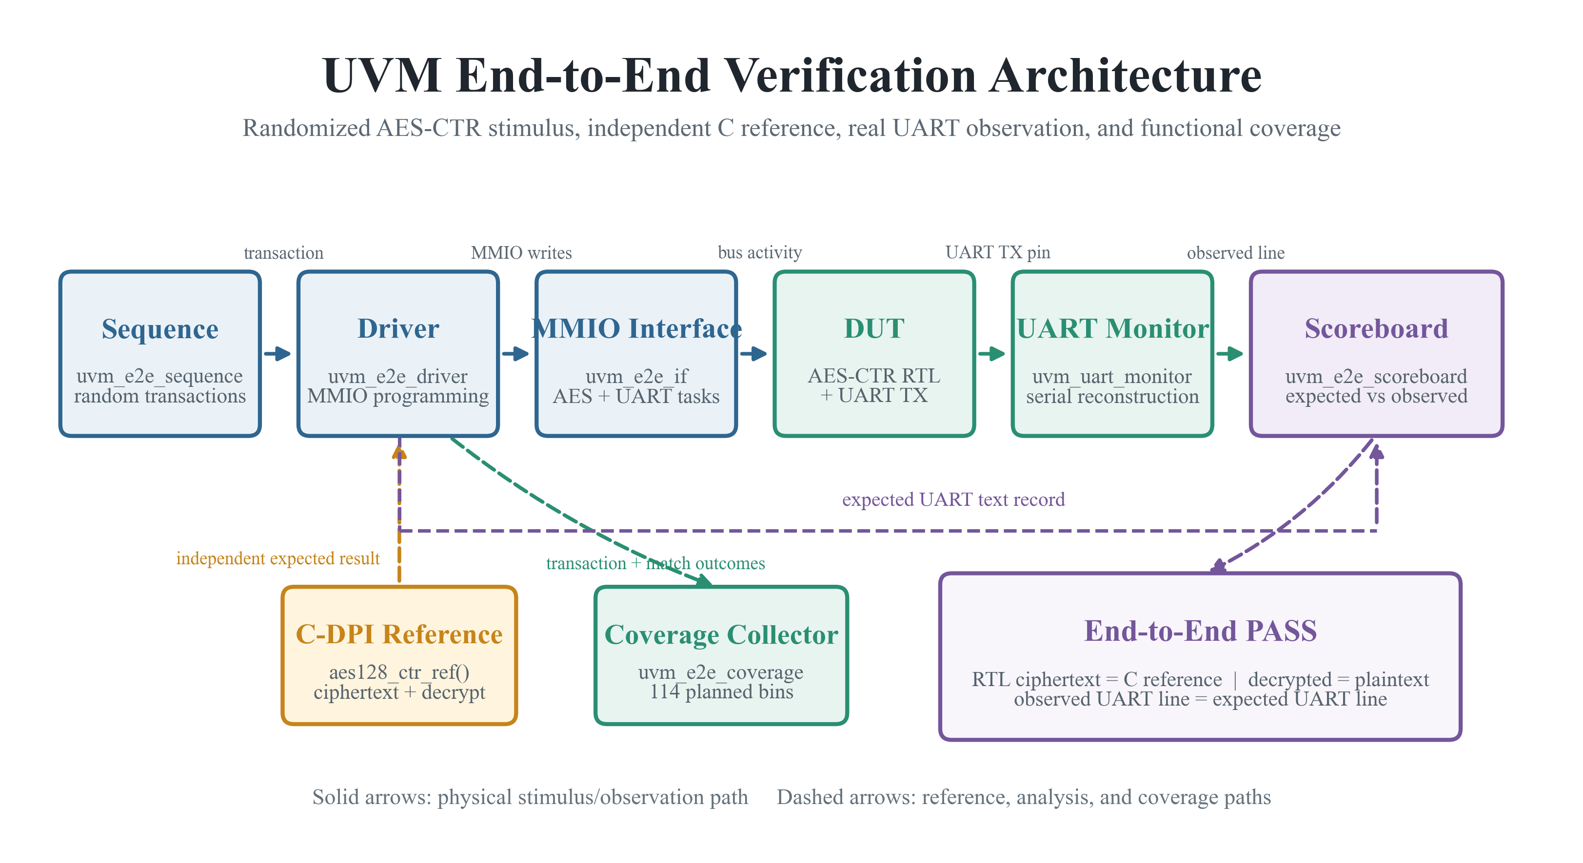
UVM ARCHITECTURE
Independent reference, serial monitor, end-to-end scoreboard
COEP Technological University
M.Tech Thesis Defense
13

Slide 14
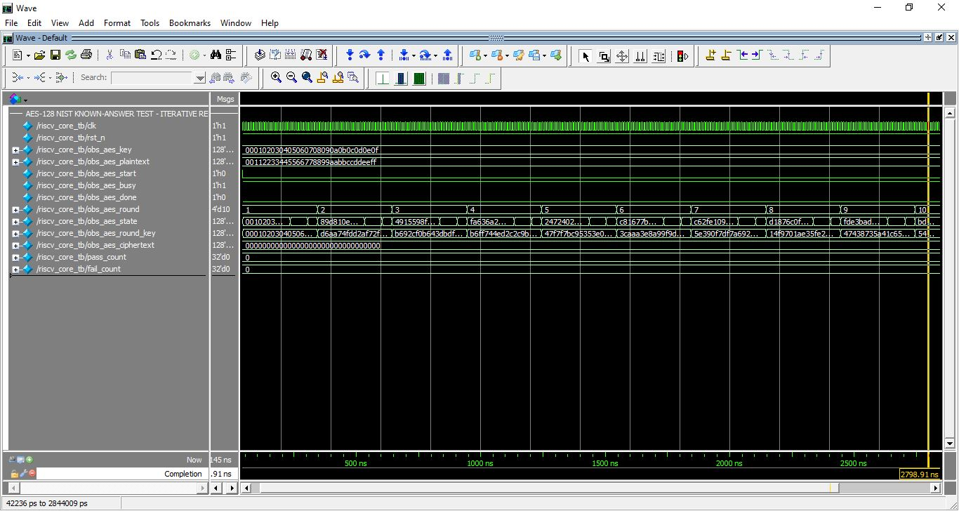
QUESTA WAVEFORM
Known-answer test: round-by-round correctness
Key 000102…0E0F
Plaintext 001122…EEFF
10 rounds observed
Ciphertext 69C4E0…C55A ✓
COEP Technological University
M.Tech Thesis Defense
14

Slide 15
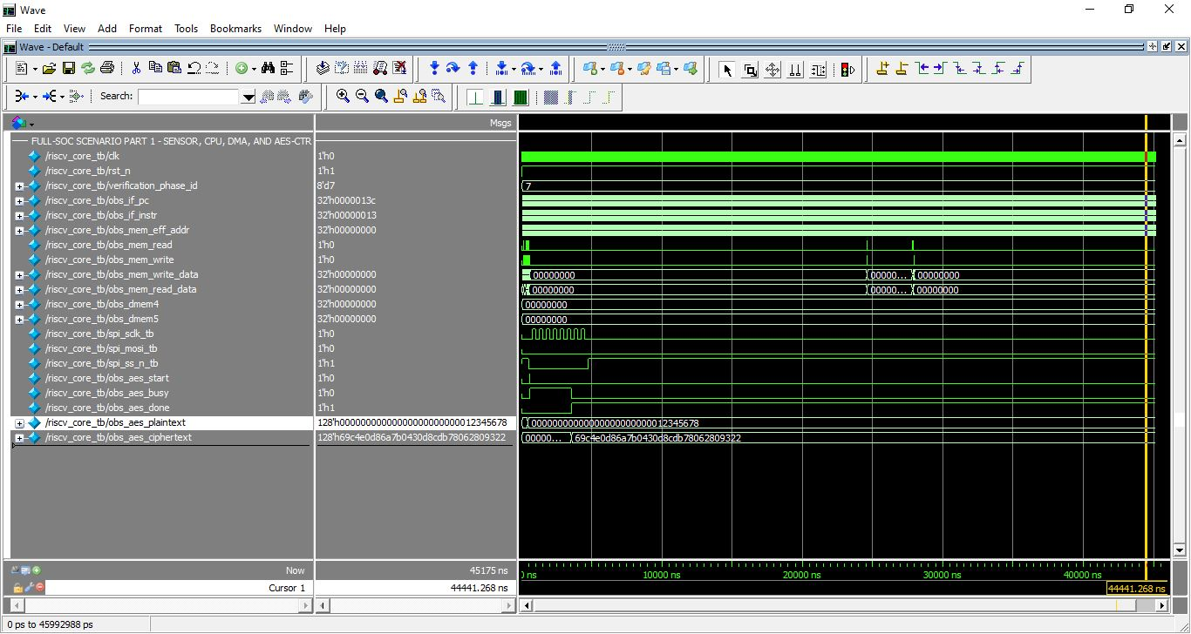
QUESTA FULL-SOC WAVEFORM
The complete transaction executes as one scenario
Sensor read
DMA complete
AES-CTR done
UART output
IRQ + sleep
COEP Technological University
M.Tech Thesis Defense
15

Slide 16
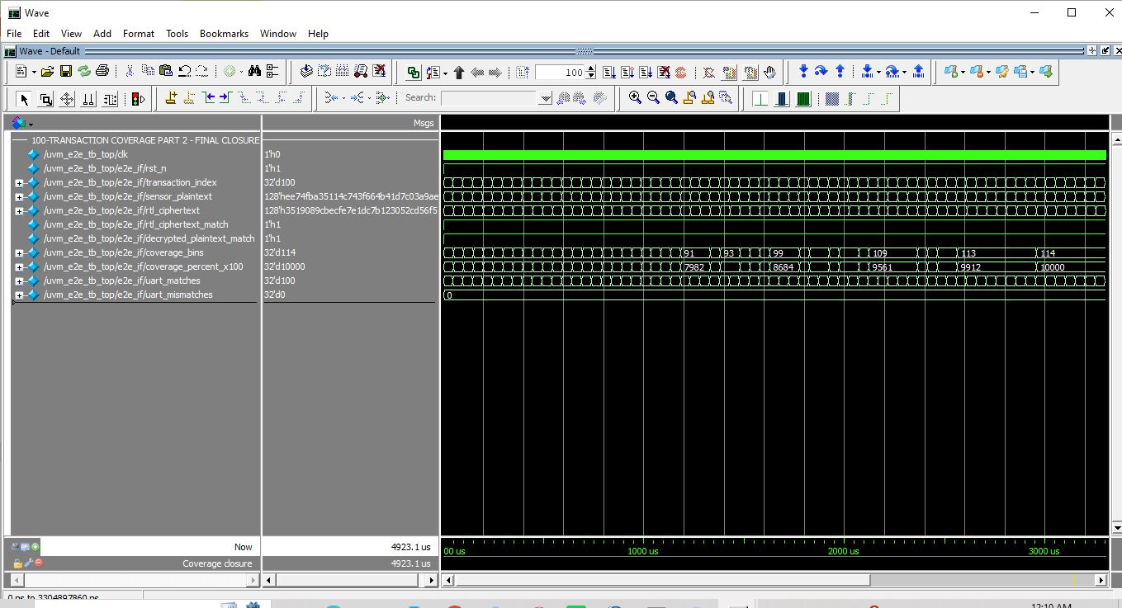
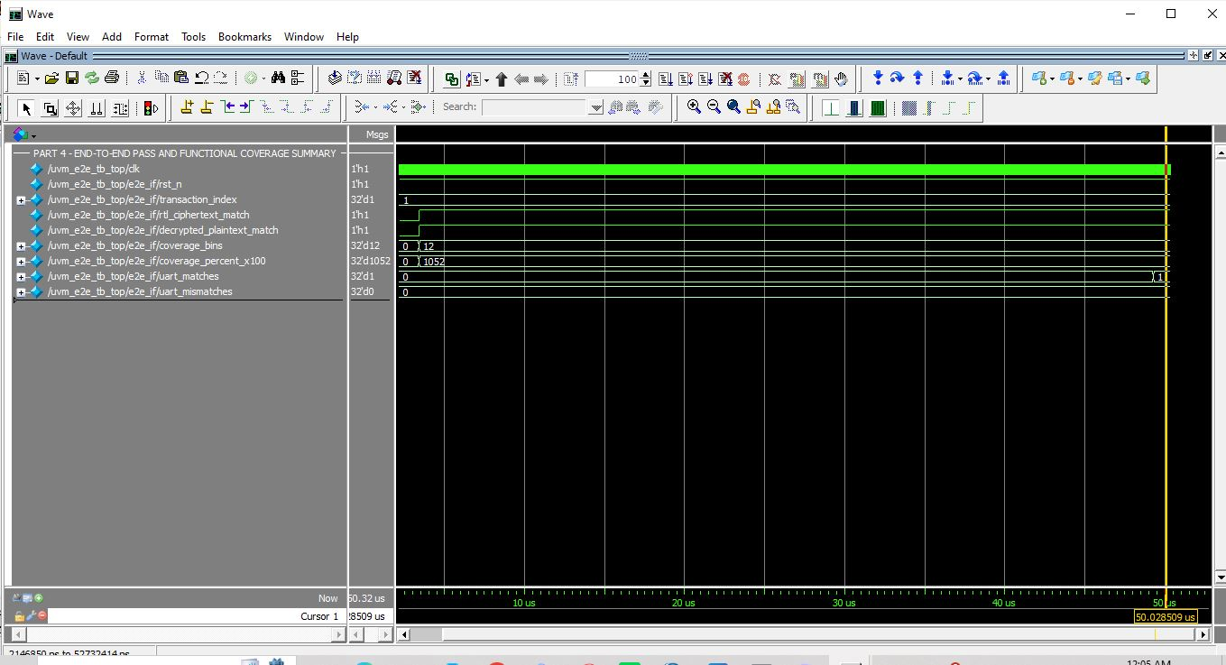
REGRESSION SUMMARY
Verification closure: multiple proofs, one consistent result
107 / 0
100
114
7
integrated RTL checks PASS / FAIL
random UVM transactions PASS
planned coverage bins
verification layers
CPU + AES + peripherals + scenario
RTL vs C-DPI + UART
portable collector
primitive to Full-SoC
COEP Technological University
M.Tech Thesis Defense
16

Slide 17
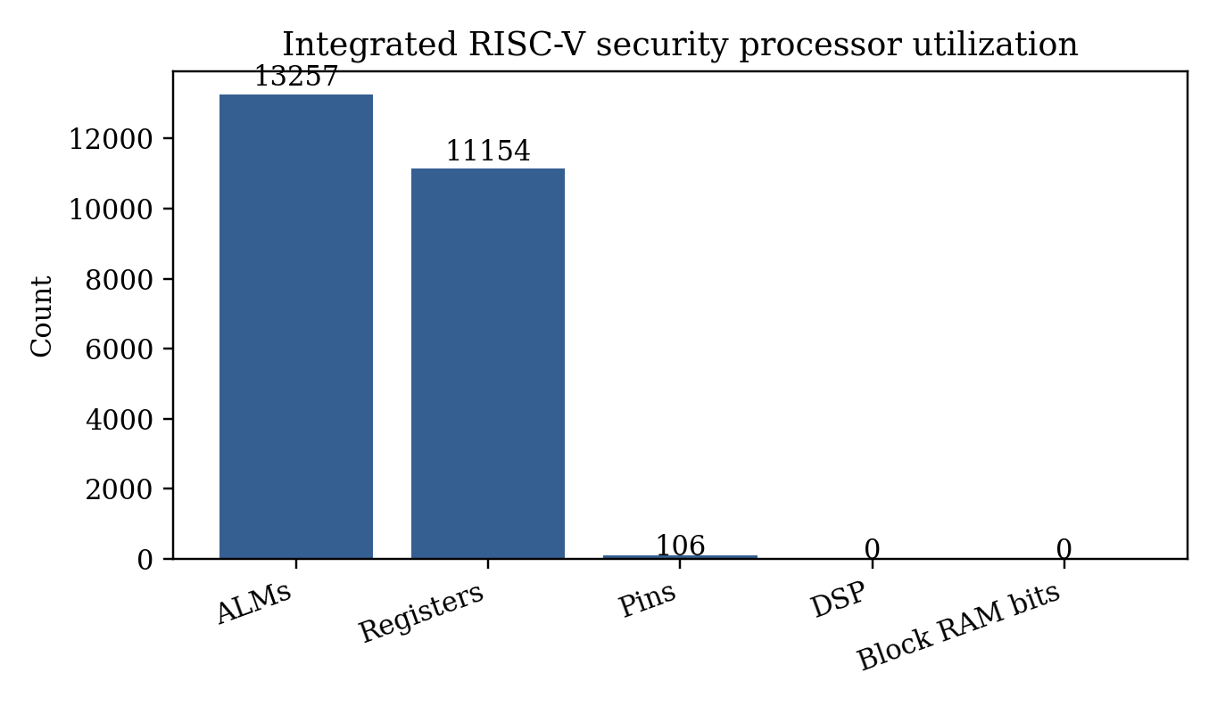
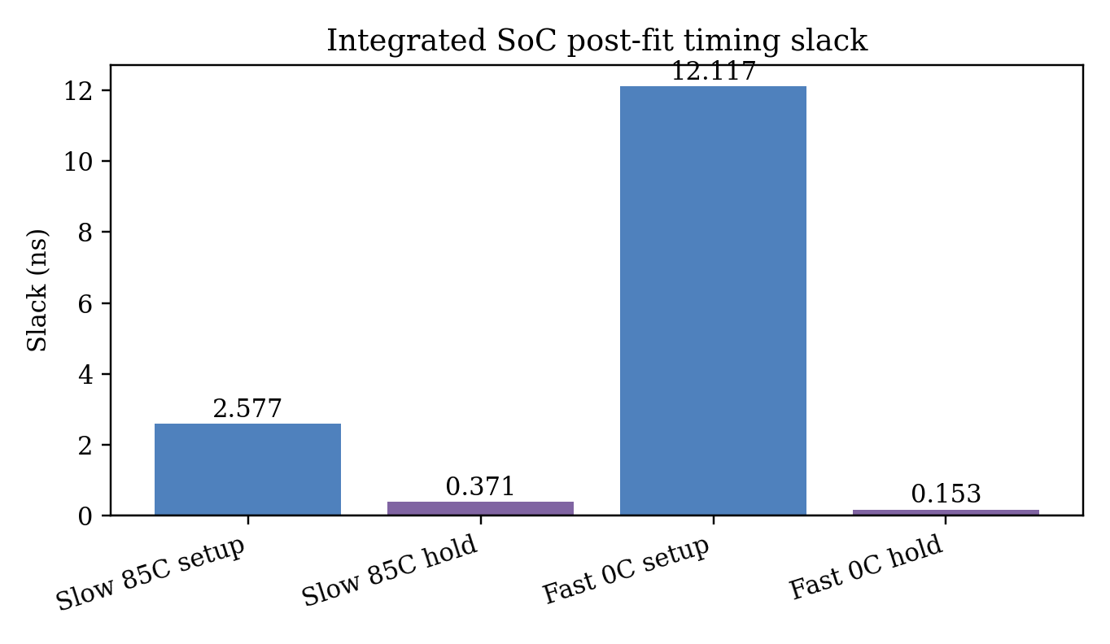
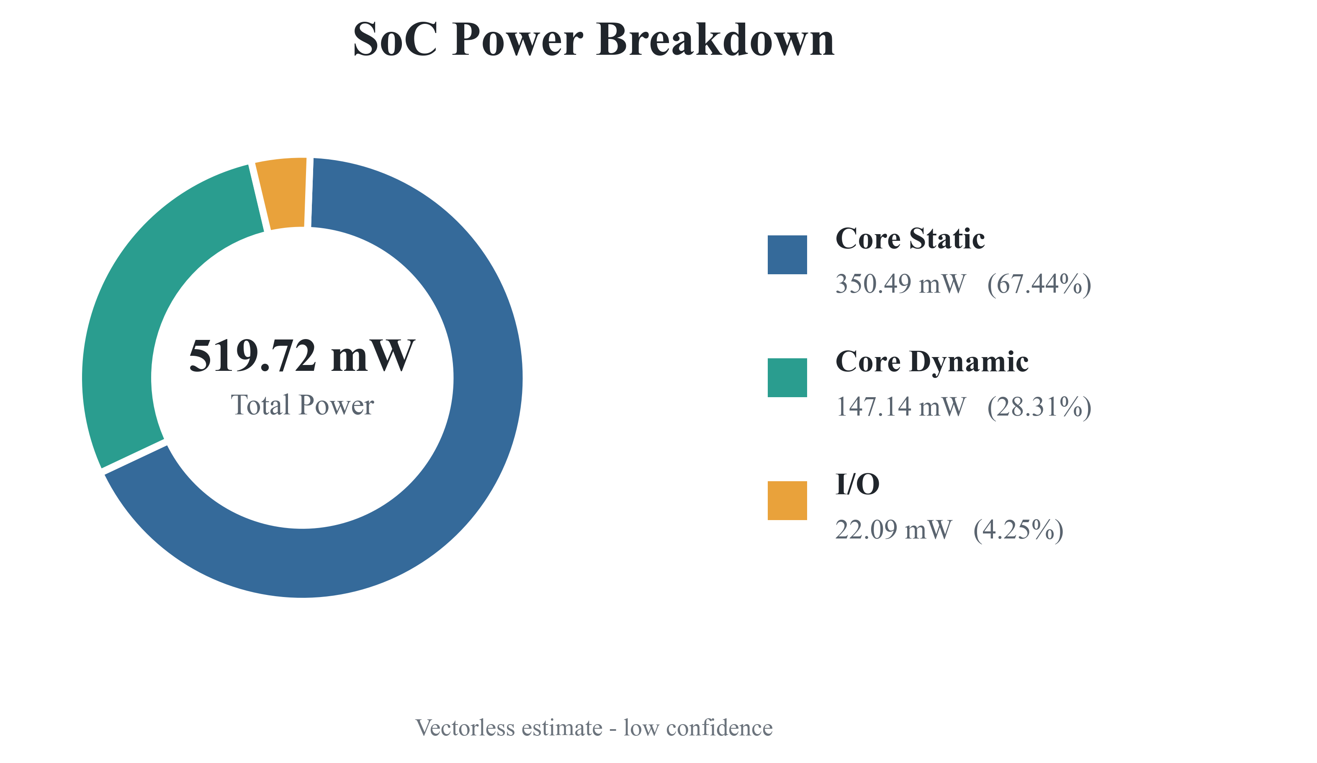
QUARTUS 23.1 · CYCLONE V · COMPLETE SOC
Integrated FPGA result: fits and meets 50 MHz timing
13,257
11,154
+2.577 ns
519.72 mW
ALMs · 23%
registers
worst setup slack
vectorless estimate
low confidence
No DSP · no block RAM · no timing violations
COEP Technological University
M.Tech Thesis Defense
17

Slide 18
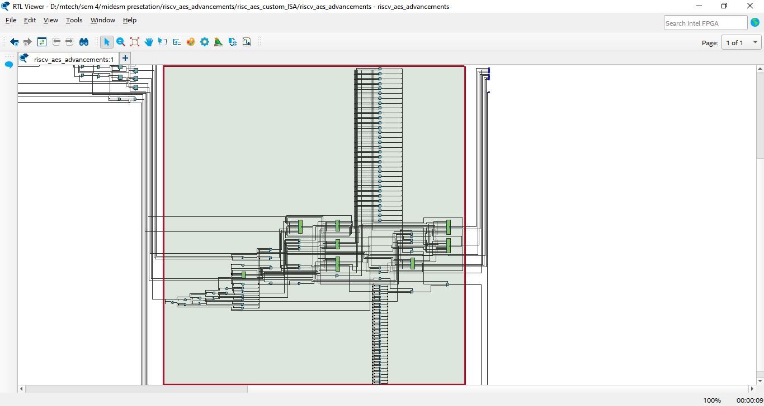
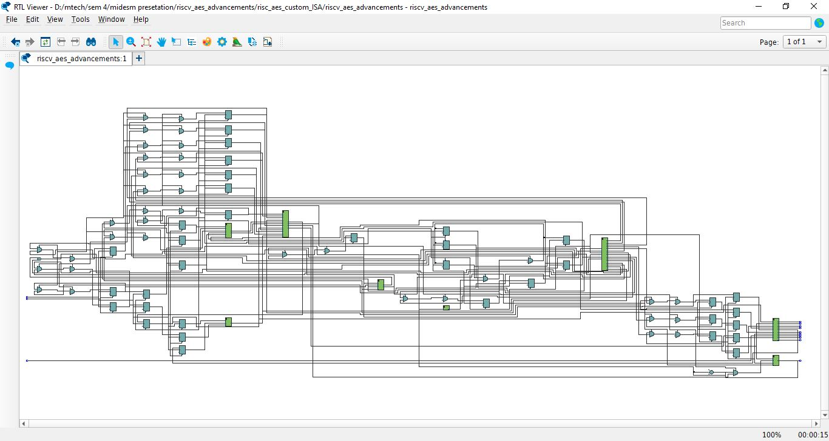
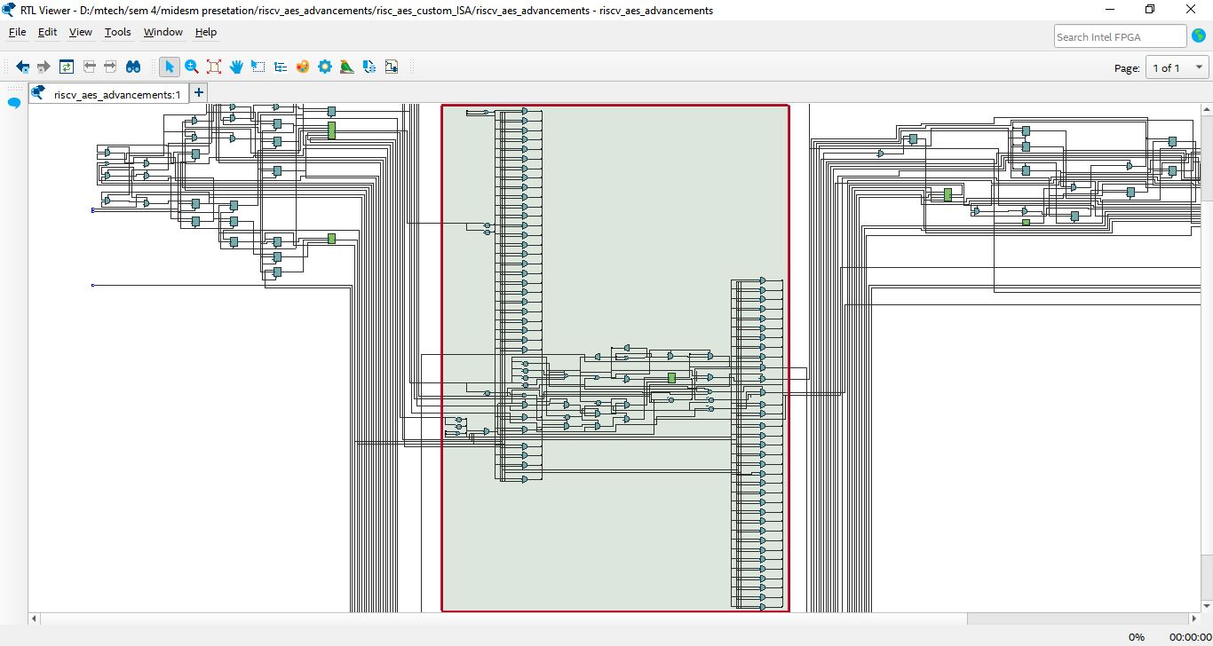
QUARTUS NETLIST EVIDENCE
Synthesis retains the complete integration hierarchy
MEM: RAM + MMIO + peripherals
EX: forwarding + ALU + branch
COEP Technological University
M.Tech Thesis Defense
18

Slide 19
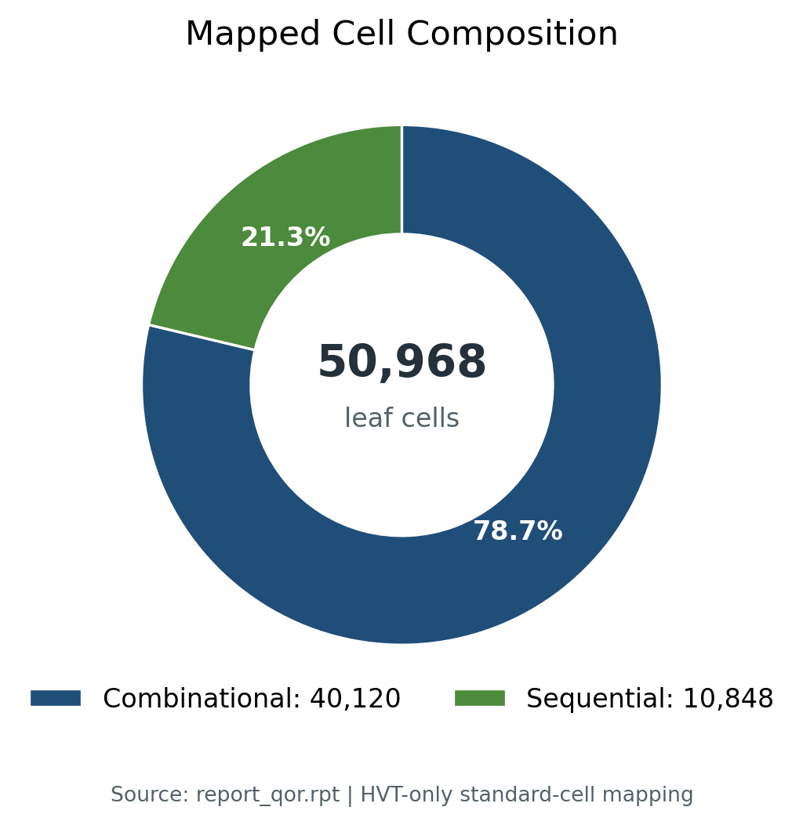
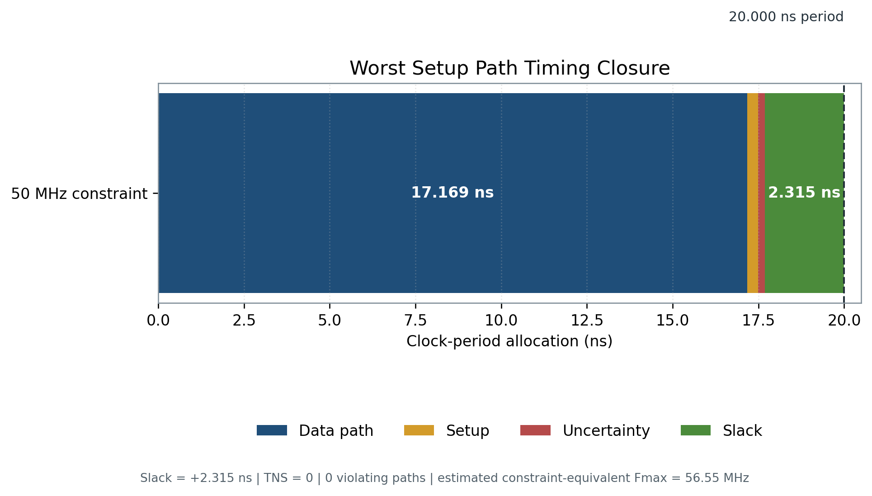
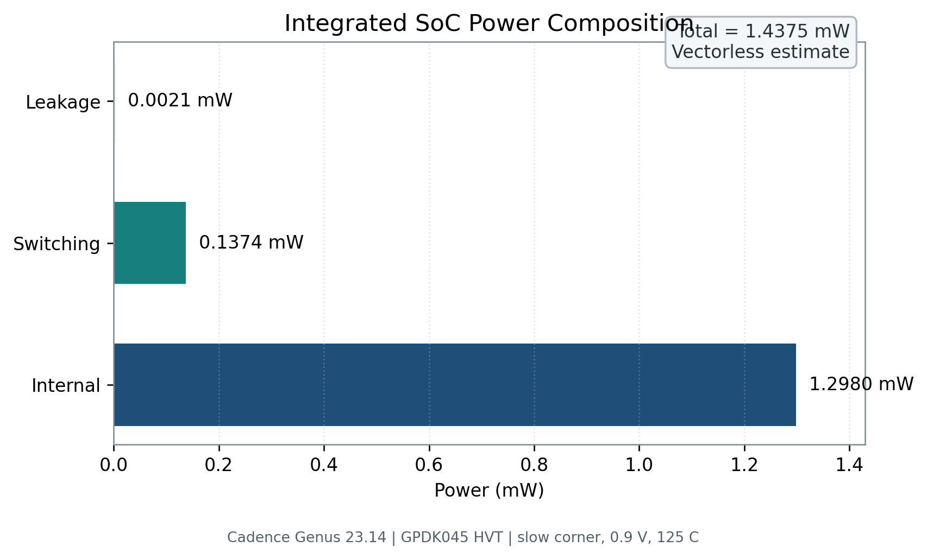
CADENCE GENUS · GPDK045 HVT · COMPLETE SOC
Complete SoC HVT synthesis: timing met at the slow corner
50,968
135,947.6 µm²
+2.315 ns
1.43753 mW
mapped leaf cells
cell area · pre-layout
setup slack at 50 MHz
vectorless total power
synthesis-stage estimate
COEP Technological University
M.Tech Thesis Defense
19

Slide 20
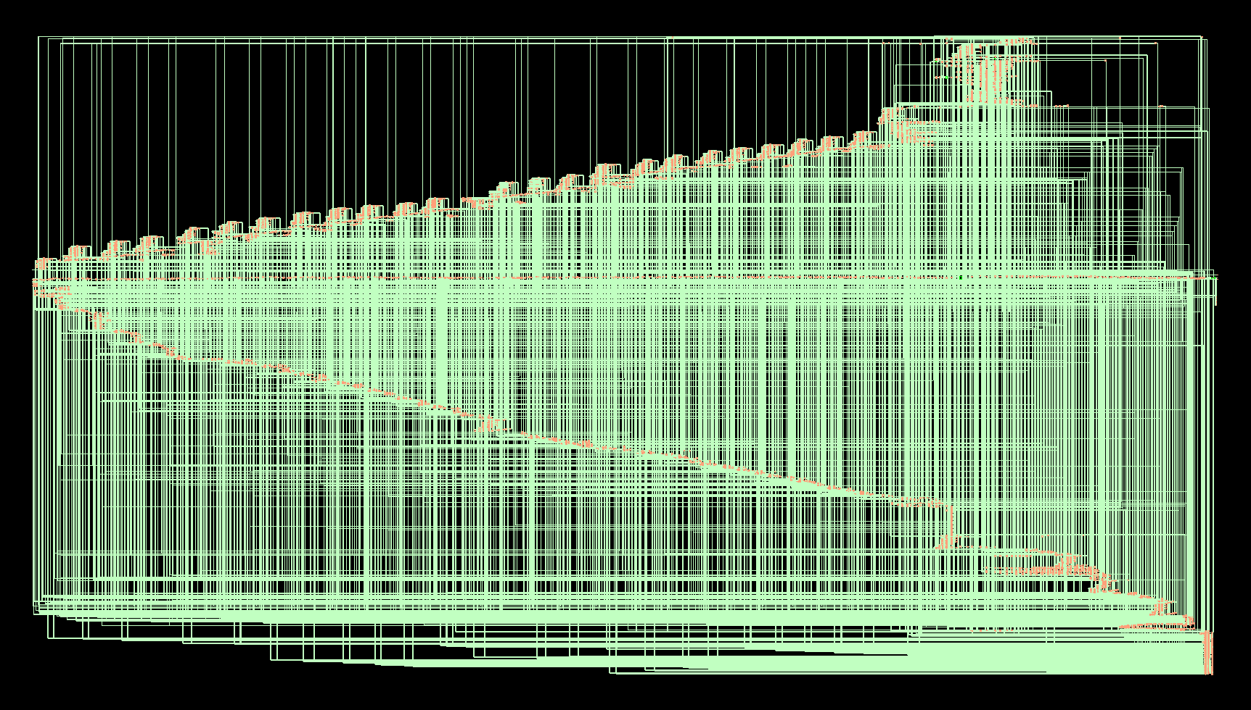
CADENCE GENUS NETLIST
Technology-mapped view of the complete security processor
50,968
mapped HVT leaf cells
17
retained hierarchies
HVT
GPDK045 mapped cells
Structural evidence not a placed layout
COEP Technological University
M.Tech Thesis Defense
20

Slide 21
INTERPRETATION DISCIPLINE
Three result domains answer three different questions
AES only
FPGA SoC
ASIC-style SoC
Cadence Genus TSMC 55 nm RVT
Quartus 23.1 Cyclone V
Cadence Genus GPDK045 HVT
Does reuse reduce AES area and power?
Does the integrated RTL fit and meet timing?
How does the complete SoC map to HVT cells?
2,694 cells 0.853 mW
13,257 ALMs +2.577 ns
50,968 cells +2.315 ns
Do not compare unlike technology, scope, activity, or implementation stages.
COEP Technological University
M.Tech Thesis Defense
21

Slide 22
ENGINEERING INTERPRETATION
Low power is architectural first, physical later
Pdyn = α · C · V² · f
What still needs physical evidence
What this RTL reduces
Activity-based power
VCD / SAIF from real workloads
• duplicated AES round logic
Clock-tree effects
post-CTS switching and insertion delay
• simultaneous active transformations
• CPU software-encryption workload
Parasitics
post-route timing and power
• idle peripheral activity through enables
Voltage corners
multi-mode, multi-corner sign-off
COEP Technological University
M.Tech Thesis Defense
22

Slide 23
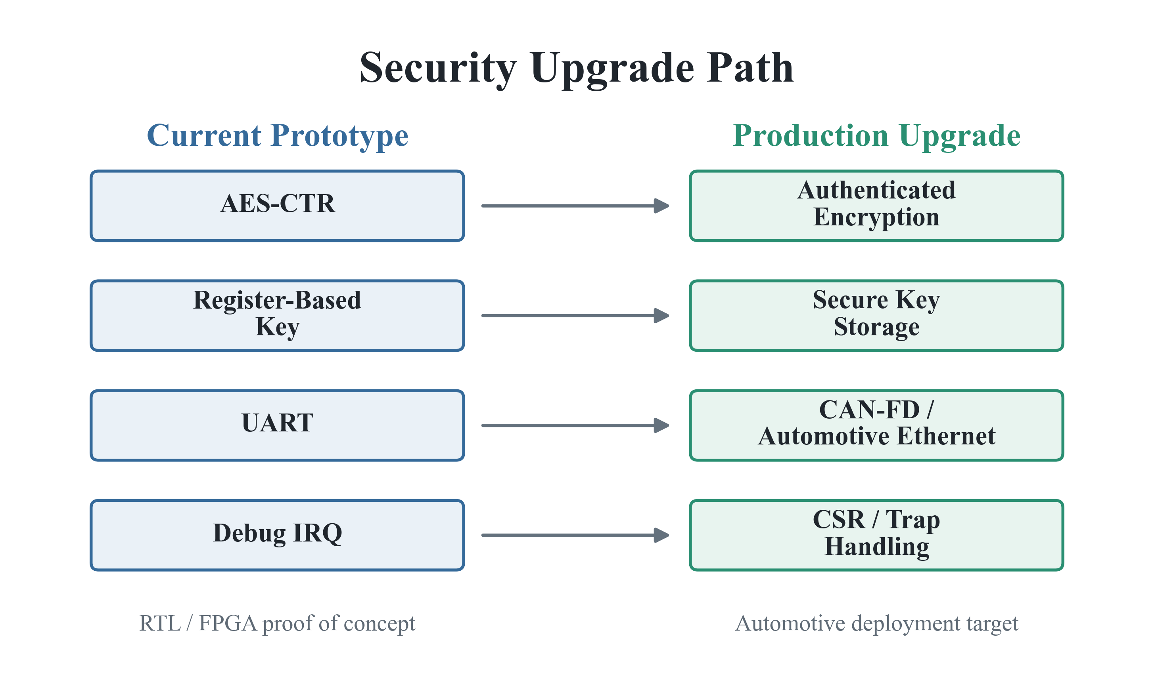
LIMITATIONS AND QUALIFICATION
From thesis prototype to automotive deployment
Production qualification: authenticated communication · secure provisioning · fault handling · ISO 26262 · ISO/SAE 21434
COEP Technological University
M.Tech Thesis Defense
23

Slide 24
CONCLUSION
What this thesis contributes
01
Reusable AES
02
Complete SoC
03
Two control paths
Large standalone area and power reduction
CPU + AES-CTR + I/O + DMA + power
MMIO and custom security ISA
04
End-to-end proof
05
Implementation evidence
RTL ↔ C reference ↔ UART ↔ decrypt
Questa + Quartus + Genus
A publishable AES microarchitecture becomes a verified, thesis-ready security processor.
COEP Technological University
M.Tech Thesis Defense
24

Slide 25
THANK YOU
Questions and Discussion
Iterative AES-128 · Five-stage RISC-V · AES-CTR · Custom ISA · UVM · FPGA/ASIC evidence
Varada Inamdar | MIS 712438020
COEP Technological University, Pune
Design verified from sensor input to encrypted UART output and reference-model recovery

