Slide 1
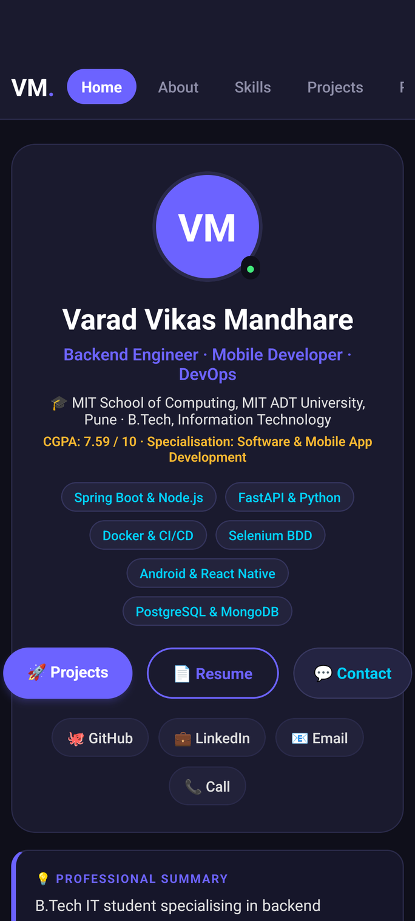
CROSS PLATFORM APP DEVELOPMENT JURY 1
DevPortfolio
Personal Developer Portfolio & Interactive Resume
Mobile Application
Varad Vikas Mandhare
B.Tech Information Technology · MIT ADT University, Pune
React Native 0.86 · TypeScript · Android SDK
Notes:
Good morning. My project is DevJourney, a personal developer portfolio built as a native mobile application with React Native and TypeScript. On the right is the actual Home screen running on the Android emulator. Over the next few minutes I will cover why I built it, how it is structured, what it contains, and how I validated it.

Slide 2
02 — MOTIVATION
One place for the whole story.
01
02
03
Traditional resume
Web portfolio
DevPortfolio App
Static and length-limited. Production projects shrink to brief bullet points with no direct path to verified source code or running demos.
Depends on desktop browsers, active internet connectivity, and shared URLs. Not tailored for on-the-go interactions during technical juries.
A high-performance native Android app keeping profile, 24+ technical skills, 6 production projects, resume, and direct contact channels one tap apart.
Building it natively in React Native & TypeScript makes the portfolio itself a working mobile engineering project.
DevPortfolio · Varad Vikas Mandhare
02 / 12
Notes:
A resume is static and limited to a page or two; my projects become bullet points and a reviewer cannot reach the code or the running product. A web portfolio helps, but it depends on a browser and someone opening a link. I wanted something I could hand over in a conversation: a native app where my profile, projects, journey, resume and contact are one tap apart. And because it is a real React Native app, the portfolio is itself evidence of my mobile development skills.

Slide 3
03 — OBJECTIVES
Six goals, one application.
01
02
03
Present the developer
Showcase production work
Demonstrate technical skills
Profile, verified academic credentials (CGPA 7.59), Class Representative leadership, and research paper.
Six projects (ELEVARE, BookSphere, Stockify, CI/CD, CyberScope, Travel Agency) with architecture notes.
24+ skills across 6 domains with animated progress bars built via React Native Animated API.
04
05
06
Instant resume access
Make contact effortless
Engineering excellence
In-app digital resume card with one-tap link to download and view the official PDF document.
One-tap native phone dialing, email drafting, LinkedIn connection, and GitHub repository navigation.
TypeScript, modular screen design, decoupled data layer, and 100% Jest unit test suite.
DevPortfolio · Varad Vikas Mandhare
03 / 12
Notes:
These were the six objectives. First, present me as a developer: skills, education, certifications and achievements. Second, showcase projects in depth rather than as one-liners. Third, document my academic and technical journey. Fourth, make the resume instantly available inside the app. Fifth, make it easy to contact me. And sixth, an engineering objective: build it in TypeScript with a modular structure so it stays maintainable as I add projects.

Slide 4




04 — TECHNOLOGY STACK
Native tooling, end to end.
CORE
ARCHITECTURE
PLATFORM & BUILD
TESTING & QA
React Native 0.86.2
Continuous ScrollView
Android Studio & SDK
Jest & Test Renderer
TypeScript 5.8
Sticky Top Navbar
Vivo 1919 (Android 12)
ESLint (Zero warnings)
React Native CLI
Animated.timing API
Gradle & JDK 21
Git & GitHub CI/CD
Bare CLI (No Expo)
Bare React Native Community CLI workflow · Zero Expo bloat · Native Android SDK
DevPortfolio · Varad Vikas Mandhare
04 / 12
Notes:
The app is written in TypeScript on React Native 0.86.2, set up with the React Native Community CLI rather than Expo, so I work directly with the native Android and iOS projects. Navigation uses React Navigation with a bottom tab navigator and native stack navigators. I built and ran it through Android Studio, the Android emulator and Gradle, with the Xcode project included for iOS. The resume viewer uses react-native-pdf, and the code is versioned with Git on GitHub.

Slide 5
05 — SYSTEM ARCHITECTURE
Unified scroll flow with dynamic navigation.
SafeAreaProvider
PROJECT STRUCTURE
src/
PortfolioApp
portfolio/
PortfolioApp coordinator
screens/
7 modular section screens
Home
About
Skills
Projects
components/
Navbar, SkillBar, Title
data/
portfolio.ts data layer
theme.ts
Dark Navy design tokens
Resume
Certs
__tests__/
Jest unit test suites
Contact
Dynamic onScroll offset calculation & smooth scrollToSection coordination
DevPortfolio · Varad Vikas Mandhare
05 / 12
Notes:
On the left is the navigation architecture. A NavigationContainer wraps a bottom TabNavigator with four tabs: Home, Projects, Journey and Profile. Projects pushes a Project Details screen, and Profile pushes Contact and Resume, as native stack screens. On the right is the source structure. Reusable UI lives in components, colours and other shared values are centralised in constants, content such as projects and the journey sits in separate data files, and navigation and screens are their own modules. That separation means adding a project is a data change, not a UI rewrite.

Slide 6
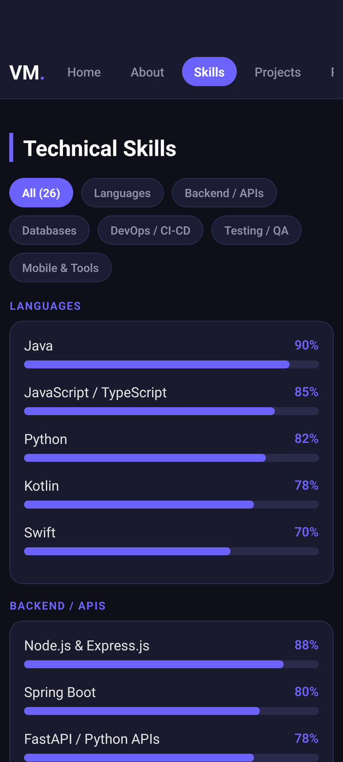
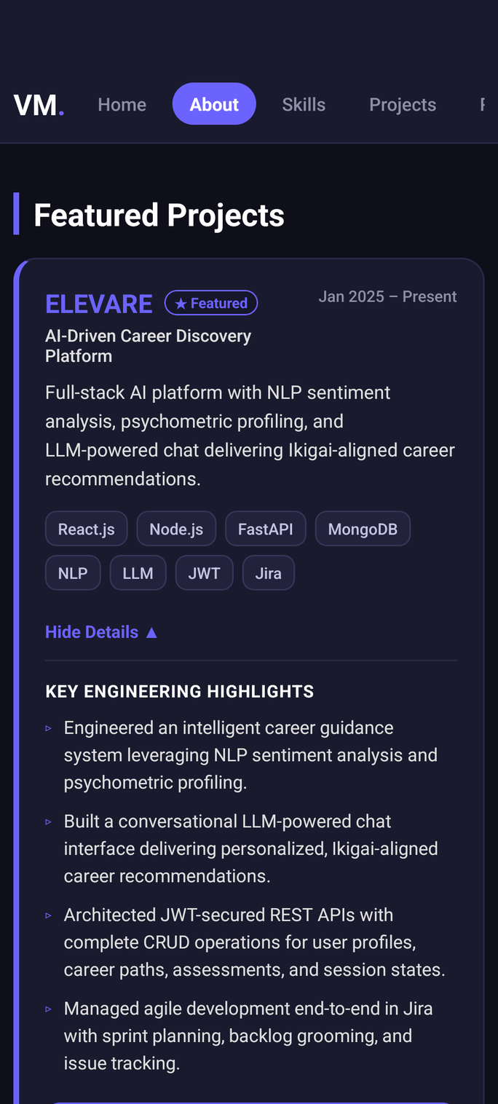
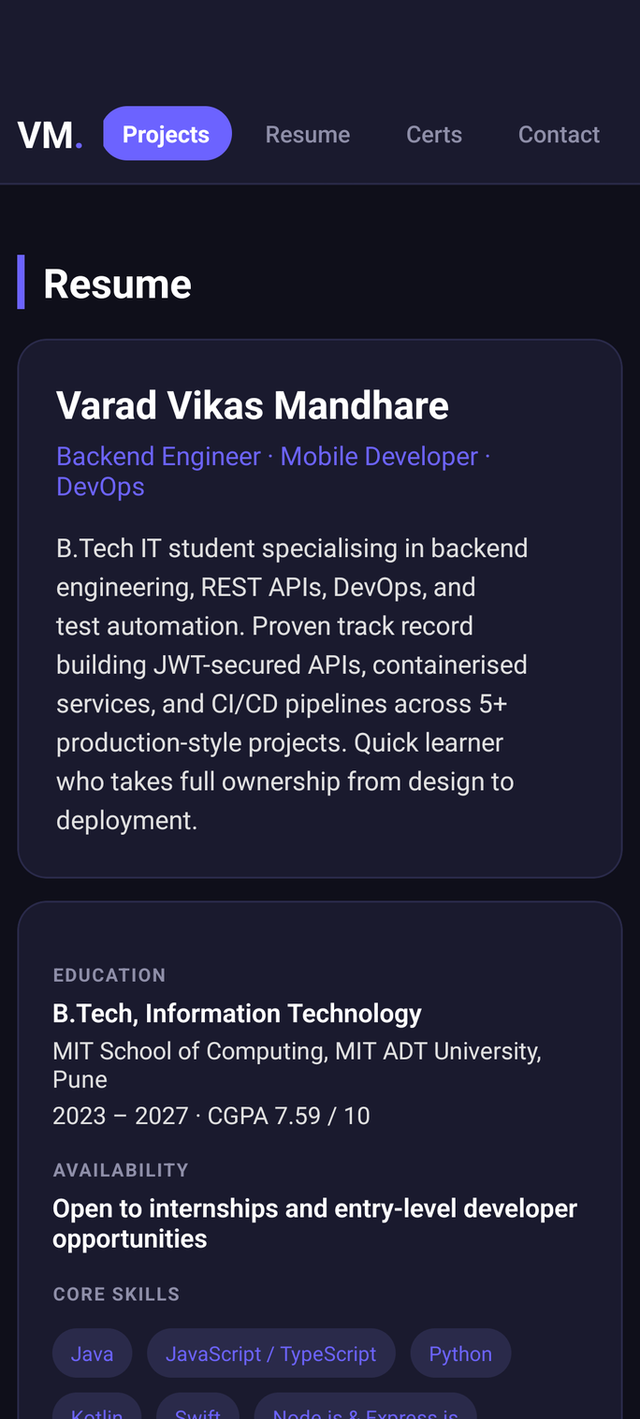
06 — APPLICATION SCREENS
Four primary sections.
01
Home
02
Skills
03
Projects
04
Resume
Hero profile, stats & CTAs
24+ animated skill bars
Featured project cards & links
Digital resume & PDF trigger
DevPortfolio · Varad Vikas Mandhare
06 / 12
Notes:
These are the four tab screens, captured from the emulator. Home introduces me, shows what I am currently building with, and lists selected work. Projects is the full catalogue of five projects, each with category, status and stack. Journey is a vertical timeline from school to today. Profile holds the about section, expertise, education, certifications and links, and it is the entry point to Contact and the Resume viewer. I can switch to the live app here if time permits.

Slide 7
07 — PROJECT SHOWCASE
Six projects, one portfolio.
#
PROJECT
WHAT IT IS
BUILT WITH
01
ELEVARE
AI-Driven Career Discovery Platform
React.js · Node.js · FastAPI · MongoDB · NLP · LLM · JWT
02
BookSphere
DSA-Powered Online Bookstore
React 18 · Supabase · PostgreSQL · Dijkstra · Knapsack DP · Selenium
03
Stockify
Retail Inventory Android App
Android (Java) · Room DB · ZXing Barcode · WorkManager · Material 3
04
Selenium CI/CD
Enterprise Test Automation Framework
Java · Selenium WebDriver · TestNG · Maven · GitHub Actions · POM
05
CyberScope-AI
WiFi Security & Analysis Platform
Python · Network Security · WiFi Auditing · FastAPI · Linux · 1st Place Win
Each project includes architecture highlights, verified GitHub repository links (github.com/Varadha9), and live demos.
DevPortfolio · Varad Vikas Mandhare
07 / 12
Notes:
The app currently showcases five projects spanning backend, full-stack, frontend, mobile and machine learning. HelpDesk is a Spring Boot and PostgreSQL ticketing system. FlowForge is a self-hosted workflow automation platform with a visual builder, conditional branching, webhook and scheduled triggers, email and WhatsApp actions, JWT auth and Redis-backed job processing. Spraylite is a Next.js storefront, Clip Vault is a React Native clipboard manager, and the MLOps Prediction API serves a model through FastAPI. Every project has its own detail page with source and demo links.

Slide 8
08 — JOURNEY & LEADERSHIP
From 2023 to today.
EDUCATION & ACHIEVEMENTS
TECHNICAL PROGRESSION
2023 – 2027
2023 – 2024
Core Java Programming & DSA
B.Tech Information Technology
MIT ADT University · CGPA 7.59 / 10 · Software & Mobile App Specialisation
2024
Full-Stack Web & MySQL (Travel Agency MVC Booking)
2023 – Present
2024
Native Android Development (Stockify, Room DB)
Class Representative (2 Years)
MIT School of Computing · Liaison for 60+ engineering students
2024 – 2025
Test Automation & CI/CD (Selenium, TestNG, GitHub Actions)
2024 – 2025
2025
Full Stack Web & AI/NLP (ELEVARE, FastAPI, LLM)
Hackathons & Research
1st Place CyberScope-AI '25 · SIH Finalist '24 · Authored NLP Ikigai Paper
2026 – Present
Cross-Platform Mobile Development (React Native, TypeScript, CPAD)
DevPortfolio · Varad Vikas Mandhare
08 / 12
Notes:
The Journey screen tells two parallel stories. On the education side: The Bishop's School from 2009 to 2021, SM Choksey Junior College for HSC, and my B.Tech in IT at MIT ADT, specialising in software and mobile application development with a minor in UX design. On the technical side: Java first, then iOS in 2024, Android in 2025, frontend and then backend full-stack work, and currently cross-platform and immersive application development, which is where this project sits.

Slide 9
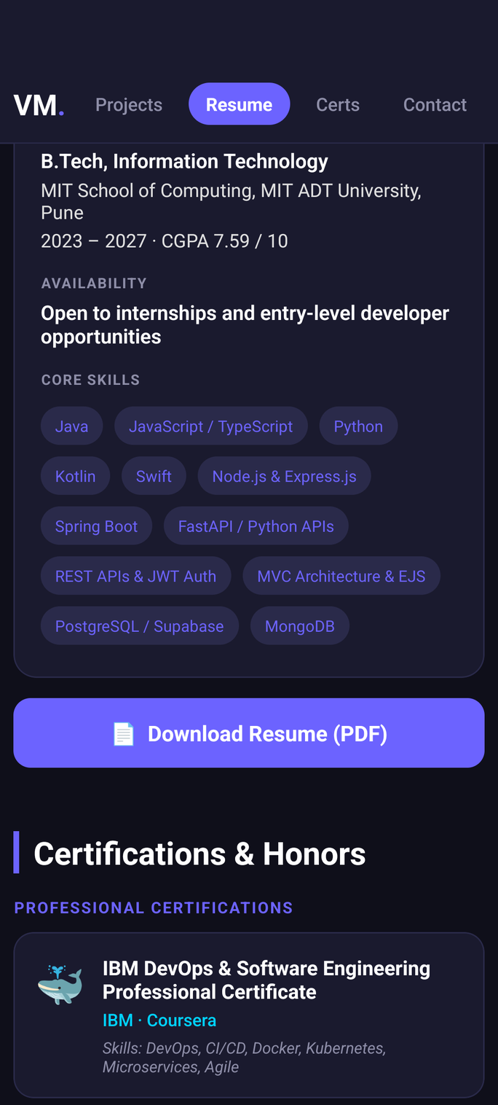
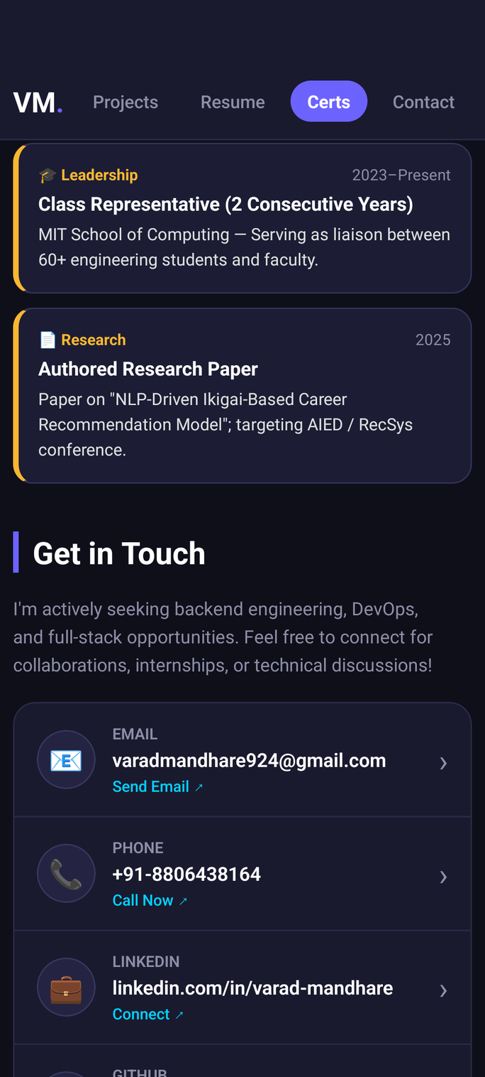








09 — KEY FEATURES
What the app does.
Animated Skill Bars
Sticky Dynamic Navbar
Smooth React Native Animated.timing
Scroll-synced active tab tracking
Direct Contact Actions
GitHub Deep Links
One-tap phone, email, LinkedIn, GitHub
Direct source links for every project
Digital Resume Viewer
Modular Data Layer
In-app summary + raw GitHub PDF action
Isolated portfolio.ts for 100% decoupling
Dark Navy Theme
Unit Tested Suite
Harmonized tokens in theme.ts
100% Jest test pass across screens
Certs
Contact
DevPortfolio · Varad Vikas Mandhare
09 / 12
Notes:
Key features. Every project has a detail page with GitHub source and a live demo where one exists. The resume is bundled as a PDF and rendered inside the app with react-native-pdf, shown on the right. The contact form collects name, email and message and hands off to the device's email app; if no email app is installed it falls back to Gmail in the browser. Navigation combines bottom tabs with nested stacks, and the whole thing sits on the modular structure from the architecture slide.

Slide 10
10 — UI / UX DESIGN
Dark aesthetic by intention.
Inspired by modern developer tooling: high contrast, vibrant multi-color accents, and fluid tactile feedback.
01
Dark navy canvas (#0F0F1A / #1A1A2E)
06
Minimalist stats & quick skill badges
02
Multi-color accents (Purple, Cyan, Green)
07
Ergonomic touch targets with feedback
03
Strong visual hierarchy & card containers
08
Dynamic top navigation with auto-sync
04
Animated progress bars (Animated API)
09
Safe area & notch adaptation
05
Thin border separators (#2A2A4A)
DevPortfolio · Varad Vikas Mandhare
10 / 12
Notes:
For the design, I deliberately redesigned the app around minimal product-design principles. It uses a dark theme and editorial typography with large headings, so hierarchy comes from type rather than decoration. Sections are numbered, separated by thin rules, and cards are kept minimal. Spacing is consistent throughout, interactive elements are marked with a subtle arrow indicator, and the bottom navigation is kept clean. The Project Details screen on the right shows most of these at once. This presentation follows the same visual language.

Slide 11

11 — TESTING AND VALIDATION
Verified on Android.
FLOWS TESTED ON PHYSICAL ANDROID DEVICE (VIVO 1919)
TYPESCRIPT & CODE QUALITY
Navigation & Sticky Navbar
Interactive Resume Viewer
npx tsc --noEmit && npm run lint
0 errors · 0 warnings · Clean compile
Continuous Section Scrolling
PDF Resume Download Action
Animated Skill Progress Bars
One-Tap Phone Dialing
TEST SUITE & ANDROID BUILD
Jest: 2 suites, 10/10 tests passed (8.4s)
Project Cards & Highlights
Email Client Hand-Off
Clean Gradle assembleDebug SUCCESS
GitHub Deep Links
LinkedIn & GitHub Links
VERSION CONTROL
github.com/Varadha9/CPAD
6b24f60 · fix: ResumeScreen — use correct fields
DevPortfolio · Varad Vikas Mandhare
11 / 12
Notes:
I tested the app manually on the Android emulator across ten flows: navigation between all tabs and stacks, project pages, GitHub, live-demo and profile links, the resume viewer, the contact form including the Gmail fallback when no email app is installed, image rendering, and scrolling on the Journey timeline. On the static side, npx tsc --noEmit completed with no TypeScript errors, and a clean Android Gradle build completed successfully. The code is on GitHub; the main build landed in commit 899c7f5.

Slide 12
12 — CONCLUSION AND FUTURE SCOPE
One app, the whole journey.
CPAD Developer Portfolio consolidates personal branding, 24+ technical skills, 6 production projects, academic milestones, and one-tap contact channels into a unified, high-performance native Android application.
FUTURE SCOPE
01
Google Play Store Release (.aab bundle)
02
Cross-Platform iOS & iPadOS Deployment
03
Offline Caching & MMKV State Persistence
04
In-App Interactive WebViews for Live Demos
05
Push Notifications via Firebase Cloud Messaging
Thank you — questions welcome
12 / 12
Notes:
To conclude, DevJourney brings together personal branding, project presentation, my academic journey and professional resources in one native mobile application, built with a maintainable TypeScript architecture and validated on Android. Next steps are a production Android release, iOS deployment, analytics to understand how it is used, more project integrations, and push notifications only if future features call for them. Thank you, I am happy to take questions or show the app live.

