Slide 1

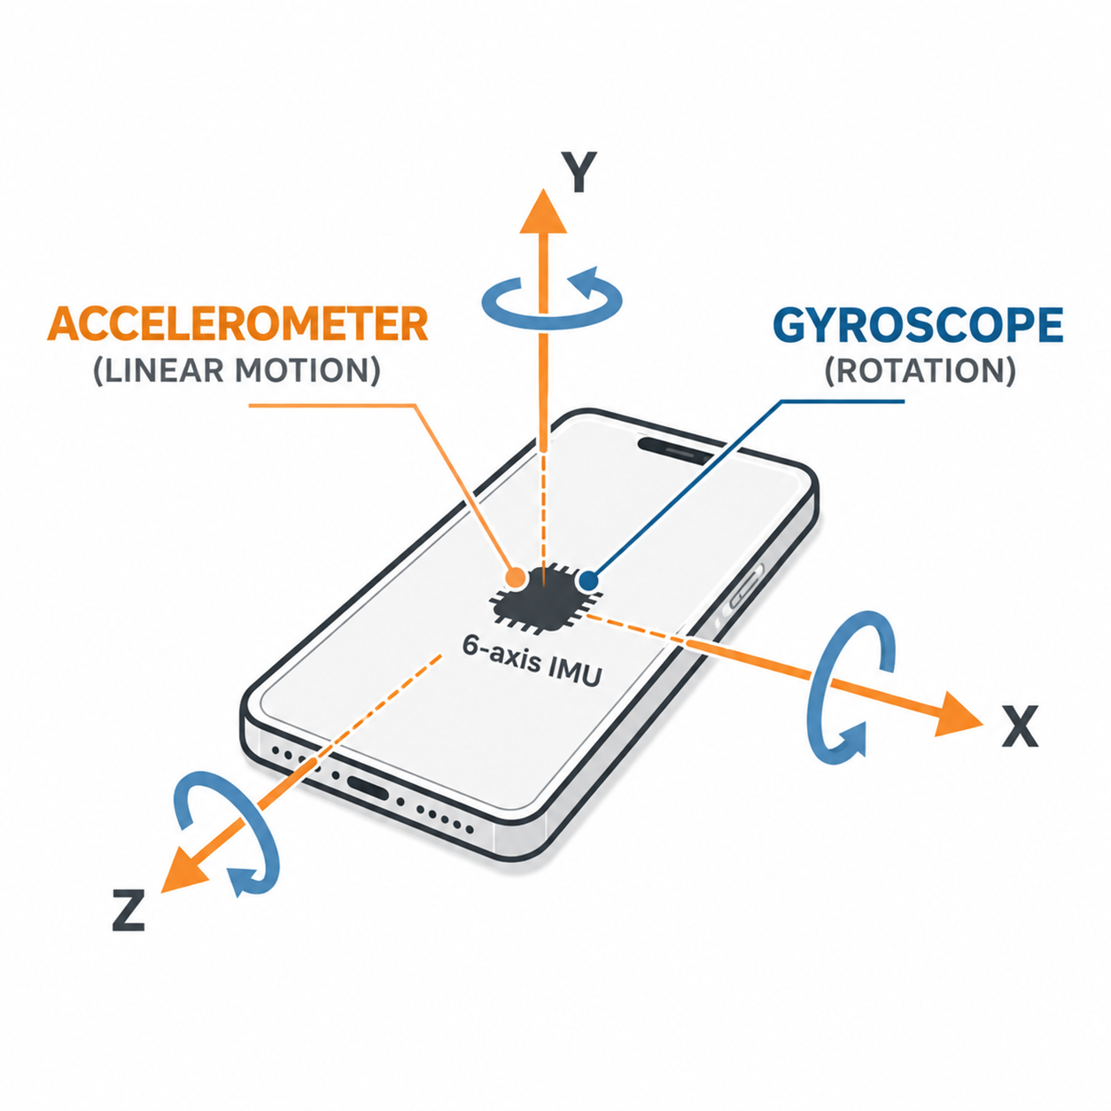
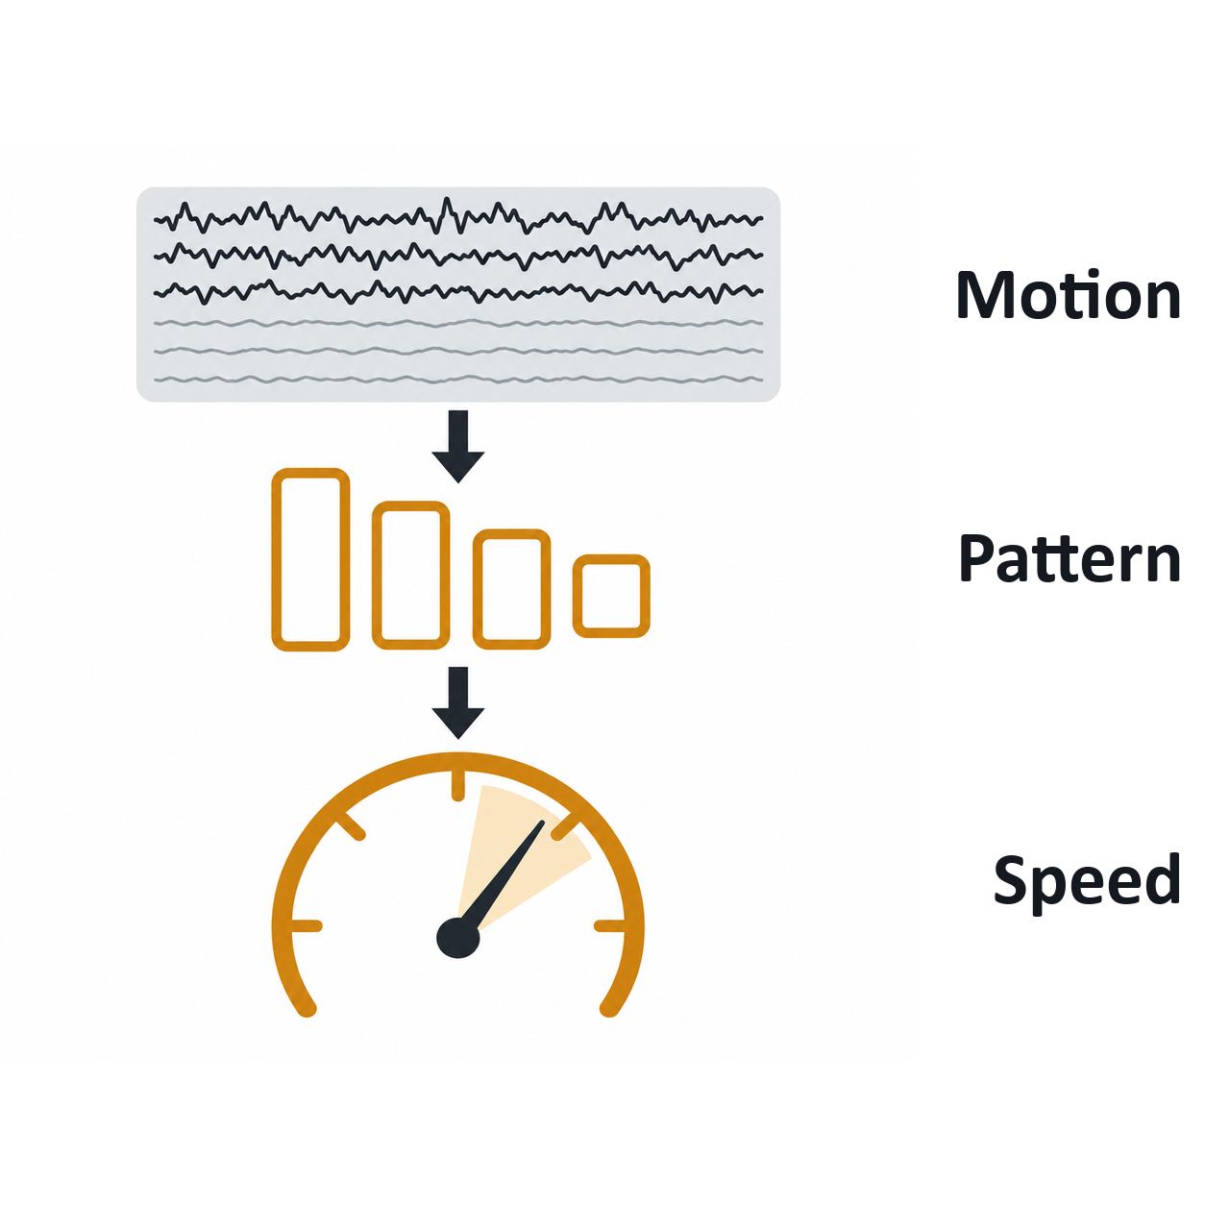
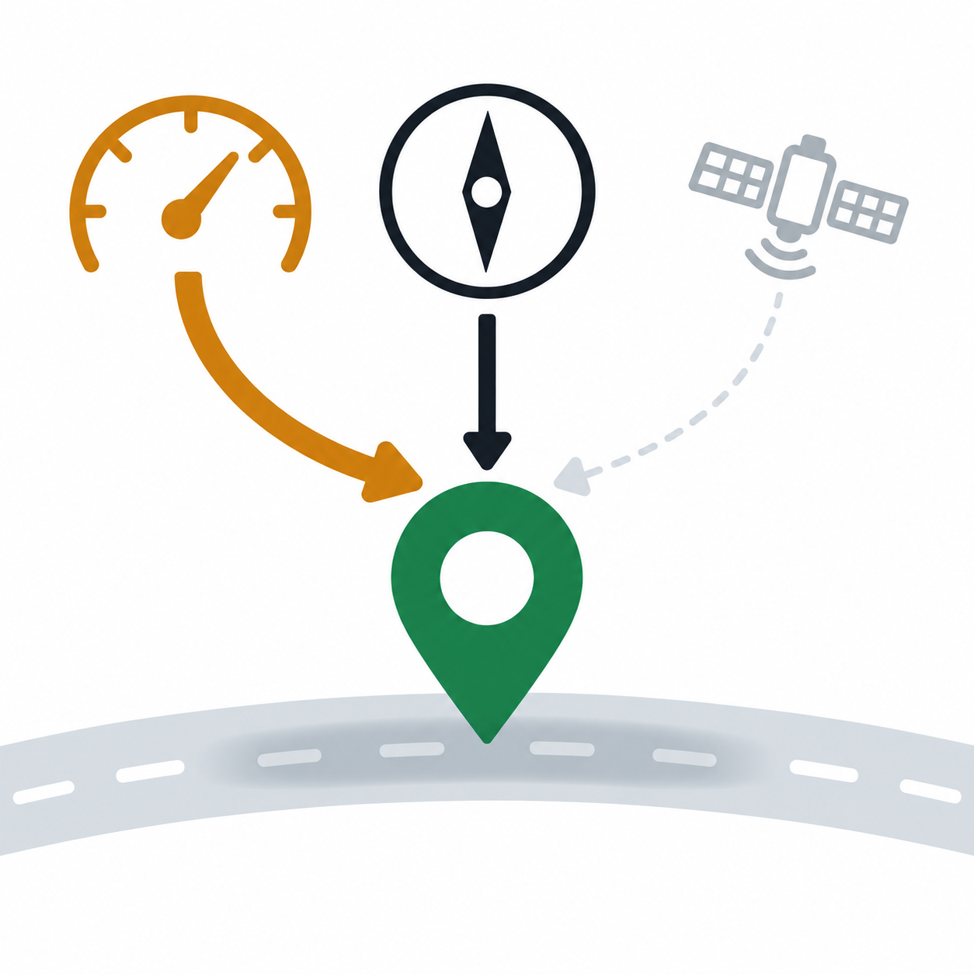
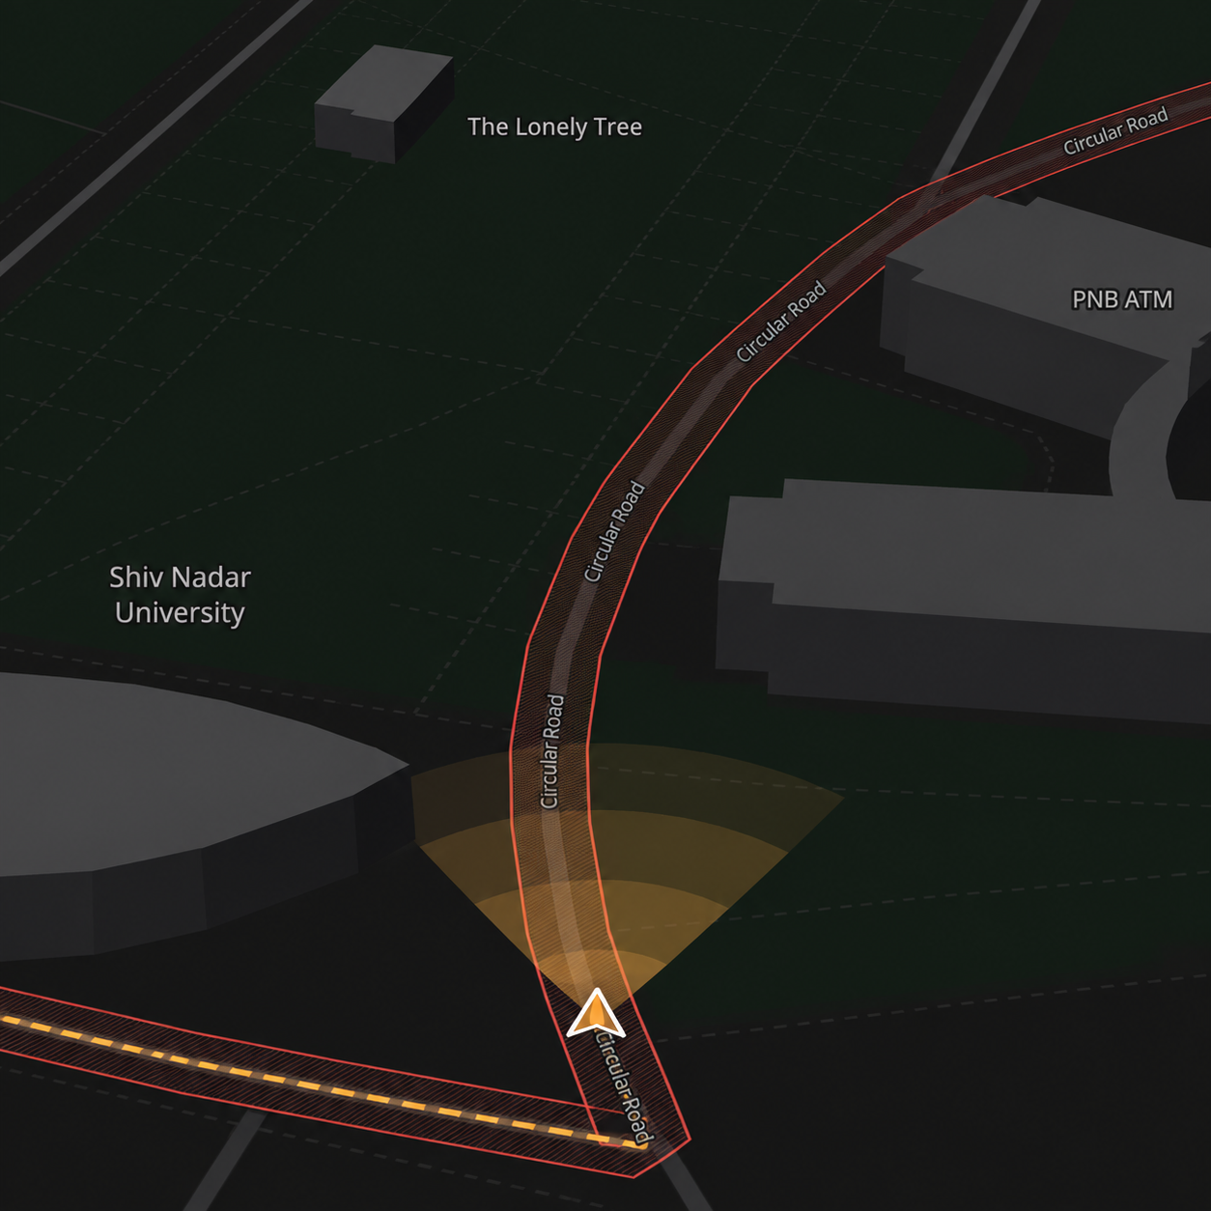

TECHNICAL APPROACH
Phone sensors
1-D CNN
Fusion filter
Live map
1 — RAW MOTION DATA
6 IMU signals, sampled at 100 Hz
3-axis accelerometer + 3-axis gyroscope.
A 2.56-second window = 256 readings of vehicle motion.
A small network learned how vibration changes with speed. It reads the speed from the motion and its own uncertainty. 57 k weights, 240 KB.
Speed, direction and the satellite never quite agree. The filter decides weight of each, 10 times a second.
The position keeps updating even when GNSS is switched off
On the test road: 569 m dead-reckoned → only 17.3 m position error at the end.
Trained on 30 logged rides over two campus roads, with GNSS speed as the label, then tested on rides the model had never seen.

