Slide 1
IBM University Engagement Project Submission
“Exploring the Power of Machine Learning with IBM Cloud”

Slide 2

Project Title – Intelliwaste Event Planner Domain of Project – Environmental Sustainability
Student Name | Recent Passport Photo | Email ID | Mobile number [WhatsApp]
VARALAKSHMI R |  | Lakshmivara200611@gmail.com | 91+ 6369546350

Slide 3
Problem Statement :
Problem Statement: Optimizing Food Waste Management in Event Planning using Generative AI.
The event industry often struggles with the logistics of largescale catering, where organizers must manage meal planning for hundreds or thousands of guests. A major challenge in this process is the lack of a data to predict food waste before an event even begins. Currently, most planners rely on rough estimates and making it safe by over-ordering, which leads to massive amounts of perfectly edible food ending up in the trash. This creates unnecessary costs and puts a heavy strain on the environment. Manual planning is often inaccurate and does not account for the specific variables that influence waste. The goal of this project is to build an intelligent, AI-powered tool that analyses event-specific data, such as guest counts, menu types, duration, and service styles, etc.. to generate accurate waste predictions. This tool will assist event managers in making informed, sustainable ordering decisions, ensuring that food is used efficiently and waste is reduced from the very start.

Slide 4
Proposed Solution :
IBM Watsonx.ai - Generative AI & Foundational Agent:
I proposed an AI-powered "Intelliwaste Event Planner" using IBM Watsonx.ai Studio and the Llama-3 model.
Essential event details (such as guest count, menu type, service duration, and serving style) are processed through the IBM Watsonx API.
The foundational agent analyses this input against sustainability benchmarks to identify waste patterns and resource inefficiencies.
Multiple prompt iterations are generated and evaluated to ensure the system provides precise, actionable waste predictions and reduction strategies.
The system delivers a clear report that empowers event planners to optimize their food orders, reducing both environmental impact and operational costs.

Slide 5
Technology Used :
IBM Cloud: I used IBM Cloud as the backbone for this project. It provides a reliable and secure environment to host the agent, ensuring that my connection to the Watsonx API is always fast and stable.
AI Model: IBM Watsonx.ai (Llama-3 Large Language Model).
Performance Metrics: Because I am working with Generative AI, I measured success by testing for consistency. I ran various scenarios to make sure the agent's logic is sound, that it stays focused on sustainability goals, and that the waste projections it generates are realistic.
Enhancements and Optimization: I focused heavily on "Prompt Engineering“, by carefully writing and refining the system instructions. I taught the agent to stay on track, provide actionable reports, and avoid hallucinating.

Slide 6
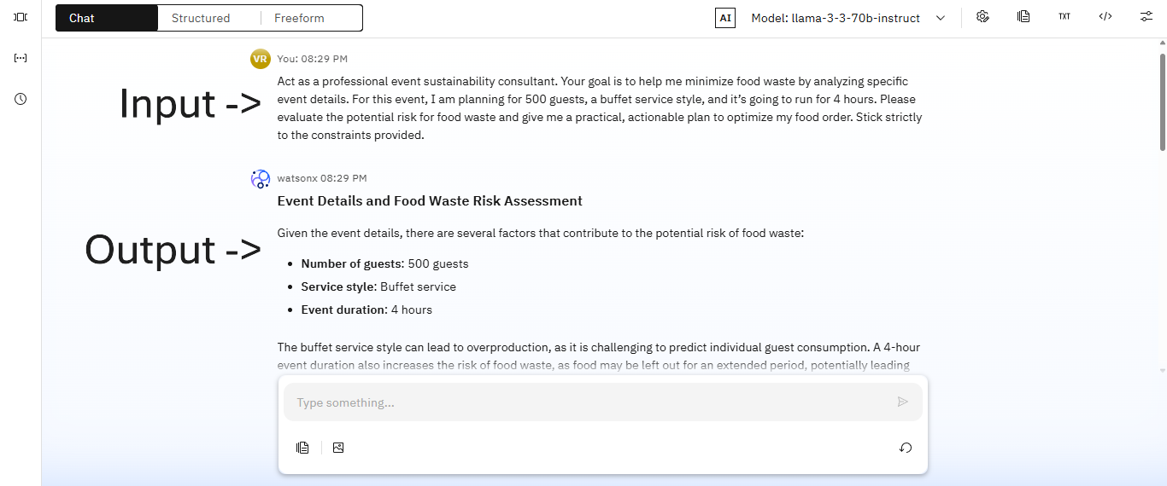
Prompt & Logic Design Screenshot:

Slide 7
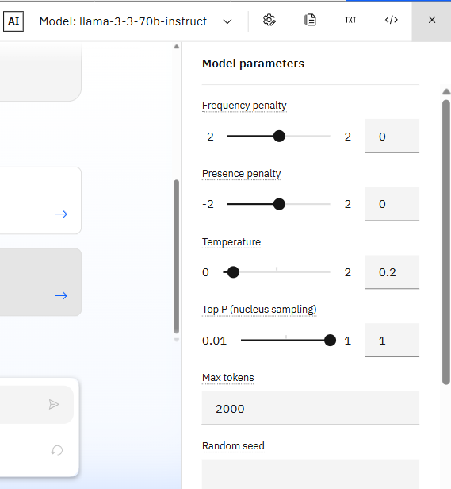
Model Configuration Screenshot:
- Used llama-3-3-70b-instruct via IBM
Watsonx.ai.
- Configured the temperature to 0.2 to
minimize hallucinations.
- Set the Max Tokens to 2000 to allow
the agent to generate strategies.

Slide 8
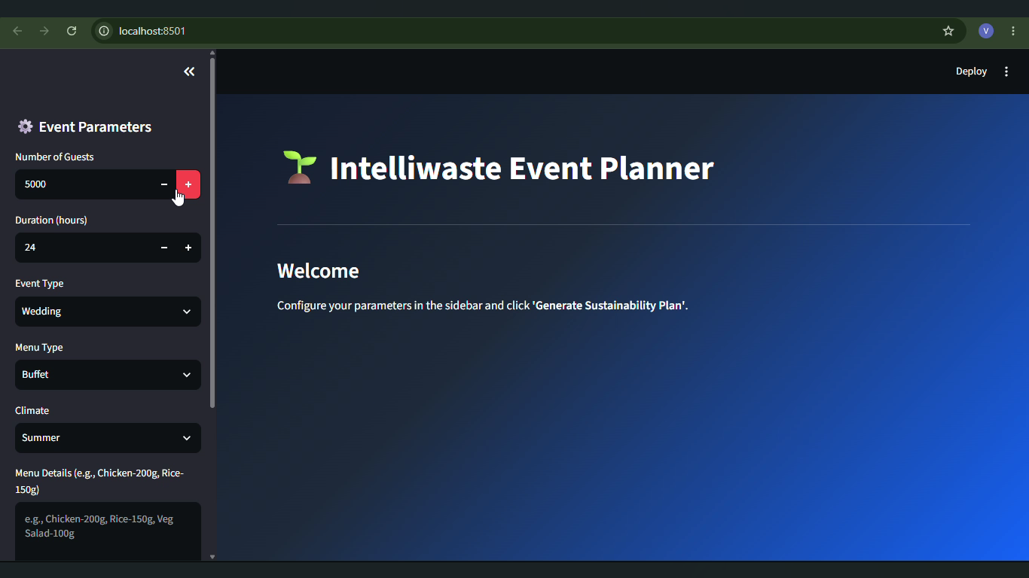
System Testing Screenshot:
- Built a custom UI using Streamlit to gather inputs.
- Established a live connection to IBM Watsonx.ai(llama-3).
- The agent instantly processes these parameters (like guest count, duration, etc.. ) and generates an actionable, sustainable plan.

Slide 9
Novelty and Uniqueness:
The solution automates complex food waste risk assessment, reducing manual planning efforts and estimation errors.
It uses IBM Watsonx.ai and the Llama-3 model to provide real-time, data-backed sustainability strategies without requiring manual analysis.
The system accurately evaluates diverse event parameters like guest count, menu type, and duration through a single, intelligent interface.
Prompt engineering helps identify potential overproduction areas and waste patterns before the event begins.
The model ensures consistent and environmentally responsible order planning, minimizing food waste and unnecessary operational costs.

Slide 10
Git Hub Link:
https://github.com/Varalakshmi2025/IntelliWaste-Planner.git

Slide 11
Future Scope:
We could connect the platform to vendor inventory systems to automate the entire food ordering process based on our AI recommendations.
Building a dedicated dashboard would allow event managers to track their sustainability progress and waste reduction patterns over time.
As we collect more real-world event data, we can continue to refine our models in IBM Watsonx.ai to increase prediction accuracy.
Developing a mobile-friendly interface would enable event staff to make adjustments to event parameters right from the venue floor.
Future updates could include handling complex variables like specific dietary restrictions, cultural preferences, and seasonal food availability to support any catering style.

Slide 12
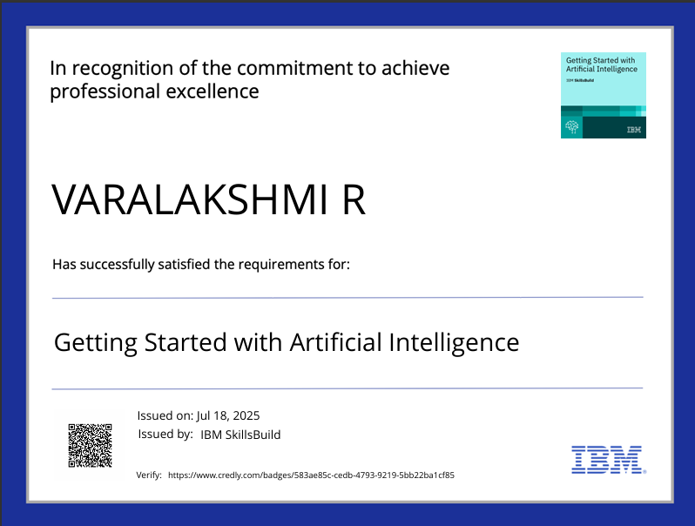
Certificates Earned:

Slide 13
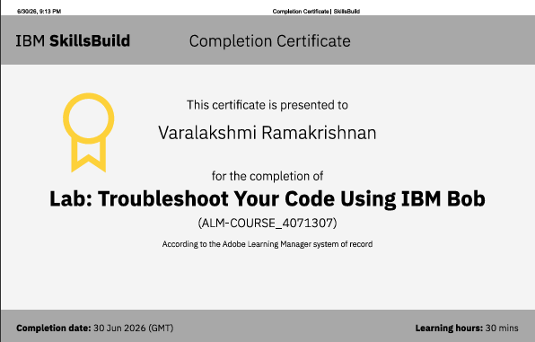
Certificates Earned:

Slide 14
Thank You! Thank you for your patience and valuable time

