Slide 1
KEYLOGGER
CAPSTONE PROJECT
Presented By:
S.VARALAKSHMI - MOUNT ZION COLLEGE OF ENGINEERING AND TECHNOLOGY - B.E / CSE

Slide 2
OUTLINE
Problem Statement
Proposed System/Solution
System Development Approach
Algorithm & Deployment
Result
Conclusion
Future Scope
References

Slide 3
Problem Statement
Develop a simple keylogger application to capture keyboard inputs discreetly. The application should operate across various platforms and be capable of running in the background without the user's knowledge.

Slide 4
Proposed Solution
Utilize Python with the tkinter library for the GUI, pynput library for capturing keyboard inputs, and json for logging. The application should have start and stop buttons to control the keylogging process.

Slide 5
System Approach
GUI Development:
Use tkinter to create a simple GUI with buttons for starting and stopping the keylogger.
Keylogging:
Implement functions to capture keyboard inputs using the pynput library.
Define functions to handle key press, hold, and release events.
Store the captured keys in memory and log them into JSON and text files.
Button Functions:
Implement functions to start and stop the keylogger, controlling the pynput listener.
Deployment:
Package the application into an executable file or distribute as Python scripts.
Ensure compatibility with various operating systems.

Slide 6
Algorithm & Deployment
Initialization:
Initialize GUI elements using Tkinter for creating the user interface.Set up global variables and callback functions for handling keyboard events.
Event Handling:
Use pynput library to capture keyboard inputs.Explain the function for handling key press,hold,and release events,updating the ‘keys_used’ list accordingly.
Logging:
generate_text_log: Writes the keystroke data to a text file (key_log.txt) in a human-readable format.
generate_json_file: Converts the keys_used list into JSON format and writes it to a file (key_log.json).
Keylogger Control:
start_keylogger: Initiates the keyboard listener using the keyboard.Listener class from the pynput library.

Slide 7
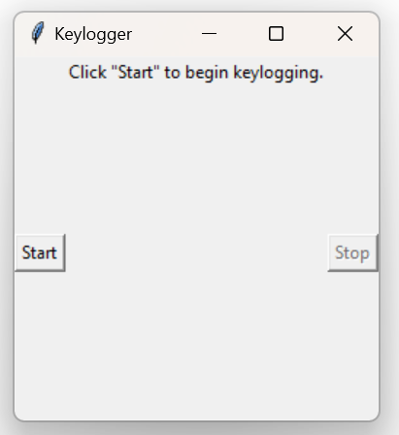
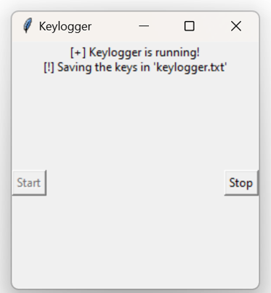
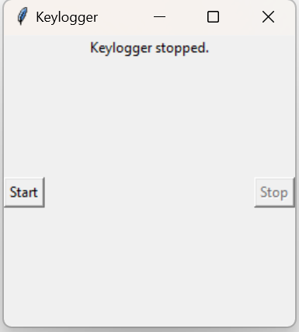
Result
The application captures keyboard inputs discreetly and saves them into JSON and text files. Users can start and stop the keylogger using the GUI buttons.

Slide 8
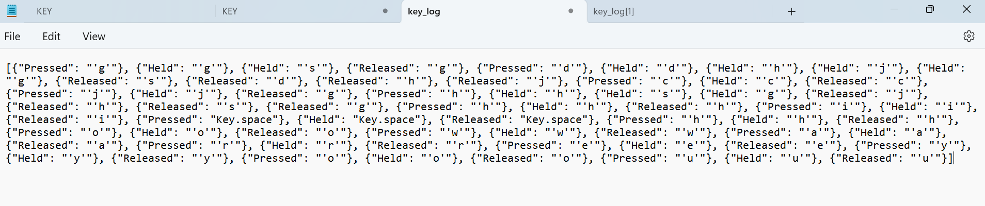
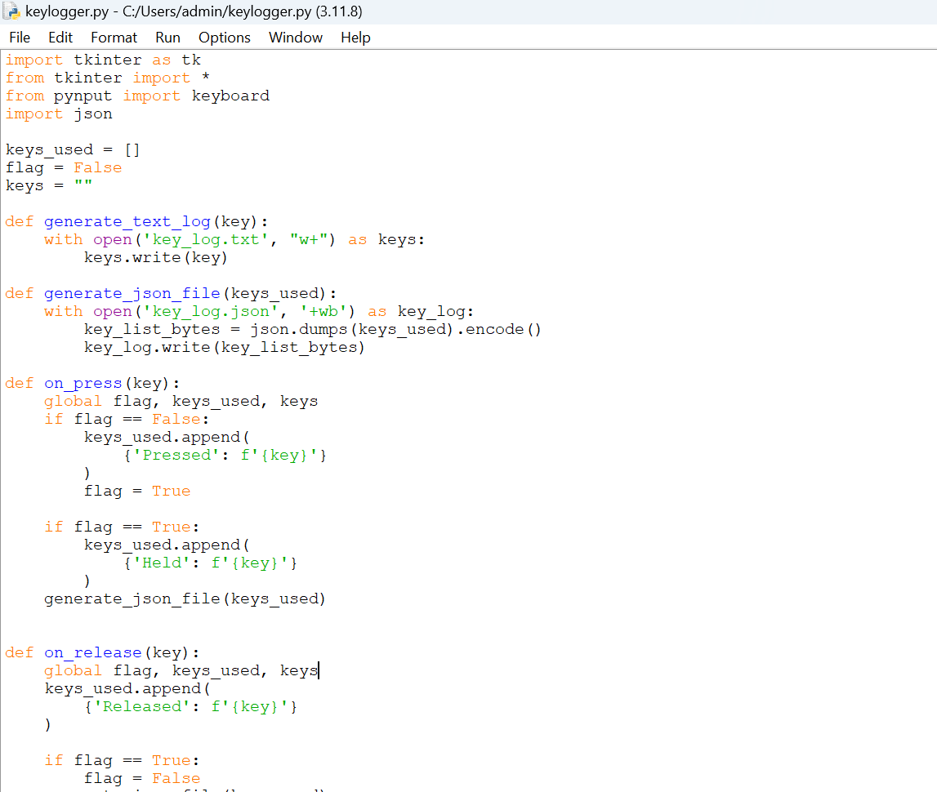
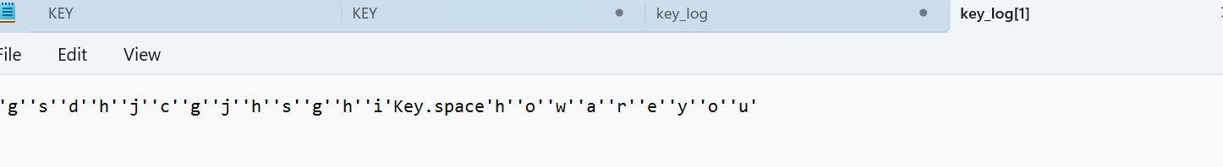
OUTPUT

Slide 9
Conclusion
The developed keylogger application provides a basic solution for capturing keyboard inputs. However, its usage should be ethical and legal, with proper consent from users. The application demonstrates the integration of GUI development, keyboard input handling, and file I/O in Python.

Slide 10
Future scope
Enhance the GUI with additional features and customization options.
Implement encryption for securely storing logged data.
Add remote monitoring and reporting capabilities.
Improve compatibility and portability across different platforms.
Integrate machine learning for advanced keylogging detection and prevention.

Slide 11
References
Python Documentation: https://docs.python.org/
Tkinter Documentation: https://docs.python.org/3/library/tkinter.html
pynput Documentation: https://pynput.readthedocs.io/en/latest/
JSON Documentation: https://docs.python.org/3/library/json.html

Slide 12
THANK YOU

