Slide 1


Transformer-Based Fake News Detection
Department of Information Technology
V R Siddhartha Engineering College
B.Tech in Information Technology
Major Project Review Presentation
Presented by
Varalakshmi Maddireddy (228W1A1233)
Lavanya Ravilla (228W1A1255)
Under the guidance of
Dr. M.Suneetha
Professor &Head

Slide 2
AGENDA
Introduction
Problem Statement
Objectives and Outcomes
Literature Review
Datasets and Requirements
Algorithms
Architecture diagram
Implementation
Results and Analysis
Conclusion and Future Work
References

Slide 3
INTRODUCTION
The exponential growth of online news platforms has led to the rapid dissemination of misinformation.
Fake news significantly impacts public opinion, decision-making, and social stability.
Manual fact-checking methods are inefficient and non-scalable.
Automated detection using Natural Language Processing (NLP) has become essential.

Slide 4
PROBLEM STATEMENT
Fake news spreads rapidly on digital platforms, causing widespread misinformation and loss of public trust. Existing ML and DL models struggle to capture deep contextual relationships in long news articles and evolving writing styles, while transformer-based models, though more accurate, still act as black-box systems with limited interpretability.

Slide 5
OBJECTIVES
OUTCOMES
To develop a transformer-based fake news detection system that accurately classifies news as real or fake.
To compare the performance of BERT and DistilBERT models in terms of accuracy, efficiency, and computational complexity.
Enables reliable detection of fake news with clear, human-understandable explanations.
Improved accuracy with transparent and interpretable results, increasing user trust and real-world usability.

Slide 6
LITERATURE REVIEW
Paper Details | Datasets Used | Algorithms | Remarks
A Joint Learning Framework for Fake News Detection (Muhammad Abdullah et al., 2025, Displays – Elsevier) | FakeNewsNet repository: PolitiFact & GossipCop datasets | Enhanced BERT (Transformer) with Joint Learning (NER + RFC + Stance Detection), Hierarchical Attention, Task-specific Masking | Achieved state-of-the-art accuracy (up to 98% on GossipCop); strong contextual understanding. Limit: high computational cost, complex architecture.
Fake news detection: comparative evaluation of BERT-like models and large language models with generative AI-annotated data (S. Raza, D. Paulen-Patterson & C. Ding, 2025, Knowledge and Information Systems) | Custom dataset of news articles AI-annotated with GPT-4 and verified by human experts | Fine-tuned BERT-like encoder models and autoregressive Large Language Models (LLMs); instruction-tuned LLM with majority voting during inference | BERT-like models generally outperform LLMs in classification accuracy; LLMs show higher robustness to text perturbations; AI-generated labels with human verification improve performance.
A Knowledge-Based Deep Learning Approach for Automatic Fake News Detection using BERT on Twitter (Vinita Nair et al., 2024, Procedia Computer Science – ICMLDE) | Twitter dataset; knowledge base built using SPO triples, sentiment polarity, occurrence, and topic modeling | Knowledge-based pipeline (NER + LDA) + DL models | Knowledge-based features improve pattern discovery on Twitter; BERT shows strong performance. Limit: relies on KB construction and social-media noise; domain-specific to Twitter.

Slide 7
Paper Details | Datasets Used | Algorithms | Remarks
Enhancing Fake News Detection Using BERT: A Comparative Analysis of Logistic Regression, RFC, LSTM and BERT (A. Ramzan, R.H. Ali, N. Ali & A. Khan, 2024, IEEE Conference) | Relatively small real-world fake news dataset (binary: Real / Fake; limited size to simulate real-world constraints) | Logistic Regression, Random Forest Classifier (RFC), LSTM, and Fine-tuned BERT (Transformer) | BERT outperformed traditional ML and LSTM models in accuracy and contextual understanding, even with small dataset size. Limit: dataset size constraints may affect generalization.
Detection of Turkish Fake News from Tweets with BERT Models (G.K. Koru & Ç. Uluyol, 2024, IEEE Access) | Turkish Twitter dataset (real and fake news tweets); includes machine-generated and human-annotated samples | Fine-tuned BERT models for Turkish language; compared with traditional ML approaches | BERT models achieved higher accuracy than classical ML methods for Turkish tweets; shows effectiveness in low-resource language settings. Limit: focused only on Turkish Twitter domain, may limit cross-domain generalization.

Slide 8
DATASETS AND REQUIREMENTS
DATASETS:
Source: Kaggle: Fake-News-Dataset – public fake & real news dataset
The dataset contains 2 classes:
Fake news articles
Real news articles
Dataset split: Train (70%), Validation (15%), Test (15%)
REQUIREMENTS:
Programming Language: Python
Deep Learning Framework: PyTorch
NLP Libraries: HuggingFace Transformers, spaCy, NLTK
Model: Fine-tuned Transformer (BERT Base / DistilBERT)
Optimizer: AdamW
Loss Function: Cross-Entropy / Task-specific joint loss (if multi-task)
Evaluation Metrics: Accuracy, F1-Score, Precision, Recall, Confusion Matrix

Slide 9
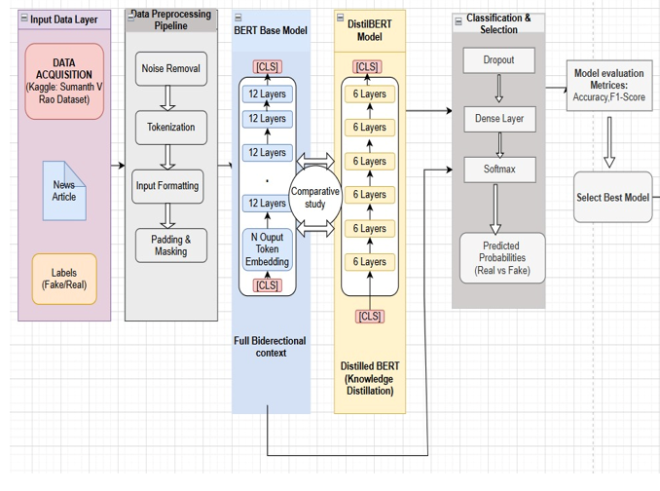
ARCHITECTURE DIAGRAM

Slide 10
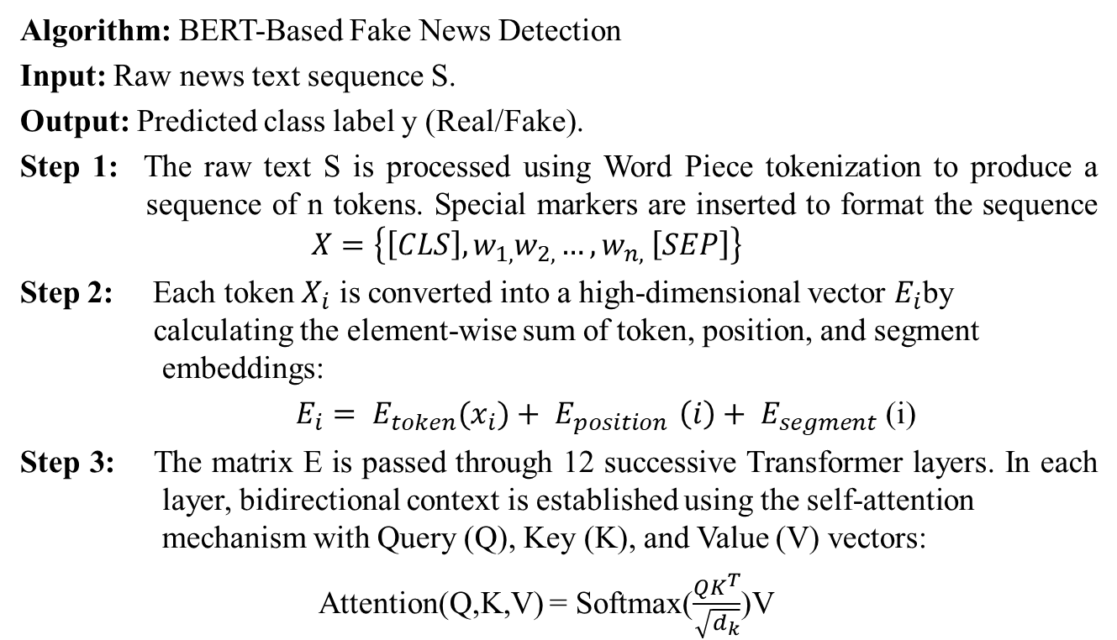
ALGORITHMS INVOLVED
Algorithm: BERT-Based Fake News Detection
Input: Raw news text sequence S.
Output: Predicted class label y (Real/Fake).
Step 1: The raw text S is processed using Word Piece tokenization to produce a sequence of n tokens. Special markers are inserted to format the sequence $X=\left\{\left[CLS\right],w_{1,}w_{2,}…,w_{n,} \left[SEP\right]\right\}$
Step 2: Each token $X_{i}$ is converted into a high-dimensional vector $E_{i}$by calculating the element-wise sum of token, position, and segment embeddings:
$E_{i}= E_{token}{(x}_{i})+ E_{position }\left(i\right)+ E_{segment}$ (i)
Step 3: The matrix E is passed through 12 successive Transformer layers. In each layer, bidirectional context is established using the self-attention mechanism with Query (Q), Key (K), and Value (V) vectors:
Attention(Q,K,V) = Softmax($\frac{QK^{T}}{\sqrt{d_{k}}}$)V

Slide 11
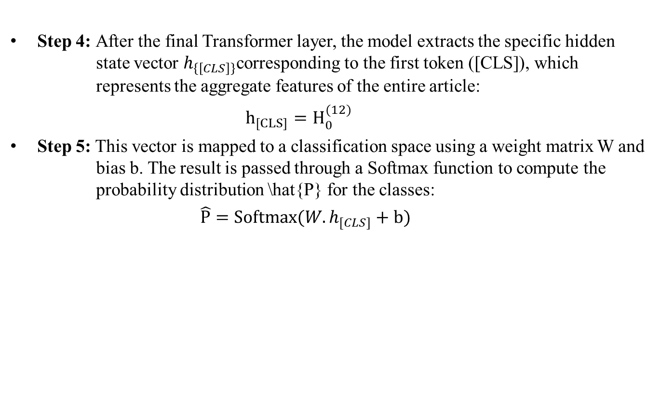
Step 4: After the final Transformer layer, the model extracts the specific hidden state vector $h_{\left\{\left[CLS\right]\right\}}$corresponding to the first token ([CLS]), which represents the aggregate features of the entire article:
$h_{[CLS]}=H_{0}^{(12)}$
Step 5: This vector is mapped to a classification space using a weight matrix W and bias b. The result is passed through a Softmax function to compute the probability distribution \hat{P} for the classes:
$\hat{P}=Softmax(W.h_{[CLS]}+b)$

Slide 12
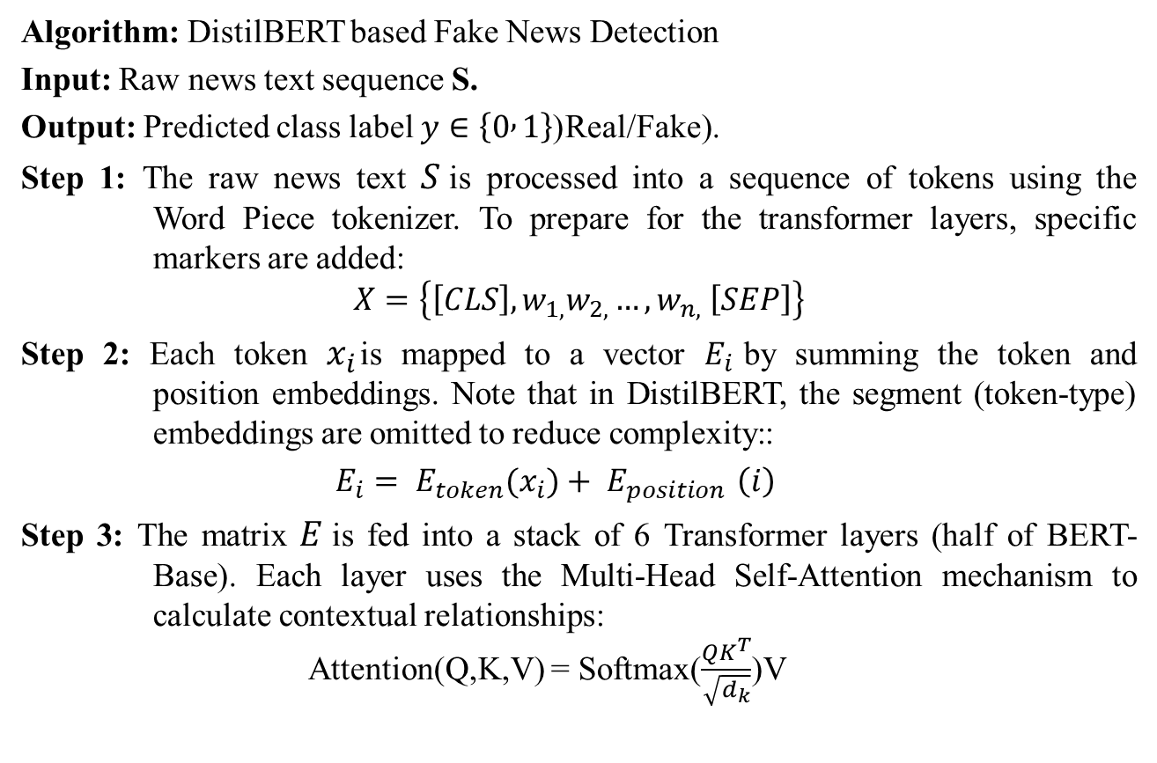
ALGORITHMS INVOLVED
Algorithm: DistilBERT based Fake News Detection
Input: Raw news text sequence S.
Output: Predicted class label $y∈\left\{0 , 1\right\}$(Real/Fake).
Step 1: The raw news text $S$is processed into a sequence of tokens using the Word Piece tokenizer. To prepare for the transformer layers, specific markers are added:
$$X=\left\{\left[CLS\right],w_{1,}w_{2,}…,w_{n,} \left[SEP\right]\right\}$$
Step 2: Each token $x_{i}$is mapped to a vector $E_{i}$by summing the token and position embeddings. Note that in DistilBERT, the segment (token-type) embeddings are omitted to reduce complexity::
$E_{i}= E_{token}{(x}_{i})+ E_{position }\left(i\right)$
Step 3: The matrix $E$is fed into a stack of 6 Transformer layers (half of BERT- Base). Each layer uses the Multi-Head Self-Attention mechanism to calculate contextual relationships: Attention(Q,K,V) = Softmax($\frac{QK^{T}}{\sqrt{d_{k}}}$)V

Slide 13
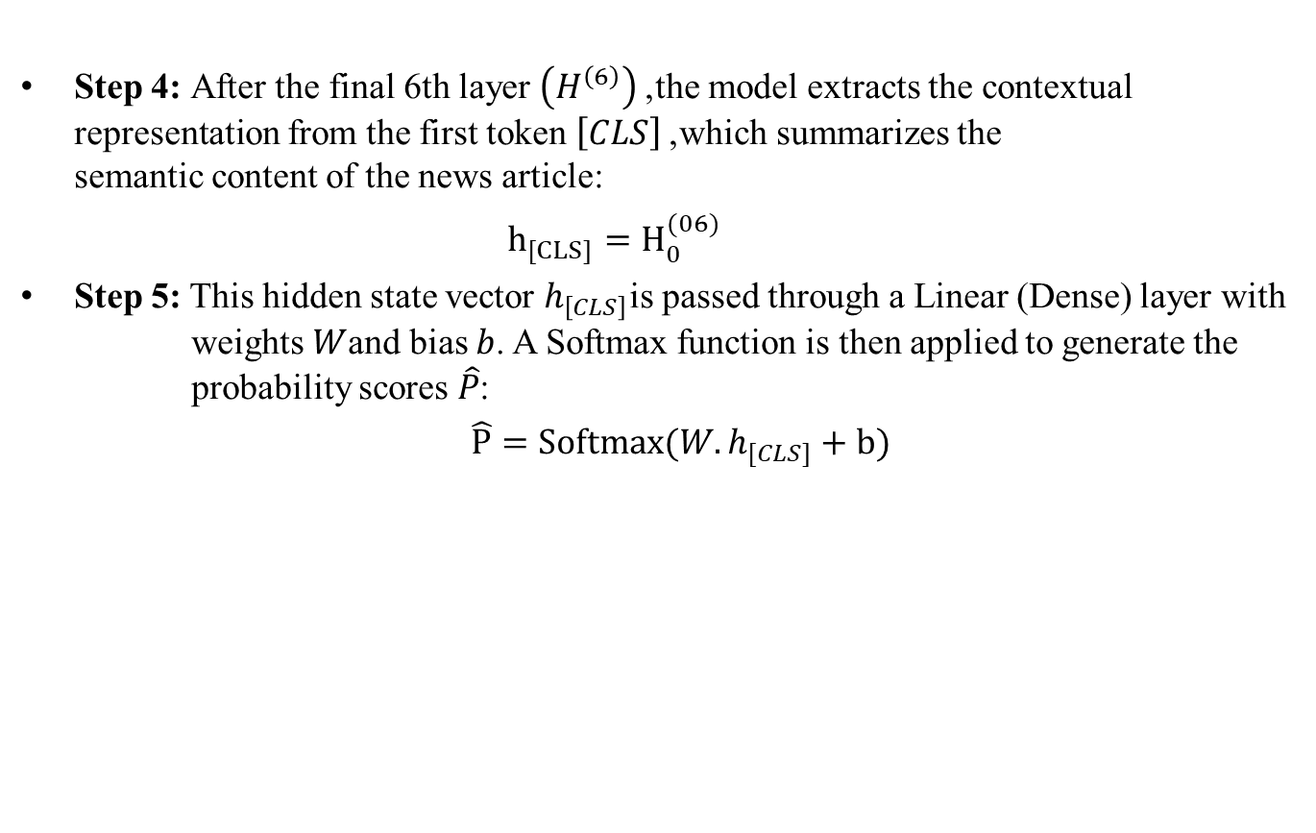
Step 4: After the final 6th layer $\left(H^{\left(6\right)}\right)$, the model extracts the contextual representation from the first token $\left[CLS\right]$, which summarizes the semantic content of the news article:
$h_{[CLS]}=H_{0}^{(06)}$
Step 5: This hidden state vector $h_{\left[CLS\right]}$is passed through a Linear (Dense) layer with weights $W$and bias $b$. A Softmax function is then applied to generate the probability scores $\hat{P}$:
$\hat{P}=Softmax(W.h_{[CLS]}+b)$

Slide 14
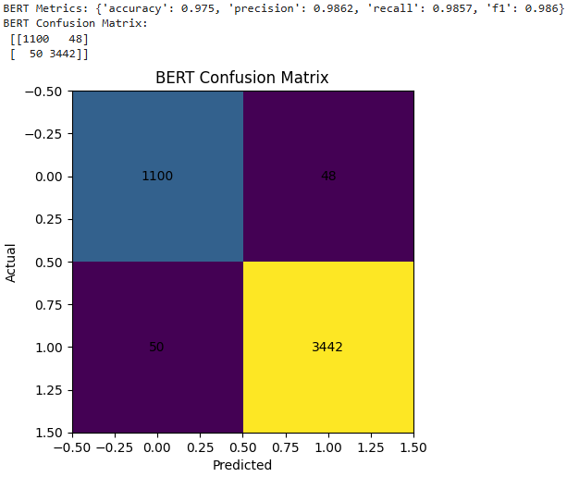
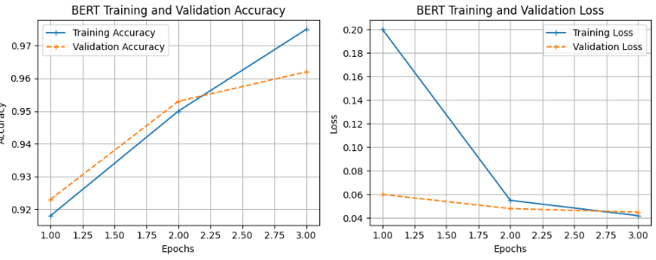
RESULTS
BERT

Slide 15
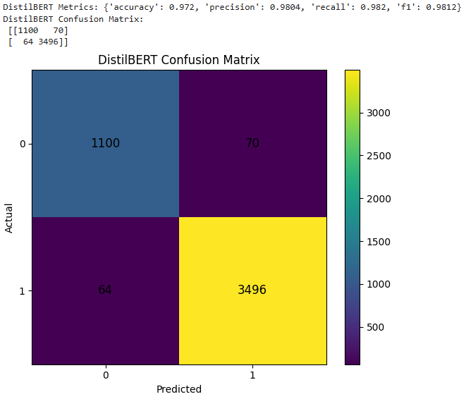
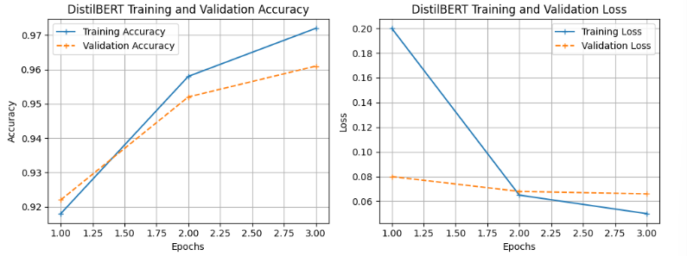
DISTILBERT

Slide 16
RESULT ANALYSIS
Model | Accuracy(%) | Precision(%) | Recall(%) | F1-score(%)
Bert | 97.5 | 98.6 | 98.5 | 98.6
DistilBert | 97.2 | 98.4 | 98.2 | 98.1
Notes:
Why Bert got highest accuracy and why not DistilBert:
This is because BERT has a deeper architecture (12 layers), which allows it to capture richer contextual relationships in the text.
On the other hand, DistilBERT is a compressed version with fewer layers, making it faster but slightly less accurate.

Slide 17
CONCLUSION
A transformer-based fake news detection system was successfully developed using BERT and DistilBERT models.
The system effectively classifies news articles as real or fake with high accuracy.
BERT achieved better performance, while DistilBERT provided faster and more efficient results.
The study demonstrates the effectiveness of transformer models in handling textual data for fake news detection.

Slide 18
FUTURE SCOPE
Advanced Transformer Models: Extend the work by implementing advanced models such as RoBERTa, XLNet, or DeBERTa to improve classification accuracy and contextual understanding.
Real-time Deployment: Develop a web-based or mobile application that can detect and flag fake news articles in real time from social media and news platforms.

Slide 19
REFERENCES
[1] Abdullah, M., Hongying, Z., Javed, A., Mamyrbayev, O., Caraffini, F. and Eshkiki, H., 2025. A joint learning framework for fake news detection. Displays, p.103154..
[2] Raza, Shaina, Drai Paulen-Patterson, and Chen Ding. "Fake news detection: comparative evaluation of BERT-like models and large language models with generative AI-annotated data." Knowledge and Information Systems 67.4 (2025): 3267-3292.
[3] Nair, Vinita, Jyoti Pareek, and Sanskruti Bhatt. "A knowledge-based deep learning approach for automatic fake news detection using BERT on Twitter." Procedia Computer Science 235 (2024): 1870-1882.
[4] Ramzan, Alishba, et al. "Enhancing fake news detection using bert: A comparative analysis of logistic regression, rfc, lstm and bert." 2024 International Conference on IT and Industrial Technologies (ICIT). IEEE, 2024.
[5] Koru, Gülsüm Kayabaşi, and Çelebı Uluyol. "Detection of Turkish fake news from tweets with BERT models." IEEE Access 12 (2024): 14918-14931.

Slide 20
THANK YOU

