Slide 1

Hindi Formality Style Transfer
DEPARTMENT OF COMPUTER SCIENCE AND ENGINEERING
S.R.K.R. ENGINEERING COLLEGE (A)
SRKR MARG, Bhimavaram, West Godavari Dist., A.P.
Batch - 2
Presented by:
Kannuru Varalakshmi 21B91A6128
Petluri Lakshmi Prasanna 22B95A6104
Vanka D S N S D M Narasimha Raja 21B91A6161
Kapaka Deeptanush 21B91A6130
Under the Guidance of :
Dr. B N V Narasimha Raju
Assistant Professor

Slide 2
Abstract
Language shapes human connection — it’s not just what we say, but how we say it. Although Formality Text Style Transfer (TST) has advanced in English, it remains underexplored for Hindi due to limited parallel corpora and challenges in separating style from content. Traditional metrics like BLEU often fail to capture stylistic details in rich languages. To address this, we introduce a bidirectional Hindi formality transfer model using IndicBART and mT5, fine-tuned on collected data. We apply data augmentation techniques like bidirectional augmentation to overcome corpus scarcity, enabling both formalization and informalization. Evaluation with BLEU, BERTScore, and perplexity shows our model significantly outperforms baselines like GPT-2, IndicGPT, and mBART, achieving stronger semantic preservation and style accuracy. This work advances style transfer for underrepresented languages, supporting social media generation, professional communication, and AI-assisted localization.

Slide 3
Introduction
Communication is influenced not just by the words used, but also by tone, phrasing, and formality.
In Hindi, adjusting formality requires complex changes in pronouns, verb conjugations, and word choices, making it more intricate than English.
Existing AI models often fail to handle these nuances effectively, leading to misinterpretations.
Objective
To develop a bidirectional Hindi Formality Style Transfer system using IndicBART and mT5 models that can accurately transform text between formal and informal styles while preserving meaning and cultural appropriateness.
Scope
The project aims to improve AI's ability to adapt tone in Hindi for various real-world applications, including:
Content localization (e.g., subtitles, instructions)
AI writing assistants (e.g., emails, reports)
Conversational agents (e.g., chatbots, virtual assistants)
Educational tools (e.g., language learning platforms)

Slide 4
Literature Review
S.no | Title of the paper | Publication year | Methodology | Advantages | Disadvantages
1 | Nonparallel Spoken-Text-Style Transfer for Linguistic Expression Control in Speech Generation | 2025 | Conditional Variational Autoencoder (CVAE) with Content Word Storage (CWS) and Cyclic Learning | Improves content preservation and style control while maintaining computational efficiency compared to large language models (LLMs). | Struggles with handling more complex style variations and lacks the flexibility of LLM-based methods.
2 | Efficient Text Style Transfer Through Robust Masked Language Model and Iterative Inference | 2024 | Robust Masked Language Model (MLM) with Iterative Inference and Contrastive Learning | Achieves state-of-the-art performance in text style transfer while maintaining content preservation and computational efficiency. | Struggles with generating highly diverse stylistic outputs due to the limitations of masked language modeling.
3 | Integrating CycleGAN and BERT for Chinese Text Style Transfer | 2024 | Cycle Generative Adversarial Network (CycleGAN) combined with Bidirectional Encoder Representations from Transformers (BERT) | Enables style transfer without requiring paired data, reducing data collection challenges. | Struggles with fine-tuning for nuanced style differences and maintaining complete semantic consistency.

Slide 5
Literature Review(contd.)
S.no | Title of the paper | Publication year | Methodology | Advantages | Disadvantages
4 | Evaluating Multilingual Abstractive Dialogue Summarization in Indian Languages using mT5-small & IndicBART | 2024 | mT5-small and IndicBART | mT5-small outperforms IndicBART in summarization tasks across Hindi, Marathi, and Bengali, demonstrating higher accuracy. | Performance is limited by computational constraints, preventing the use of larger models like mT5-base or mBART-large for potentially better results.
5 | Memory-Enhanced Text Style Transfer with Dynamic Style Learning and Calibration | 2024 | Memory-Enhanced Transfer Method (METM) with Dynamic Style Learning and Calibration | Achieves better trade-offs between style transfer accuracy and content preservation by dynamically retrieving fine-grained style signals. | Memory-based methods require additional computational resources and may struggle with generalization to unseen styles.
6 | SC2: Towards Enhancing Content Preservation and Style Consistency in Long Text Style Transfer | 2024 | SC2 (Joint Style-Content Weigher (JSCW) module with Style Consistency Loss. | Improves content preservation and maintains style consistency in long text style transfer. | Requires more computational resources due to multiple refinement layers and a style consistency mechanism.

Slide 6
Literature Review(contd.)
S.no | Title of the paper | Publication year | Methodology | Advantages | Disadvantages
7 | Hindi News Articles Headline Generation Based on Abstractive Text Summarization | 2023 | Seq2Seq with Attention, IndicBART, and Multilingual T5 | IndicBART performed best, achieving higher ROUGE scores and better summarization quality compared to other models. | Generated summaries were not evaluated by human experts, limiting the assessment of linguistic quality.
8 | Abstractive Hindi Text Summarization: A Challenge in a Low-Resource Setting | 2023 | Compares transformer (BERT, mT5) and seq2seq models, using ICE-H metric for Hindi evaluation and multi-task learning for generalization. | Custom evaluation metric for Hindi; better adaptability across tasks. | Limited training data; pre-trained embeddings may miss domain-specific nuances.

Slide 7
Problem Statement
Formality in communication shapes politeness, respect, and social context. Misalignment in formality—especially in platforms like professional emails, customer chats, and localized content—can cause misunderstandings and poor user experience.
While Formality Style Transfer (FST), Hindi remains underrepresented due to several challenges:
Lack of Datasets: Scarcity of large, high-quality parallel Hindi corpora annotated for formality.
Linguistic Complexity: Hindi formality involves deep grammatical, morphological, and syntactic changes, making style transfer harder.
Semantic Preservation Issues: Models struggle to maintain meaning while adjusting style bidirectionally.
Thus, there is an urgent need for a dedicated, robust system to address the data, linguistic, evaluation and modeling challenges unique for Hindi.

Slide 8




Methodology
Data Collection
Model Selection
A manually curated parallel corpus of Hindi sentence pairs
Pre-Processing
mT5, IndicBART
& Ensemble Model
Evaluation
Tokenization
T5 Tokenizer - mt5
Auto Tokenizer - IndicBART
Metrics
BLEU, BERT, Perplexity

Slide 9
Methodology(contd.)
Approach:
We followed a systematic approach to build a Hindi formality transfer model:
Data Collection: Collected a parallel corpus of formal and informal Hindi sentence pairs.
Pre-Processing: Cleaned and tokenized the data using suitable tokenizers.
Model Selection: Trained and fine-tuned models like mT5, IndicBART, and also developed an ensemble model.
Evaluation: Evaluated model performance using BLEU, BERTScore, and Perplexity metrics.
Techniques/Tools Used:
Programming Language: Python
Libraries: Hugging Face Transformers, TensorFlow/PyTorch
Tokenizers: T5Tokenizer for mT5, AutoTokenizer for IndicBART
Hardware: GPU-enabled systems for faster training

Slide 10
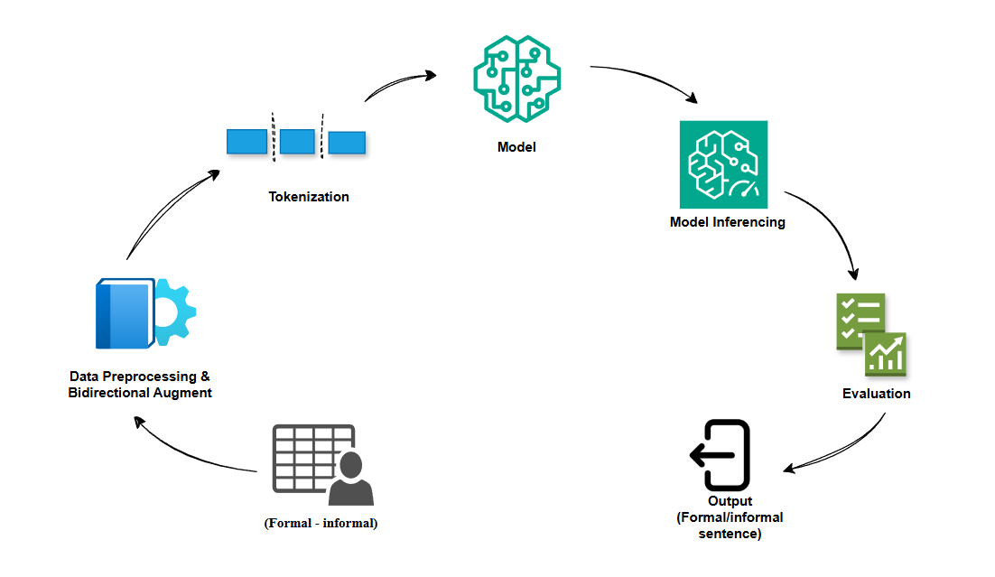
Implementation

Slide 11
Implementation(contd.)
Dataset:
50,000 Hindi formal–informal sentence pairs covering diverse domains like emails, conversations, academic writing, and social media.
Features:
Input: Hindi sentence (formal or informal).
Target: The corresponding sentence in the opposite style (informal or formal).
Preprocessing Steps:
Text normalization like truncation (removal of extra spaces).
Language-specific cleaning (removal of noise like special symbols).
Bidirectional augmentation: Each sentence pair used twice (formal→informal and informal→formal).
Tokenization using model-specific tokenizers.
Implementation:
Model Selection: Chose mT5-small for multilingual strength and IndicBART for Indic language specialization.
Fine-Tuning: Fine-tuned on a Hindi parallel corpus using pretrained checkpoints.
Training: Applied transformer-based architectures, ensuring effective semantic preservation and style adaptation.
Ensemble Strategy: Combined mT5 and IndicBART outputs to enhance fluency and style accuracy.

Slide 12
Results
Evaluation Metrics Used:
BLEU: Measures n-gram overlap for syntactic similarity. Higher BLEU indicates better matching with reference.
BERTScore (F1, Precision, Recall): Measures semantic similarity using contextual embeddings.
Perplexity: Evaluates model fluency, lower perplexity indicates smoother, more confident text generation.
Model | BLEU Score | BERTscore F1 | BERTscore Precision | BERTscore recall | Perplexity
mT5 | 23.31 | 0.85 | 0.85 | 0.85 | 8.25
IndicBART | 17.84 | 0.81 | 0.82 | 0.81 | 5.36
Ensemble Model | 21.25 | 0.84 | 0.84 | 0.84 | 6.20
GPT-2 | 0.26 | 0.60 | 0.58 | 0.62 | 3.13
IndicGPT | 20.01 | 0.63 | 0.62 | 0.65 | 41.77
mBART | 8.91 | 0.77 | 0.80 | 0.74 | 15.07

Slide 13
Results(contd.)
Analysis:
mT5 shows the best overall performance with the highest BLEU (23.31) and BERTScore F1 (0.85), balancing accuracy and semantic preservation.
IndicBART excels in fluency, achieving the lowest perplexity (5.36), producing the most natural-sounding outputs.
Ensemble Model combines the strengths of mT5 and IndicBART, delivering balanced performance across accuracy, semantic similarity, and fluency.
GPT-2 and mBART show poor performance on BLEU and BERTScore, indicating weaker control over style and semantics.
IndicGPT has moderate BLEU (20.01) but poor semantic alignment (BERTScore F1: 0.63) and high perplexity (41.77), resulting in less stable outputs.
mT5 emerges as the most effective model for Hindi formality style transfer, delivering strong lexical, semantic, and fluency performance across all metrics.

Slide 14
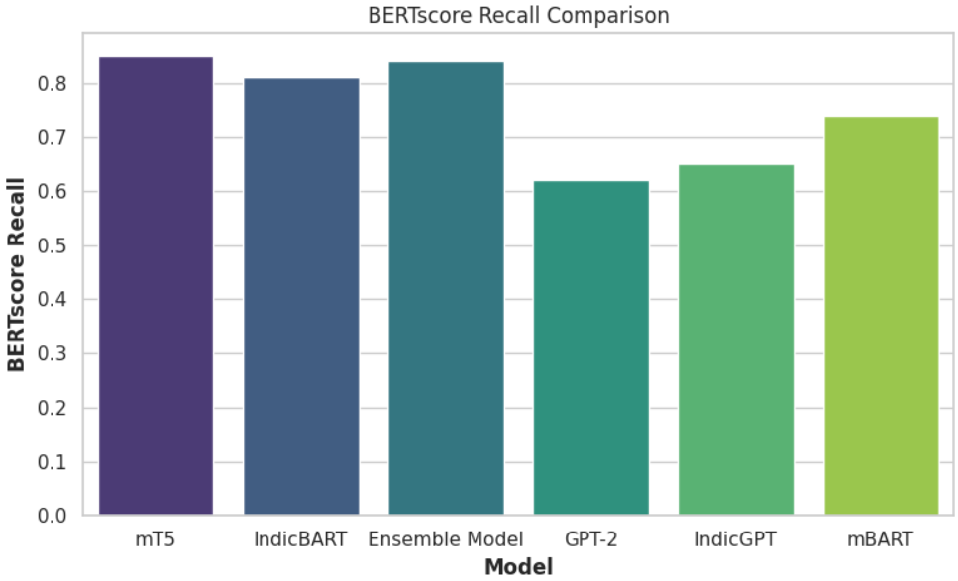
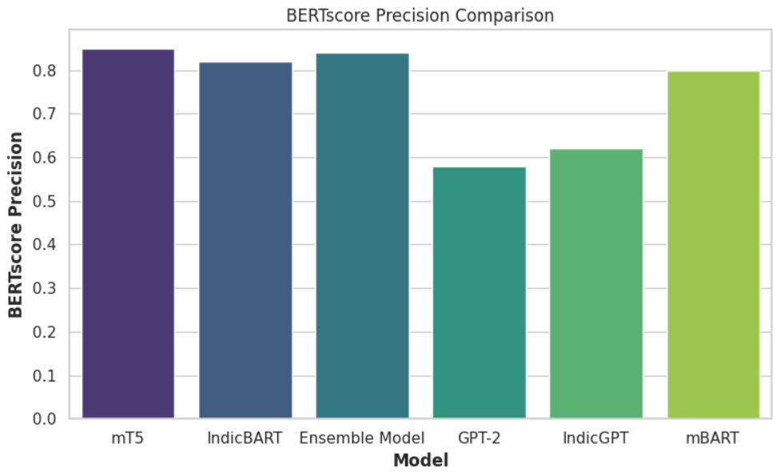
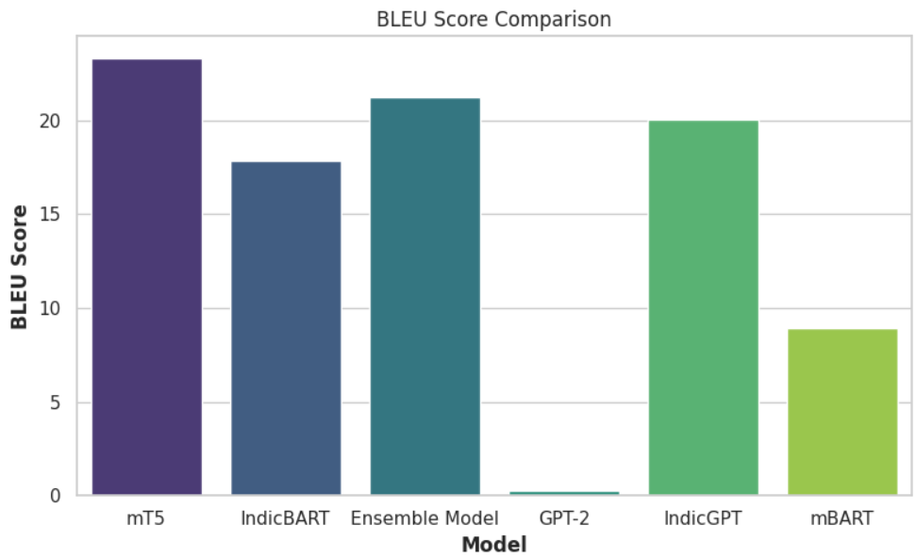
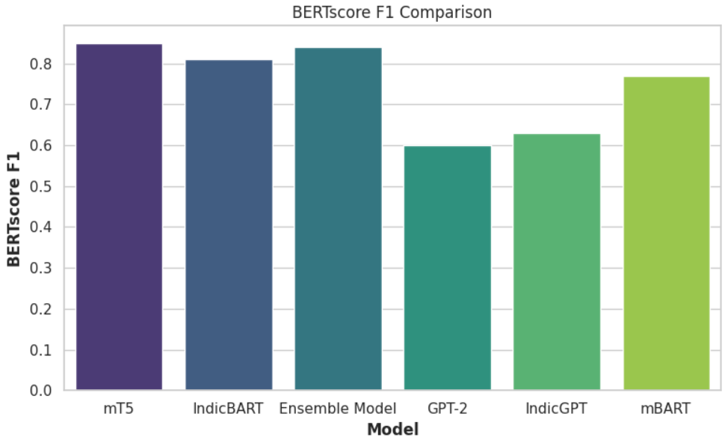
Results(contd.)

Slide 15
Discussion
Limitations:
The model's performance may be inconsistent across diverse domains such as legal and healthcare where nuanced formality transformations are required.
The dataset primarily focuses on Hindi, and the system might struggle with regional variations and less formal contexts.
Future Work:
Expand the system to include texts from varied domains like legal and healthcare, improving the model's adaptability across contexts.
Extend the methodology to other Indian languages such as Marathi, Bengali, and Gujarati, leveraging multilingual transformer models for broader applicability.

Slide 16
Conclusion
Formality adjustment in digital communication is crucial for improving clarity and engagement, especially in diverse contexts like professional and customer interactions.
Hindi formality style transfer faces challenges due to its complex grammar, honorifics, and lack of high-quality datasets.
Fine-tuning mT5 and IndicBART on a Hindi formal-informal corpus showed improvements in accuracy, semantic preservation, and fluency.
mT5 emerged as the best model, setting a new benchmark for Hindi formality style transfer, with strong performance in lexical accuracy and semantic fidelity.

Slide 17
References
Jin, D., Jin, Z., Zhou, J. T., & Sarkar, R. (2022). Deep Learning for Text Style Transfer: A Survey. arXiv preprint arXiv:2201.08295.
Hu, Z., Lee, R. K.-W., Aggarwal, C. C., & Zhang, A. (2022). Text Style Transfer: A Review and Experimental Evaluation. arXiv preprint arXiv:2201.00136.
Toshevska, M., & Gievska, S. (2021). A Review of Text Style Transfer using Deep Learning. Applied Sciences, 11(16), 7315. doi: [Insert DOI if available].
Rao, S., & Tetreault, J. (2018). Dear Sir or Madam, May I Introduce the GYAFC Dataset: Corpus, Benchmarks and Metrics for Formality Style Transfer. In Proceedings of the 2018 Conference of the North American Chapter of the Association for Computational Linguistics: Human Language Technologies, Volume 1 (Long Papers), 1335–1345. https://doi.org/10.18653/v1/N18-1123.
Xu, R., Meng, F., Sun, J., & Zhu, Q. (2019). Formality Style Transfer with Hybrid Textual Annotations. In Proceedings of the AAAI Conference on Artificial Intelligence, 33, 7385-7392. https://doi.org/10.1609/aaai.v33i01.33017385.
Kumar, M., Ojha, A. K., & Talamadupula, K. (2021). XFORMAL: A Benchmark for Multilingual Formality Style Transfer. In Proceedings of the 2021 Conference on Empirical Methods in Natural Language Processing, 6356–6368. https://doi.org/10.18653/v1/2021.emnlp-main.504.
Gupta, E., Singh, V., Kumar, M., Dasgupta, S., Ghosh, S., & Rudra, K. (2023). InFormal: A Formality Style Transfer Dataset for Four Indic Languages. arXiv preprint arXiv:2305.14669.

Slide 18
References (contd.)
Mukherjee, S., Kumar, M., Goyal, T., Ghosh, S., & Rudra, K. (2024). Multilingual Text Style Transfer: Datasets & Models for Indian Languages. arXiv preprint arXiv:2401.15752.
Krishna, K. P., Khapra, M. M., & Kumar, P. (2022). Few-shot Controllable Style Transfer for Low-Resource Multilingual Settings. In Findings of the Association for Computational Linguistics: ACL 2022, 1059–1072. https://doi.org/10.18653/v1/2022.findings-acl.84.
Lai, V., Yang, D., & Callison-Burch, C. (2023). Formality-Aware Few-Shot Learning for Response Generation. In Proceedings of the 17th Conference of the European Chapter of the Association for Computational Linguistics, 240–251. https://doi.org/10.18653/v1/2023.eacl-main.18.
Shen, T., Lei, T., Barzilay, R., & Jaakkola, T. (2017). Style Transfer from Non-Parallel Text by Cross-Alignment. In Advances in Neural Information Processing Systems 30 (NIPS 2017), 6833–6843.
Li, B., Zhu, H., Zhang, Z., Lyu, M. R., & King, I. (2022). Contrastive Learning for Unsupervised Text Style Transfer. In Findings of the Association for Computational Linguistics: ACL 2022, 1106–1117. https://doi.org/10.18653/v1/2022.findings-acl.87.
Rebuffel, C., Côté, M.-A., & Douville, A. (2022). Controlling Manner vs. Content in Style Transfer with Information-Theoretic Decomposition. In International Conference on Learning Representations (ICLR).

Slide 19
References(contd.)
Wu, H., Xiao, Z., & Wu, H. (2021). Controllable Text Style Transfer via Editing Entangled Latent Representation. In Proceedings of the AAAI Conference on Artificial Intelligence, 35(16), 13900-13908. https://doi.org/10.1609/aaai.v35i16.17648.
Zhang, Y., Jin, Z., Zhou, J. T., & Sarkar, R. (2020). Parallel Data Augmentation for Formality Style Transfer. In Proceedings of the 58th Annual Meeting of the Association for Computational Linguistics, 3384–3394. https://doi.org/10.18653/v1/2020.acl-main.311.
Liu, Y., Feng, J., Sui, Z., & Chang, B. (2022). Exploring Content Representation Learning for Text Style Transfer. In Findings of the Association for Computational Linguistics: ACL 2022, 2424–2436. https://doi.org/10.18653/v1/2022.findings-acl.193.
Yang, Z., Hu, Z., Zhang, X., & Zhang, A. (2022). STAP: A Sequence-to-Sequence Pre-training Approach for Text Style Transfer. In Findings of the Association for Computational Linguistics: EMNLP 2022, 1088–1101. https://doi.org/10.18653/v1/2022.findings-emnlp.77.
Xue, L., Constant, N., Roberts, A., Kale, M., Al-Rfou, R., Siddhant, A., Barua, A., & Raffel, C. (2021). mT5: A Massively Multilingual Pre-trained Text-to-Text Transformer. In Proceedings of the 2021 Conference of the North American Chapter of the Association for Computational Linguistics: Human Language Technologies, 483–498. https://doi.org/10.18653/v1/2021.naacl-main.41.

Slide 20
References(contd.)
Dabre, R., Kunchukuttan, A., Kumar, R., & Bhattacharyya, P. (2022). IndicBART: A Pre-trained Model for Indic Natural Language Generation. arXiv preprint arXiv:2201.05182.
Vinuthna, P., Anand, E., & Khapra, M. M. (2023). Leveraging Pre-trained Language Models for Task-Oriented Dialogue in Indic Languages. In Workshop on Representation Learning for NLP (RepL4NLP @ ACL). https://doi.org/10.18653/v1/2023.repl4nlp-1.26.
Sinha, K., Kumar, R., Kunchukuttan, A., Dabre, R., Kumar, A., & Bhattacharyya, P. (2021). Pretraining Multilingual Language Models for Indic Languages. arXiv preprint arXiv:2109.10664.
Goyal, T., Kumar, M., Kumar, M., Ghosh, S., & Rudra, K. (2022). Evaluating the Evaluation Metrics for Style Transfer: A Case Study in Hindi. In Proceedings of the Language Resources and Evaluation Conference (LREC), 1550–1559.
Tian, Y., Zhang, Y., & Black, A. W. (2022). StylePTB: A Compositional Benchmark for Fine-grained Controllable Text Style Transfer. In Proceedings of the 2022 Conference on Empirical Methods in Natural Language Processing, 10907–10921. https://doi.org/10.18653/v1/2022.emnlp-main.743.
24. Mukherjee, S., Kumar, M., Goyal, T., Ghosh, S., & Rudra, K. (2024). Are Large Language Models Actually Good at Text Style Transfer? arXiv preprint arXiv:2402.02419.

Slide 21
THANK YOU

