Slide 1

Sparse and Redundant Representations and Their Applications in
Signal and Image Processing (236862)
Section 1: Introduction & Mathematical Warmup
Winter Semester, 2018/2019
Michael (Miki) Elad

Slide 2
Meeting Plan
Quick review of the material covered
Answering questions from the students and getting their feedback
Addressing issues raised by other learners
Discussing new material
Administrative issues
FLIPPED CLASS

Slide 3
Overview of the Material
Overview What This Field is All About?
Take 1: A New Transform What is this field all about?
Take 2: Modeling Data
A Closer Look at the SparseLand Model
Who Works on this and Who Are We?
Several examples: Applications Leveraging this Model
This Course: Scope and Style
Mathematical Warm-Up
Underdetermined Linear Systems & Regularization
The Temptation of Convexity
A Closer Look at L1 Minimization
Conversion of (P1) to Linear Programming
Seeking Sparse Solutions
Promoting Sparse Solutions
The L0 Norm and the (P0) Problem
A Signal Processing Perspective

Slide 4
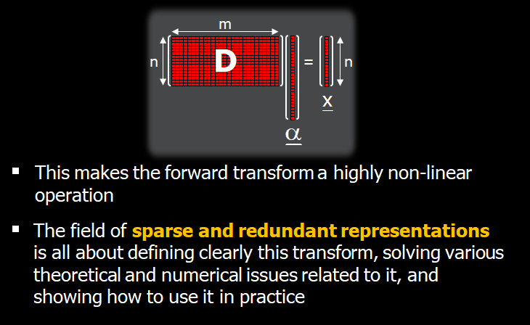
Issues Raised by Other Learners
sparsity and non-linearity
In the introduction video you say, “clearly, seeking the sparsest solution implies that the forward transformation is highly non-linear”. It is not immediately obvious to me what you exactly mean by this. Do you mean that the optimization problem to seek this optimal alpha is very non-convex or were you alluding to some other properties of this problem?

Slide 5
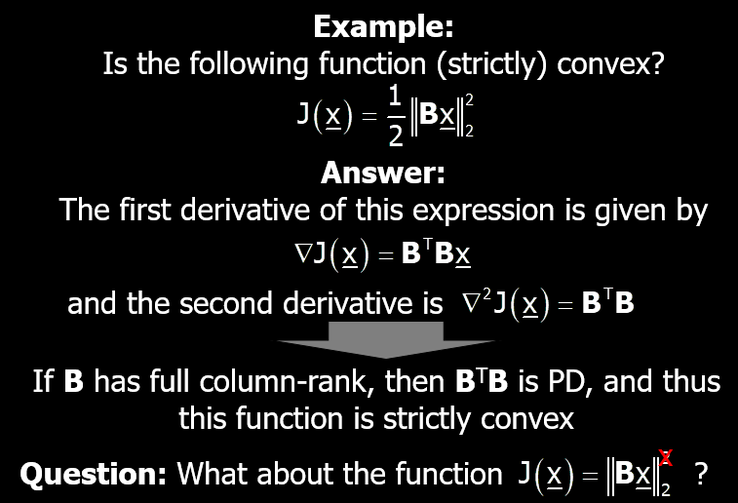

Issues Raised by Other Learners
What about ${\left\|Bx\right\|}_{2}$?
Is it a convex function ? Is it strictly convex?
Working with the derivative in order to explore this could be quite tedious …
Graphically, this function is a cone with straight lines emerging from the origin, and as such, this function is not strictly convex
This is true to ${\left\|Bx\right\|}_{1}$ and ${\left\|Bx\right\|}_{∞}$ as well

Slide 6
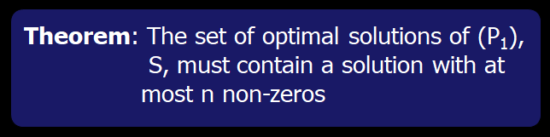
Issues Raised by Other Learners
Why the linear term must be zero?
In the ‘a closer look at l1 minimization’ of the introduction section, the proof of the second theorem says: "Looking at this resulting expression, we now wonder about the linear term – could it be non-zero? The answer is negative: If it is positive, it implies that we can choose epsilon as a small negative value, and get that the L1 of x is smaller than the L1 of x*, which is a contradiction to the optimality of x*." Why the linear term cannot be negative when epsilon is negative? I don't understand.
With respect to the conclusions presented in the slide 99 of the section 1... It is not clear to me how can I choose an epsilon to null one entry in the expression x*+epsilon*h. What is the guarantee that there is such a small epsilon that when provided to the above expression allows nulls one of the entries?

Slide 7
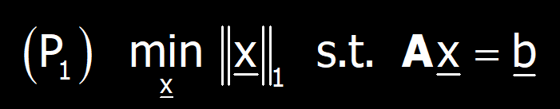
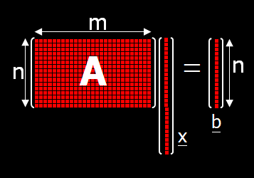
Issues Raised by Other Learners

Slide 8
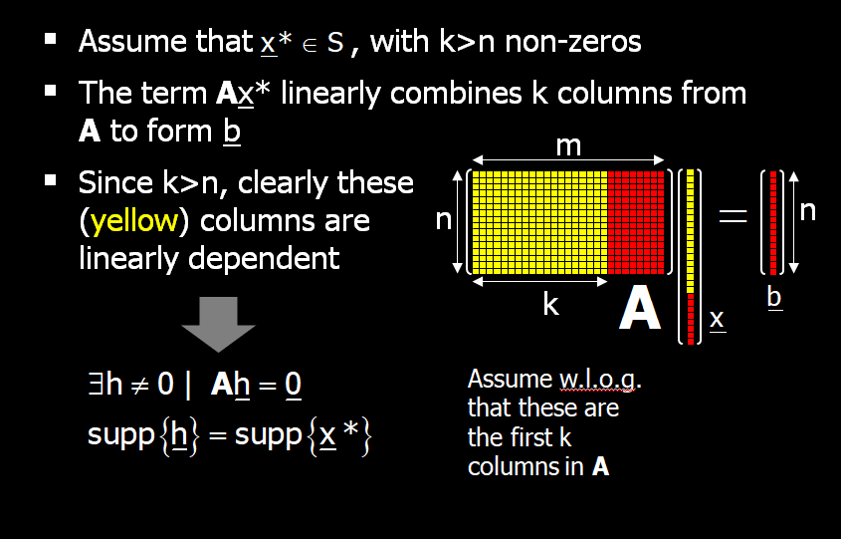
Issues Raised by Other Learners

Slide 9
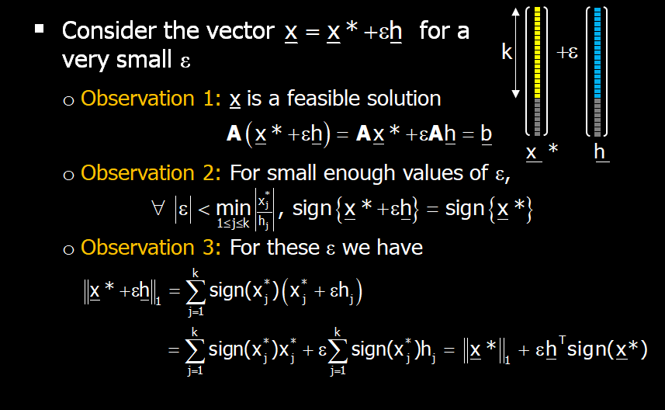
Issues Raised by Other Learners

Slide 10
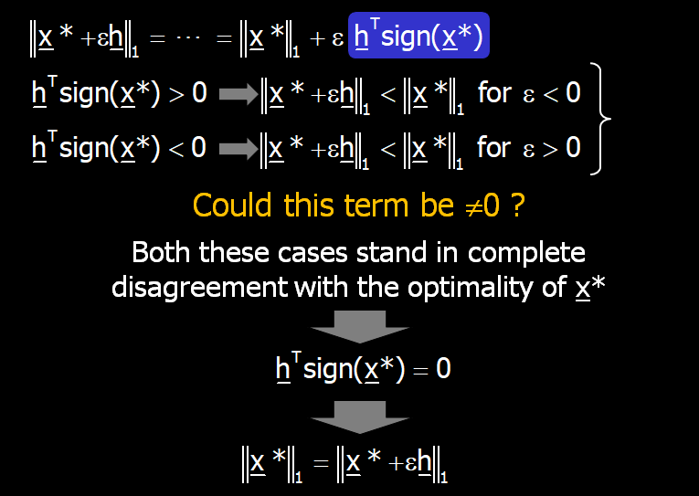
Issues Raised by Other Learners

Slide 11
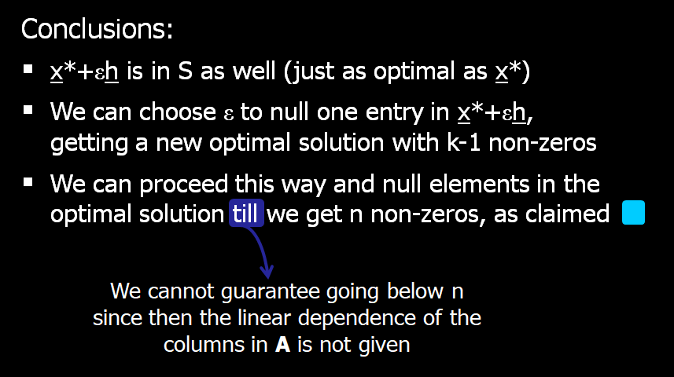
Issues Raised by Other Learners

Slide 12
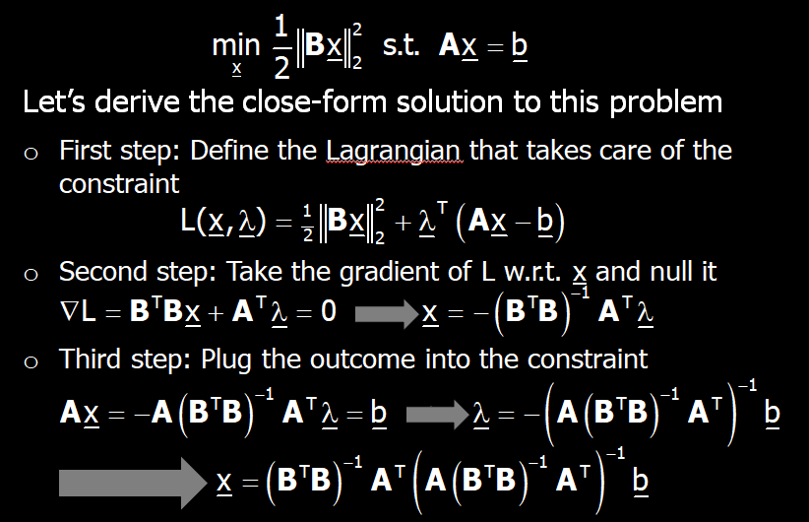

Issues Raised by Other Learners
Matrix and Vector Derivatives
In the first section, in the slides 73 and 85, I noticed that the derivative (gradient) of the expressions is obtained in a direct way. In practice, how can I evaluate these derivatives? Is there any software/tool to perform this task automatically?

Slide 13

Your Questions or Feedback

Slide 14
New Material?
Let’s discuss
Relation to wavelet theory
The flaws of P₀

Slide 15
Relation to Wavelet Theory
Wavelet is a very rich topic, that could be easily fitted into a whole course (and more)
The work on wavelet emerged (in the context of signal processing) in ~ 1985, led by Stephane Mallat, Ingrid Daubechies, Ives Meyer, Ronald Coifman, Albert Cohen, …
Its essence : A new and highly effective transform for representing signals
How? By choosing (smartly!) a mother wavelet, and creating the basis functions as shifts and dilations of it

Slide 16
Relation to Wavelet Theory
Wavelet main features:
Multiscale analysis
Ability to handle transient (local) parts in the signal
Shift invariance (?)
Vanishing moments
Sparse set of coefficients
Non-linear approximation
Orthogonality (or bi-orthogonality)
Fast implementation
… & a rich theory

Slide 17
Relation to Wavelet Theory
What will we take from these in this course?
Wavelet main features:
Multiscale analysis
Ability to handle transient (local) parts in the signal
Shift invariance (?)
Vanishing moments
Sparse set of coefficients
Non-linear approximation
Orthogonality (or bi-orthogonality)
Fast implementation
… & a rich theory
And we will have our own, quite rich, theory

Slide 18
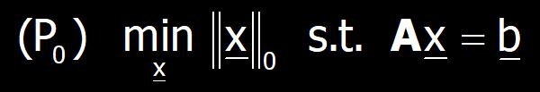
Flaws of P₀
The equality constraint Ax=b is too strict:
Suppose that for a given b₀ the system Ax=b₀ has a sparse solution
For a slightly perturbed vector b=b₀+v (v is random), the system Ax=b will not have a sparse solution at all
The L₀-measure is too strict:
Suppose that x₀ is very sparse
A random pertur. of it, x=x₀+εu (ε<<1 and ||u||₂=1) is fully dense
So, what shall we do? Wait and see …

Slide 19
Administrative Issues
Matlab/Python
Other issues?

Slide 20

